Slide 1
Machine Learning Lab

Slide 2
Let's try to understand Spark a little bit using PySpark and the classical “Word Count” example
This presentation is to accompany:
MSTC_PySpark_WordCount.ipynb
Some references:
Holden Karau
http://www.bigdataspain.org/2017/speakers/holden-karau/
- http://youtu.be/Wg2boMqLjCg
- https://www.youtube.com/watch?v=4xsBQYdHgn8
- https://www.youtube.com/watch?v=V6DkTVvy9vk
- https://www.youtube.com/watch?v=vfiJQ7wg81Y
- https://robertovitillo.com/2015/06/30/spark-best-practices/
- https://www.slideshare.net/SparkSummit/getting-the-best-performance-with-pyspark
Bringing pandas-like capabilities to Spark DataFrames
https://towardsdatascience.com/handyspark-bringing-pandas-like-capabilities-to-spark-dataframes-5f1bcea9039e

Slide 3
Let's try to understand Spark a little bit using PySpark and the classical “Word Count” example
This presentation is to accompany:
MSTC_PySpark_WordCount.ipynb
Slides:
https://www.slideshare.net/SparkSummit/getting-the-best-performance-with-pyspark
https://files.gotocon.com/uploads/slides/conference_3/33/original/GOTO%20Chicago%20-%20Apache%20Spark%20Beyond%20Shuffling%20-%20Why%20it%20isn't%20magic%20-%20but%20also%20where%20there%20is%20some%20really%20cool%20magic.pdf
https://es.slideshare.net/databricks/strata-sj-everyday-im-shuffling-tips-for-writing-better-spark-programs

Slide 4
WARNING!
There are also a multitude of presentations on Slideshare about tuning Spark, try and read / watch the most recent ones.
Anything older than 18 months be sceptical of, and anything older than 2 years just ignore.

Slide 5
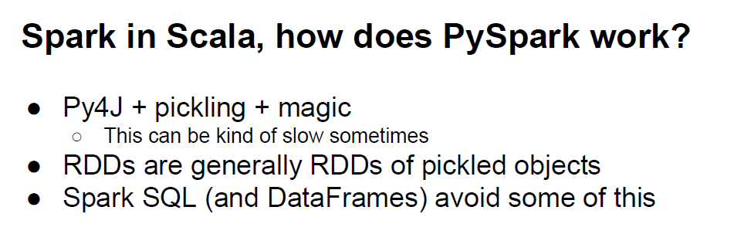

Slide 6
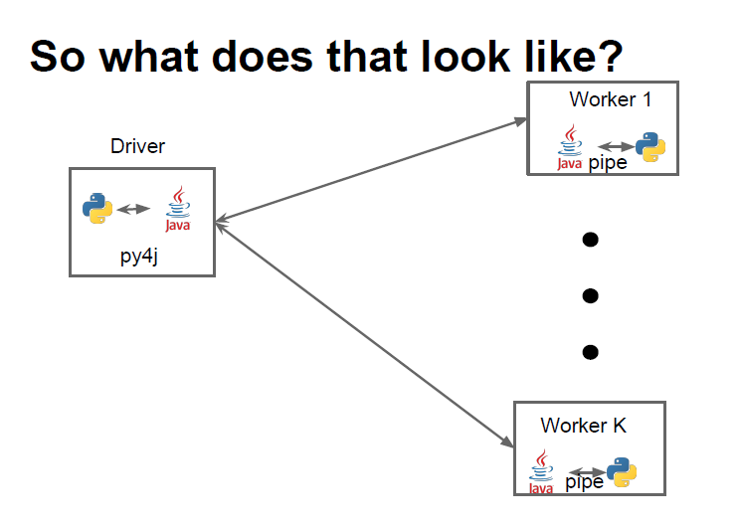

Slide 7
Pickling
Pickling is absolutely necessary for distributed and parallel computing.
Pickling is a way to convert a python object (list, dict, etc.) into a character stream. The idea is that this character stream contains all the information necessary to reconstruct the object in another python script.

Slide 8
Python object serialization
“Pickling” is the process whereby a Python object hierarchy is converted into a byte stream,
and “unpickling” is the inverse operation, whereby a byte stream (from a binary file or bytes-like object) is converted back into an object hierarchy.
Pickling (and unpickling) is alternatively known as “serialization”, “marshalling,” [1] or “flattening”

Slide 9

Example: Word Count

Slide 10
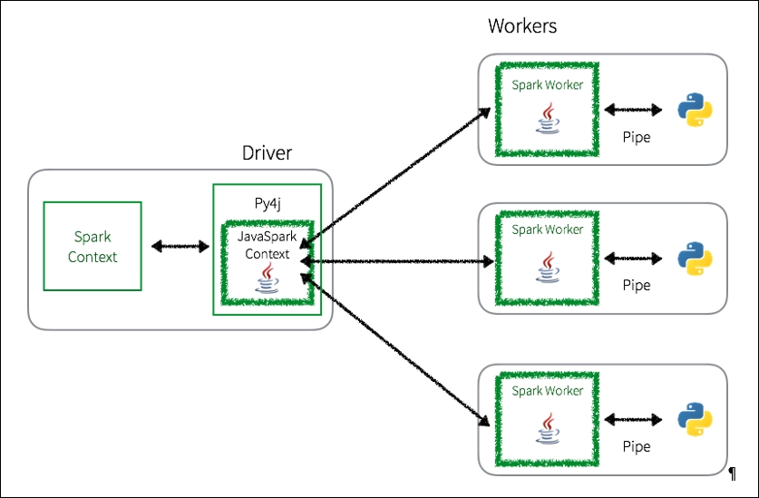
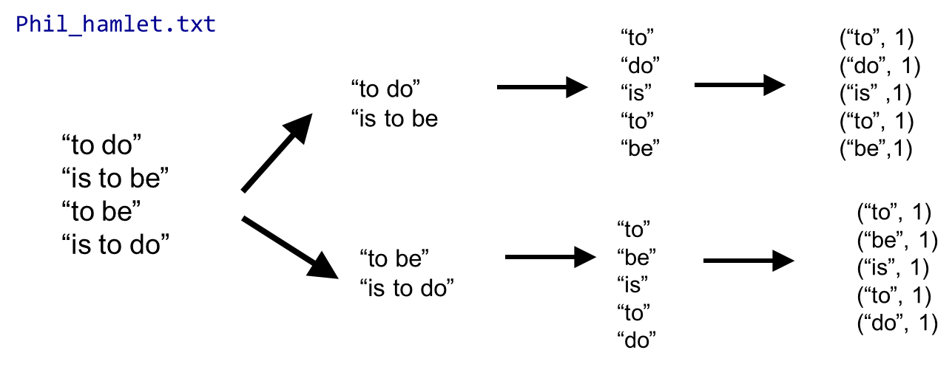
Example: Word Count

Slide 11
Example: Word Count
lines = sc.textFile(“textfile.txt”)
Word_count = lines.flatMap(lambda line: line.split(“ ”)) \ .map(lambda word: (word, 1)) \ .reduceByKey(lambda x, y: x + y)
flatMap
map
textfile.txt

Slide 12
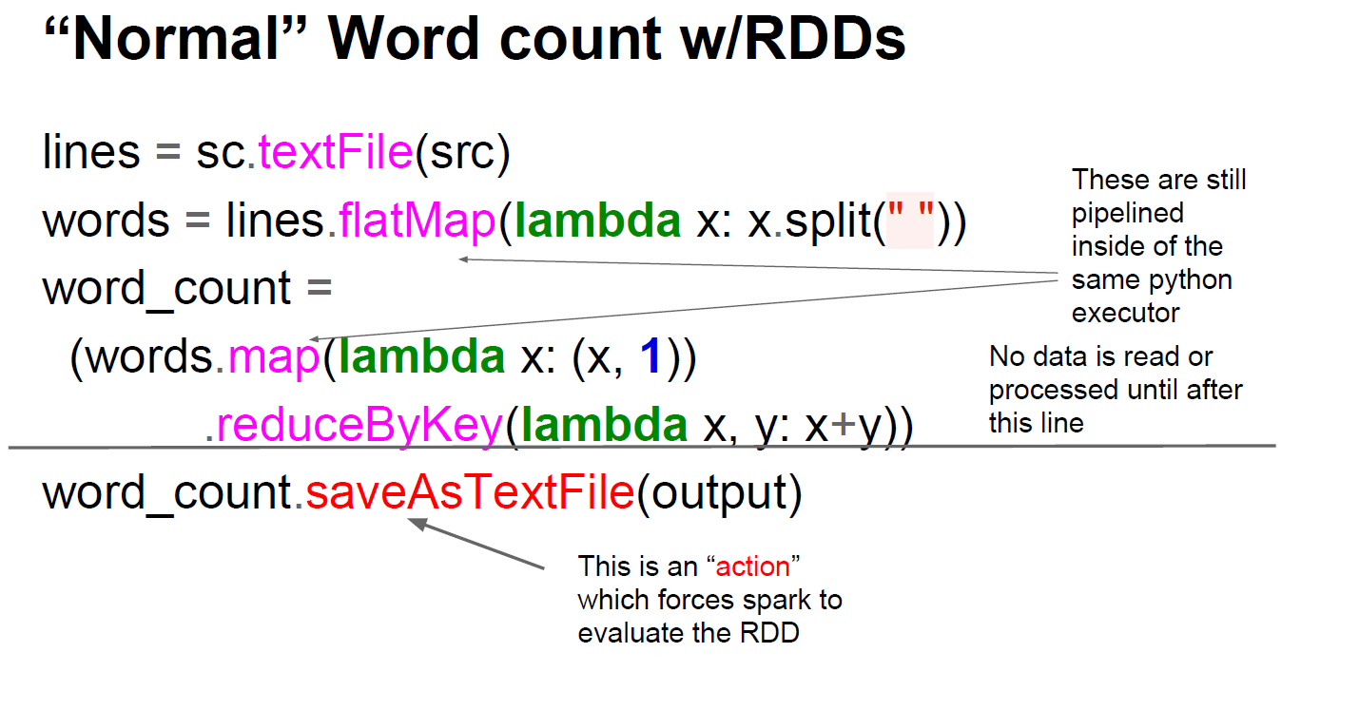

Slide 13
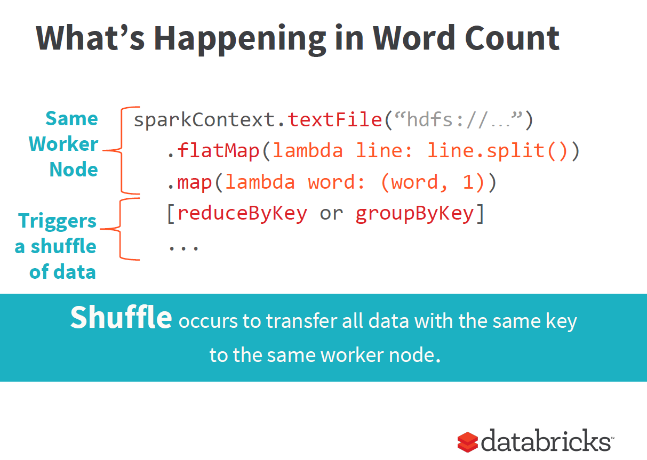

Slide 14
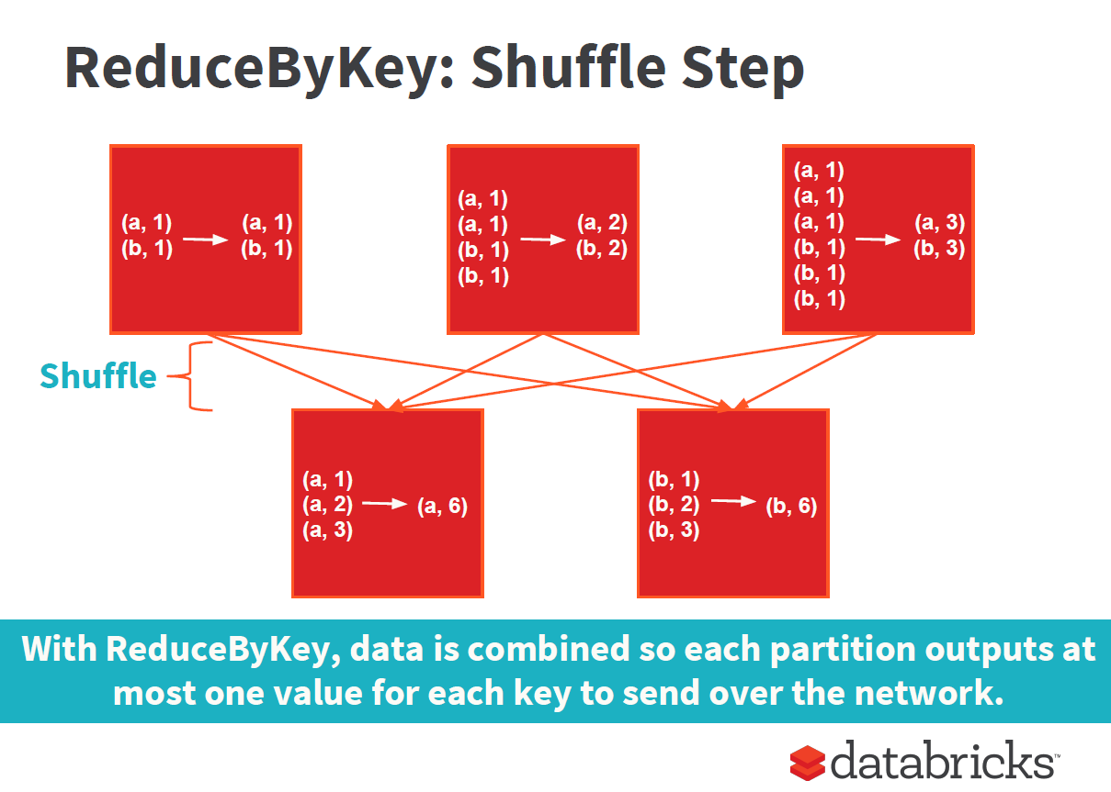

Slide 15
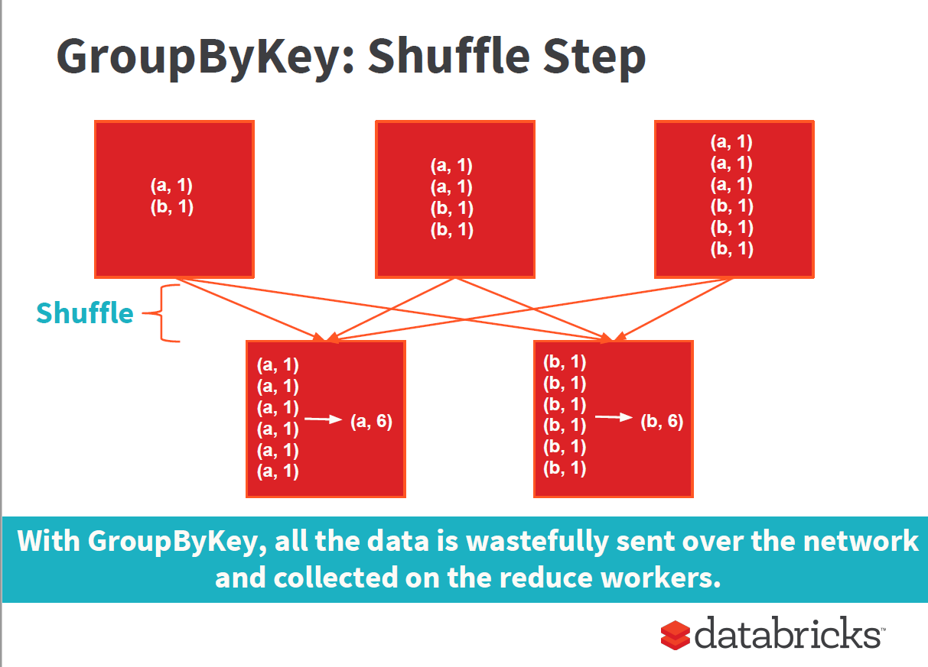

Slide 16
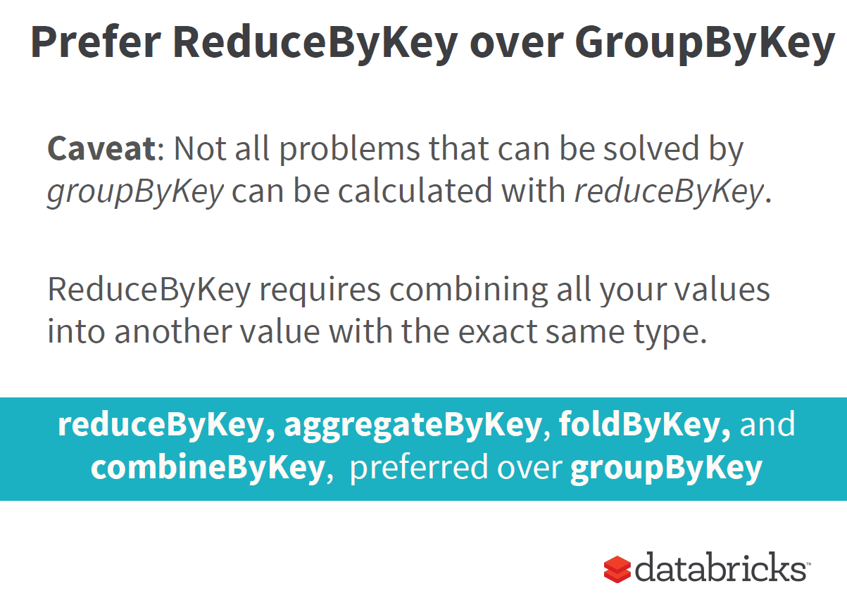

Slide 17
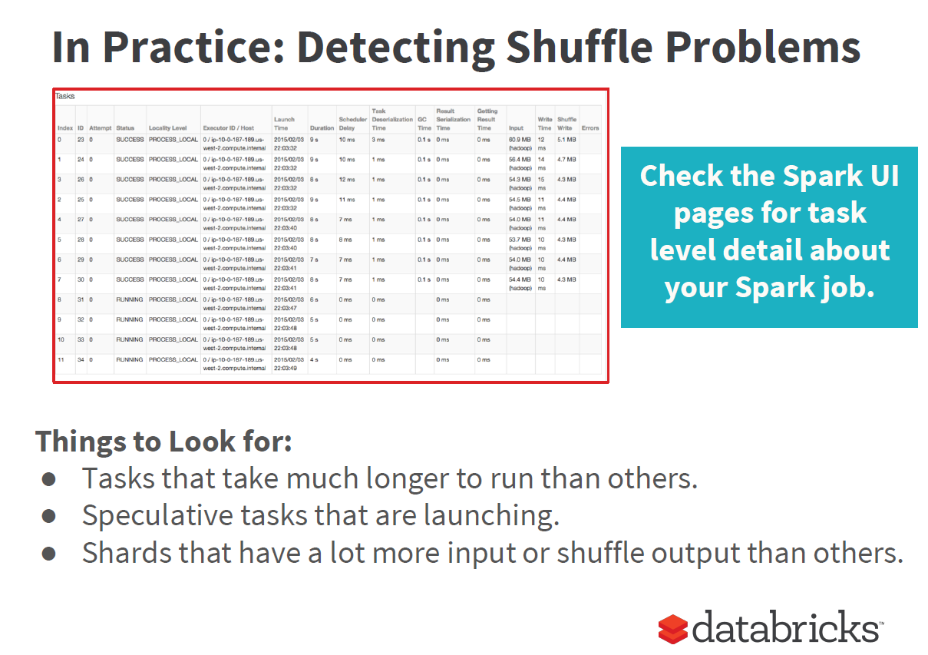

Slide 18
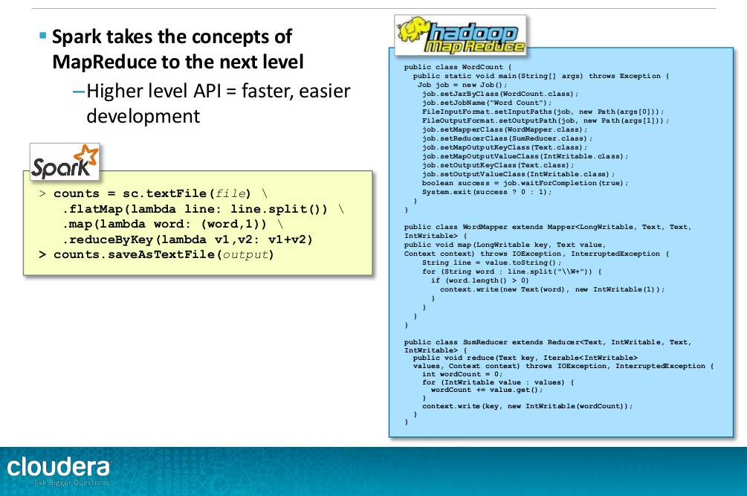

Slide 19
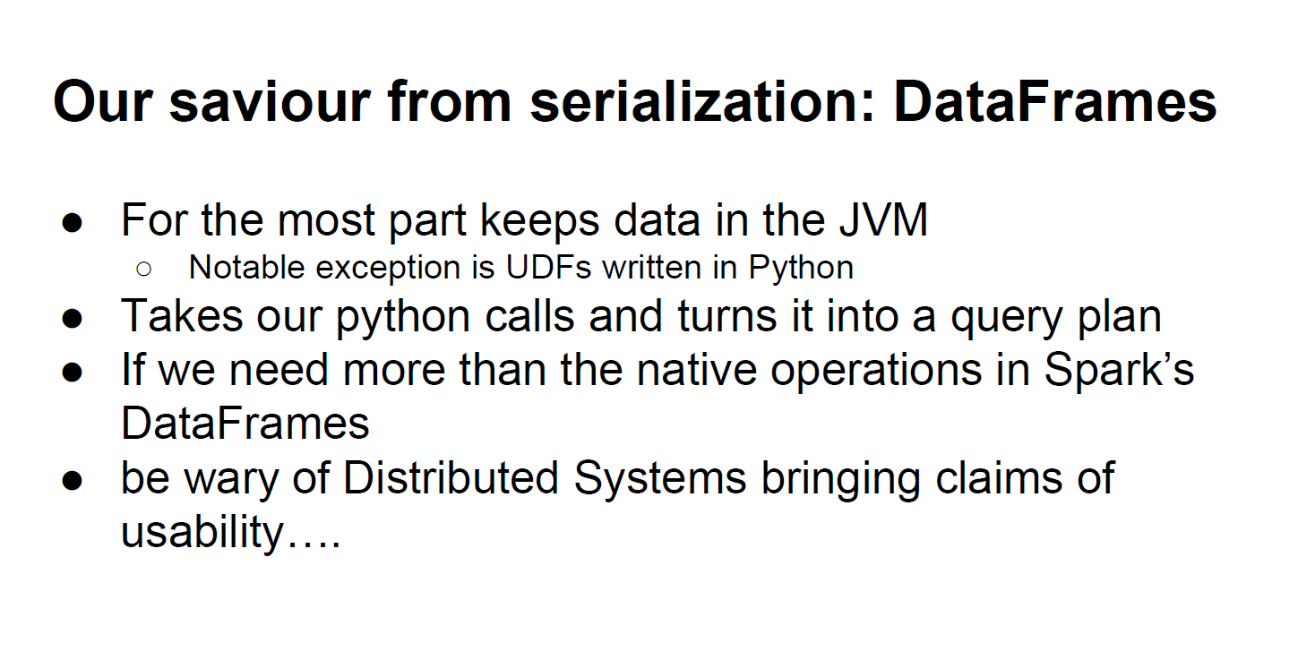

Slide 20
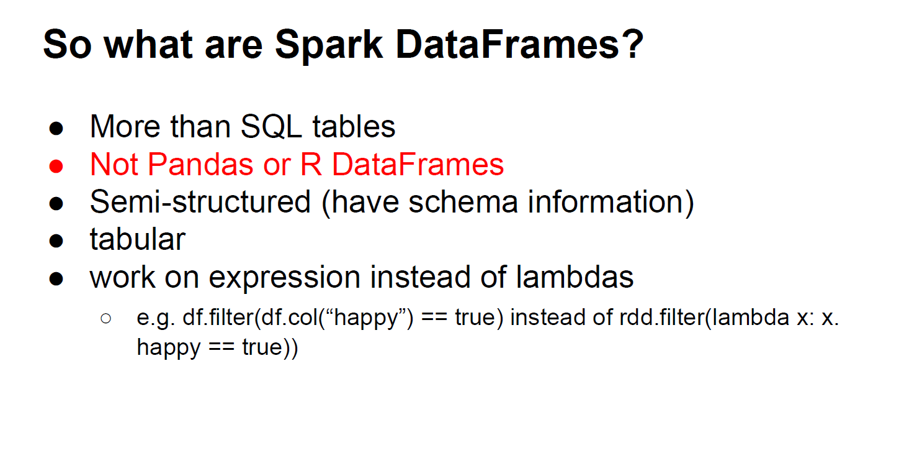
BUT: Follow HandySpark: bringing pandas-like capabilities to Spark DataFrames
https://towardsdatascience.com/handyspark-bringing-pandas-like-capabilities-to-spark-dataframes-5f1bcea9039e

