Slide 1
Machine Learning Lab

Slide 2
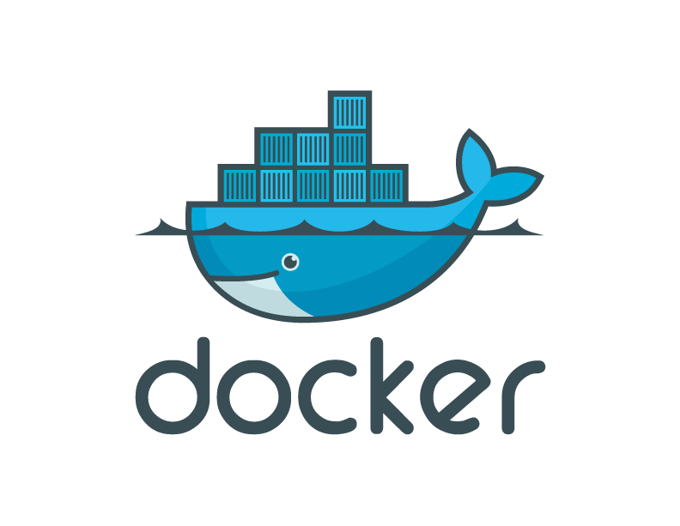
Dockers
Docker, Containers, and the Future of Application Delivery

Slide 3
A useful analogy…

Slide 4
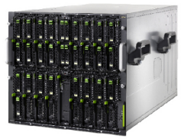
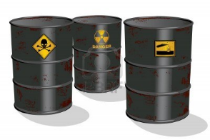
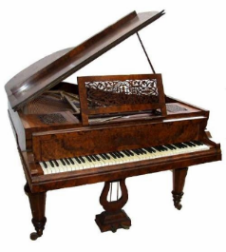
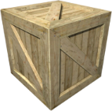
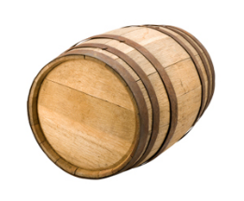
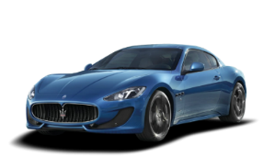
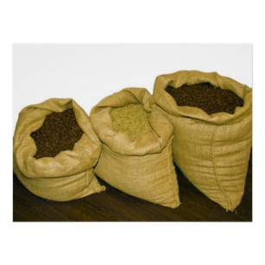
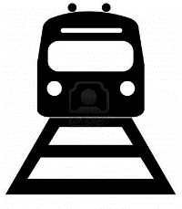


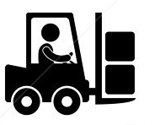
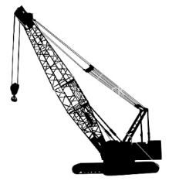
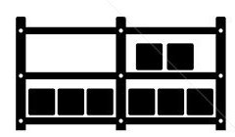

Cargo Transport Pre-1960
Do I worry about how goods interact (e.g. coffee beans next to spices)
Multiplicity of Goods
Multipilicity of methods for transporting/storing
Can I transport quickly and smoothly
(e.g. from boat to train to truck)

Slide 5


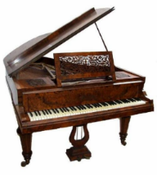
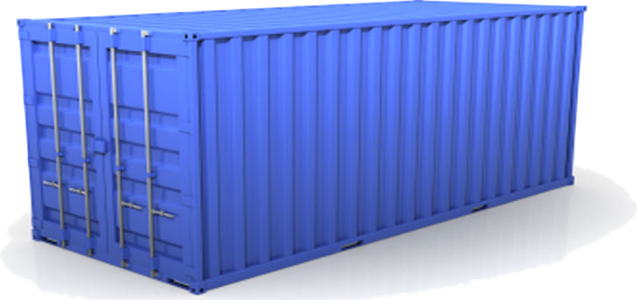
Solution: Intermodal Shipping Container
Do I worry about how goods interact (e.g. coffee beans next to spices)
Multiplicity of Goods
A standard container that is loaded with virtually any goods, and stays sealed until it reaches final delivery.
…in between, can be loaded and unloaded, stacked, transported efficiently over long distances, and transferred from one mode of transport to another
Multiplicity of methods for transporting/storing
Can I transport quickly and smoothly
(e.g. from boat to train to truck)

Slide 6
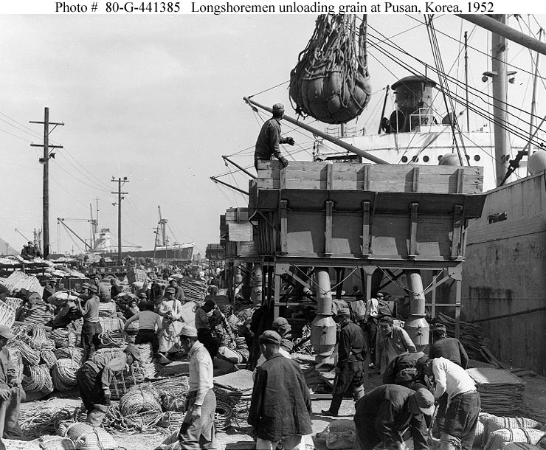
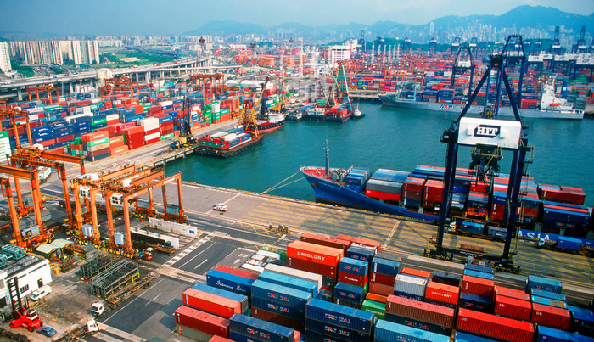
and spawned an Intermodal Shipping Container Ecosystem
90% of all cargo now shipped in a standard container
Order of magnitude reduction in cost and time to load and unload ships
Massive reduction in losses due to theft or damage
Huge reduction in freight cost as percent of final goods (from >25% to <3%)
massive globalizations
5000 ships deliver 200M containers per year

Slide 7
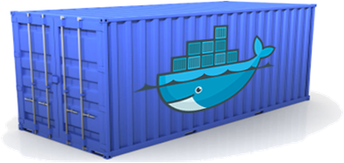
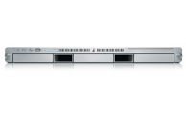
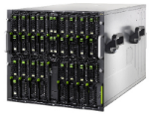
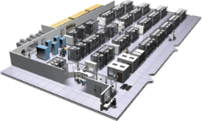
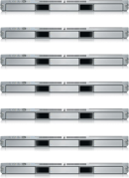


Docker is a shipping container system for code
Static website
User DB
Web frontend
Queue
Analytics DB
Do services and apps interact appropriately?
Multiplicity of Stacks
An engine that enables any payload to be encapsulated as a lightweight, portable, self-sufficient container…
…that can be manipulated using standard operations and run consistently on virtually any hardware platform
Multiplicity of hardware environments
Can I migrate smoothly and quickly
Development VM
QA server
Customer Data Center
Public Cloud
Production Cluster
Contributor’s laptop

Slide 8
Containers vs. VMs
App
A
App
A’
App
B
Containers are isolated,
but share OS and, where
appropriate, bins/libraries
Bins/
Libs
Bins/
Libs
Bins/
Libs
VM
Guest
OS
Guest
OS
Guest
OS
Guest
OS
Guest
OS
App A
App A’
App B
App B’
App B’
App B’
Container
Docker
Hypervisor (Type 2)
Bins/Libs
Bins/Libs
Host OS
Host OS
Server
Server

Slide 9
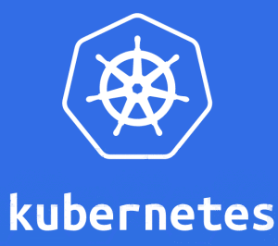
Kubernetes
Kubernetes is based on Google’s experience of many years working with Linux containers.
It is, in a way, a replica of what Google has been doing for a long time but, this time, adapted to Dockers

Slide 10
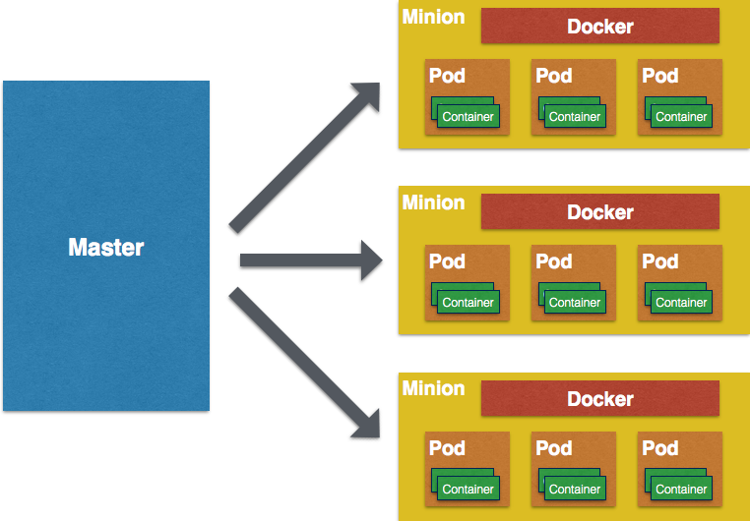
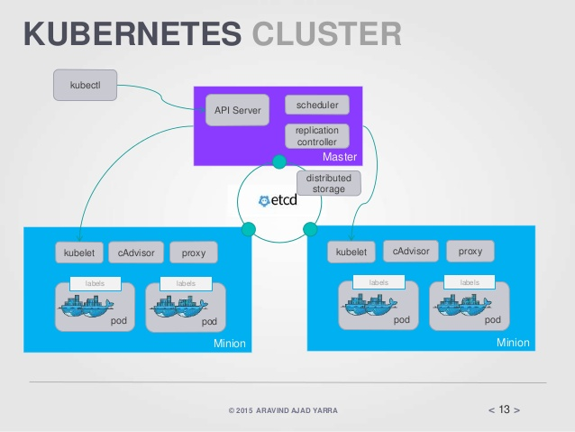
Kubernetes

