Slide 1
Machine Learning Lab

Slide 2
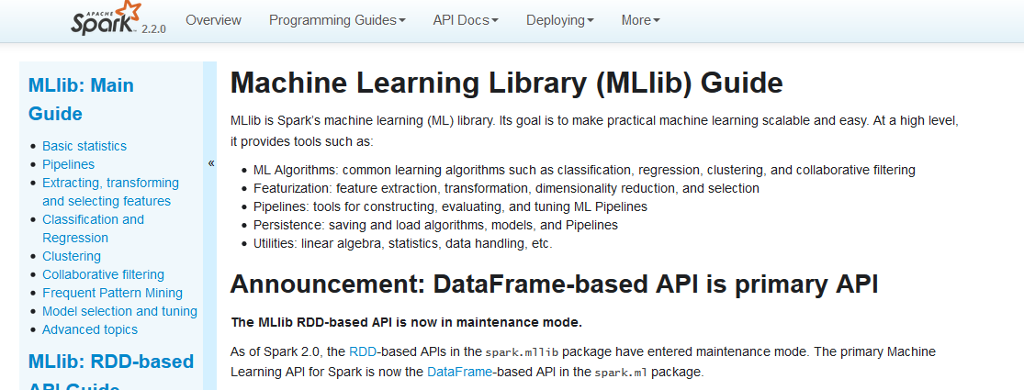
Spark Machine Learning Library https://spark.apache.org/docs/2.2.0/ml-guide.html

Slide 3
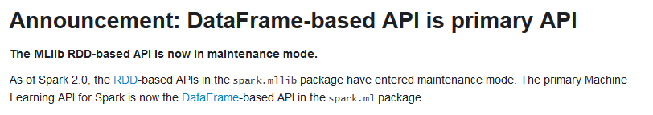

Slide 4
Why is MLlib switching to the DataFrame-based API?
DataFrames provide a more user-friendly API than RDDs.
The DataFrame-based API for MLlib provides a uniform API across ML algorithms and across multiple languages.
DataFrames facilitate practical ML Pipelines, particularly feature transformations. See the Pipelines guide for details.

Slide 6

https://www.slideshare.net/KhalidSalama2/machine-learning-with-spark-65317854

Slide 7
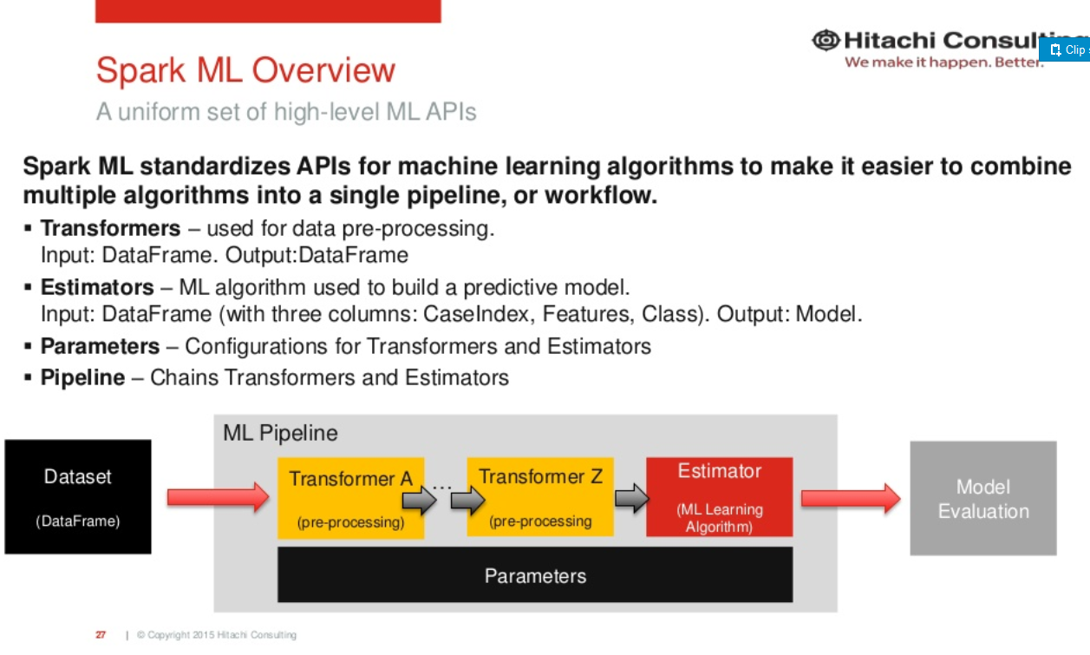

Slide 9
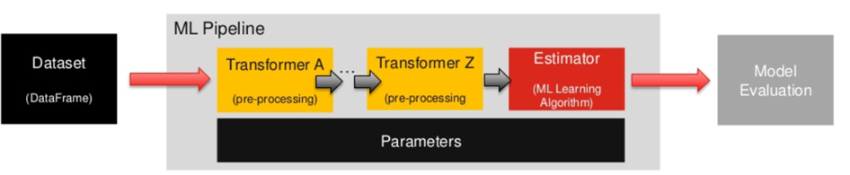
Columns in a DataFrame are named.
….. such as “text,” “features,” and “label.”

Slide 10
Transformers
https://spark.apache.org/docs/2.2.0/ml-pipeline.html#transformers
A Transformer is an abstraction that implements a method transform(), which converts one DataFrame into another, generally by appending one or more columns:
inputCol=‘inputColumn‘
outputCol=‘outputColumn’

Slide 11
Transformers
https://spark.apache.org/docs/2.2.0/ml-pipeline.html#transformers
Transformers include:
feature transformers: e.g. take a DataFrame, read a column (e.g., text), map it into a new column (e.g., feature vectors), and output a new DataFrame with the mapped column appended.
and learned models: e.g. take a DataFrame, read the column containing feature vectors, predict the label for each feature vector, and output a new DataFrame with predicted labels appended as a column.

Slide 12
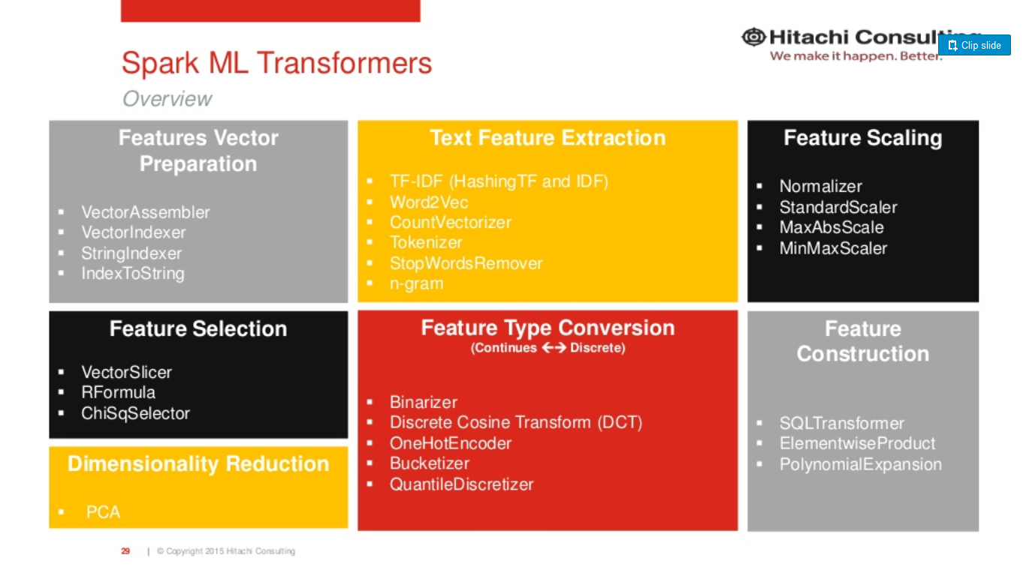

Slide 13
Extracting, transforming and selecting features
https://spark.apache.org/docs/2.2.0/ml-features.html

Slide 14
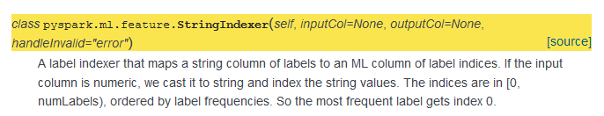
StringIndexer
https://spark.apache.org/docs/2.2.0/api/python/pyspark.ml.html#pyspark.ml.feature.StringIndexer

Slide 15
… after “feature engineering” … the feature engineering results are then combined using the VectorAssembler, before being passed to ML Estimator

Slide 16
DataFrame can use ML Vector
Local vector
A local vector has integer-typed and 0-based indices and double-typed values, stored on a single machine.
MLlib supports two types of local vectors: dense and sparse.
A dense vector is backed by a double array representing its entry values, while a sparse vector is backed by two parallel arrays: indices and values.
For example, a vector (1.0, 0.0, 3.0) can be represented in dense format as [1.0, 0.0, 3.0] or in sparse format as (3, [0, 2], [1.0, 3.0]), where 3 is the size of the vector.

Slide 17
Estimators
An Estimator abstracts the concept of a learning algorithm or any algorithm that fits or trains on data.
Technically, an Estimator implements a method fit(), which accepts a DataFrame and produces a Model, which is a Transformer.
For example, a learning algorithm such as LogisticRegression is an Estimator, and calling fit() trains a LogisticRegressionModel, which is a Model and hence a Transformer.

Slide 18
