Slide 1
Machine Learning Lab

Slide 2
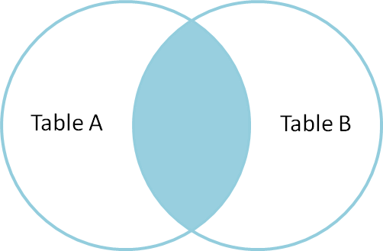
Python Introduction: type of joins
Inner join : merge
returns a new DataFrame that contains only those rows that have matching values in both of the original DataFrames.

Slide 3
Python Introduction: type of joins
Merge_df = pd.merge(left_df, right_df, on=‘column', how='inner')

Slide 4
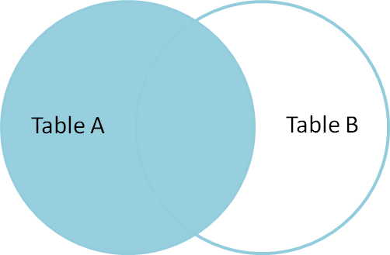
Python Introduction: type of joins
Left join : merge + how=‘left’
Return all of the rows from the left DataFrame, even those rows whose join key(s) do not have values in the right DataFrame.
Rows in the left DataFrame that are missing values for the join key(s) in the right DataFrame will simply have null (i.e., NaN or None)
Note: a left join will still discard rows from the right DataFrame that do not have values for the join key(s) in the left DataFrame.

Slide 5
Python Introduction
Other join types
The pandas merge function supports other join types:
Right (outer) join: Invoked by passing how='right' as an argument. Similar to a left join, except all rows from the right DataFrame are kept, while rows from the left DataFrame without matching join key(s) values are discarded.
.

Slide 6
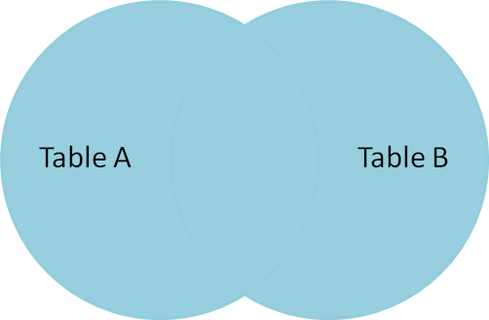
Python Introduction
Full (outer) join: Invoked by passing how='outer' as an argument. This join type returns the all pairwise combinations of rows from both DataFrames; i.e., the result DataFrame will NaN where data is missing in one of the dataframes. This join type is very rarely used.

Slide 7
Python Introduction: join and merge Pandas dataframes
See, for example:
https://chrisalbon.com/python/data_wrangling/pandas_join_merge_dataframe/

Slide 8
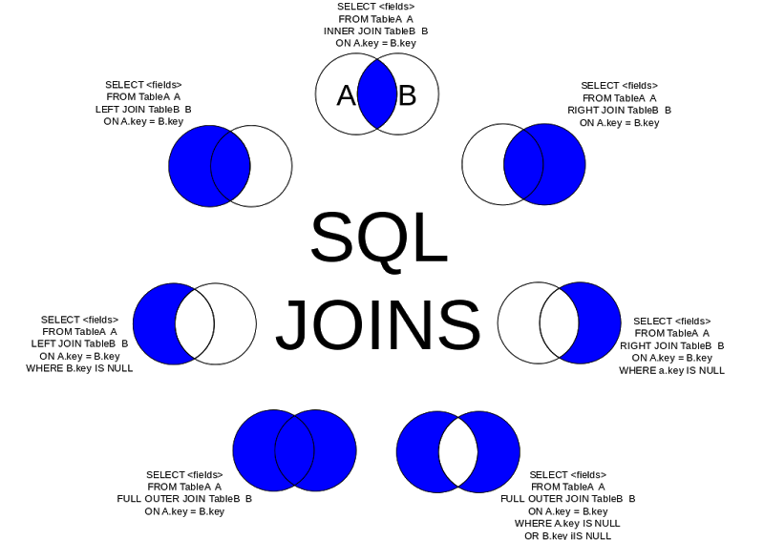

Slide 9
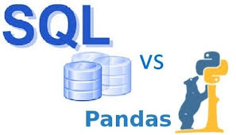

Slide 10
Since many potential pandas users have some familiarity with SQL, this page is meant to provide some examples of how various SQL operations would be performed using pandas.
https://pandas.pydata.org/pandas-docs/stable/getting_started/comparison/comparison_with_sql.html

