Slide 1
Machine Learning Lab

Slide 2
Linear Regression in R
We will study 3.4 The Marketing Plan following 3.6 Lab: Linear Regression in text book:
An Introduction to Statistical Learning with Applications in R. Gareth James, Daniela Witten, Trevor Hastie and Robert Tibshirani. Springer, 2013.
Suppose that we are statistical consultants hired by a client to provide advice on how to improve sales of a particular product.
The Advertising data set consists of the sales of that product in 200 different markets, along with advertising budgets for the product in each of those markets for three different media: TV, radio, and newspaper.

Slide 3
Linear Regression in R
Questions we might seek to address:
Is there a relationship between advertising budget and sales?
How strong is the relationship between advertising budget and sales?
Which media contribute to sales?
How accurately can we estimate the effect of each medium on sales?
How accurately can we predict future sales?
Is the relationship linear?
Is there synergy among the advertising media?

Slide 4
Linear Regression in R
We can follow R-script file:
LinearRegression_Advertising.R

Slide 5
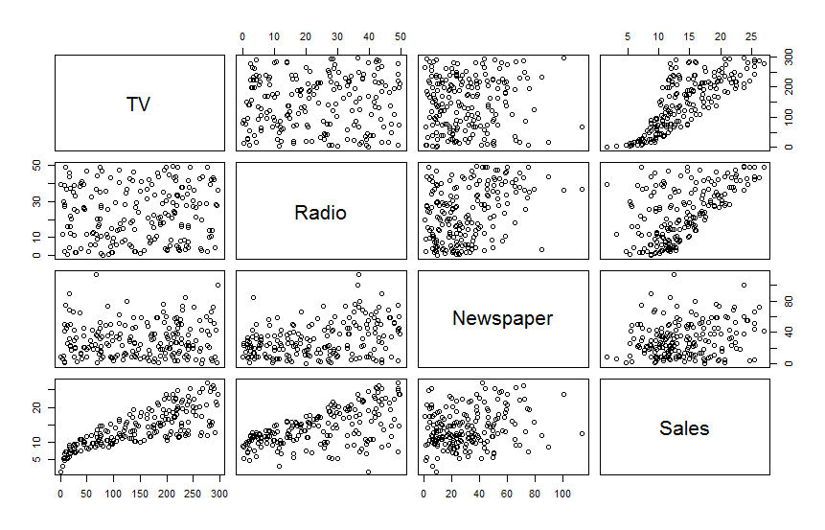
Linear Regression in R
Scatterplots
Advertising=read.csv("Advertising.csv")
fix(Advertising)
pairs(~ TV + Radio + Newspaper + Sales, Advertising)

Slide 6
Linear Regression in R
Simple LR
lm.fit=lm(Sales~TV,data=Advertising)
attach(Advertising)
lm.fit=lm(Sales~TV)
> summary(lm.fit)
Call:
lm(formula = Sales ~ TV)
Residuals:
Min 1Q Median 3Q Max
-8.3860 -1.9545 -0.1913 2.0671 7.2124
Coefficients:
Estimate Std. Error t value Pr(>|t|)
(Intercept) 7.032594 0.457843 15.36 <2e-16 ***
TV 0.047537 0.002691 17.67 <2e-16 ***
---
Signif. codes: 0 ‘***’ 0.001 ‘**’ 0.01 ‘*’ 0.05 ‘.’ 0.1 ‘ ’ 1
Residual standard error: 3.259 on 198 degrees of freedom
Multiple R-squared: 0.6119, Adjusted R-squared: 0.6099
F-statistic: 312.1 on 1 and 198 DF, p-value: < 2.2e-16

Slide 7
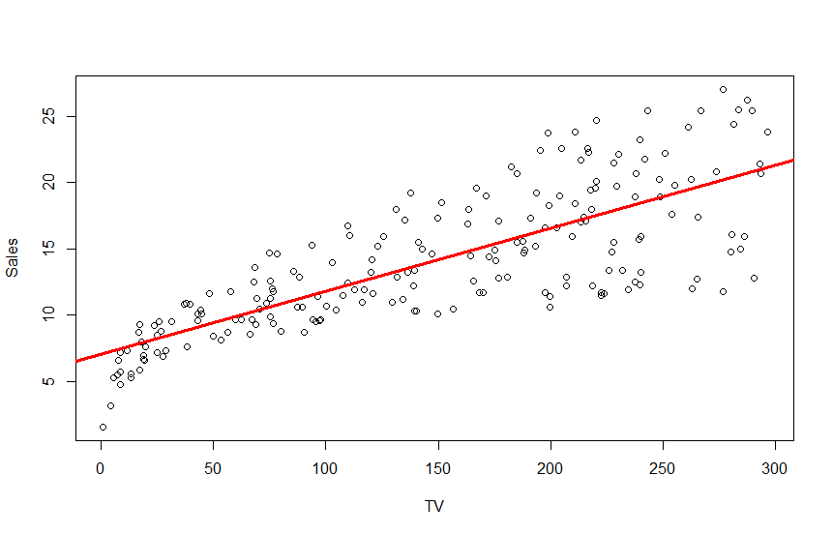
Linear Regression in R
Regression Line (Figure 3.1 in text book)
> plot(TV,Sales)
> abline(lm.fit,lwd=3,col=2)

Slide 8
Linear Regression in R
Simple LR
> names(lm.fit)
[1] "coefficients" "residuals" "effects" "rank" "fitted.values" "assign" "qr"
[8] "df.residual" "xlevels" "call" "terms" "model"
> coef(lm.fit)
(Intercept) TV
7.03259355 0.04753664

Slide 9
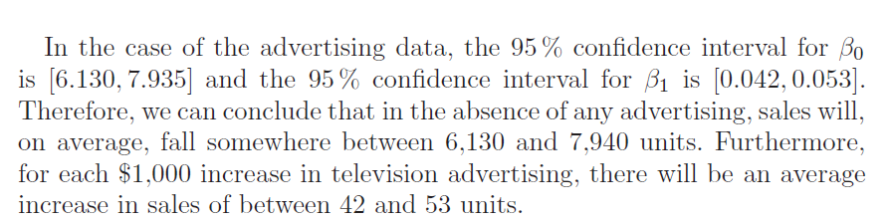
Linear Regression in R
Simple LR
> confint(lm.fit)
2.5 % 97.5 %
(Intercept) 6.12971927 7.93546783
TV 0.04223072 0.05284256
>

Slide 10
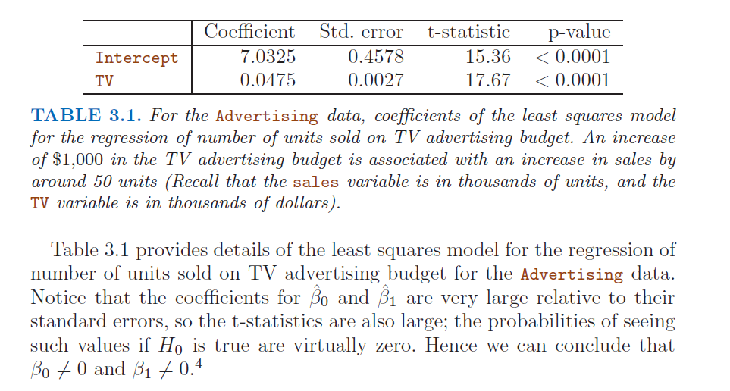
Linear Regression in R

Slide 11
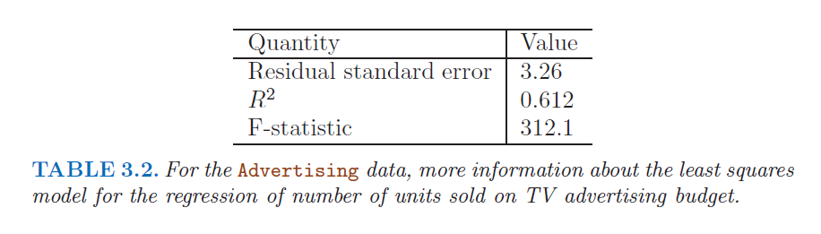
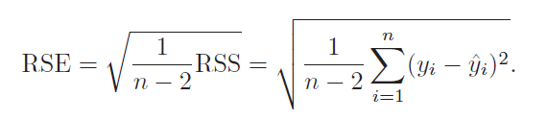
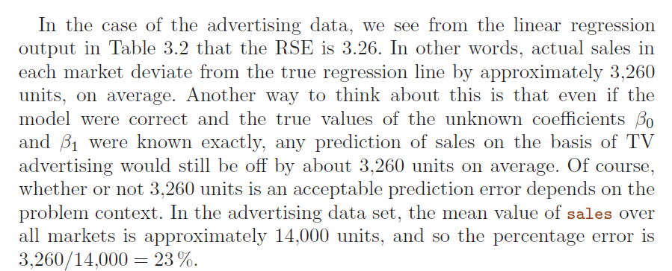
Linear Regression in R

Slide 12
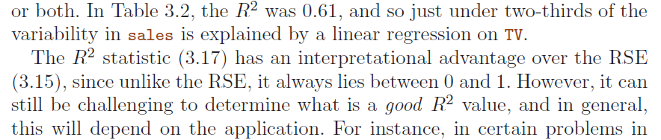
Linear Regression in R

Slide 13
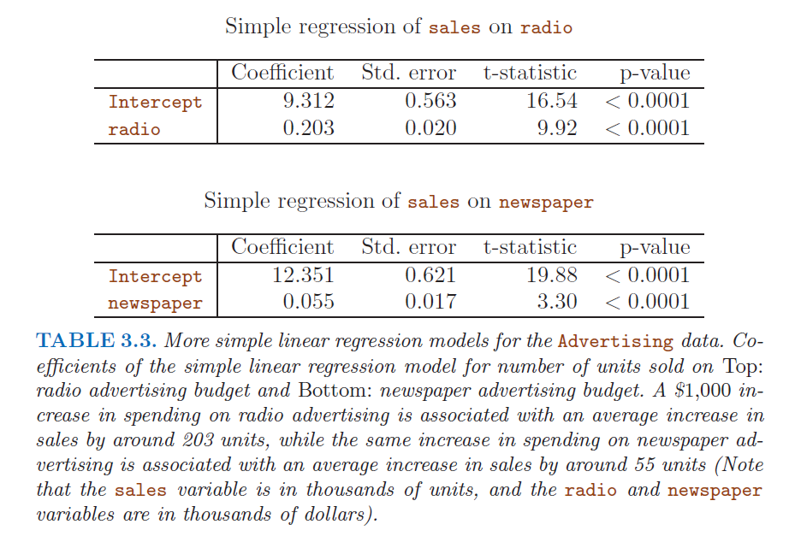
Linear Regression in R

Slide 14

Linear Regression in R
Multiple LR
> # Multiple Linear Regression
> # lm.fit=lm(Sales~TV+Radio+Newspaper,data=Advertising)
> # ~.-X = all variables but X (as X is not a variable … it means use ALL !)
>
> lm.fit=lm(Sales~.-X,data=Advertising)
> summary(lm.fit)
Call:
lm(formula = Sales ~ . - X, data = Advertising)
Residuals:
Min 1Q Median 3Q Max
-8.8277 -0.8908 0.2418 1.1893 2.8292
Coefficients:
Estimate Std. Error t value Pr(>|t|)
(Intercept) 2.938889 0.311908 9.422 <2e-16 ***
TV 0.045765 0.001395 32.809 <2e-16 ***
Radio 0.188530 0.008611 21.893 <2e-16 ***
Newspaper -0.001037 0.005871 -0.177 0.86
---
Signif. codes: 0 ‘***’ 0.001 ‘**’ 0.01 ‘*’ 0.05 ‘.’ 0.1 ‘ ’ 1
Residual standard error: 1.686 on 196 degrees of freedom
Multiple R-squared: 0.8972, Adjusted R-squared: 0.8956
F-statistic: 570.3 on 3 and 196 DF, p-value: < 2.2e-16
We interpret βj as the average
effect on Y of a one unit increase in Xj , holding all other predictors fixed.

Slide 15
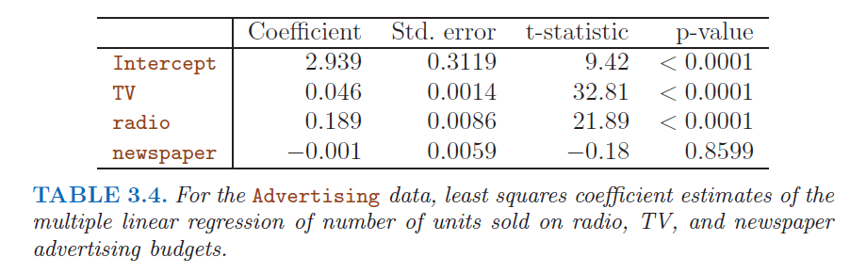
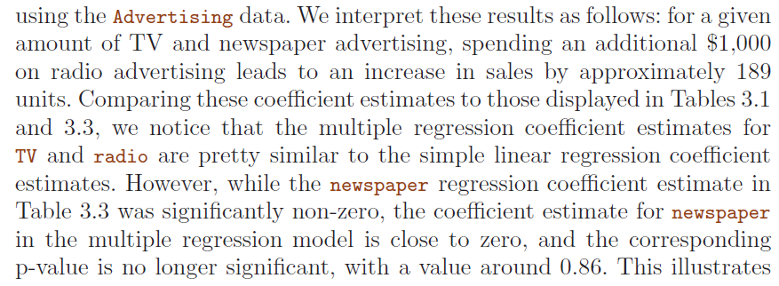
Linear Regression in R
simple and multiple regression coefficients can be quite different

Slide 16
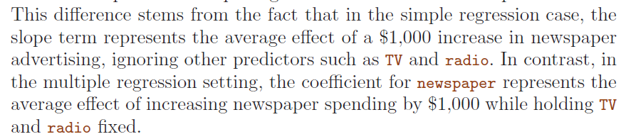
Linear Regression in R
simple and multiple regression coefficients can be quite different

Slide 17
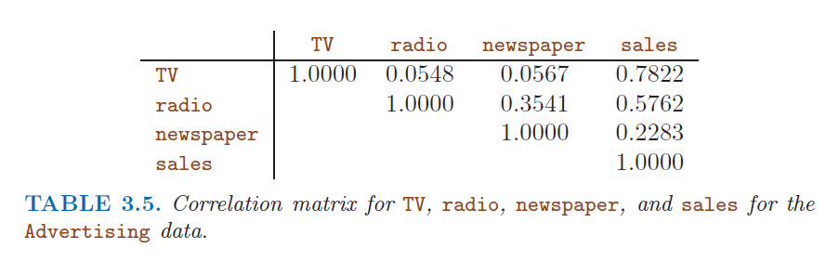
Linear Regression in R
Does it make sense for the multiple regression to suggest no relationship between sales and newspaper while the simple linear regression implies the opposite? In fact it does

Slide 18
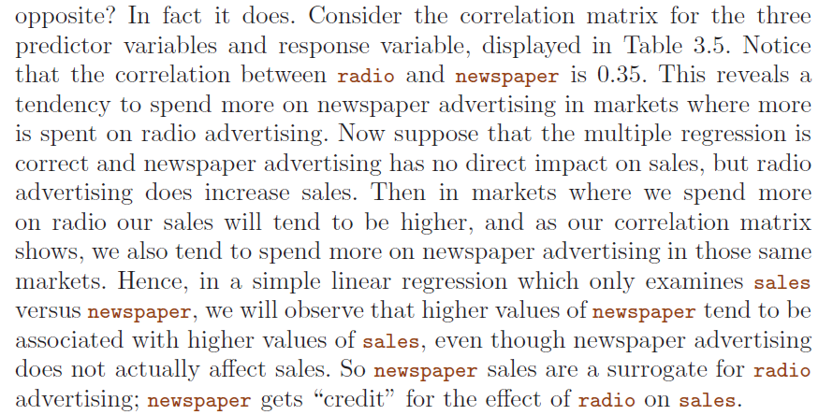
Linear Regression in R

Slide 19
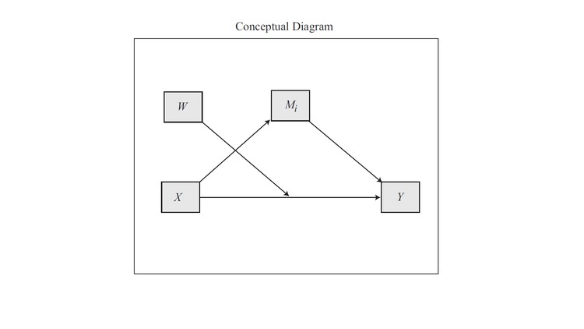
Linear Regression in R
Confounders, mediation, moderation,…
Hayes, Andrew F. Introduction to mediation, moderation, and conditional process analysis: A regression-based approach. Guilford Press, 2013.
https://www.udemy.com/mediation-moderation-and-conditional-process-analysis/
https://www.datacamp.com/courses/moderation-and-mediation

Slide 20

Multiple Linear Regression Some Important Questions
Is There a Relationship Between the Response and Predictors? … or.. Is at least one of the predictors X₁,X₂, . . . , X_{p} useful in predicting the response?
Do all the predictors help to explain Y , or is only a subset of the predictors useful?
How well does the model fit the data?
Given a set of predictor values, what response value should we predict, and how accurate is our prediction?.
Text Book:

Slide 21
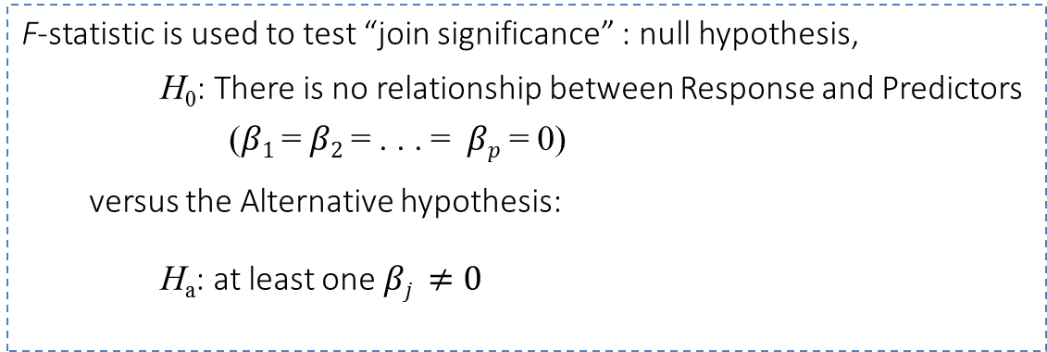
Multiple Linear Regression Some Important Questions
Is There a Relationship Between the Response and Predictors?
F-statistic is used to test “join significance” : null hypothesis,
H₀: There is no relationship between Response and Predictors
($β1$ = $β2$ = . . . = $βp$ = 0)
versus the Alternative hypothesis:
H_{a}: at least one $βj ≠0$
Text Book:

Slide 22


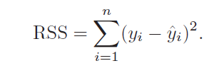
Multiple Linear Regression Some Important Questions
Is There a Relationship Between the Response and Predictors?
TSS = total sum of squares
(total variance)
RSS = residual sum of squares
(variance after regression)
F $≈$ (explained variance) / (unexplained variance)

Slide 23

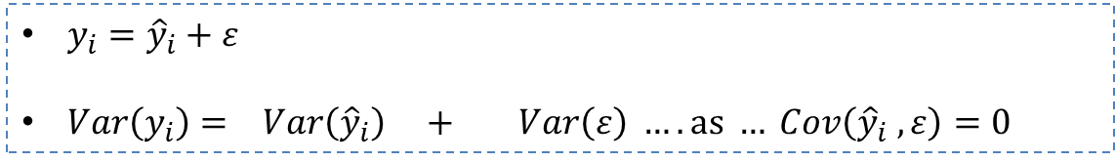

Multiple Linear Regression Some Important Questions
Some brief (and informal) ideas on F-tests
TSS = total sum of squares
(total variance)
RSS = residual sum of squares
(variance after regression)
$F$ $≈$ $\frac{(explained variance)}{(unexplained variance) }$
$y_{i}={\hat{y}}_{i}+ε$
$Var\left(y_{i}\right)= Var\left({\hat{y}}_{i}\right) + Var\left(ε\right) …. as … Cov\left({\hat{y}}_{i} , ε\right)=0$
$TSS=ESS \left(explained\right)+RSS \left(unexplained\right)$
$$ESS = TSS − RSS$$

Slide 24


Multiple Linear Regression Some Important Questions
Is There a Relationship Between the Response and Predictors?
TSS = total sum of squares
(total variance)
F $≈$ (explained variance) / (unexplained variance)
RSS = residual sum of squares
(variance after regression)
If the model assumption about error: $ε\sim N\left(0,σ\right)$ i.i.d is correct, then:
The variance of residual error (n-p-1 degrees of freedom)
and that, provided H₀ is true (with p degrees of freedom)

Slide 25


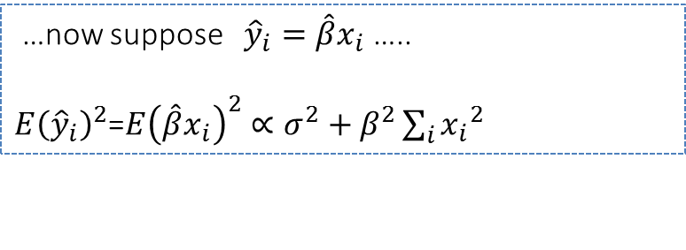
Multiple Linear Regression Some Important Questions
Some brief (and informal) ideas on F-tests
TSS = total sum of squares
(total variance)
RSS = residual sum of squares
(variance after regression)
$F$ $≈$ $\frac{(explained variance)}{(unexplained variance) }$
$$Var\left(y_{i}\right)= Var\left({\hat{y}}_{i}\right) + Var\left(ε\right) …. as … Cov\left({\hat{y}}_{i} , ε\right)=0$$
$TSS=ESS \left(explained\right)+RSS \left(unexplained\right)$
…now suppose ${\hat{y}}_{i}=\hat{β}x_{i}$ …..
$E{\left({\hat{y}}_{i}\right)}^{2}$=$E{\left(\hat{β}x_{i}\right)}^{2}∝σ^{2}+β^{2}\sum_{i}{{x_{i}}^{2}}$
$$ESS = TSS − RSS$$
Hence, provided H₀ is true => $β=0⇒$

Slide 26

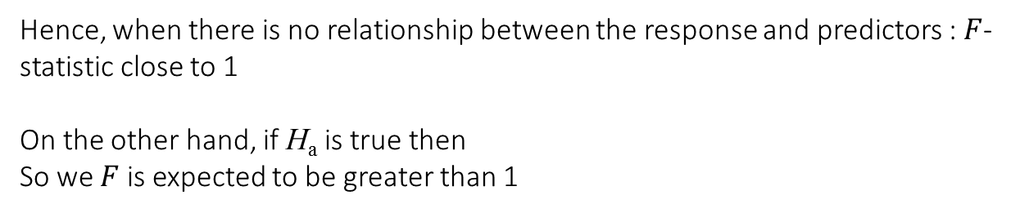
Multiple Linear Regression Some Important Questions
Is There a Relationship Between the Response and Predictors?
F $≈$ (explained variance) / (unexplained variance)
TSS = total sum of squares
(total variance)
The variance of residual error (n-p-1 degrees of freedom)
and that, provided H₀ is true (with p degrees of freedom)
RSS = residual sum of squares
(variance after regression)
Hence, when there is no relationship between the response and predictors : $F$-statistic close to 1
On the other hand, if H_{a} is true then
So we $F$ is expected to be greater than 1

Slide 27
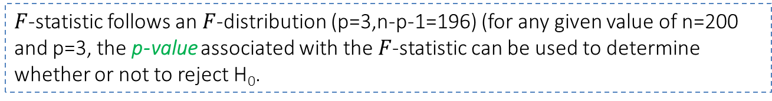
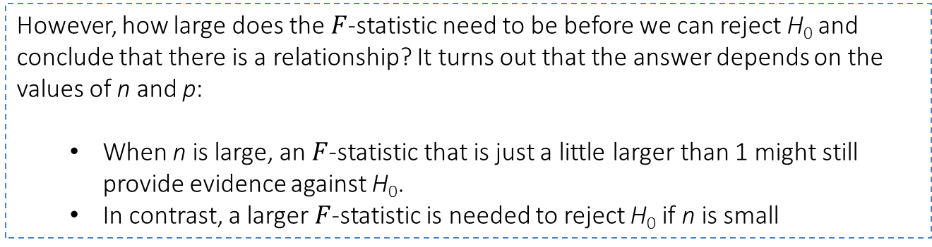
Multiple Linear Regression Some Important Questions
Is There a Relationship Between the Response and Predictors?
However, how large does the $F$-statistic need to be before we can reject H₀ and conclude that there is a relationship? It turns out that the answer depends on the values of n and p:
When n is large, an $F$-statistic that is just a little larger than 1 might still provide evidence against H₀.
In contrast, a larger $F$-statistic is needed to reject H₀ if n is small
$F$-statistic follows an $F$-distribution (p=3,n-p-1=196) (for any given value of n=200 and p=3, the p-value associated with the $F$-statistic can be used to determine whether or not to reject H₀.
F-statistic: 570.3 on 3 and 196 DF, p-value: < 2.2e-16

Slide 28


Multiple Linear Regression Some Important Questions
Is There a Relationship Between the Response and Predictors?
Sometimes we want to test that a particular subset of q of the coefficients are zero.
This corresponds to a null hypothesis H₀ :
($βj$ = 0 for j subset of q coefficients; q < p)
Procedure:
Fit a second model that uses all the variables except those q
Obtain the residual sum of squares for that model = RSS₀
Then use the F-statistic:

Slide 29
Multiple Linear Regression Some Important Questions
Is There a Relationship Between the Response and Predictors?
t-statistic in Table 3.4 is equivalent to the $F$-test (the square of t-statistic is the $F$) that omits that single variable from the model (i.e. q=1)
So t-statistic in Table 3.4 reports the partial effect of adding that variable to the model.
p-values indicate that:
TV and radio are related to sales,
but that there is no evidence that newspaper is associated with sales, in the presence of these two

Slide 30
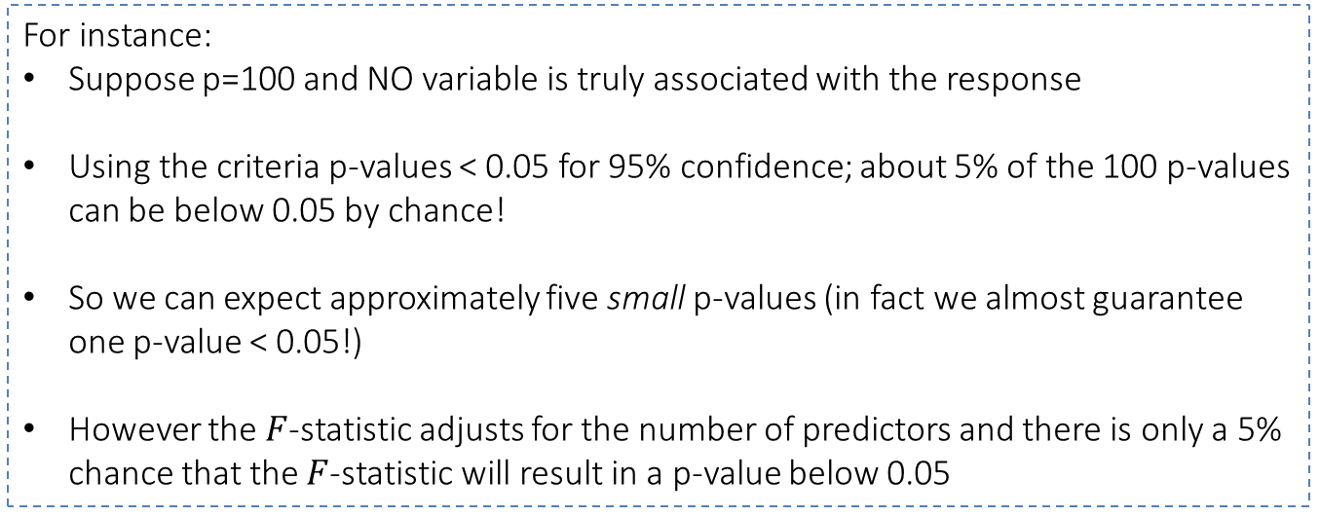
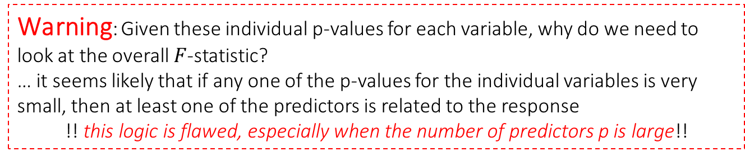
Multiple Linear Regression Some Important Questions
Is There a Relationship Between the Response and Predictors?
Warning: Given these individual p-values for each variable, why do we need to look at the overall $F$-statistic?
… it seems likely that if any one of the p-values for the individual variables is very small, then at least one of the predictors is related to the response
!! this logic is flawed, especially when the number of predictors p is large!!
For instance:
Suppose p=100 and NO variable is truly associated with the response
Using the criteria p-values < 0.05 for 95% confidence; about 5% of the 100 p-values can be below 0.05 by chance!
So we can expect approximately five small p-values (in fact we almost guarantee one p-value < 0.05!)
However the $F$-statistic adjusts for the number of predictors and there is only a 5% chance that the $F$-statistic will result in a p-value below 0.05

Slide 31
Multiple Linear Regression Some Important Questions
Is There a Relationship Between the Response and Predictors?
Wide Data & Big Data
Wide Data:
If p > n (>>n wide data) we cannot even fit a multiple linear regression using least squares!!
We will discuss later feature selection and along the course high-dimensionality
Big Data:
If n >> p … shouldn’t we be more confident on the results itself??
To be discussed….
Too Big to Fail Large Samples and the p-value Problem
http://www.galitshmueli.com/system/files/Largesample-12-6-2012.pdf

Slide 32
Multiple Linear Regression Some Important Questions
Is There a Relationship Between the Response and Predictors? … or.. Is at least one of the predictors X₁,X₂, . . . , X_{p} useful in predicting the response?
Do all the predictors help to explain Y , or is only a subset of the predictors useful?
How well does the model fit the data?
Given a set of predictor values, what response value should we predict, and how accurate is our prediction?.
Text Book:

Slide 33
Multiple Linear Regression Some Important Questions
Do all the predictors help to explain Y , or is only a subset of the predictors useful?
…. it is often the case that the response is only related to a subset of the predictors
…. looking at individual p-values , when there is a large number of predictors, can lead to false discoveries
Introduction to Feature Selection: deciding on important variables
Test all possible combinations and decide based on some statistics … but it requires to test 2^{p} models!!!
Three classical approaches:
Forward selection: adding predictors one by one, select the best one (for example the lowest RSS) (might include variables early that later become redundant)
Backward selection: start with all and remove the worst one (for example, largest p-value) (cannot be used if p > n!)
Mixed selection: combination of forward and backward selection (different strategies!)
Text Book:

Slide 34
Multiple Linear Regression Some Important Questions
Is There a Relationship Between the Response and Predictors? … or.. Is at least one of the predictors X₁,X₂, . . . , X_{p} useful in predicting the response?
Do all the predictors help to explain Y , or is only a subset of the predictors useful?
How well does the model fit the data?
Given a set of predictor values, what response value should we predict, and how accurate is our prediction?.
Text Book:

Slide 35
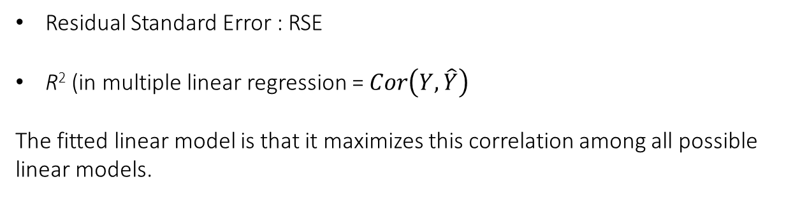
Multiple Linear Regression Some Important Questions
How well does the model fit the data?
Residual Standard Error : RSE
R² (in multiple linear regression = $Cor\left(Y,\hat{Y}\right)$
The fitted linear model is that it maximizes this correlation among all possible linear models.
There is a small increase in R² if we include newspaper advertising in the model that already contains TV and radio advertising, even though we saw earlier that the p-value for newspaper advertising is not significant.
It turns out that R² will always increase when more variables
Therefore and adjusted R² , that accounts for the number of predictors, is used.
Text Book:

Slide 36
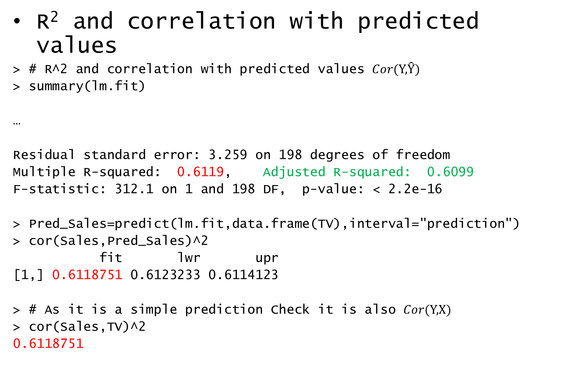
Linear Regression in R
R² and correlation with predicted values
> # R^2 and correlation with predicted values $Cor(\text{Y}\text{,}\hat{\text{Y}})$
> summary(lm.fit)
…
Residual standard error: 3.259 on 198 degrees of freedom
Multiple R-squared: 0.6119, Adjusted R-squared: 0.6099
F-statistic: 312.1 on 1 and 198 DF, p-value: < 2.2e-16
> Pred_Sales=predict(lm.fit,data.frame(TV),interval="prediction")
> cor(Sales,Pred_Sales)^2
fit lwr upr
[1,] 0.6118751 0.6123233 0.6114123
> # As it is a simple prediction Check it is also $Cor(\text{Y}\text{,} X)$
> cor(Sales,TV)^2
0.6118751

Slide 37
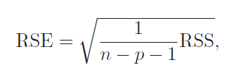
Multiple Linear Regression Some Important Questions
How well does the model fit the data?
Residual Standard Error : RSE
The model that contains only TV and radio as predictors has an RSE of 1.681
The model that contains only TV has an RSE of 3.26
Using TV and radio the model is much accurate
The model that also contains newspaper as a predictor has an RSE of 1.686
No point in using newspaper
Note: when adding newspaper RSE increases: the decrease in RSS can be small relative to the increase in p.
Text Book:

Slide 38
Multiple Linear Regression Some Important Questions
How well does the model fit the data?
Other metrics such as the Minimum Absolute Error (MAE) can be considered
plot(abs(Sales-Pred_Sales[,1]))
MAE=sum(abs(Sales-Pred_Sales[,1]))/length(Sales)
[1] 2.549806
While … Residual standard error: 3.259 on 198 degrees of freedom
It is also worth plotting data to discover non-linearities and synergy or interaction between predictors (will be discussed later)
Text Book:

Slide 39
Multiple Linear Regression Some Important Questions
Is There a Relationship Between the Response and Predictors? … or.. Is at least one of the predictors X₁,X₂, . . . , X_{p} useful in predicting the response?
Do all the predictors help to explain Y , or is only a subset of the predictors useful?
How well does the model fit the data?
Given a set of predictor values, what response value should we predict, and how accurate is our prediction?.
Text Book:

Slide 40
Multiple Linear Regression Some Important Questions
Given a set of predictor values, what response value should we predict, and how accurate is our prediction?.
Confidence intervals: how close are estimated values to real values due to the inaccuracy in the coefficient estimation (reducible error)
Model bias: we are supposing a linear model
Prediction intervals: even if we knew the true coefficients the response cannot be predicted (random error ε in the model; irreducible error). Prediction intervals incorporate both reducible error + irreducible error
Text Book:

Slide 41
Multiple Linear Regression Some Important Questions
Given a set of predictor values, what response value should we predict, and how accurate is our prediction?.
Simple LR : predict()
> # 95% confidence interval associated with each TV value
>predict(lm.fit,data.frame(TV=c(10,100,200)),
interval="confidence")
fit lwr upr
1 7.50796 6.65052 8.36540
2 11.78626 11.26782 12.30470
3 16.53992 16.00567 17.07418
>
> # prediction interval for predicted Sales
>predict(lm.fit,data.frame(TV=c(10,100,200)),
interval="prediction")
fit lwr upr
1 7.50796 1.024881 13.99104
2 11.78626 5.339251 18.23326
3 16.53992 10.091624 22.98822
Text Book:

Slide 42
Multiple Linear Regression Some Important Questions
For example, given that interval
$100,000 is spent on TV advertising and $20,000 is spent on radio advertising
in each city, the 95% confidence interval is [10,985, 11,528]. We interpret
this to mean that 95% of intervals of this form will contain the true value of
f(X).
On the other hand, a prediction interval can be used to quantify the prediction
uncertainty surrounding sales for a particular city. Given that $100,000 is interval spent on TV advertising and $20,000 is spent on radio advertising in that city the 95% prediction interval is [7,930, 14,580]. We interpret this to mean that 95% of intervals of this form will contain the true value of Y for this city.
Note that both intervals are centered at 11,256, but that the prediction interval is substantially wider than the confidence interval, reflecting the increased uncertainty about sales for a given city in comparison to the average sales over many locations.
Text Book:

Slide 43
Multiple Linear Regression Other Considerations in the Regression Model
Other Considerations in the Regression Model:
Qualitative Predictors
Extensions of the Linear Model
Potential Problems
Text Book:

Slide 44
Multiple Linear Regression Qualitative Predictors
Other Considerations in the Regression Model:
Qualitative Predictors
Extensions of the Linear Model
Potential Problems
Text Book:

Slide 45
Multiple Linear Regression Qualitative Predictors
Quantitative Predictors
Credit data:
balance: average credit card debt
quantitative predictors: age, cards (no. of credit cards), education (years of education),income (in thousands of dollars), limit (credit limit) and rating (credit rating)
qualitative predictors: gender, student (student status), status (marital status), and ethnicity (Caucasian, African American or Asian)
Text Book:

Slide 46
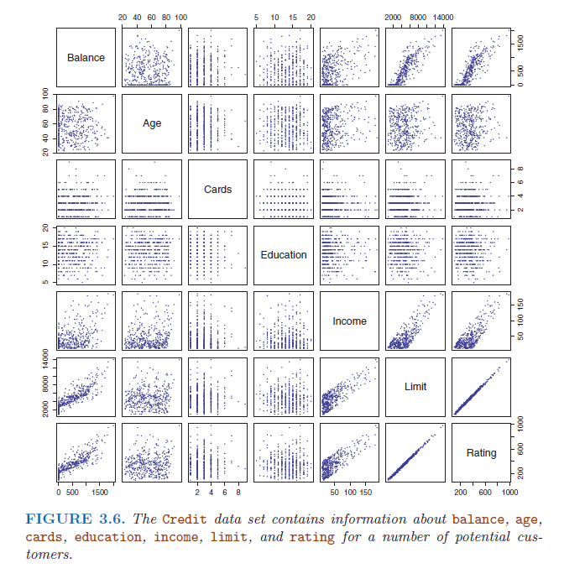
Multiple Linear Regression Qualitative Predictors
Credit data:
balance: average credit card debt
v.s.
quantitative predictors: age, cards (no. of credit cards), education (years of education),income (in thousands of dollars), limit (credit limit) and rating (credit rating)
Text Book:

Slide 47


Multiple Linear Regression Qualitative Predictors
Predictors with only two levels:
Create a dummy variable:
Interpret the regression equation:
β0 can be interpreted as the average credit card balance among males
β0 + β1 as the average credit card balance among females
β1 as the average difference in credit card balance between females and males.
Text Book:

Slide 48

Multiple Linear Regression Qualitative Predictors
The average credit card debt for males is estimated to be $509.80,
whereas females are estimated to carry $19.73 in additional debt for a total of $509.80 + $19.73 = $529.53.
However, we notice that the p-value for the dummy variable is very high. This indicates that there is no statistical evidence of a difference in average credit card balance between the genders.
Text Book:

Slide 49


Multiple Linear Regression Qualitative Predictors
The decision for the dummy variable is arbitrary BUT alter the interpretation:
Now β₀ can be interpreted as the overall average credit card balance (ignoring the gender effect)
β₁ is the amount that females are above the average and males are below the average.
In this example, the estimate for β₀ would be $519.665, halfway between the male and female averages of $509.80 and $529.53.
The estimate for β₁ would be $9.865, which is half of $19.73, the average difference between females and males.
It is important to note that the final predictions for the credit balances of males and females will be identical regardless of the coding scheme used. The only difference is in the way that the coefficients are interpreted.
Text Book:

Slide 50



Multiple Linear Regression Qualitative Predictors
Qualitative Predictors with More that Two levels:
Solution A: several dummy variables.
β0 can be interpreted as the average credit card balance for African Americans
β1 can be interpreted as the difference in the average balance between the Asian and African American categories
β2 can be interpreted as the difference in the average balance between the Caucasian and African American categories
There will always be one fewer dummy variable than the number of levels. The level with no dummy variable—African American in this example—is known as the baseline
Text Book:

Slide 51
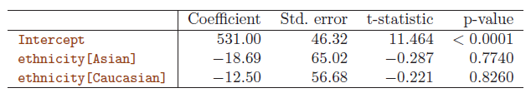
Multiple Linear Regression Qualitative Predictors
The estimated balance for the baseline, African American, is $531.00.
The Asian category will have $18.69 less debt than the African American category
The Caucasian will have $12.50 less debt than the African American category.
However, the p-values suggest no statistical evidence of a real difference in credit card balance between the ethnicities.
Rather than rely on the individual coefficients, we can use an F-test to test H0 : β1 = β2 = 0; this does not depend on the coding.
This F-test has a p-value of 0.96, indicating that we cannot reject the null hypothesis that there is no relationship between balance and ethnicity.
Text Book:

Slide 52
Multiple Linear Regression Qualitative Predictors
Qualitative Predictors with More that Two levels:
Solution A: several dummy variables.
This solution presents no difficulties when incorporating both quantitative and qualitative predictors.
For example, to regress balance on both a quantitative variable such as income and a qualitative
variable such as student, we must simply create a dummy variable for student and then fit a multiple regression model using income and the dummy variable as predictors for credit card balance.
There are many different ways of coding qualitative variables besides the dummy variable approach taken here.
All of these approaches lead to equivalent model fits, but the coefficients are different and have different interpretations, and are designed to measure particular contrasts. (This topic contrast
is beyond the scope of the book/course, and so we will not pursue it further)
Text Book:

Slide 53

Multiple Linear Regression Qualitative Predictors
Qualitative Predictors with More that Two levels:
Solutions “B”: when there is a large number of qualitative predictors!!
Examples: To represent:
Words in documents
Events in web interaction
Events in sensor networks (IoT)
….
We will discuss it in the ML lab following: Categorical Data and One-Hot-Encoding

Slide 54
Multiple Linear Regression Other Considerations in the Regression Model
Other Considerations in the Regression Model:
Qualitative Predictors
Extensions of the Linear Model
Potential Problems
Text Book:

Slide 55
Multiple Linear Regression Extensions of the Linear Model
Extensions of the Linear Model: the two most important assumptions in Multiple Linear Regression are:
Additive: the effect of changes in a predictor X_{j} on the response Y is independent of the values of the other predictors.
Linear: the change in the response Y due to a one-unit change in X_{j} is constant, regardless of the value of X_{j}
We will see methods that relax these two assumptions.
But there are also some common classical approaches for extending the linear model

Slide 56






Multiple Linear Regression Extensions of the Linear Model
Removing the Additive Assumption:
Extend the model with an interaction term β₃
X₂ will change the impact of X₁ on Y
$$Y=β_{0}+β_{1}X_{1}+\left(β_{2}+β_{3}X_{1}\right)X_{2}$$
$$=β_{0}+β_{1}X_{1}+\tilde{β}2X_{2}$$
$$\tilde{β}2=β_{2}+β_{3}X_{1}$$
X₁ will change the impact of X₂ on Y
Note: see the example of no. workers and working lines in Text Book

Slide 57
Multiple Linear Regression Extensions of the Linear Model
Removing the Additive Assumption:
Advertisement data case
Suppose that spending money on radio advertising actually increases the effectiveness of TV advertising, so that the slope term for TV should increase as radio increases.
In this situation, given a fixed budget of $100; 000, spending half on radio and half on TV may increase sales more than allocating the entire amount to either TV or to radio.
In marketing, this is known as a synergy effect, and in statistics it is referred to as an interaction effect.

Slide 58
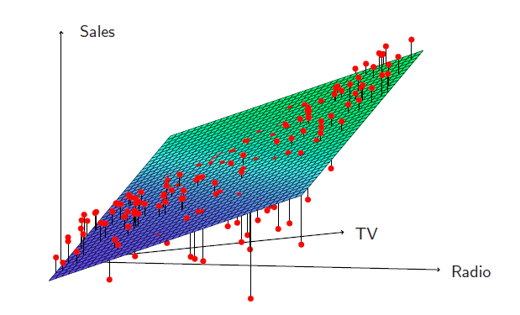
Multiple Linear Regression Extensions of the Linear Model
Interaction in the Advertising data?
When levels of either TV or radio are low, then the true sales are lower than predicted by the linear model.
But when advertising is split between the two media, then the model tends to underestimate sales.

Slide 59


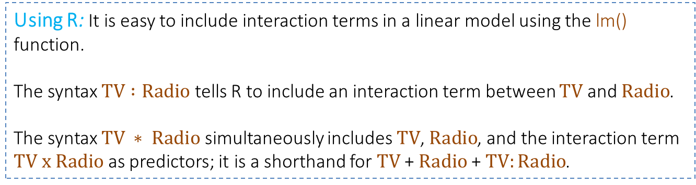
Multiple Linear Regression Extensions of the Linear Model
Modelling interactions - Advertising data
$sales=β_{0}+β_{1}TV+β_{1}Radio$ ${+ β}_{3}(TV x Radio)$
$=β_{0}+\left(β_{2}+β_{3}TV\right)Radio$ ${+ β}_{1}TV$
$$=β_{0}+\left(β_{1}+β_{3}Radio\right)TV{+ β}_{2}Radio$$
Using R: It is easy to include interaction terms in a linear model using the lm() function.
The syntax $TV :Radio$ tells R to include an interaction term between $TV$ and $Radio$.
The syntax $TV ∗ Radio$ simultaneously includes $TV$, $Radio$, and the interaction term $TV x Radio$ as predictors; it is a shorthand for $TV$+ $Radio$+ $TV:Radio$.

Slide 60


Multiple Linear Regression Extensions of the Linear Model
$sales=β_{0}+β_{1}TV+β_{1}Radio$ ${+ β}_{3}(TV x Radio)$
$=β_{0}+\left(β_{2}+β_{3}TV\right)Radio$ ${+ β}_{1}TV$
$$=β_{0}+\left(β_{1}+β_{3}Radio\right)TV{+ β}_{2}Radio$$
> lm.fit=lm(Sales~TV*Radio,data=Advertising)
> summary(lm.fit)
Call:
lm(formula = Sales ~ TV * Radio, data = Advertising)
Residuals:
Min 1Q Median 3Q Max
-6.3366 -0.4028 0.1831 0.5948 1.5246
Coefficients:
Estimate Std. Error t value Pr(>|t|)
(Intercept) 6.750e+00 2.479e-01 27.233 <2e-16 ***
TV 1.910e-02 1.504e-03 12.699 <2e-16 ***
Radio 2.886e-02 8.905e-03 3.241 0.0014 **
TV:Radio 1.086e-03 5.242e-05 20.727 <2e-16 ***
---
Signif. codes: 0 ‘***’ 0.001 ‘**’ 0.01 ‘*’ 0.05 ‘.’ 0.1 ‘ ’ 1
Residual standard error: 0.9435 on 196 degrees of freedom
Multiple R-squared: 0.9678, Adjusted R-squared: 0.9673
F-statistic: 1963 on 3 and 196 DF, p-value: < 2.2e-16

Slide 61
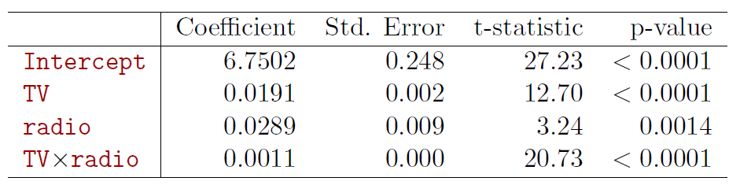
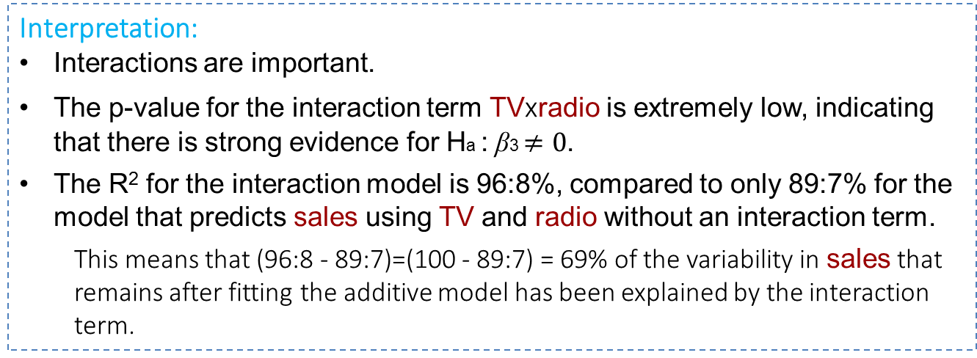
Multiple Linear Regression Extensions of the Linear Model
Interpretation:
Interactions are important.
The p-value for the interaction term TVxradio is extremely low, indicating that there is strong evidence for Ha : β3 $≠0$.
The R² for the interaction model is 96:8%, compared to only 89:7% for the model that predicts sales using TV and radio without an interaction term.
This means that (96:8 - 89:7)=(100 - 89:7) = 69% of the variability in sales that remains after fitting the additive model has been explained by the interaction term.

Slide 62


Multiple Linear Regression Extensions of the Linear Model
$sales=β_{0}+β_{1}TV+β_{1}Radio$ ${+ β}_{3}(TV x Radio)$
$=β_{0}+\left(β_{2}+β_{3}TV\right)Radio$ ${+ β}_{1}TV$
$$=β_{0}+\left(β_{1}+β_{3}Radio\right)TV{+ β}_{2}Radio$$
Interpretation (cont.):
The coefficient estimates in the table suggest that an increase in TV advertising of $1,000 is associated with increased sales of:
An increase in radio advertising of $1,000 will be associated with an increase in sales of:

Slide 63
Multiple Linear Regression Extensions of the Linear Model
Hierarchy when adding interaction terms
Sometimes it is the case that an interaction term has a very small p-value, but the associated main effects (in this case, TV and radio) do not.
The hierarchy principle:
If we include an interaction in a model, we should also include the main effects, even if the p-values associated with their coefficients are not significant.
The rationale for this principle is that interactions are hard to interpret in a model without main effects – their meaning is changed.
Specifically, the interaction terms also contain main effects, if the model has no main effect terms.

Slide 64
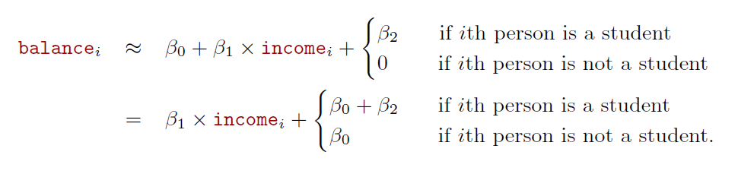
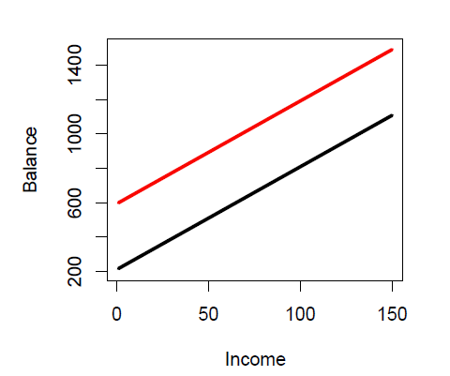

Multiple Linear Regression Extensions of the Linear Model
Interactions between qualitative and quantitative variables
Consider the Credit data set, and suppose that we wish to predict balance using income (quantitative) and student (qualitative).
Without an interaction term, the model takes the form:

Slide 65
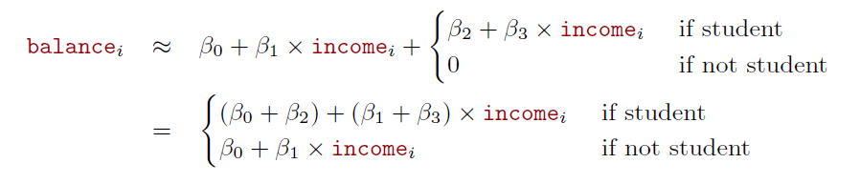
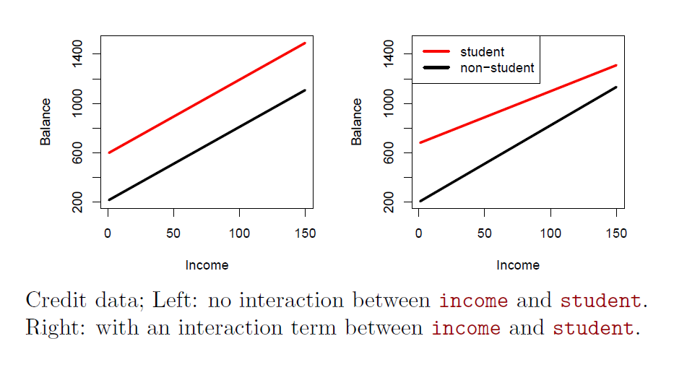
Multiple Linear Regression Extensions of the Linear Model
With an interaction term, the model takes the form:
$balance=β_{0}+β_{1}income+β_{2}Student$ ${+ β}_{3}(income x Student)$

Slide 66
Why ANOVA and Linear Regression are the Same Analysis
OPTIONAL TOPIC:
If your graduate statistical training was anything like mine, you learned ANOVA in one class and Linear Regression in another. My professors would often say things like “ANOVA is just a special case of Regression,” but give vague answers when pressed.
http://www.theanalysisfactor.com/why-anova-and-linear-regression-are-the-same-analysis/

Slide 67
General Linear Models (NOT Generalized!! We will see them later!)
GENERAL LINEAR MODELS
ε ~ Normal
R: lm()
ANOVA
Multiple Linear Regression
t-test
Simple Linear Regression
ANCOVA

Slide 68
Regression and ANOVA
Multiple regression:
Y = β₀ + β₁·X₁ + β₂·X₂ + β₃·X₃ + … + Error
{X’s are continuous variables}
ANOVA:
Y = γ₀ + γ₁ ( Z₁)+ γ₂( Z₂) + γ₃( Z₃) + … + Error
{Z’s are categorical variables, defining groups}

Slide 69
Analysis of Covariance (mixture of ANOVA and regression)
Y = β₀+β₁·X₁+β₂·X₂+…+γ₁( Z₁)+γ₂( Z₂)+... +Error
{X’s are continuous variables}
{Z’s are categorical variables, defining groups}
Important assumption: Parallelism: β’s the same for all groups
Estimate β’s and γ’s using least squares

Slide 70
Analysis of Covariance
Analysis of Covariance (ANCOVA) is a statistical test related to ANOVA
It tests whether there is a significant difference between groups after controlling for variance explained by a covariate
A covariate is a continuous variable that correlates with the dependent variable

Slide 71
So, what does all that mean?
This means that you can, in effect, “partial out” a continuous variable and run an ANOVA on the results
This is one way that you can run a statistical test with both categorical and continuous independent variables

Slide 72
Hypotheses for ANCOVA
H₀ and H₁ need to be stated slightly differently for an ANCOVA than a regular ANOVA
H₀: the group means are equal after controlling for the covariate
H₁: the group means are not equal after controlling for the covariate

Slide 73
Assumptions for ANCOVA
ANOVA assumptions:
Variance is normally distributed
Variance is equal between groups
All measurements are independent
Also, for ANCOVA:
Relationship between the Dependent Variable (Response, Y) and covariate is linear
The relationship between the DV and covariate is the same for all groups

Slide 74
Multiple Linear Regression Extensions of the Linear Model
But let’s continue …
Extensions of the Linear Model: the two most important assumptions in Multiple Linear Regression are:
Additive: the effect of changes in a predictor X_{j} on the response Y is independent of the values of the other predictors.
Linear: the change in the response Y due to a one-unit change in X_{j} is constant, regardless of the value of X_{j}

Slide 75
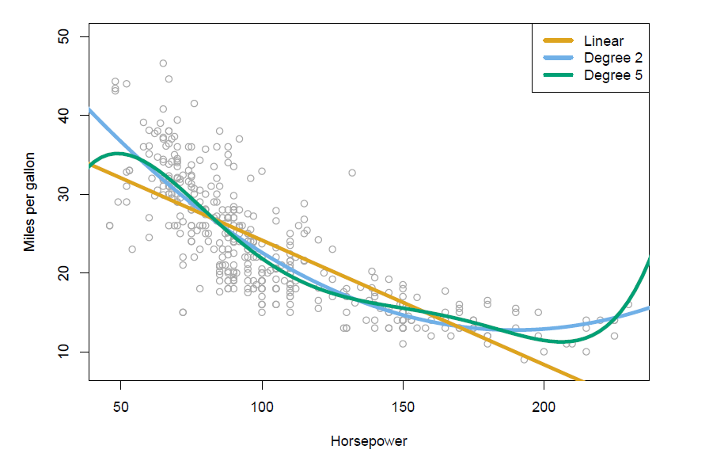
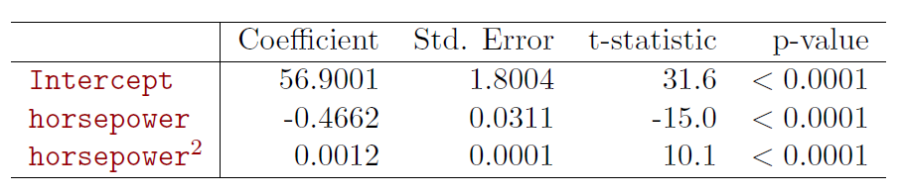
Multiple Linear Regression Extensions of the Linear Model
Non-linear effects of predictors
Polynomial regression on Auto data
We will see more complex approaches for performing regression non-linear fits

Slide 76

Multiple Linear Regression Other Considerations in the Regression Model
Other Considerations in the Regression Model:
Qualitative Predictors
Extensions of the Linear Model
Potential Problems
1. Non-linearity of the response-predictor relationships.
2. Correlation of error terms.
3. Non-constant variance of error terms.
4. Outliers.
5. High-leverage points.
6. Collinearity.
“… identifying and overcoming these problems is as much an art as a science.”
Text Book:

Slide 77
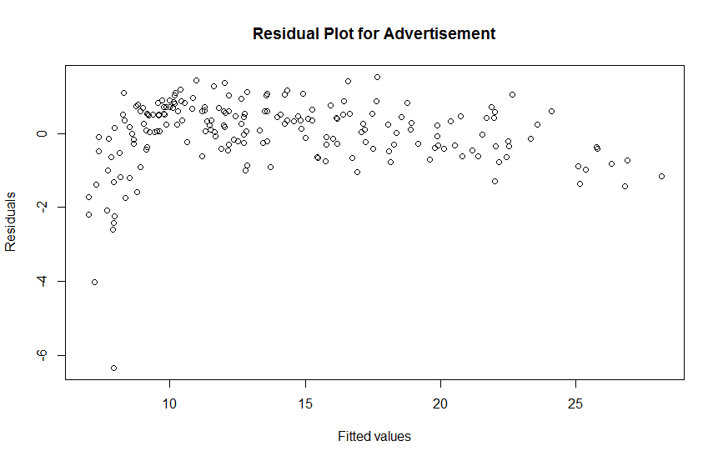
Multiple Linear Regression Other Considerations in the Regression Model
1. Non-linearity of the response-predictor relationships.
Residual plots are a useful graphical tool for identifying non-linearity
> # Plotting studentized residuals
> plot(predict(lm.fit),residuals(lm.fit),xlab='Fitted values',ylab='Residuals',main='Residual Plot for Advertisement')

Slide 78
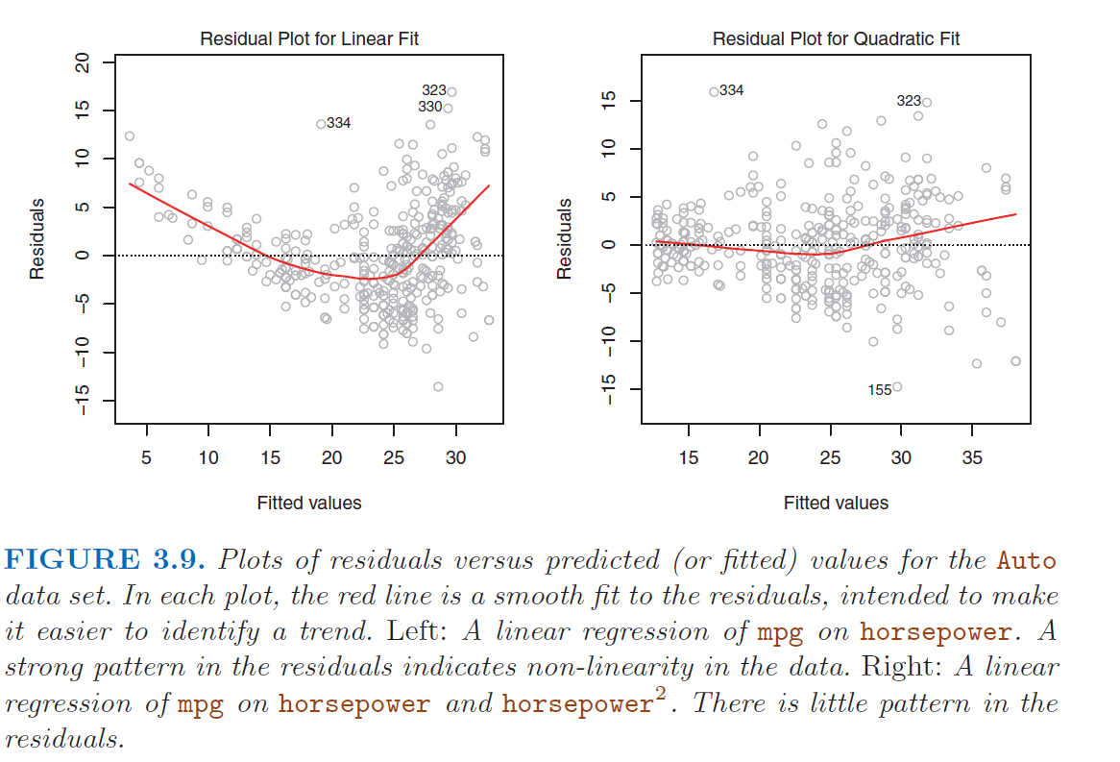
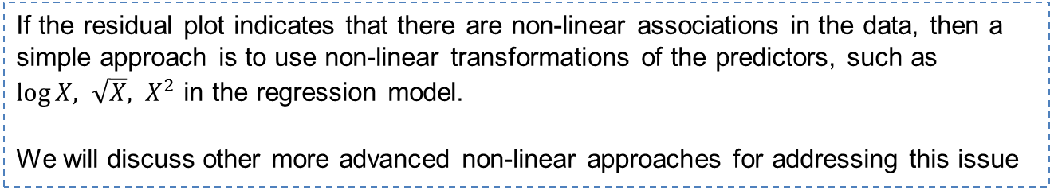
Multiple Linear Regression Other Considerations in the Regression Model
If the residual plot indicates that there are non-linear associations in the data, then a simple approach is to use non-linear transformations of the predictors, such as $\log{X, \sqrt{X}, X^{2}}$ in the regression model.
We will discuss other more advanced non-linear approaches for addressing this issue

Slide 79
Multiple Linear Regression Other Considerations in the Regression Model
Potential Problems
1. Non-linearity of the response-predictor relationships.
2. Correlation of error terms.
3. Non-constant variance of error terms.
4. Outliers.
5. High-leverage points.
6. Collinearity.
“… identifying and overcoming these problems is as much an art as a science.”
Text Book:

Slide 80

Multiple Linear Regression Other Considerations in the Regression Model
2. Correlation of error terms.
An important assumption of the linear regression model is that the error
terms, $ε_{1},ε_{2}$, …, $ε_{n}$are uncorrelated.
If in fact there is correlation among the error terms, then the estimated standard errors will tend to underestimate the true standard errors. As a result:
Confidence and prediction intervals will be narrower than they should be.
p-values will be lower than they should be; this could cause us to erroneously conclude that a parameter is statistically significant.
In short, if the error terms are correlated, we may have an unwarranted sense of confidence in our model.

Slide 81
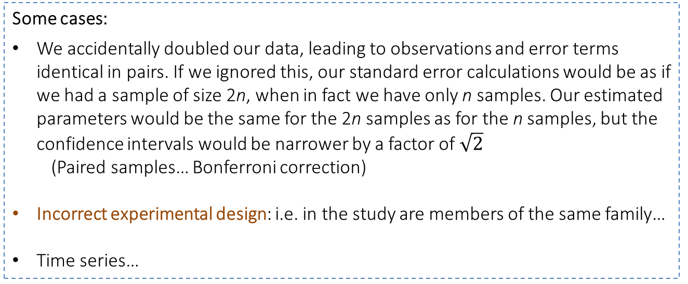
Multiple Linear Regression Other Considerations in the Regression Model
2. Correlation of error terms.
Some cases:
We accidentally doubled our data, leading to observations and error terms identical in pairs. If we ignored this, our standard error calculations would be as if we had a sample of size 2n, when in fact we have only n samples. Our estimated parameters would be the same for the 2n samples as for the n samples, but the confidence intervals would be narrower by a factor of $\sqrt{2}$
(Paired samples… Bonferroni correction)
Incorrect experimental design: i.e. in the study are members of the same family…
Time series…

Slide 82
Multiple Linear Regression Other Considerations in the Regression Model
Potential Problems
1. Non-linearity of the response-predictor relationships.
2. Correlation of error terms.
3. Non-constant variance of error terms.
4. Outliers.
5. High-leverage points.
6. Collinearity.
“… identifying and overcoming these problems is as much an art as a science.”
Text Book:

Slide 83

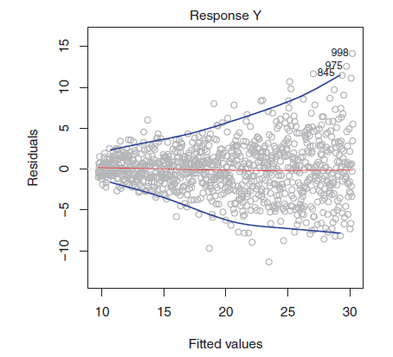
Multiple Linear Regression Other Considerations in the Regression Model
3. Non-constant variance of error terms.
not true!
non-constant variances in errors = heteroscedasticity
Can be identified from the presence of a funnel shape in residual plots.
For example: variance of the errors increase with the value of the response

Slide 84
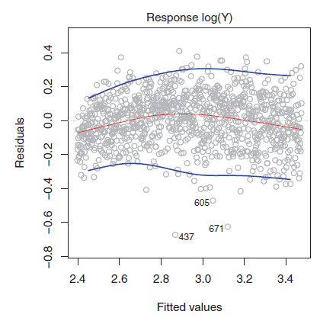
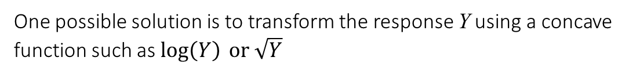
Multiple Linear Regression Other Considerations in the Regression Model
3. Non-constant variance of error terms.
heteroscedasticity
Example: variance of the errors increase with the value of the response
One possible solution is to transform the response Y using a concave function such as $log\left(Y\right){\text{or} \sqrt{Y}}$
Such a transformation results in a greater amount of shrinkage of the larger responses, leading to a reduction in heteroscedasticity

Slide 85
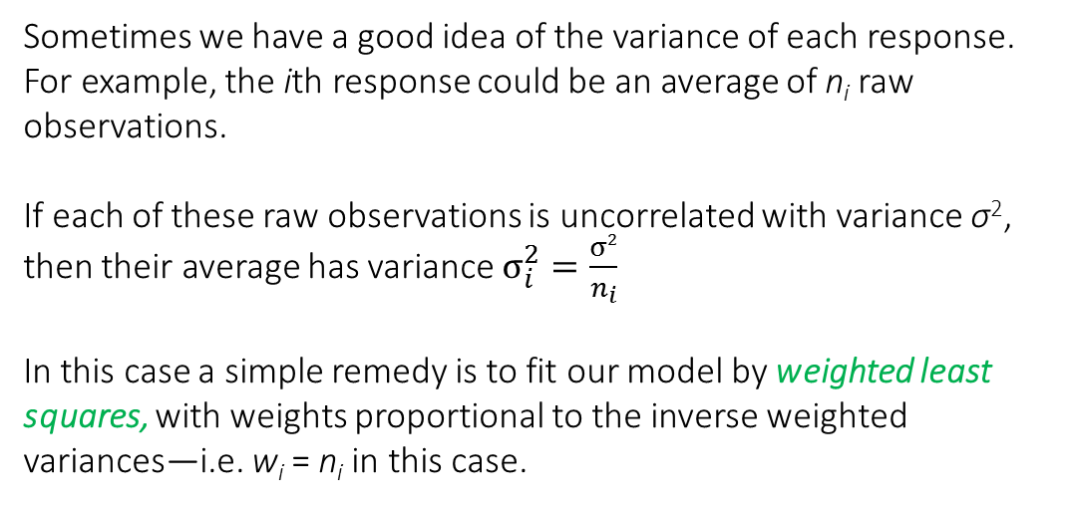
Multiple Linear Regression Other Considerations in the Regression Model
3. Non-constant variance of error terms.
weighted least squares
Sometimes we have a good idea of the variance of each response. For example, the ith response could be an average of n_{i} raw observations.
If each of these raw observations is uncorrelated with variance σ², then their average has variance $σ_{i}^{2}=\frac{σ2}{n_{i}}$
In this case a simple remedy is to fit our model by weighted least squares, with weights proportional to the inverse weighted
variances—i.e. w_{i} = n_{i} in this case.

Slide 86
Multiple Linear Regression Other Considerations in the Regression Model
Potential Problems
1. Non-linearity of the response-predictor relationships.
2. Correlation of error terms.
3. Non-constant variance of error terms.
4. Outliers.
5. High-leverage points.
6. Collinearity.
“… identifying and overcoming these problems is as much an art as a science.”
Text Book:

Slide 87
Multiple Linear Regression Other Considerations in the Regression Model
4. Outliers
An outlier is a point for which y_{i} is far from the value predicted by the model. Outliers can arise for a variety of reasons, such as incorrect recording of an observation during data collection.
Residual plots can be used to identify outliers.
To decide how large : studentized residuals (dividing each residual by its estimated standard error ; better that standardized residuals)

Slide 88
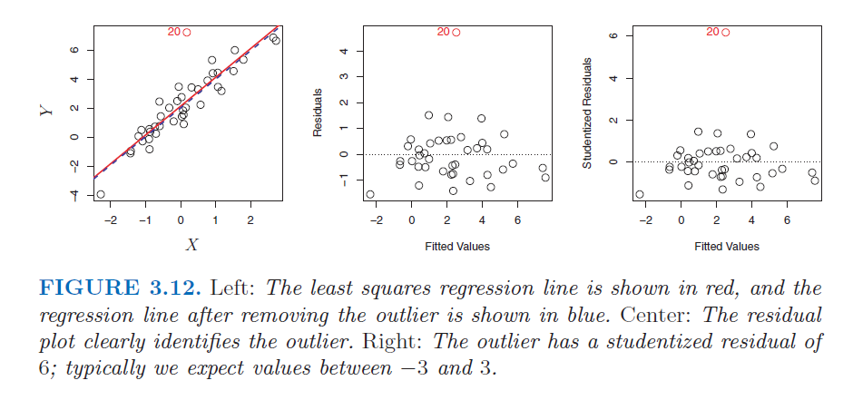
Multiple Linear Regression Other Considerations in the Regression Model
4. Outliers
> # Plotting residuals
> plot(predict(lm.fit),residuals(lm.fit),xlab='Fitted values',ylab='Residuals',main='Residual Plot')
> # Plotting studentized residuals
> plot(predict(lm.fit),rstudent(lm.fit),xlab='Fitted values',ylab='Studentized Residuals',main='Studentized Residuals')

Slide 89
Multiple Linear Regression Other Considerations in the Regression Model
4. Outliers
Sometimes removing an outlier can have little effect in the model
It can also affect the Residual Standard Error RSE, confidence intervals, R²

Slide 90
Multiple Linear Regression Other Considerations in the Regression Model
Potential Problems
1. Non-linearity of the response-predictor relationships.
2. Correlation of error terms.
3. Non-constant variance of error terms.
4. Outliers.
5. High-leverage points.
6. Collinearity.
“… identifying and overcoming these problems is as much an art as a science.”
Text Book:

Slide 91
Multiple Linear Regression Other Considerations in the Regression Model
5. High-leverage points
High leverage observations tend to have a sizable impact on the estimated regression line. It is cause for concern if the least squares line is heavily affected by just a couple of observations, because any problems with these points may invalidate the entire fit.
For this reason, it is important to identify high leverage observations

Slide 92
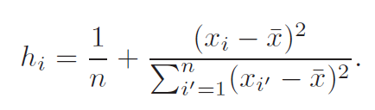
Multiple Linear Regression Other Considerations in the Regression Model
5. High-leverage points
The leverage statistic. A large value of this statistic indicates an observation with high leverage. For a simple linear regression:
There is a simple extension of h_{i} to the case of multiple predictors
The leverage statistic h_{i} is always between 1/n and 1, and the average leverage for all the observations is always equal to (p+1)/n.
Leverage is the proportion
of the total sum of squares
of the explanatory variable
contributed by the ith case

Slide 93
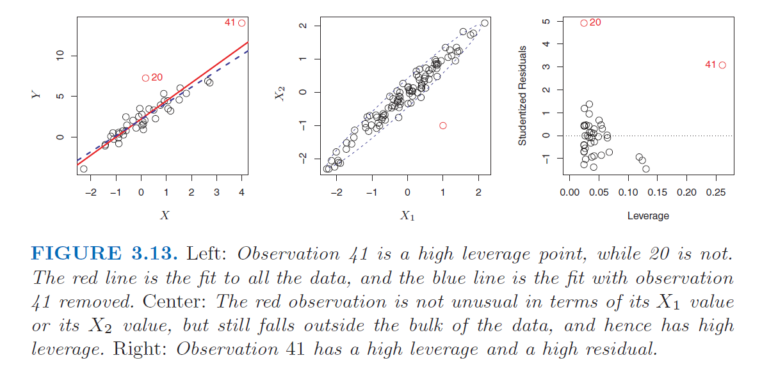
Multiple Linear Regression Other Considerations in the Regression Model
5. High-leverage points
So if a given observation has a leverage statistic that greatly exceeds (p+1)/n, then we may suspect that the corresponding point has high leverage.

Slide 94
Multiple Linear Regression Other Considerations in the Regression Model
5. High-leverage points
An influential point is one if removed from the data would significantly change the fit. An influential point may either be an outlier or have large leverage, or both, but it will tend to have at least one of those properties.
Cook’s distance is a commonly used influence measure that combines these two properties. Typically, points with Cook’s distance greater than 1 are classified as being influential

Slide 95

Linear Regression in R
Residuals
> # par(mfrow=c(2,2)) divides plot region in 2 x 2
> par(mfrow=c(2,2))
> plot(lm.fit)

Slide 96
Linear Regression in R
Quantile-quantile plots can be useful for comparing two samples to determine if they arise from the same distribution, in that case Normal distribution

Slide 97
Multiple Linear Regression Other Considerations in the Regression Model
Potential Problems
1. Non-linearity of the response-predictor relationships.
2. Correlation of error terms.
3. Non-constant variance of error terms.
4. Outliers.
5. High-leverage points.
6. Collinearity.
“… identifying and overcoming these problems is as much an art as a science.”
Text Book:

Slide 98

Multiple Linear Regression Other Considerations in the Regression Model
6. Collinearity
Collinearity refers to the situation in which two or more predictor variables are closely related to one another

Slide 99

Multiple Linear Regression Other Considerations in the Regression Model
6. Collinearity
The presence of collinearity can make difficult to separate out the individual effects of collinear variables on the response

Slide 100


Multiple Linear Regression Other Considerations in the Regression Model
6. Collinearity
Since collinearity reduces the accuracy of the estimates of the regression coefficients, it causes the standard error for $β_{j}$ to grow.
Recall that the t-statistic for each predictor is calculated by dividing for $β_{j}$ by its standard error.
The importance of the limit variable has been masked due to the presence of collinearity.
To avoid such a situation, it is desirable to identify and address potential
collinearity problems while fitting the model.

Slide 101


Multiple Linear Regression Other Considerations in the Regression Model
6. Collinearity
To identify and address potential collinearity problems:
look at the correlation matrix…
it is possible for collinearity to exist between three or more variables even if no pair of variables has a particularly high correlation. We call this situation multicollinearity
Can be assessed using the variance inflation factor (VIF).

Slide 102

Multiple Linear Regression Other Considerations in the Regression Model
6. Collinearity
As a rule of thumb, a VIF value that exceeds 5 or 10 indicates a problematic amount of collinearity.

Slide 103
Multiple Linear Regression Other Considerations in the Regression Model
6. Collinearity
To faced with collinearity, there are two simple solutions:
The first is to drop one of the problematic variables from the regression.
The second solution is to combine the collinear variables together into a single predictor. For instance, we might take the average of standardized versions of limit and rating in order to create a new variable that measures credit worthiness.

Slide 104
Linear Regression in R
The Marketing Plan:
Questions we might seek to address:
Is there a relationship between advertising budget and sales?
F-statistic very low -> clear evidence of relationship
How strong is the relationship between advertising budget and sales?
RSE = 1,681 (mean value of response = 14,002) -> 12% percentage error
R² explain almost 90% of the variance in sales
Which media contribute to sales?
p-values for TV and radio are low, but the p-value for newspaper is not. This suggests that only TV and radio are related to sales
….

Slide 105
Linear Regression in R
How accurately can we estimate the effect of each medium on sales?
Confidence intervals 95% for β_{i} : TV (0.043, 0.049) Radio (0,172, 0,206) newspaper (-0.013, 0.011)
newspaper includes zero -> not statistically significant given TV and radio
No collinearity: VIF scores 1,005, 1,145 and 1,145 for TV, radio and newspaper
Separate simple regressions indicate:
Strong association between TV and sales and between radio and sales.
There is evidence of a mild association between newspaper and sales, when the values of TV and radio are ignored.
…

Slide 106
Linear Regression in R
How accurately can we predict future sales?
The accuracy associated with this estimate depends on whether we wish to predict:
an individual response, Y = f(X) + ε, prediction interval
or the average response, f(X) , confidence interval.
Prediction intervals will always be wider than confidence intervals because they account for the uncertainty associated with ε, the irreducible error.
Is the relationship linear?
we observe a non-linear effect in Figure 3.5, though this effect could also be observed in a residual plot
Is there synergy among the advertising media?
A small p-value associated with the interaction term indicates the presence of such
relationships. Figure 3.5 suggested that the Advertising data may not be additive. Including an interaction term in the model results in a substantial increase in R², from around 90% to almost 97%.

Slide 107
Multiple Linear Regression
NEXT:
Lab: Linear Regression in Spark
MLLab_8_BigO_Complexity_Notation.pptx
MLLab_9_PrinciplesDistributed_LinearRegression.pptx
MLLab_10_LinearRegression_with_Spark.pptx
Theory: Linear Regression & K-Nearest Neighbors
Chap3_ML_LinearRegression.pptx (last part of this ppt)

Slide 108
Linear Regression in R
Text book website:
Datasets: (see Linear Regression activity)

Slide 109
Linear Regression in R
Experiment with applied exercises in Chapter 3 of text book
Review: writing functions in R

