Slide 1
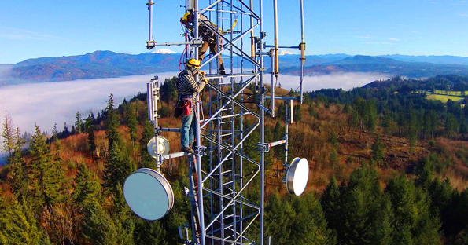

Slide 2
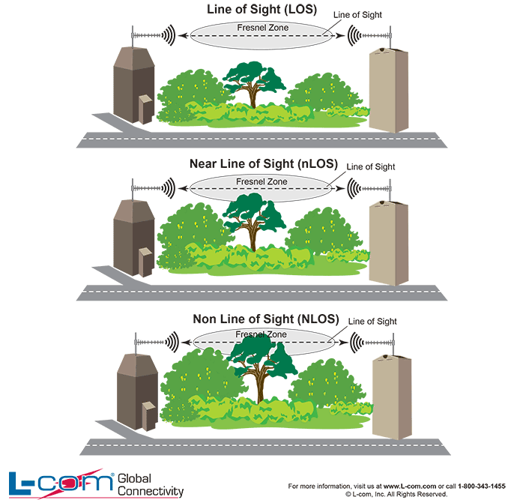

Slide 3
def check_los(origin, destination, tower_height_1, tower_height_2, interval):
"This function checks if there is LoS between two points or not“
NOTE: origin, destination MUST BE geopy.Point

Slide 4
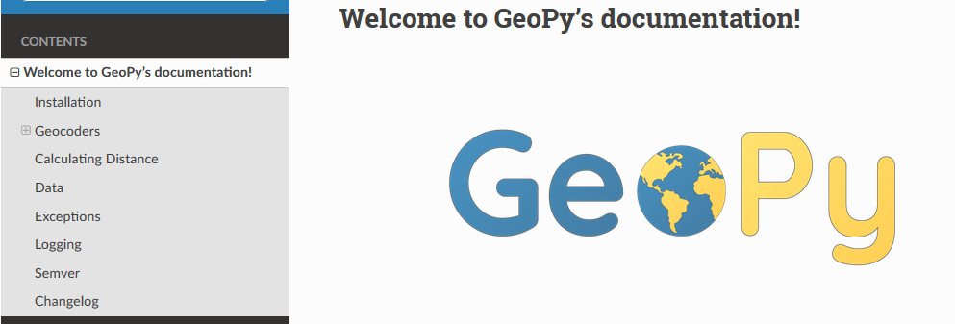
geopy is a Python 2 and 3 client for several popular geocoding web services.
geopy makes it easy for Python developers to locate the coordinates of addresses, cities, countries, and landmarks across the globe using third-party geocoders and other data sources (Google Maps, Bing Maps, or Nominatim)

Slide 5
See for example: Graph Theory and Topology Design
Dijkstra's Algorithm : A Quick Intro on How it Works
https://www.youtube.com/watch?v=eFZCPlZCyIM

Slide 6
