Slide 1
Predictive & Descriptive Learning Machine Learning Lab
Half-Term Assignment
Luis Hernández

Slide 2
PRDL & MLlab Half-Term Assignment
CONTENTS:
Dataset : Sleep Apnea Patients
Sleep Apnea
Dataset description
Data Analysis
Insights using Linear Regression
Conclusions
Dataset: XXX

Slide 3
Sleep Apnea Dataset
Sleep Apnea (I)
This dataset contains information from individuals suspect to suffer Sleep Apnea Syndrome
“Sleep apnea is a serious sleep disorder that occurs when a person's breathing is interrupted during sleep. People with untreated sleep apnea stop breathing repeatedly during their sleep, sometimes hundreds of times. This means the brain -- and the rest of the body -- may not get enough oxygen”
https://www.webmd.com/sleep-disorders/sleep-apnea/sleep-apnea

Slide 4
Sleep Apnea Dataset
Sleep Apnea (II)
Risk factors for sleep apnea include:
Being male
Being overweight
Being over age 40
Having a large neck size (17 inches or greater in men and 16 inches or greater in women)
https://www.webmd.com/sleep-disorders/sleep-apnea/sleep-apnea

Slide 5
Sleep Apnea Dataset
Sleep Apnea Dataset description (I):
The datase contains 5 variables: Gender, IAH, Weight, Height, Age, Cervical
The AHI is calculated by dividing the number of apnea events by the number of hours of sleep. The AHI values for adults are categorized as:[
Normal: AHI<5
Mild sleep apnea: 5≤AHI<15
Moderate sleep apnea: 15≤AHI<30
Severe sleep apnea: AHI≥30
https://en.wikipedia.org/wiki/Apnea%E2%80%93hypopnea_index

Slide 6
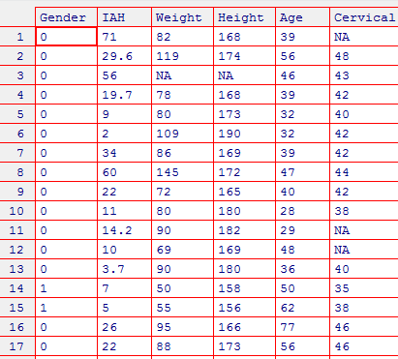
Sleep Apnea Dataset
Sleep Apnea Dataset description (II):
Using R I have read the Excel file: There are NA values as “-1” that I’ve omitted
library(readxl)
OSA=read_excel(OSA_DB_UPM.xlsx",na="-1")
fix(OSA)
OSA=na.omit(OSA)

Slide 7
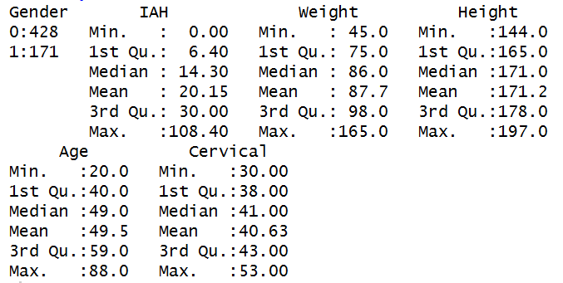
Sleep Apnea Dataset
Sleep Apnea Dataset description (III):
#Describe Database using R summary()
# First define Gender as a factor!
OSA$Gender = factor(OSA$Gender)
summary(OSA)

Slide 8
Sleep Apnea Dataset
Sleep Apnea Dataset description (III):
Comments:
the number of males 428 vs 171 females
IAH ranges… box plots? … histograms
Other features

Slide 9
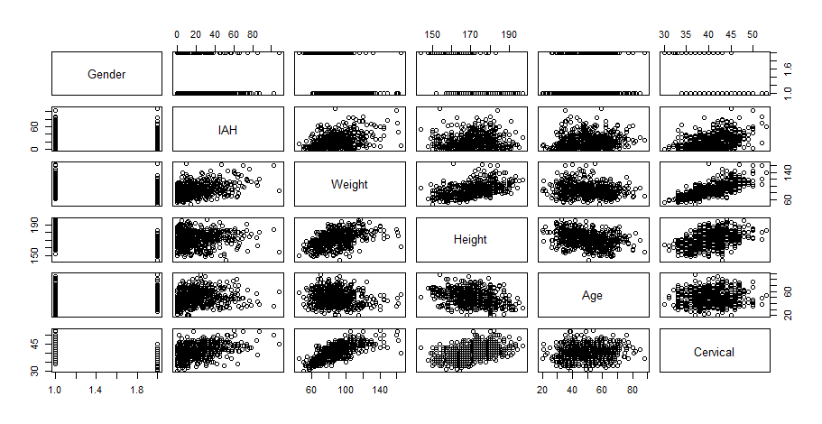
Sleep Apnea Dataset
Data Analysis (I):
I’ve used pairs(OSA) to obtain scatter plots…

Slide 10
Sleep Apnea Dataset
Data Analysis (II):
Thinking that my target should be PREDICTING IAH from the other variables…
From pairs() I can see:
Seems linear correlation between IAH and Weight, and Cervical
BUT Weight and Cervical seems to be correlated
…….

Slide 11
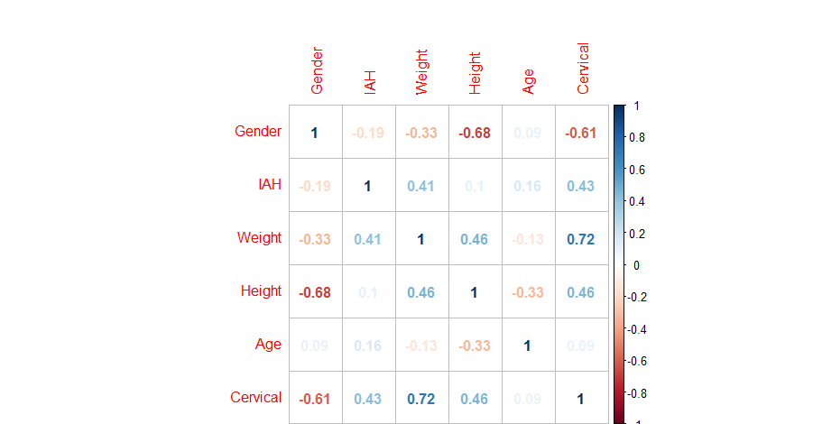
Sleep Apnea Dataset
Data Analysis (III):
I’ve obtained the correlation matrix
library(corrplot)
# back to as.numeric for including it..
OSA$Gender = as.numeric(OSA$Gender)
M <- cor(OSA)
corrplot(M, method="number")

Slide 12
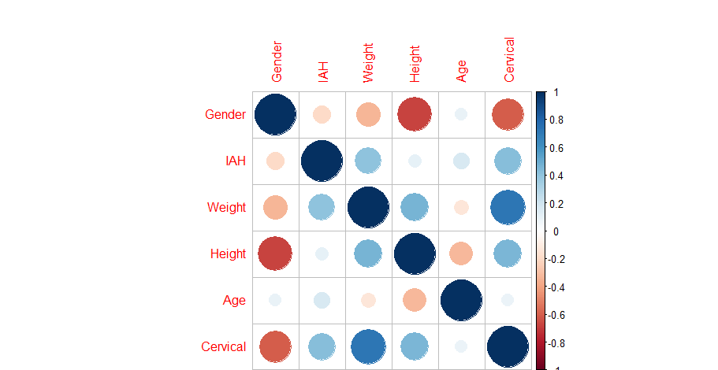
Sleep Apnea Dataset

Slide 13
Sleep Apnea Dataset
Insights using Multiple LR (I):
attach(OSA)
lm.fit=lm(IAH~Weight+Height+Cervical+Age)
Summary(lm.fit)

Slide 14
Sleep Apnea Dataset
Insights using Multiple LR (II): Analyze these results!!
Call:
lm(formula = IAH ~ Weight + Height + Cervical + Age)
Residuals:
Min 1Q Median 3Q Max
-37.282 -10.886 -3.186 8.600 78.229
Coefficients:
Estimate Std. Error t value Pr(>|t|)
(Intercept) -30.52850 13.93144 -2.191 0.028815 *
Weight 0.28810 0.05351 5.384 1.05e-07 ***
Height -0.18505 0.08503 -2.176 0.029922 *
Cervical 1.13859 0.25820 4.410 1.23e-05 ***
Age 0.21855 0.05951 3.673 0.000262 ***
---
Signif. codes:
0 ‘***’ 0.001 ‘**’ 0.01 ‘*’ 0.05 ‘.’ 0.1 ‘ ’ 1
Residual standard error: 15.87 on 594 degrees of freedom
Multiple R-squared: 0.2401, Adjusted R-squared: 0.235
F-statistic: 46.93 on 4 and 594 DF, p-value: < 2.2e-16

Slide 15
Sleep Apnea Dataset
Insights using Multiple LR (II…):
DISCUSS : predicting the average!!!
COMPARE WITH Naive predictor!!

Slide 16
Sleep Apnea Dataset
Insights using Multiple LR (II…): Analyze by gender !
OSA_male=subset(OSA, Gender==0)
## Predicting two particular cases
newdata = data.frame(Height=c(185,180),Weight=c(100,80),Cervical=c(42,39),Age=c(58,46))
predict(lm_male.fit, newdata)

Slide 17
Sleep Apnea Dataset
Insights using Multiple LR (II):
## Discuss about the ASSUMPTIONS of Linear Regression
Explore Residuals, distrib (hist) of variables, IAH,..
plot(predict(lm_male.fit), residuals(lm_male.fit))
plot(predict(lm_male.fit), rstudent(lm_male.fit))

