Slide 1
Predictive & Descriptive Learning Machine Learning Lab
Final Project
Eduardo López & Luis Hernández

Slide 2
PRDL & MLlab Final Project
CONTENTS:
Introduction:
Churn Prediction
State-of-the Art: https://archive.org/stream/IJETR032280/IJETR032129_djvu.txt
…
Dataset : Orange Telecoms Churn Dataset

Slide 3
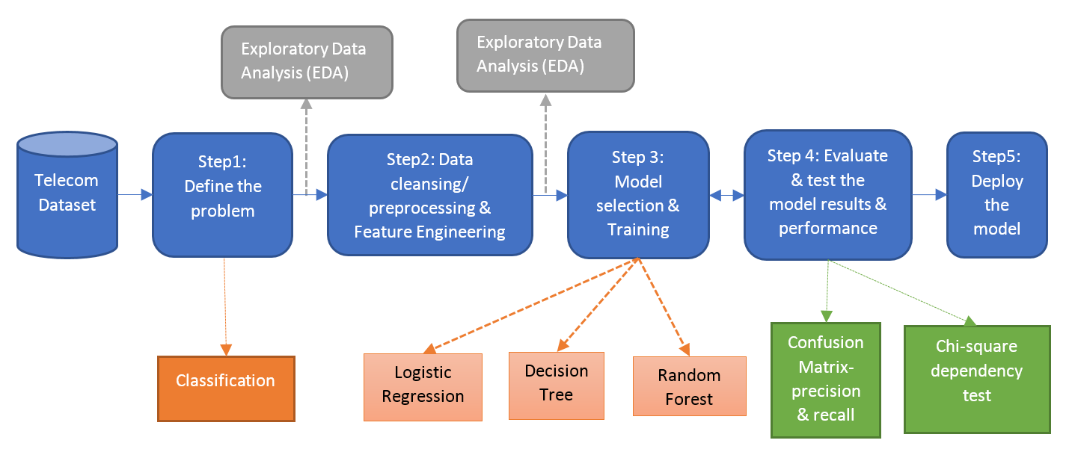
PRDL & MLlab Final Project
CONTENTS (I):
Methodological Approach

Slide 4
PRDL & MLlab Final Project
CONTENTS (II):
Exploratory Data Analysis
Feature analysis
Descriptive Learning:
PCA
Clustering (User’s segmentation)

Slide 5
PRDL & MLlab Final Project
CONTENTS (III):
Churn Prediction
Experimental Protocol:
Cross-validation
Computational Approach:
Python
R
Spark (PySpark)
Machine Learning algorithms:
Logistic Regression
…
Results
Discussion
Conclusions

Slide 6
Orange Telecoms Churn Dataset
Orange Telecoms Churn Dataset
Consists of cleaned customer activity data (features), along with a churn label specifying whether the customer canceled their subscription or not.
The data can be fetched from BigML's S3 bucket, churn-80 and churn-20. The two sets are from the same batch, but have been split by an 80/20 ratio.
churn-80 will be used for training and cross-validation purposes,
churn-20 will be used for final testing and model performance evaluation.
Similar large-dataset in :http://www.vincentlemaire-labs.fr/kddcup2009/
https://mapr.com/blog/churn-prediction-pyspark-using-mllib-and-ml-packages/

Slide 7
Orange Telecoms Churn Dataset
Churn in Telecom dataset
https://bigml.com/user/francisco/gallery/dataset/5163ad540c0b5e5b22000383
By the way…. Machine Learning as a Service
We can comment BigML-like initiatives:
https://predicsis.ai/blog/2015/9/29/machine-learning-wars-amazon-ml-vs-google-api-vs-bigml-vs-predicsis-api

Slide 8
In AWS
https://aws.amazon.com/es/blogs/ai/predicting-customer-churn-with-amazon-machine-learning/
State: the US state in which the customer resides, indicated by a two-letter abbreviation; for example, OH or NJ
Account Length: the number of days that this account has been active
Area Code: the three-digit area code of the corresponding customer’s phone number
Phone: the remaining seven-digit phone number
Int’l Plan: whether the customer has an international calling plan: yes/no
VMail Plan: whether the customer has a voice mail feature: yes/no
VMail Message: presumably the average number of voice mail messages per month
Day Mins: the total number of calling minutes used during the day
Day Calls: the total number of calls placed during the day
Day Charge: the billed cost of daytime calls
Eve Mins, Eve Calls, Eve Charge: the billed cost for calls placed during the evening
Night Mins, Night Calls, Night Charge: the billed cost for calls placed during nighttime
Intl Mins, Intl Calls, Intl Charge: the billed cost for international calls
CustServ Calls: the number of calls placed to Customer Service
Churn?: whether the customer left the service: true/false
In RED : not in these csv…

Slide 9
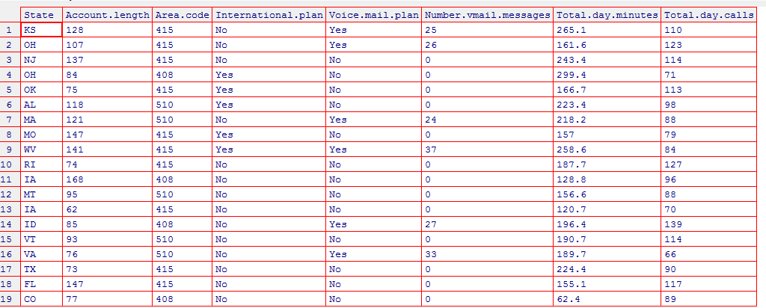
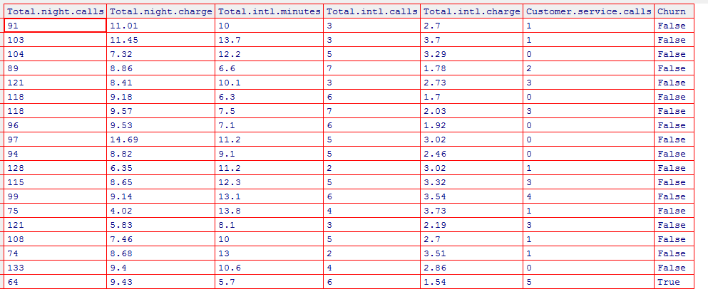
Exploratory Analysis
file_train ='churn-bigml-80.csv'
CV_data <- read.csv(file_train, header=TRUE, sep=",")
fix(CV_data)

Slide 10
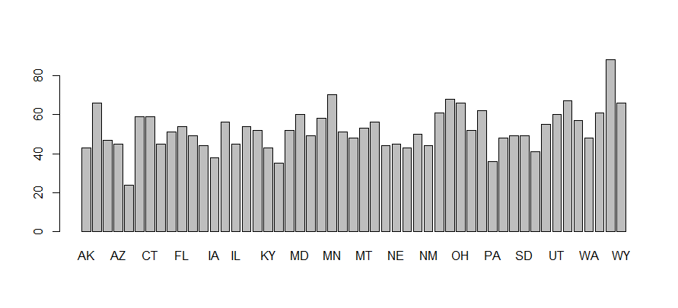
# Number states
List_States=unique(CV_data$State)
List_States2=levels(CV_data$State)
length(List_States)
51
and number users per state
barplot(summary(CV_data$State))

Slide 11
# Number states
List_States=unique(CV_data$State)
List_States2=levels(CV_data$State)
length(List_States)
51
and number users per state
barplot(summary(CV_data$State))

Slide 12
# Analyze number of churns per State
TT=tapply(CV_data$State, CV_data$Churn, summary)
# Look for a better way for plotting...
windows()
par(mfrow=c(3,1))
barplot(TT$True,col=c("red"))
barplot(TT$False,col=c("darkblue"))
barplot(TT$True/(TT$True+TT$False),col=c("green"))
dev.off()

Slide 13
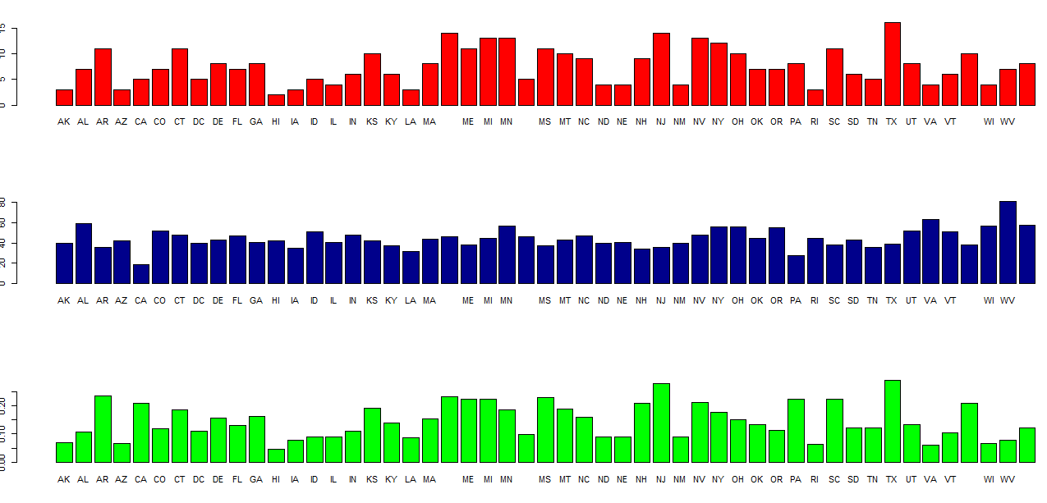
Some states higher churn rates than others…

Slide 14
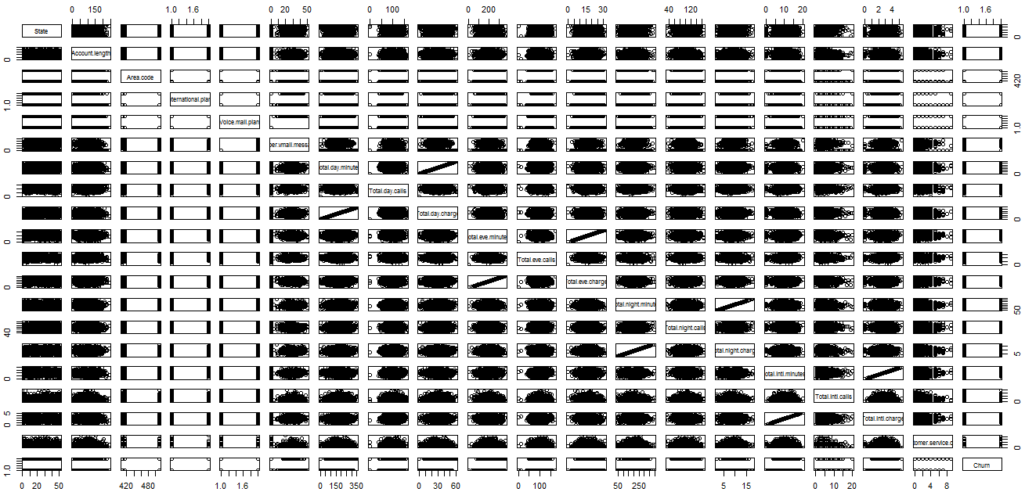
# Scater plots
pairs(CV_data)
High “linearity” between some features…

Slide 15
High “linearity” between some features…
As expected between minutes and charge
# so we will remove
#'Total.day.charge',
#'Total.eve.charge',
#'Total.night.charge',
#'Total.intl.charge'
# So we will remove from data
# …using “set” from data.table library
library(data.table)
set(CV_data, j = c('State',
'Area.code',
'Total.day.charge',
'Total.eve.charge',
'Total.night.charge',
'Total.intl.charge') , value = NULL)
State and Area Code “linearity” also dropped-out as they
are categorical… BUT they should be used!!

Slide 16
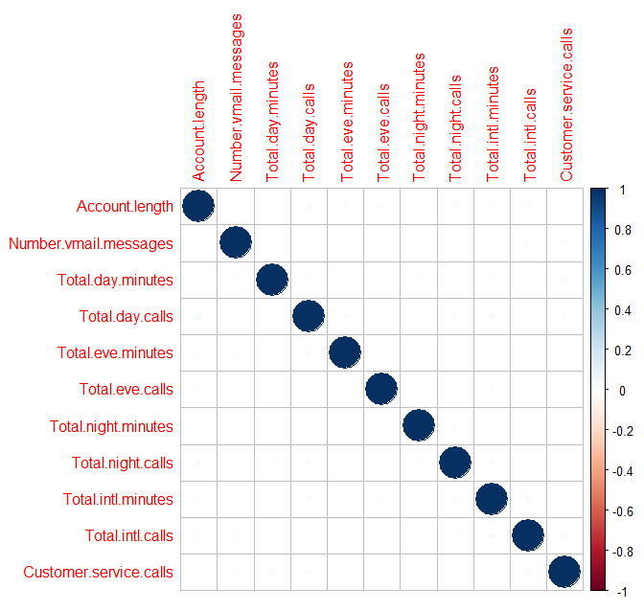
We can analyze correlations…. BUT as we are working in a Classification problem better analyze discriminative power of features …
library(corrplot)
# after removing factors
M <- cor(CV_data[c(-2,-3,-14)])
corrplot(M, method="circle")
Very Small correlation coeffs

Slide 17
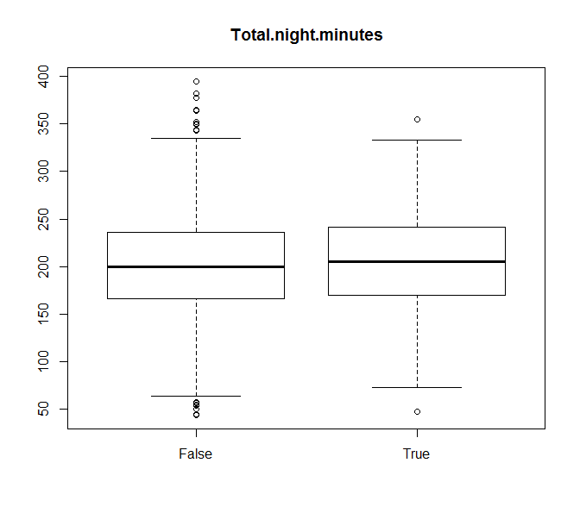
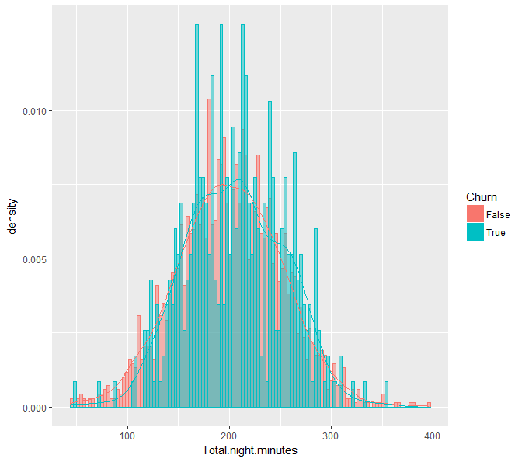
Discrimination can be studied using: boxplot, class-histograms, …

Slide 18
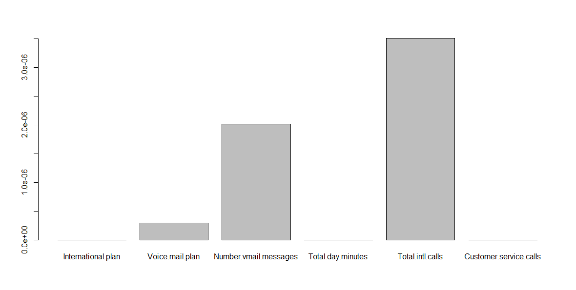
Studying discriminant power using statistical tests…
kruskal.test(Total.night.minutes ~ Churn, data = CV_data)
Kruskal-Wallis chi-squared = 2.8035, df = 1, p-value = 0.09406
Apply for all features and find the more discriminant ones: 14th is Churn
P_values=apply(CV_data[,-14], 2, function(x) kruskal.test(x,CV_data[,14])$p.value)
barplot(P_values[P_values<=.00001])

Slide 19
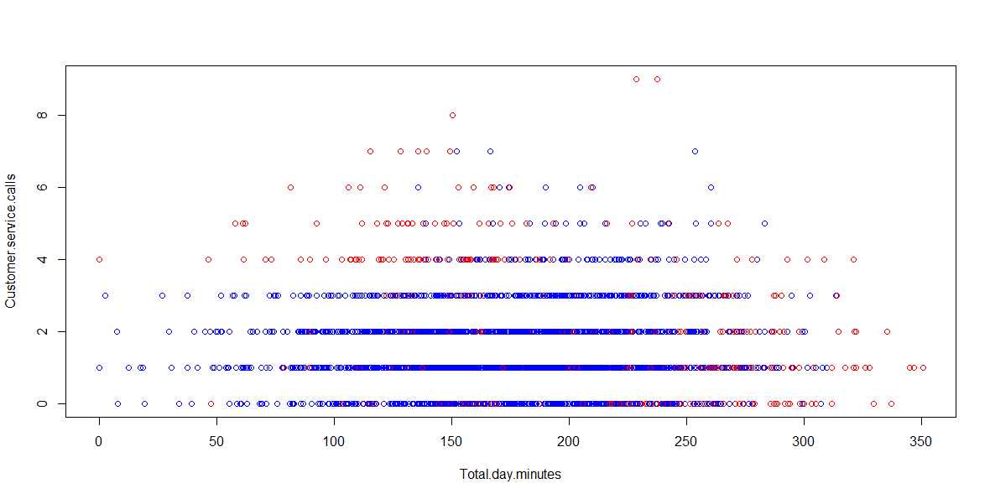
# scatter plot between two features in different colors per class
attach(CV_data)
plot(Total.day.minutes, Customer.service.calls, col=c("blue","red")[Churn])

Slide 20
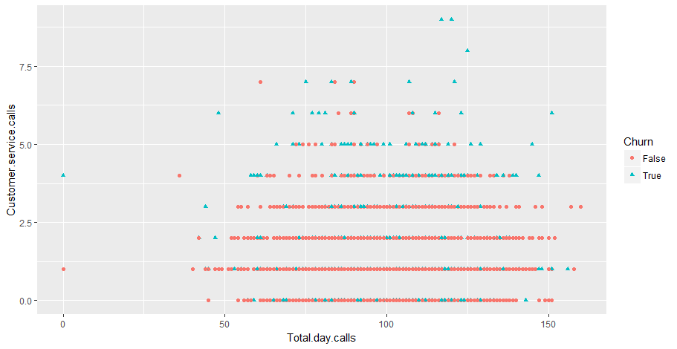
qplot(Total.day.calls, Customer.service.calls, colour = Churn, shape = Churn, data = CV_data)

Slide 21
# Other ways to inspect discrimination power
#dplyr: A Grammar of Data Manipulation
#A fast, consistent tool for working with data frame
# like objects, both in memory and out of memory.
library(dplyr)
group_by(CV_data, Churn) %>%
summarise(
count = n(),
mean = mean(Customer.service.calls, na.rm = TRUE),
sd = sd(Customer.service.calls, na.rm = TRUE),
median = median(Customer.service.calls, na.rm = TRUE),
IQR = IQR(Customer.service.calls, na.rm = TRUE)
)
Churn count mean sd median IQR
<fctr> <int> <dbl> <dbl> <dbl> <dbl>
1 False 2278 1.453029 1.152125 1 1
2 True 388 2.206186 1.882536 2 3

Slide 22
Ready for some “possible” effect of the relevant features…
Customer calls: malfunctioning
International calls: promotions?
… these could be supported by some pre-existing analysis, reports, references, etc.. (search them…)

Slide 23
Model Selection

Slide 24
# Number states
List_States=unique(CV_data$State)

Slide 25
# Number states
List_States=unique(CV_data$State)

Slide 26
Exploratory Analysis
Numb

Slide 27
Exploratory Analysis
Numb

Slide 28
Exploratory Analysis
Numb

Slide 29
Exploratory Analysis
Numb

Slide 30
Exploratory Analysis
Numb

Slide 31
Exploratory Analysis
Numb

Slide 32
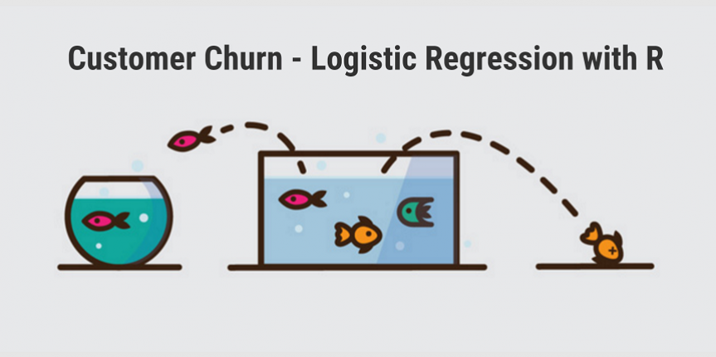
Orange Telecoms Churn Dataset
http://www.treselle.com/blog/customer-churn-logistic-regression-with-r/

