Slide 1
Predictive & Descriptive Learning Machine Learning Lab
Final Project
Eduardo López & Luis Hernández

Slide 2
PRDL & MLlab Final Project
CONTENTS:
Introduction:
Churn Prediction
State-of-the Art: https://archive.org/stream/IJETR032280/IJETR032129_djvu.txt
…
Dataset : Orange Telecoms Churn Dataset

Slide 3
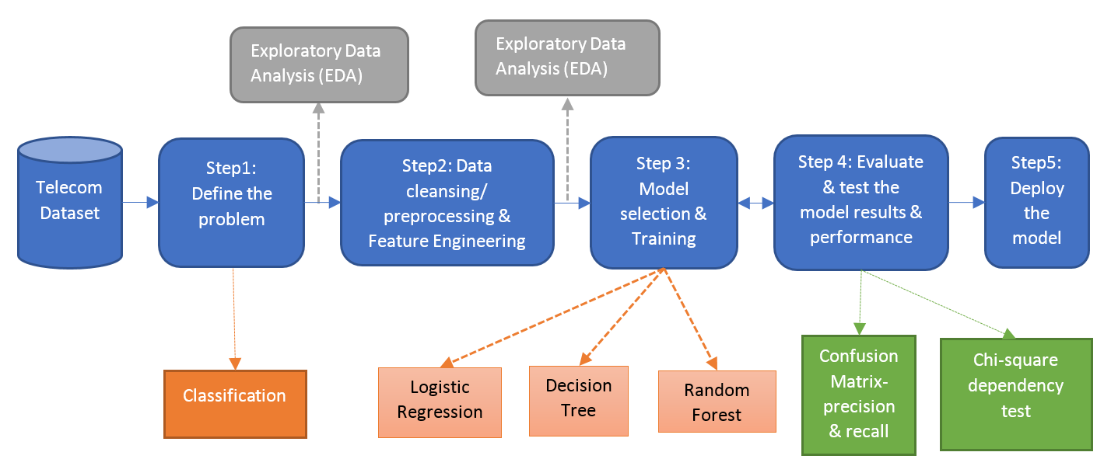
PRDL & MLlab Final Project
CONTENTS (I):
Methodological Approach

Slide 4
PRDL & MLlab Final Project
CONTENTS (II):
Exploratory Data Analysis
Feature analysis
Descriptive Learning:
PCA
Clustering (User’s segmentation)

Slide 5
PRDL & MLlab Final Project
CONTENTS (III):
Churn Prediction
Experimental Protocol:
Cross-validation
Computational Approach:
Python
R
Spark (PySpark)
Machine Learning algorithms:
Logistic Regression
…
Results
Discussion
Conclusions

Slide 6
Orange Telecoms Churn Dataset
Orange Telecoms Churn Dataset
Consists of cleaned customer activity data (features), along with a churn label specifying whether the customer canceled their subscription or not.
The data can be fetched from BigML's S3 bucket, churn-80 and churn-20. The two sets are from the same batch, but have been split by an 80/20 ratio.
churn-80 will be used for training and cross-validation purposes,
churn-20 will be used for final testing and model performance evaluation.
Similar large-dataset in :http://www.vincentlemaire-labs.fr/kddcup2009/
https://mapr.com/blog/churn-prediction-pyspark-using-mllib-and-ml-packages/

Slide 7
Orange Telecoms Churn Dataset
Churn in Telecom dataset
https://bigml.com/user/francisco/gallery/dataset/5163ad540c0b5e5b22000383
By the way…. Machine Learning as a Service
We can comment BigML-like initiatives:
https://predicsis.ai/blog/2015/9/29/machine-learning-wars-amazon-ml-vs-google-api-vs-bigml-vs-predicsis-api

Slide 8
In AWS
https://aws.amazon.com/es/blogs/ai/predicting-customer-churn-with-amazon-machine-learning/
State: the US state in which the customer resides, indicated by a two-letter abbreviation; for example, OH or NJ
Account Length: the number of days that this account has been active
Area Code: the three-digit area code of the corresponding customer’s phone number
Phone: the remaining seven-digit phone number
Int’l Plan: whether the customer has an international calling plan: yes/no
VMail Plan: whether the customer has a voice mail feature: yes/no
VMail Message: presumably the average number of voice mail messages per month
Day Mins: the total number of calling minutes used during the day
Day Calls: the total number of calls placed during the day
Day Charge: the billed cost of daytime calls
Eve Mins, Eve Calls, Eve Charge: the billed cost for calls placed during the evening
Night Mins, Night Calls, Night Charge: the billed cost for calls placed during nighttime
Intl Mins, Intl Calls, Intl Charge: the billed cost for international calls
CustServ Calls: the number of calls placed to Customer Service
Churn?: whether the customer left the service: true/false
In RED : not in these csv…

Slide 9
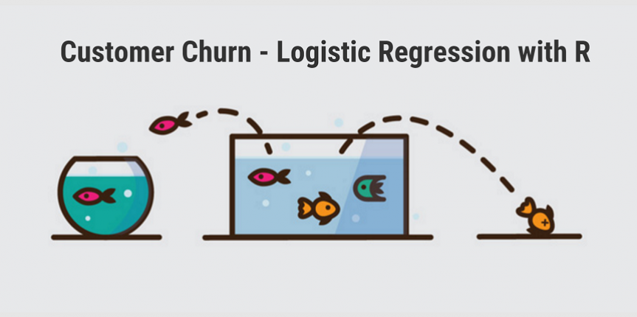
Orange Telecoms Churn Dataset
http://www.treselle.com/blog/customer-churn-logistic-regression-with-r/

Slide 10
Exploratory Analysis
Number of states?

