Slide 1
Predictive & Descriptive Learning Machine Learning Lab
Final Project
Eduardo López & Luis Hernández

Slide 2
PRDL & MLlab Final Project
TABLE of CONTENTS:
Introduction:
Churn Prediction: what is it? Why is it important?...
State-of-the Art: you must include [REFS]
Web sites, papers, etc,…
https://archive.org/stream/IJETR032280/IJETR032129_djvu.txt
Project Structure: (description of this document)
Dataset : Orange Telecoms Churn Dataset
…

Slide 3
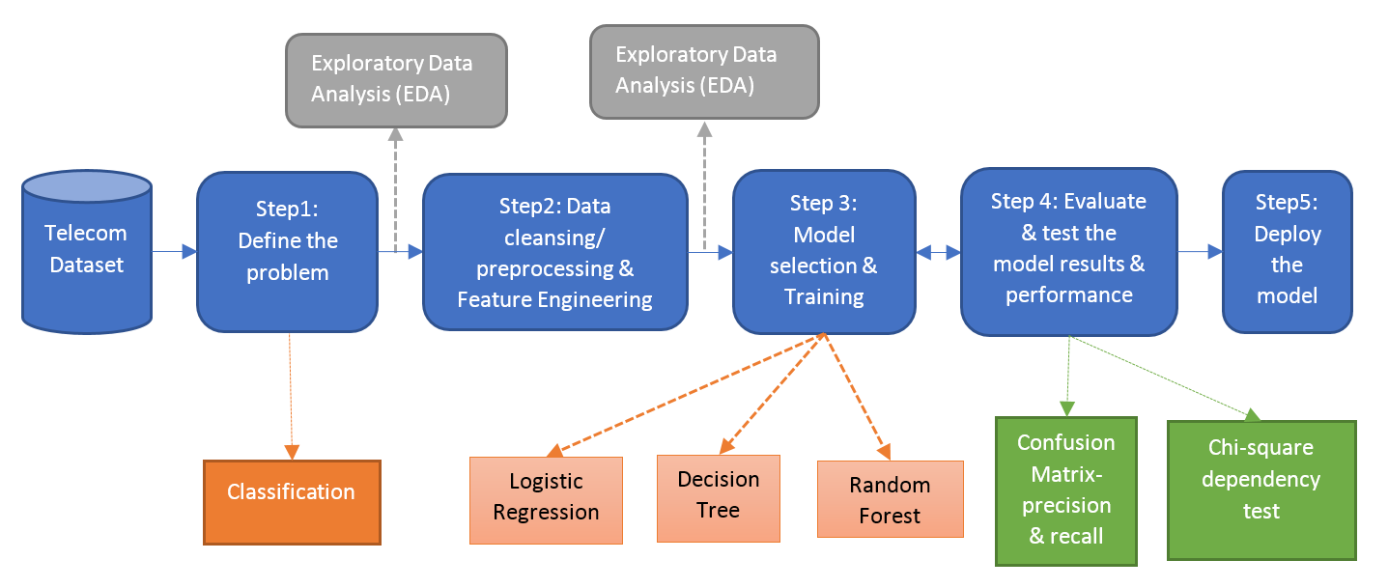
PRDL & MLlab Final Project
CONTENTS (I):
Methodological Approach

Slide 4
PRDL & MLlab Final Project
CONTENTS (II):
Exploratory Data Analysis
Feature analysis
Descriptive Learning:
PCA
Clustering (User’s segmentation)

Slide 5
PRDL & MLlab Final Project
CONTENTS (III):
Churn Prediction
Fitting Interpretable Models for Exploratory Data Analysis
Logistic Regression case
Machine Learning algorithms:
Simple Logistic Regression
Model assessment
Linear Models:
Logistic Regression, LDA, QDA,…

Slide 6
PRDL & MLlab Final Project
CONTENTS (IV):
Non-linear Machine Learning algorithms:
Tress, RF, Bagging, Boosting
SVM
Deep Learning
Computational languages and environments:
R
Python
Spark: PySpark, SparkR,…
Results
Discussion
Conclusions

Slide 7
Orange Telecom Churn Dataset
Orange Telecom Churn Dataset
Consists of cleaned customer activity data (features), along with a churn label specifying whether the customer canceled their subscription or not.
The data can be fetched from BigML's S3 bucket, churn-80 and churn-20. The two sets are from the same batch, but have been split by an 80/20 ratio.
churn-80 will be used for training and cross-validation purposes,
churn-20 will be used for final testing and model performance evaluation.
Similar large-dataset in :http://www.vincentlemaire-labs.fr/kddcup2009/
https://mapr.com/blog/churn-prediction-pyspark-using-mllib-and-ml-packages/

Slide 8
Orange Telecoms Churn Dataset
Churn in Telecom dataset
https://bigml.com/user/francisco/gallery/dataset/5163ad540c0b5e5b22000383
By the way…. Machine Learning as a Service
We can comment BigML-like initiatives:
https://predicsis.ai/blog/2015/9/29/machine-learning-wars-amazon-ml-vs-google-api-vs-bigml-vs-predicsis-api

Slide 9
In AWS
https://aws.amazon.com/es/blogs/ai/predicting-customer-churn-with-amazon-machine-learning/
State: the US state in which the customer resides, indicated by a two-letter abbreviation; for example, OH or NJ
Account Length: the number of days that this account has been active
Area Code: the three-digit area code of the corresponding customer’s phone number
Phone: the remaining seven-digit phone number
Int’l Plan: whether the customer has an international calling plan: yes/no
VMail Plan: whether the customer has a voice mail feature: yes/no
VMail Message: presumably the average number of voice mail messages per month
Day Mins: the total number of calling minutes used during the day
Day Calls: the total number of calls placed during the day
Day Charge: the billed cost of daytime calls
Eve Mins, Eve Calls, Eve Charge: the billed cost for calls placed during the evening
Night Mins, Night Calls, Night Charge: the billed cost for calls placed during nighttime
Intl Mins, Intl Calls, Intl Charge: the billed cost for international calls
CustServ Calls: the number of calls placed to Customer Service
Churn?: whether the customer left the service: true/false
In RED : not in these csv…

Slide 10
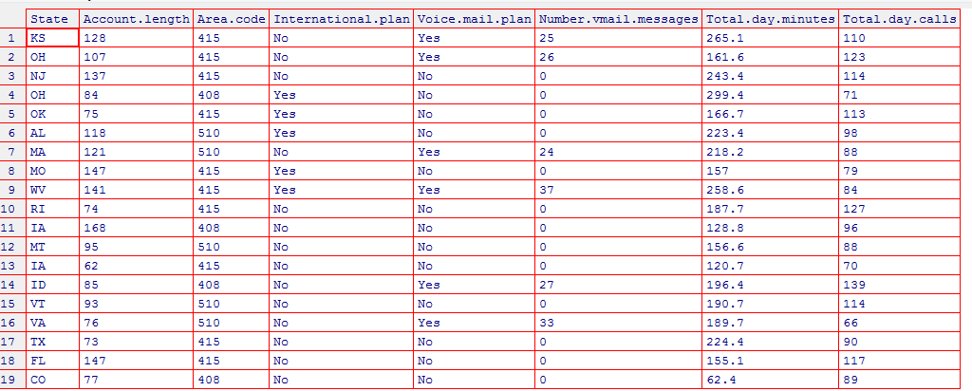
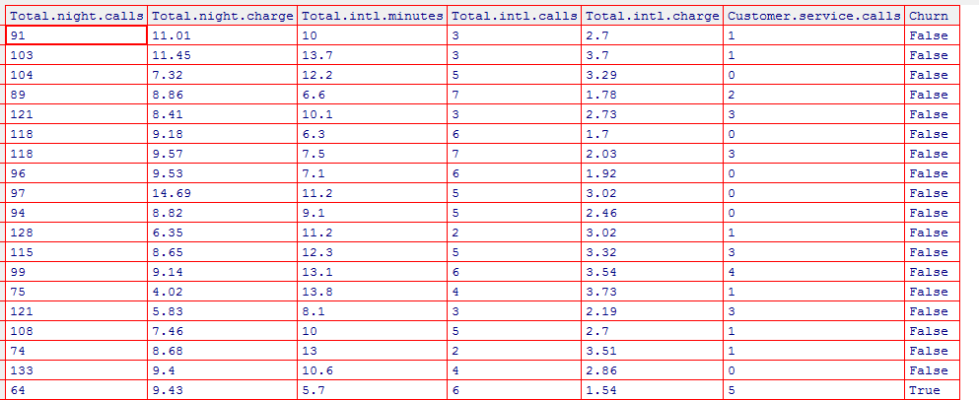
Exploratory Analysis
file_train ='churn-bigml-80.csv'
CV_data <- read.csv(file_train, header=TRUE, sep=",")
fix(CV_data)

Slide 11
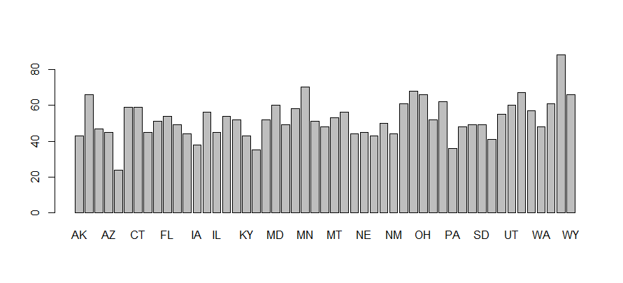
# Number states
List_States=unique(CV_data$State)
List_States2=levels(CV_data$State)
length(List_States)
51
and number users per state
barplot(summary(CV_data$State))

Slide 12
# Number states
List_States=unique(CV_data$State)
List_States2=levels(CV_data$State)
length(List_States)
51
and number users per state
barplot(summary(CV_data$State))

Slide 13
# Analyze number of churns per State
TT=tapply(CV_data$State, CV_data$Churn, summary)
# Look for a better way for plotting...
windows()
par(mfrow=c(3,1))
barplot(TT$True,col=c("red"))
barplot(TT$False,col=c("darkblue"))
barplot(TT$True/(TT$True+TT$False),col=c("green"))
dev.off()

Slide 14
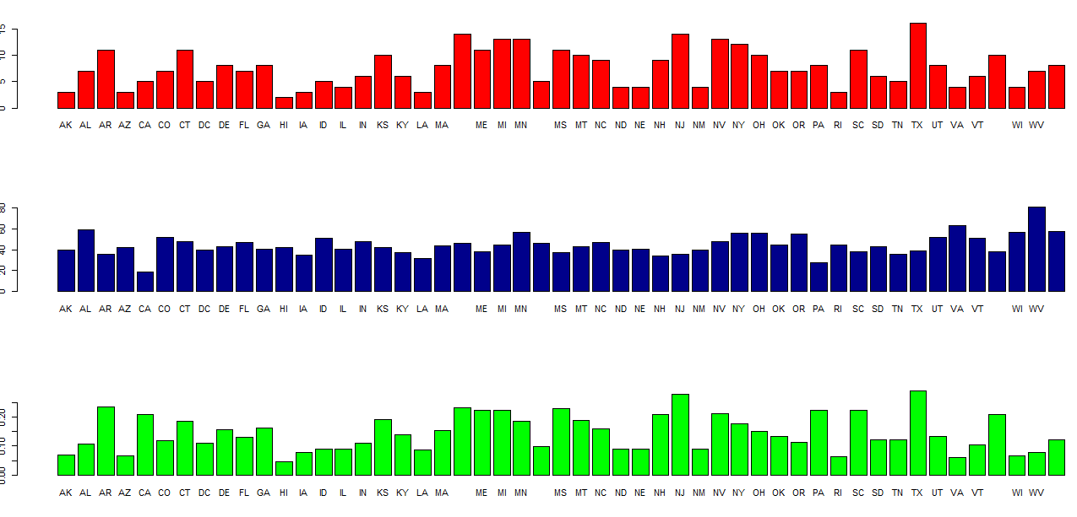
Some states higher churn rates than others…

Slide 15
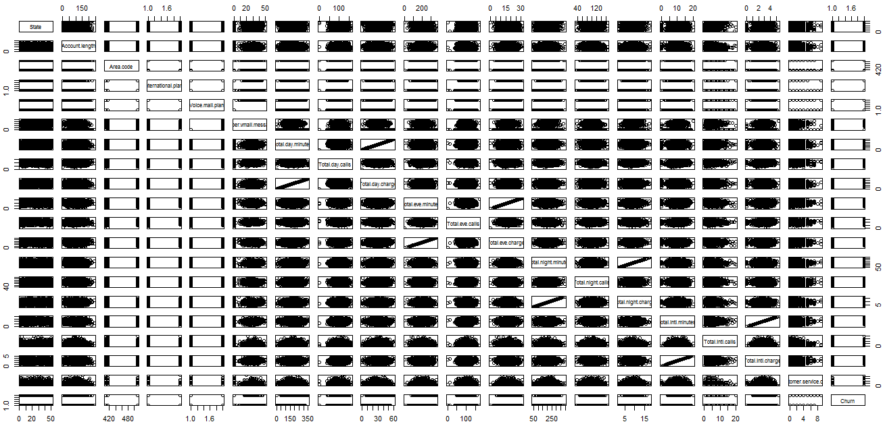
# Scater plots
pairs(CV_data)
High “linearity” between some features…

Slide 16
High “linearity” between some features…
As expected between minutes and charge
# so we will remove
#'Total.day.charge',
#'Total.eve.charge',
#'Total.night.charge',
#'Total.intl.charge'
# So we will remove from data
# …using “set” from data.table library
library(data.table)
set(CV_data, j = c('State',
'Area.code',
'Total.day.charge',
'Total.eve.charge',
'Total.night.charge',
'Total.intl.charge') , value = NULL)
State and Area Code “linearity” also dropped-out as they
are categorical… BUT they should be used!!

Slide 17
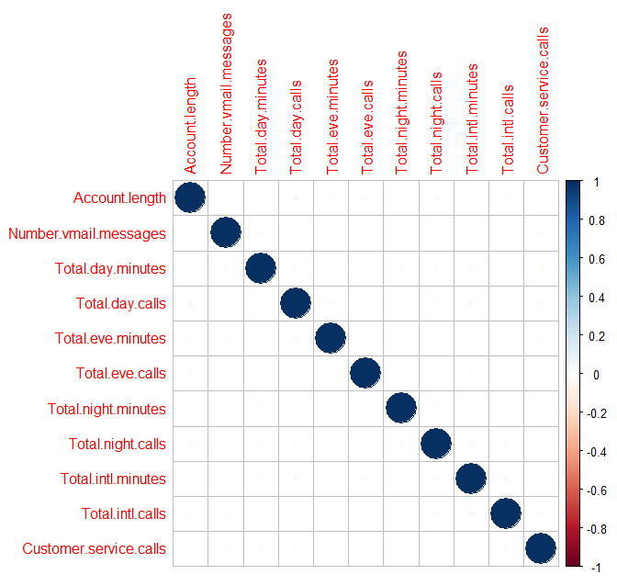
We can analyze correlations…. BUT as we are working in a Classification problem better analyze discriminative power of features …
library(corrplot)
# after removing factors
M <- cor(CV_data[c(-2,-3,-14)])
corrplot(M, method="circle")
Very Small correlation coeffs

Slide 18
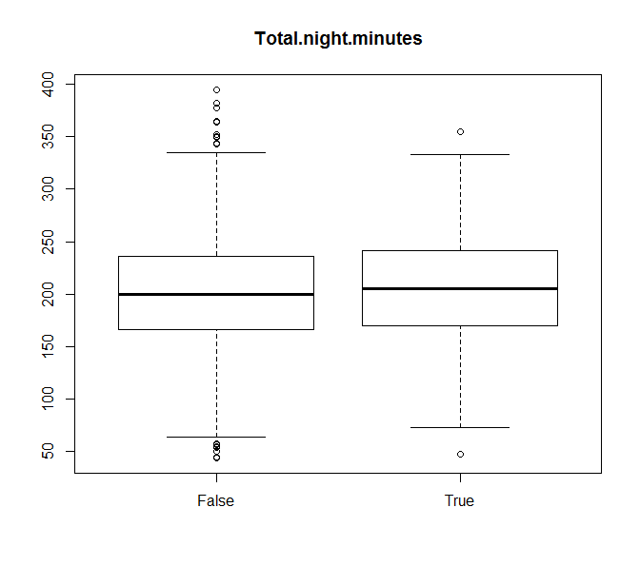
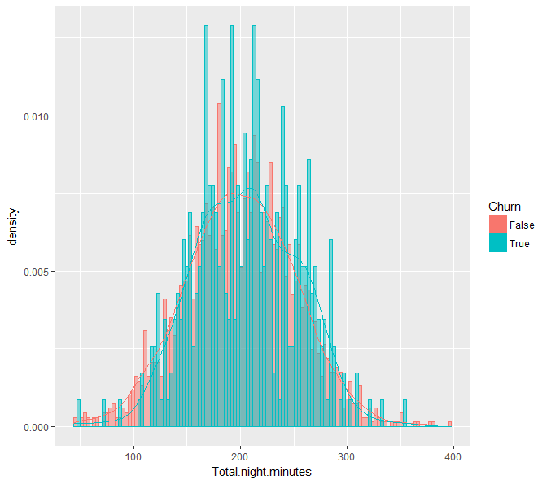
Discrimination can be studied using: boxplot, class-histograms, …

Slide 19
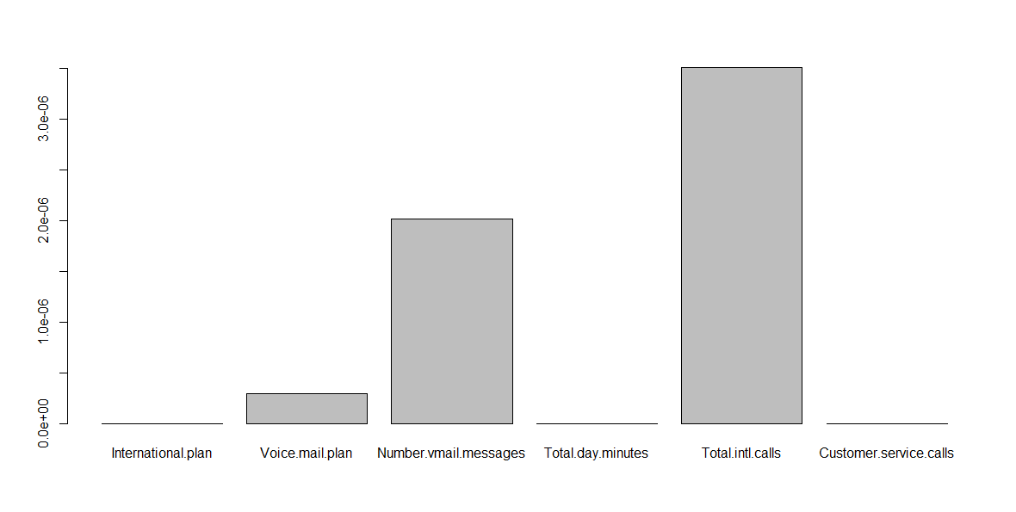
Studying discriminant power using statistical tests…
kruskal.test(Total.night.minutes ~ Churn, data = CV_data)
Kruskal-Wallis chi-squared = 2.8035, df = 1, p-value = 0.09406
Apply for all features and find the more discriminant ones: 14th is Churn
P_values=apply(CV_data[,-14], 2, function(x) kruskal.test(x,CV_data[,14])$p.value)
barplot(P_values[P_values<=.00001])

Slide 20
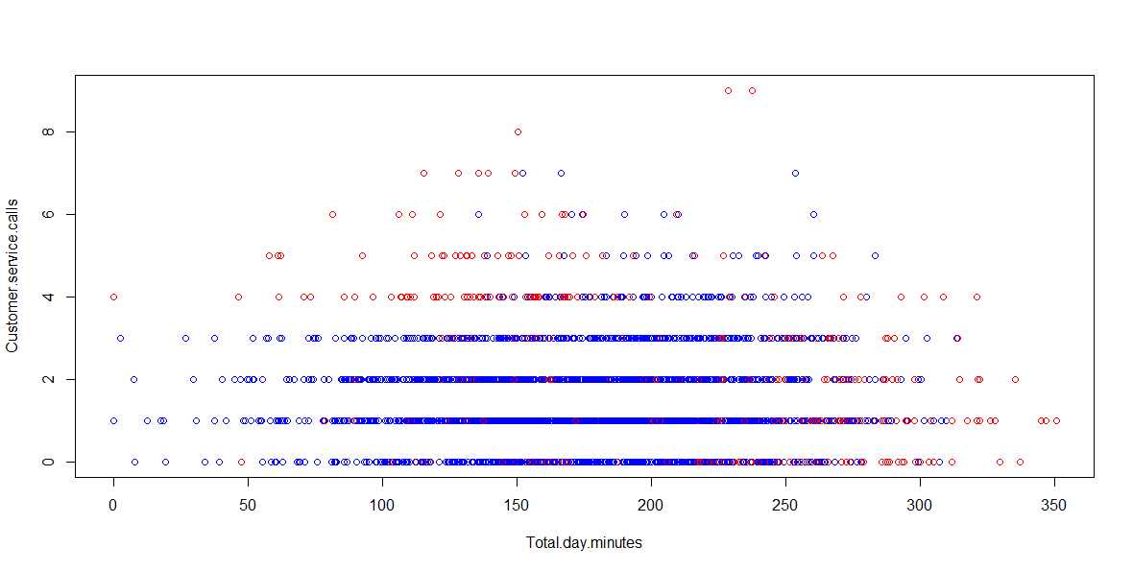
# scatter plot between two features in different colors per class
attach(CV_data)
plot(Total.day.minutes, Customer.service.calls, col=c("blue","red")[Churn])

Slide 21
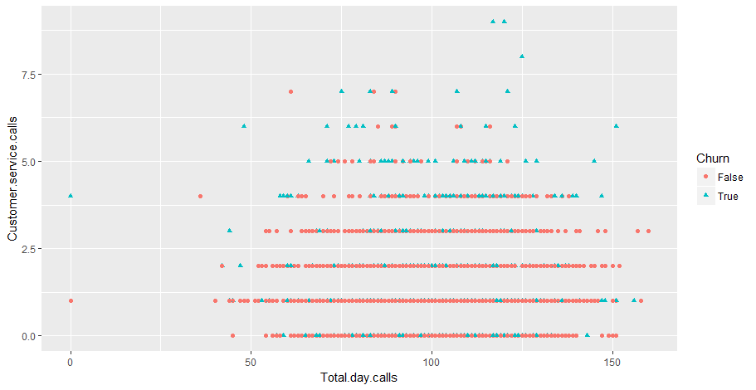
qplot(Total.day.calls, Customer.service.calls, colour = Churn, shape = Churn, data = CV_data)

Slide 22
# Other ways to inspect discrimination power
#dplyr: A Grammar of Data Manipulation
#A fast, consistent tool for working with data frame
# like objects, both in memory and out of memory.
library(dplyr)
group_by(CV_data, Churn) %>%
summarise(
count = n(),
mean = mean(Customer.service.calls, na.rm = TRUE),
sd = sd(Customer.service.calls, na.rm = TRUE),
median = median(Customer.service.calls, na.rm = TRUE),
IQR = IQR(Customer.service.calls, na.rm = TRUE)
)
Churn count mean sd median IQR
<fctr> <int> <dbl> <dbl> <dbl> <dbl>
1 False 2278 1.453029 1.152125 1 1
2 True 388 2.206186 1.882536 2 3

Slide 23
CONCLUSIONS TO EXPLORATORY ANALYSIS
…your conclusions here:
Ready for some “possible” effect of the relevant features…
Customer calls: malfunctioning
International calls: promotions?
… these could be supported by some pre-existing analysis, reports, references, etc.. (search them…)
DON’T FORGET considering also FEATURE ENGINEERING

Slide 24
PRDL & MLlab Final Project
CONTENTS (III):
Churn Prediction
Fitting Interpretable Models for Exploratory Data Analysis
Logistic Regression case
Machine Learning algorithms:
Simple Logistic Regression
Model assessment
Linear Models:
Logistic Regression, LDA, QDA,…

Slide 25
Next Step: Model Selection

Slide 26
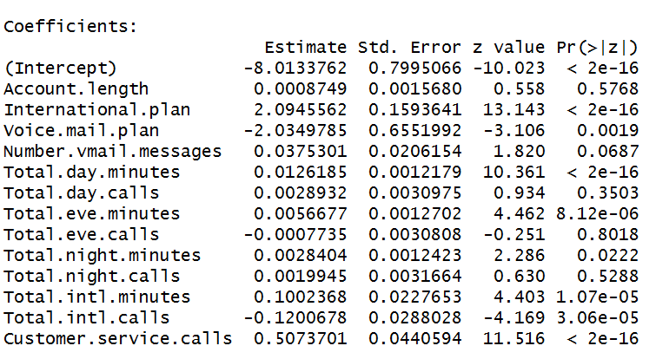

# Fitting a Logistic Regression Model (glm binomial) on the training data using ALL features
glm.fit=glm(Churn ~ . ,data=CV_data,family=binomial)
INTERPRETABLE MODELS
Analyze:
Relevant predictors
Sign (+ , -)

Slide 27
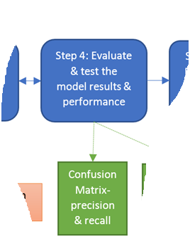
Next Step: Model Selection

Slide 28
# TRAIN ERROR
Confusion Matrix & Classification ERROR
# Basic Confusion matrix en MCE with Threshold 0.5
glm.pred=rep ("False" ,2666)
glm.pred[glm.probs >.5]="True"
table(glm.pred ,Churn)
mean(glm.pred==Churn)
Churn
glm.pred False True
False 2214 302
True 64 86
MCE = 0.8627157

Slide 29
Churn
glm.pred False True
False 2214 302
True 64 86
MCE = 0.8627157
Predicting always FALSE
Churn
glm.pred False True
False 2278 388
MCE = 0.8544636

Slide 30
# TEST ERROR
first prepare test data in a similar way as training data
glm.probs =predict (glm.fit ,final_test_data , type="response")
Churn
glm.pred False True
False 552 77
True 20 18
MCE = 0.8545727
Predicting always FALSE
Churn
glm.pred False True
False 572 95
MCE = 0.8575712

Slide 31
m39-734-551

Slide 32
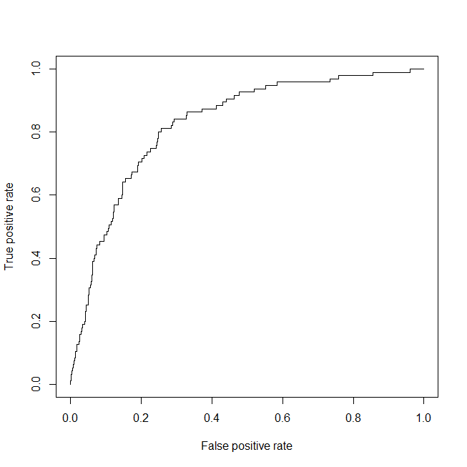
# TEST ERROR using ROC, DET and other assessment metrics

Slide 33
# TEST ERROR using ROC, DET and other assessment metrics
AUC = 0.83

Slide 34
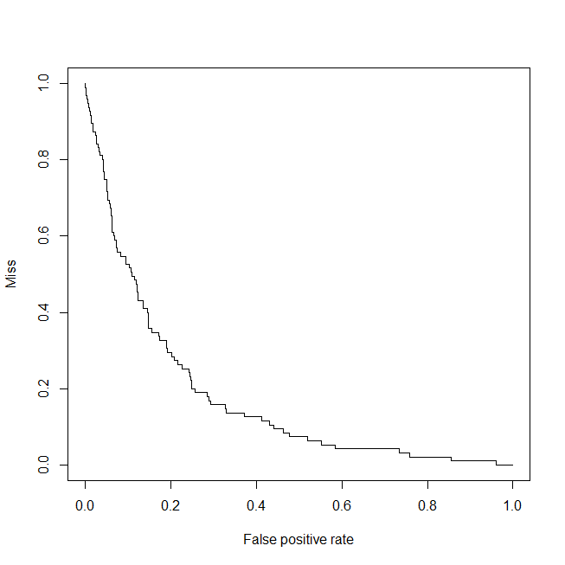
# DET “like” !
EER= 0.23

Slide 35
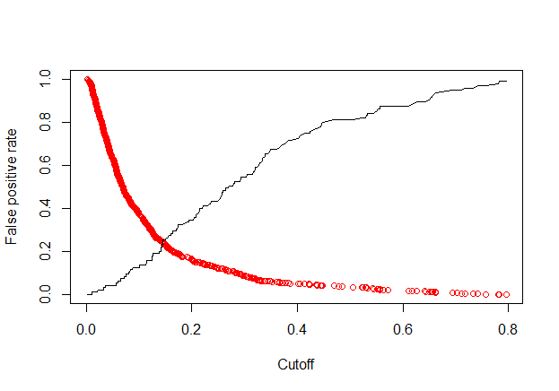
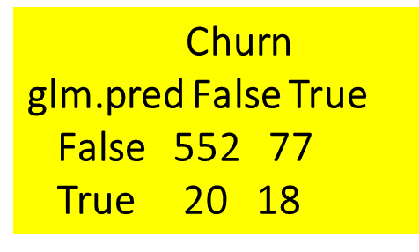
# TEST ERROR
false positive rate & miss (false negative) as function of Threshold
RED
Miss
EER= 0.23
FPR = 20/(552+20) = 0.03496503
FNR=MISS= 77/(77+18) 0.8105263
Threshold
0.5
TPR = 18/(77+18) = 0.19 = Sensitivity=Recall

Slide 36

# TEST ERROR: study other metrics
For Th = 0.5
Precision = 0.4736842
Recall : Sensitivity: TPR: = 0.19
F1 = 0.2706767
The F₁ score is the harmonic average of the precision and recall, where an F₁ score reaches its best value at 1 (perfect precision and recall) and worst at 0.
TPR = 18/(77+18) = 0.19 = Sensitivity=Recall
PPV = Precision = 18/(18+20)=0.47

Slide 37
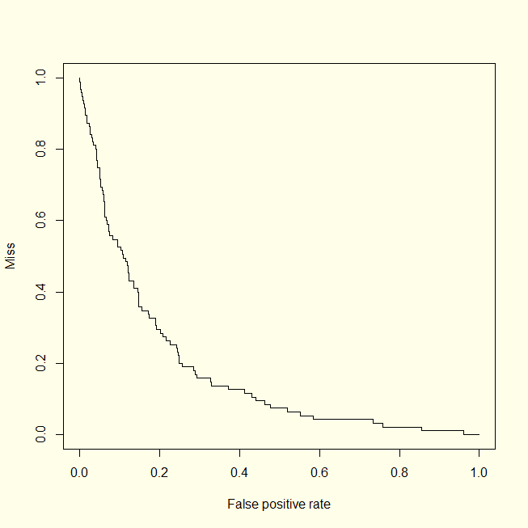
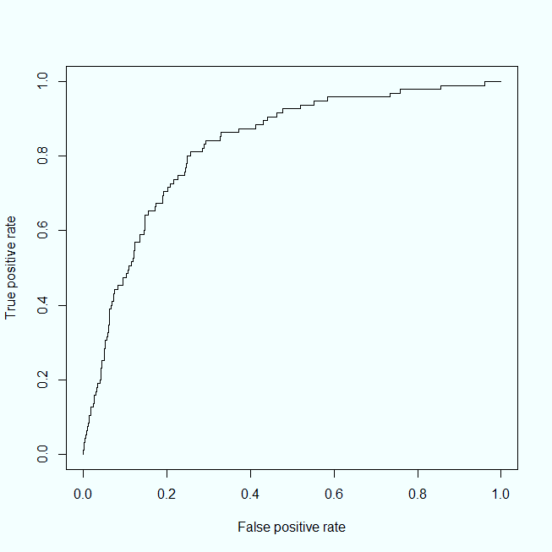
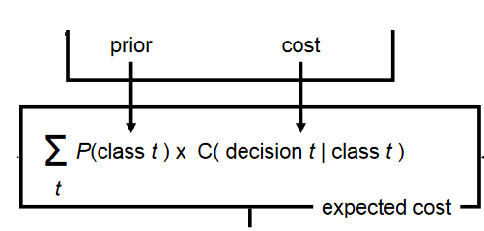
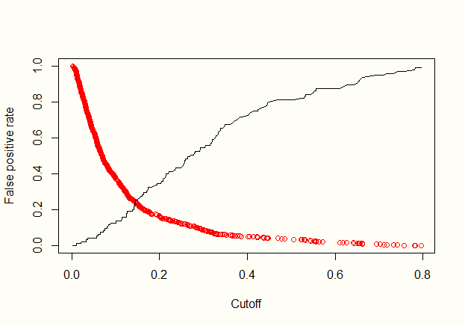


Optimum working point ?
X?
X?
X?

Slide 38
PRDL & MLlab Final Project
CONTENTS (III):
Churn Prediction
Fitting Interpretable Models for Exploratory Data Analysis
Logistic Regression case
Machine Learning algorithms:
Simple Logistic Regression
Model assessment
Comparing Linear Models:
Logistic Regression, LDA, QDA,…

Slide 39
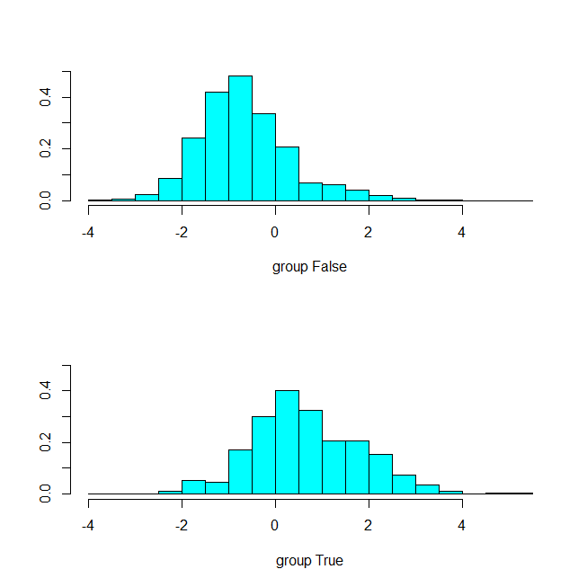
# TEST ERROR: compare LR, LDA , QDA,… kNN…
# TRY LDA LDA is part of MASS library
library (MASS)
lda.fit=lda(Churn ∼ . ,data=CV_data)
lda.fit
plot(lda.fit)
lda.predict=predict (lda.fit , final_test_data)
lda.pred=rep("False" ,667)
lda.pred[lda.predict$posterior[,2] >.5]="True"
table(lda.pred ,final_test_data$Churn)

Slide 40
# TEST ERROR: compare LR, LDA , QDA,… kNN…
# Quadratic Discriminant Analysis
qda.fit=qda(Churn ∼ . ,data=CV_data)
qda.predict=predict (qda.fit , final_test_data)

Slide 41
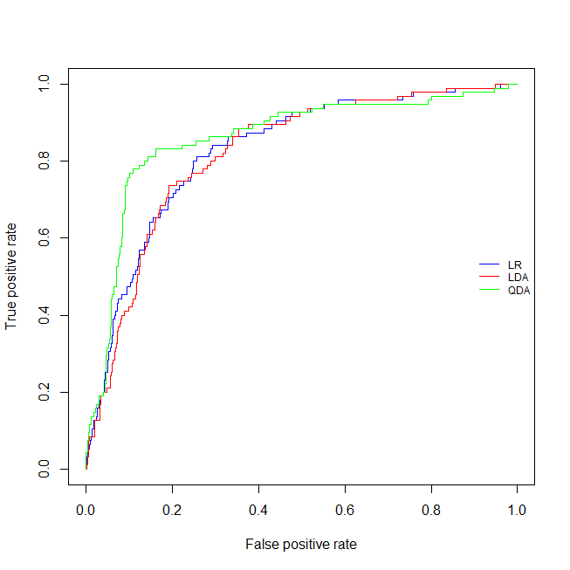
# TEST ERROR: compare LR, LDA , QDA,… kNN…

Slide 42
Let’s try using Cross-Validation
The boot library includes cv.glm() for cross-validation
# ...you should concatenate CV_data and final_test_data
# For Logistic Regression
# https://stats.stackexchange.com/questions/77094/cost-function-in-cv-glm-for-a-fitted-logistic-model-when-cutoff-value-of-the-mo
library(boot)
mycost <- function(r, pi = 0) mean(abs(r-pi) > 0.5)
glm.fit=glm(Churn ~ . ,data=CV_data,family=binomial)
# Leave-one-out
cv.err =cv.glm(CV_data , cost=mycost , glm.fit)
cat('LOOV Estimated Classification ERROR' ,cv.err$delta)
# K-fold cross-validation k=10
cv.err =cv.glm(CV_data , cost=mycost , glm.fit, K=10)
cat('k-fold CV Estimated Classification ERROR' ,cv.err$delta)
LOOV Estimated Classification ERROR 0.1391598 0.1391301
k-fold K=10 CV Estimated Classification ERROR 0.1406602 0.1407349

Slide 43
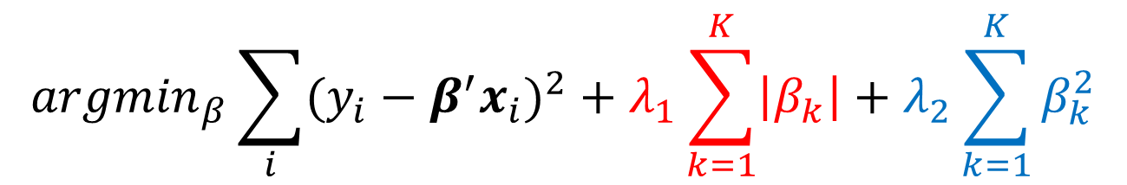
Cross-Validation for Ridge Regression and Lasso
library(glmnet)
Implements
Elastic Net: Combination of Ridge and LASSO
$${argmin}_{β}\sum_{i}{{(y_{i}−β^{′}x_{i})}^{2}}+λ_{1}\sum_{k=1}^{K}{\left|β_{k}\right|}+λ_{2}\sum_{k=1}^{K}{β_{k}^{2}}$$

Slide 44
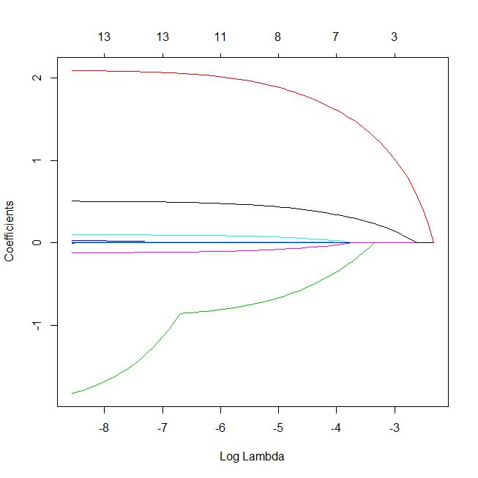
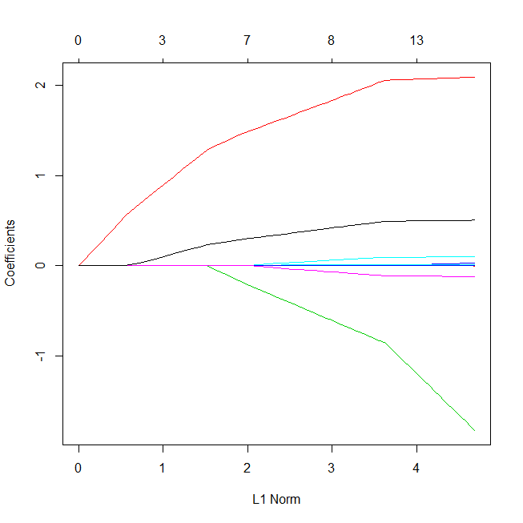
# alpha = 0 for ridge regression / 1 for lasso
glmmod <- glmnet(as.matrix(CV_data[c(-14)]),
Churn, alpha=1, family="binomial")
plot(glmmod, xvar="lambda")
plot(glmmod)

Slide 45
# Search for a grid of lambdas
lambdas <- 10^seq(1, -3, by = -.1)
# …using Cross-validation and different eval measures…
cv.glmmod <- cv.glmnet(as.matrix(CV_data[c(-14)]),
as.factor(Churn),nfolds=10,
lambda = lambdas,
alpha=1, family="binomial",
type.measure="auc")

Slide 46
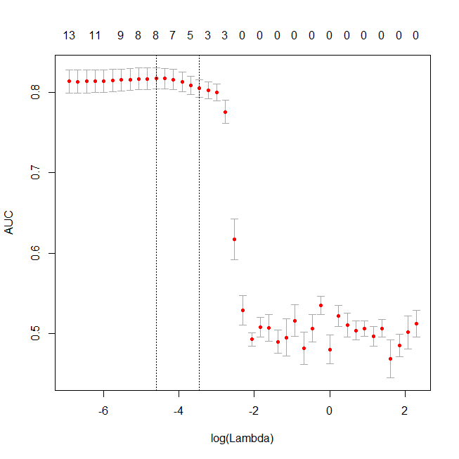
plot(cv.glmmod)
8 features
(Intercept) -5.5311330812
Account.length .
International.plan 1.7949016711
Voice.mail.plan -0.5653239554
Number.vmail.messages .
Total.day.minutes 0.0098953273
Total.day.calls .
Total.eve.minutes 0.0029308939
Total.eve.calls .
Total.night.minutes 0.0004810834
Total.night.calls .
Total.intl.minutes 0.0572328126
Total.intl.calls -0.0605628439
Customer.service.calls 0.4067470146

Slide 47
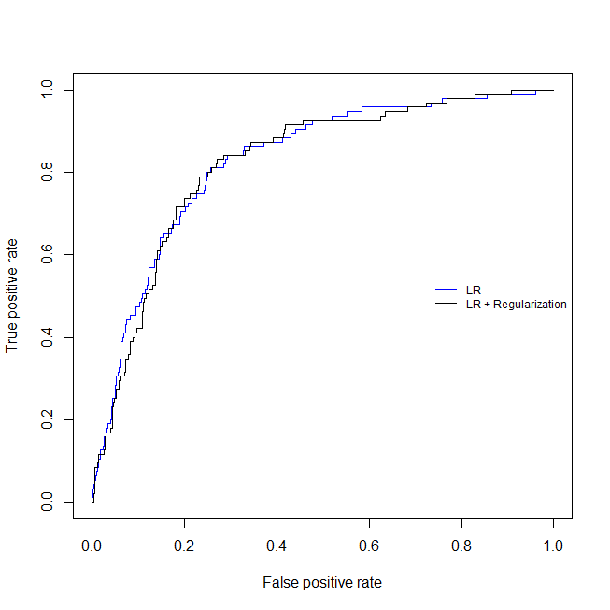
# PERFORMANCE using TEST ERROR
No significant difference…

Slide 48
# Feature Selection using Cross-Validation
https://topepo.github.io/caret/feature-selection-overview.html
Filter / Wrapper methods

Slide 49
# TEST ERROR
first prepare test data in a similar way as training data
mean(glm.pred==Churn)

Slide 50
# TEST ERROR
first prepare test data in a similar way as training data
mean(glm.pred==Churn)

Slide 51
# TEST ERROR
first prepare test data in a similar way as training data
mean(glm.pred==Churn)

Slide 52
# TEST ERROR
first prepare test data in a similar way as training data
mean(glm.pred==Churn)

Slide 53
# TEST ERROR
first prepare test data in a similar way as training data
mean(glm.pred==Churn)

Slide 54
# TEST ERROR
first prepare test data in a similar way as training data
mean(glm.pred==Churn)

Slide 55
# TEST ERROR
first prepare test data in a similar way as training data
mean(glm.pred==Churn)

Slide 56
# TEST ERROR
first prepare test data in a similar way as training data
mean(glm.pred==Churn)

Slide 57
# TEST ERROR
first prepare test data in a similar way as training data
mean(glm.pred==Churn)

Slide 58
# TEST ERROR
first prepare test data in a similar way as training data
mean(glm.pred==Churn)

Slide 59
# TEST ERROR
first prepare test data in a similar way as training data
mean(glm.pred==Churn)

Slide 60
# TEST ERROR
first prepare test data in a similar way as training data
mean(glm.pred==Churn)

Slide 61
# TEST ERROR
first prepare test data in a similar way as training data
mean(glm.pred==Churn)

Slide 62
# TEST ERROR
first prepare test data in a similar way as training data
mean(glm.pred==Churn)

Slide 63
# TEST ERROR
first prepare test data in a similar way as training data
mean(glm.pred==Churn)

Slide 64
Exploratory Analysis
Numb

Slide 65
Exploratory Analysis
Numb

Slide 66
Exploratory Analysis
Numb

Slide 67
Exploratory Analysis
Numb

Slide 68
Exploratory Analysis
Numb

Slide 69
Exploratory Analysis
Numb

Slide 70
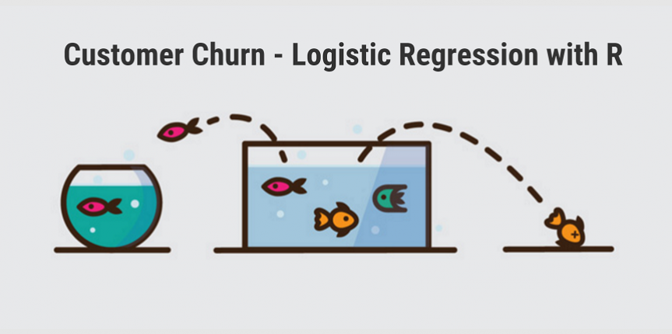
Orange Telecoms Churn Dataset
http://www.treselle.com/blog/customer-churn-logistic-regression-with-r/

