Slide 1
Machine Learning Lab

Slide 2
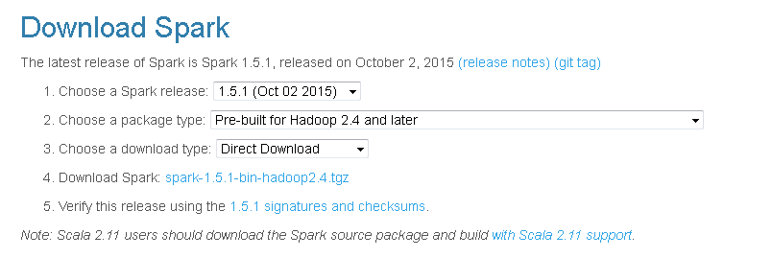
Apache Spark Introduction
Downloading Spark & Getting Start
http://spark.apache.org/downloads.html
Windows: install in a directory without spaces
Spark runs on Java 7+, Python 2.6+ and R 3.1+. For the Scala API, Spark 1.5.1 uses Scala 2.10.
You will need to use a compatible Scala version (2.10.x).

Slide 3
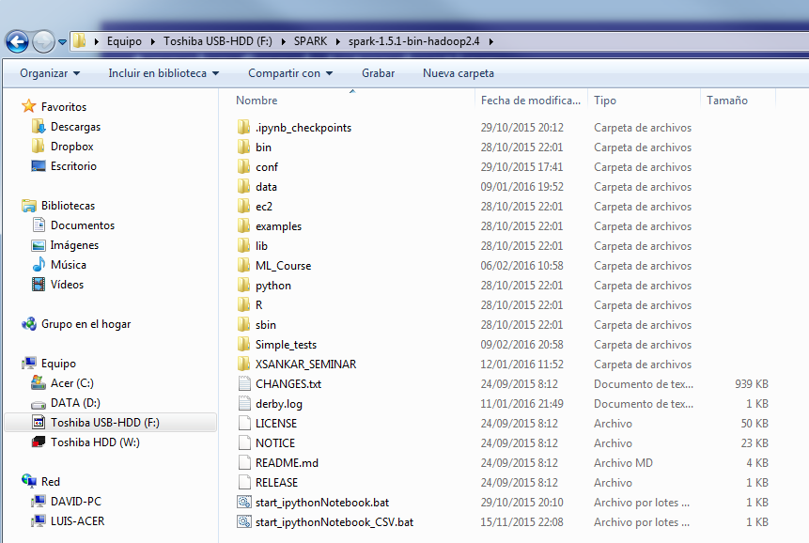
Apache Spark Introduction
Downloading Spark & Getting Start
So, once you have downloaded the installation zip unzip it in a windows directory without spaces

Slide 4

Apache Spark Introduction
…and then:
Verify for Java version (and update if needed!)
Better use ANACONDA to install Python (2.7)
https://www.continuum.io/downloads

Slide 5
Apache Spark Introduction
Check that Python is properly installed opening a command window and executing
>python
… now, before starting SPARK let us introduce some Core Spark Contexts,,,,

Slide 6
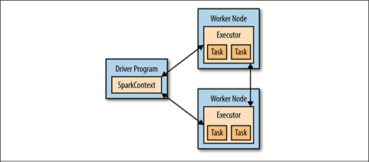
Apache Spark Introduction
Introduction to Core Spark Concepts
At a high level, every Spark application consists of a driver program that runs the user’s main function and executes various parallel operations on a cluster.
A driver program can be the Spark shell, that we will call from python:
## Interactive Python Shell
.\bin\pyspark (en windows “\” )

Slide 7
Apache Spark Introduction
Driver programs access Spark through a SparkContext object
The first thing a Spark program must do is to create a SparkContext object, which tells Spark how to access a cluster.
To create a SparkContext you first need to build a SparkConf object that contains information about your application.

Slide 8
Apache Spark Introduction
Using the Python Shell
In the shell a SparkContext object is automatically created for you
Once you have a SparkContext you can use it to build RDDs in two ways :
parallelizing an existing collection in your driver program,
or referencing a dataset in an external storage system, such as a shared filesystem, HDFS, HBase, or any data source offering a Hadoop InputFormat.

Slide 9
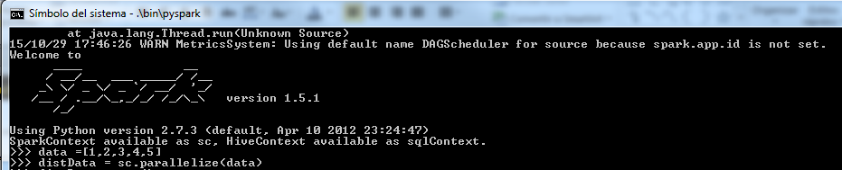
Apache Spark Introduction
## Execute the Interactive Python Shell
## you must open a command shell and be in the installation directory!!
.\bin\pyspark (en windows “\”)

Slide 10
Apache Spark Introduction
To control the verbosity of the logging:
Create log4j.properties file in conf directory by copying log4j.properties.template and
change
log4j.rootCategory=INFO, console
to
log4j.rootCategory=WARN, console

Slide 11
Apache Spark Introduction
As you have a SparkContext automatically created by the Python Shell
>>> sc
<pyspark.context.SparkContext object at 0x0000000003019828>
As we see before, now you can use it to build RDDs and There are two ways to create RDDs:
parallelizing an existing collection in your driver program,
or referencing a dataset in an external storage system, such as a shared filesystem, HDFS, HBase, or any data source offering a Hadoop InputFormat.

Slide 12
Apache Spark Introduction
## parallelizing an existing collection data and build a Resilient distributed dataset (RDD) distData
>>> data = [1, 2, 3, 4, 5]
>>> distData = sc.parallelize(data)
you can consult some references as:
The Python Tutorial
https://docs.python.org/2/tutorial/
http://ai.berkeley.edu/tutorial.html#PythonBasics
## so you can operate on this (RDD) distData, for example counting the number of elements
>>> distData.count()
5

Slide 13
Apache Spark Introduction
>>> sc.parallelize(range(1000),4).count()
1000
Number of partitions:
One important parameter for parallel collections is the number of partitions to cut the dataset into.
Spark will run one task for each partition of the cluster. Typically you want 2-4 partitions for each CPU in your cluster.
Normally, Spark tries to set the number of partitions automatically based on your cluster.
However, you can also set it manually by passing it as a second parameter to parallelize (e.g. sc.parallelize(data, 10)).
Note: some places in the code use the term slices (a synonym for partitions) to maintain backward compatibility.

Slide 14
Apache Spark Introduction
## Build a Resilient distributed dataset (RDD) distData by referencing a dataset in an external storage system
>>> distFile = sc.textFile("README.md")
Once created, distFile can be acted on by dataset operations.
For example, we can add up the sizes of all the lines using the
map and reduce operations as follows:
>>> distFile.map(lambda s: len(s)).reduce(lambda a, b: a + b)
3495
PySpark can create distributed datasets from any storage source supported by Hadoop, including your local file system, HDFS, Cassandra, HBase, Amazon S3, etc. Spark supports text files, SequenceFiles, and any other Hadoop InputFormat.

Slide 15
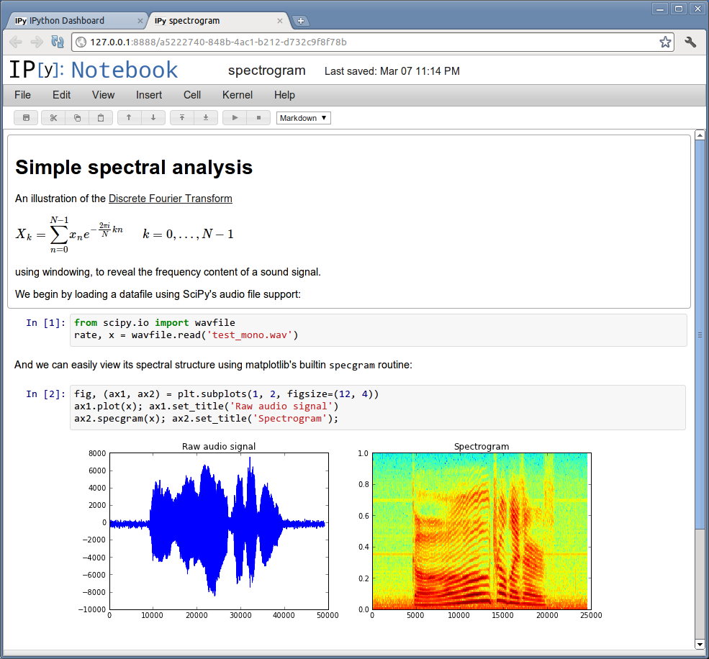
Apache Spark Introduction
The IPython Notebook
http://ipython.org/notebook.html
The IPython Notebook is an interactive computational environment, in which you can combine code execution, rich text, mathematics, plots and rich media, as shown in this example session:

Slide 16
Apache Spark Introduction
Ipython
http://ipython.org/
Already install if installing ANACONDA
… Python 2.7.9 and later (on the python2 series), and Python 3.4 and later include pip by default [1], so you may have pip already.
(jump to:
3) Set the proper environment variables:
On Windows
…
See / execute .bat file:
start_ipythonNotebook.bat
)

Slide 17
Apache Spark Introduction
Ipython
http://ipython.org/
… Python 2.7.9 and later (on the python2 series), and Python 3.4 and later include pip by default [1], so you may have pip already.
If you have to install Install pip
To install pip, securely download get-pip.py. [2]
Then run the following (which may require administrator access):
python get-pip.py

Slide 18
Apache Spark Introduction
http://pandaquality.blogspot.com.es/2015/05/pyspark-ipython-on-windows.html
1) Install ipython, pyradline:
$ pip install ipython $ pip install pyreadline 2) Make sure that the ipython executable is in your path (if you can run pip with no problems, that should be ok as well).

Slide 19
Apache Spark Introduction
http://pandaquality.blogspot.com.es/2015/05/pyspark-ipython-on-windows.html
3) Set the proper environment variables:
On Windows:
$ set PYSPARK_DRIVER_PYTHON=ipython
Sin comillas “ipython”
(or set it permanently in the control panel)
On Mac/Linux:
$ declare -x PYSPARK_DRIVER_PYTHON="ipython"
(or add it to your ~/.bash_profile or ~/.bashrc file)
On Windows + Spark < 1.4.0: $ set IPYTHON=1
4) Run pyspark, and you'll get it in IPython with auto completion working! Now you'll never mistake spelling sc.paralelize sc.parrallelize sc.parallelize again!

Slide 20
Apache Spark Introduction
Bonus rounds (also available from ANACONDA installation): Notebook
5) If you want to use pyspark and IPython Notebook, you can install IPython Notebook, and then make pyspark use it:
On Windows:
$ set PYSPARK_DRIVER_PYTHON_OPTS=notebook
(or set it permanently in the control panel)
On Mac/Linux:
$ declare -x PYSPARK_DRIVER_PYTHON_OPTS="notebook"
(or add it to your ~/.bash_profile or ~/.bashrc file)
On Windows + Spark < 1.4.0:
$ set IPYTHON_OPTS=notebook
In the next IPython Notebook, the sc object will be available right from the start (no need to define it) as well as the pyspark module.
6) Last but not least, like any good Java program Spark makes a big drama out of its execution by printing out lots and lots of lengthy log messages. You can turn them off by following this StackOverflow answer:
http://stackoverflow.com/questions/25193488/how-to-turn-off-info-logging-in-pyspark
Enjoy Sparking!

Slide 21
Apache Spark Introduction
Some additional steps to allow write file and CSV in Windows 7:
Copy winutils into a directory, for example X:\SPARK\winutils
Add or check this (X: root!!) in start_ipythonNotebook_CSV.bat
…
set HADOOP_CONF=X:\SPARK\winutils
set HADOOP_CONF_DIR=X:\SPARK\winutils
set HADOOP_HOME=X:\SPARK\winutils
.\bin\pyspark --packages com.databricks:spark-csv_2.11:1.2.0
From windows cmd execute:
start_ipythonNotebook_CSV.bat
… and Jupyter should appear in:
http://localhost:8888/tree

Slide 22
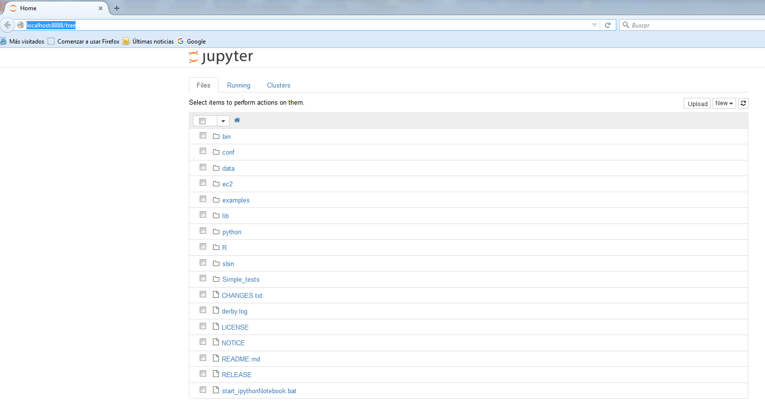
Apache Spark Introduction

Slide 23
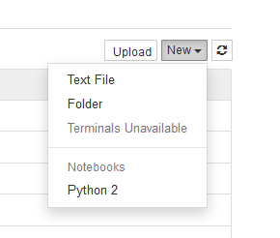
Apache Spark Introduction
Let’s create a Noteebok
… first create a new folder: call it Simple_tests

Slide 24
Apache Spark Introduction

Slide 25
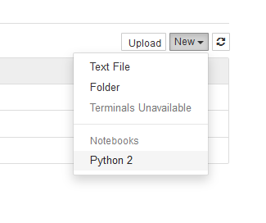
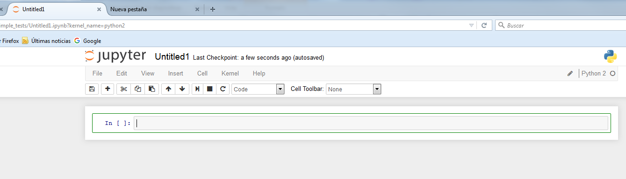
Apache Spark Introduction
Move to Simple_tests folder
…. and create a new Python 2 Notebook

Slide 26
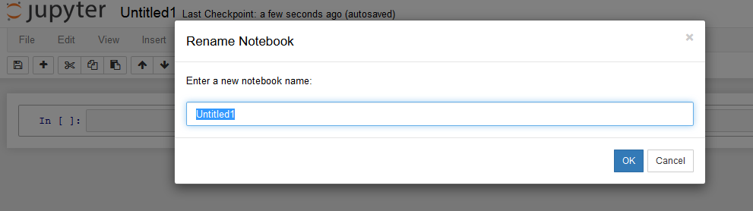
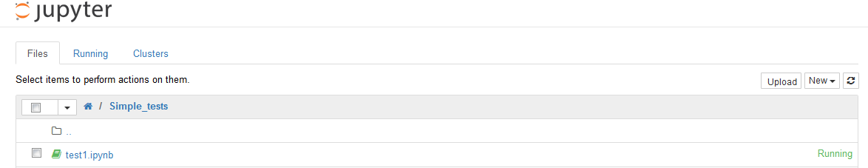
Apache Spark Introduction
Under File upper menu
Rename it to: test1

Slide 27
Apache Spark Introduction
then you will see: test1.ipynb running in
http://localhost:8888/tree/Simple_tests#
ipynb : is the extension for ipython Notebooks
An active Notebook is linked to a running kernel

Slide 28
Apache Spark Introduction
The IPython Notebook
http://ipython.readthedocs.org/en/master/notebook/notebook.html#introduction
…
An open notebook has exactly one interactive session connected to an IPython kernel, which will execute code sent by the user and communicate back results.
This kernel remains active if the web browser window is closed, and reopening the same notebook from the dashboard will reconnect the web application to the same kernel. In the dashboard, notebooks with an active kernel have a Shutdown button next to them, whereas notebooks without an active kernel have a Delete button in its place.

Slide 29
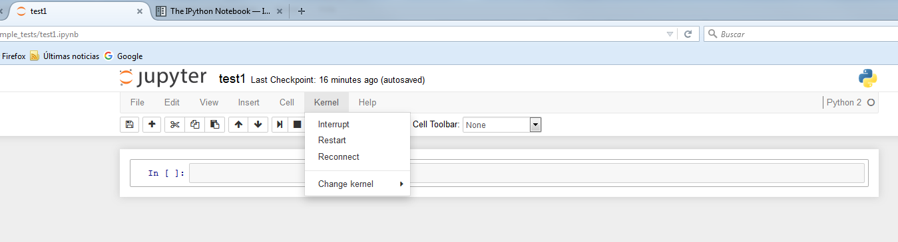
Apache Spark Introduction

Slide 30
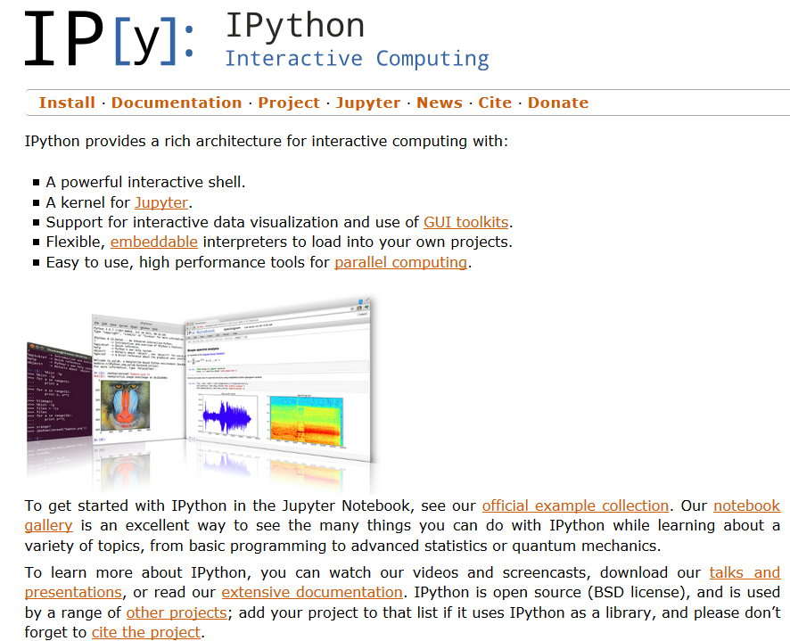
Apache Spark Introduction

Slide 31
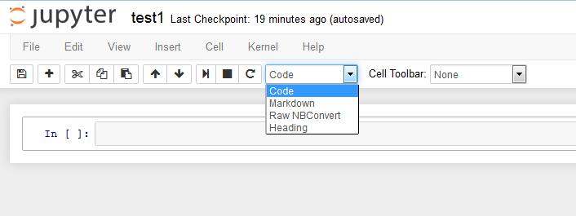
Apache Spark Introduction
Basic guidelines…
you can add a new cell (code , marked content, etc..)
Execute the code in the cell, and results will appear below
Cut & paste, etc…

Slide 32
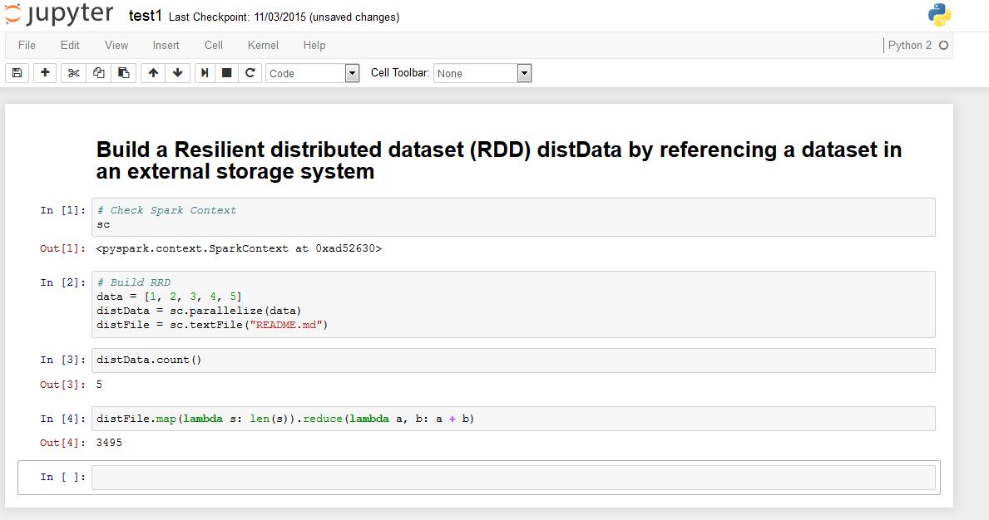
Apache Spark Introduction
Create and test the following Notebook:
See, for example when problems with the location of README.md arises..

Slide 33
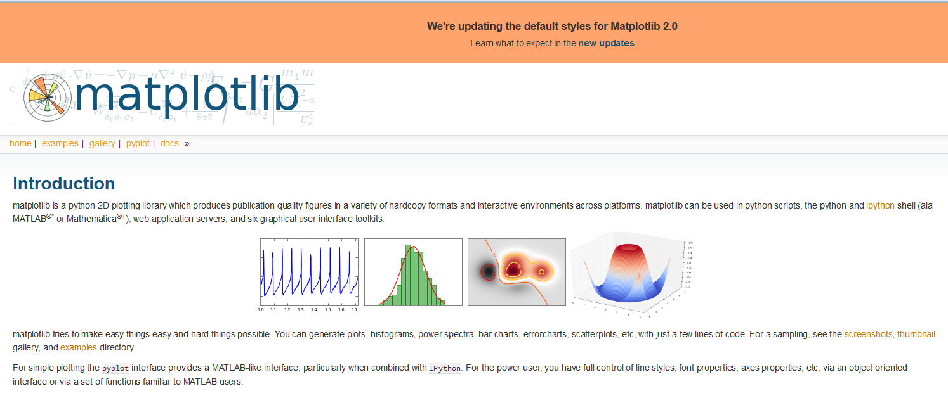
Apache Spark Introduction
PROBLEM:
http://stackoverflow.com/questions/28848270/import-matplotlib-pyplot-gives-importerror-dlopen-library-not-loaded-libpng1
Your suggestion worked! I just tried "conda remove matplotlib", "pip install matplotlib", and then "conda install matplotlib", and presto! Man, you have no idea how long this problem has vexed me. Bless you all.
For plotting and other scientific tools ….

Slide 34
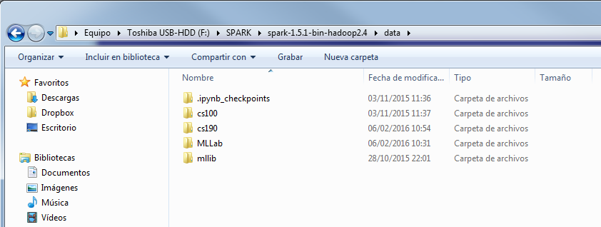
Apache Spark Introduction
For the following examples you have to copy:
cs100 ; cs190 and Mllab directories in SPARK data dir

Slide 35
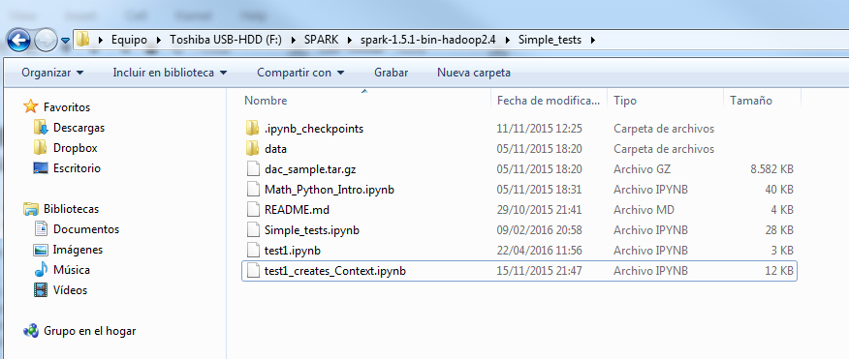
Apache Spark Introduction
…and the content in Simple_test directory:

Slide 36
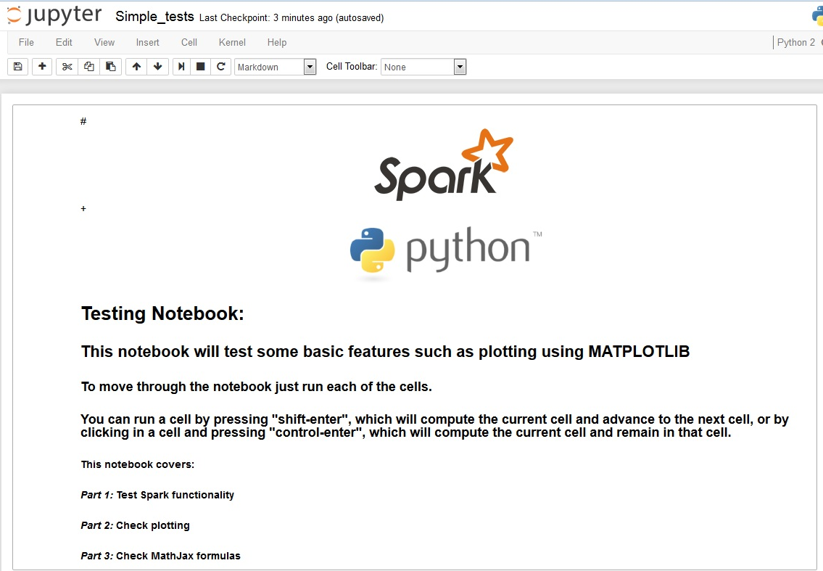
Apache Spark Introduction
Now run the Notebook: Simple_tests.ipynb
that will test that some basic functionality has been properly setup

Slide 37

Apache Spark Introduction
Now we can use:
Math_Python_Intro.ipynb
to present some basic Math and Python operations
This material has been adapted from the course:

Slide 38

Apache Spark Introduction
Math and Python review
Adapted from the course: edX BerkeleyX: CS190.1x Scalable Machine Learning
This notebook reviews vector and matrix math, the NumPy Python package, and Python lambda expressions.
Part 1 covers vector and matrix math using NumPy a Python library for working with array
Part 2 provides additional information about NumPy and how it relates to array usage in Spark's Machine Learning Lib MLlib.
Part 3 provides an overview of lambda expressions.

Slide 39
Apache Spark Introduction
END
(backup slides)

Slide 40
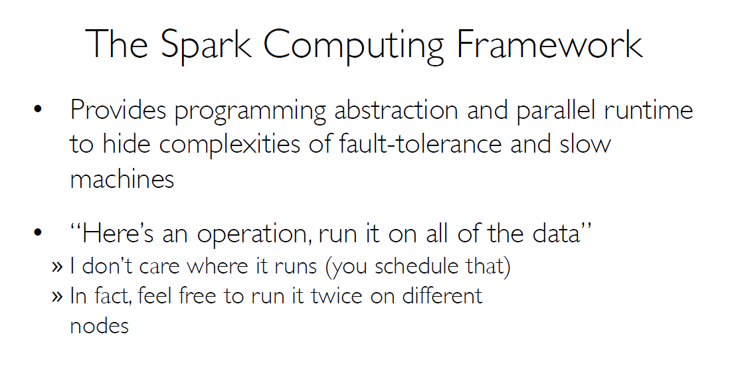
Apache Spark Introduction

Slide 41
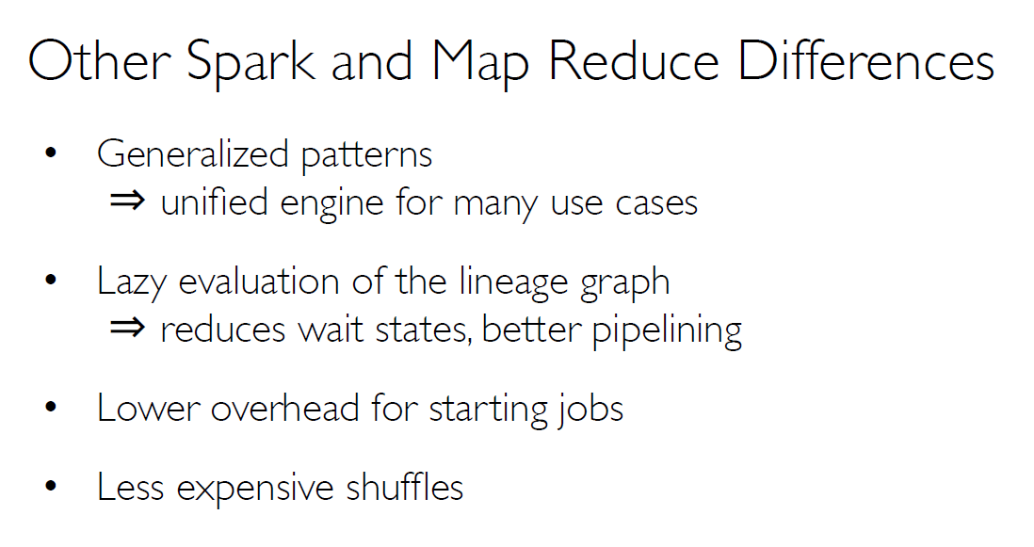
Apache Spark Introduction

Slide 42
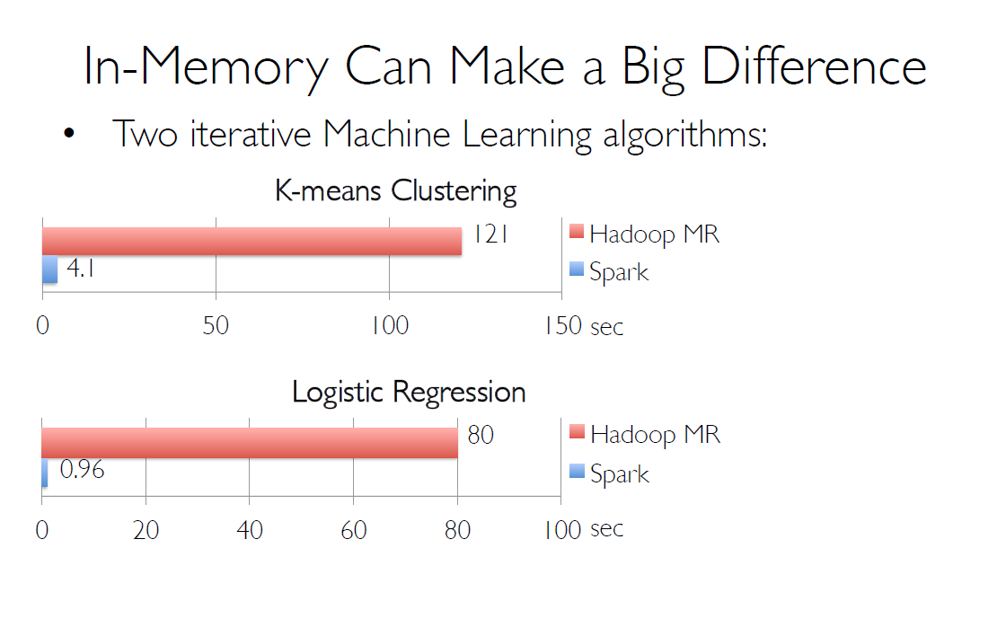
Apache Spark Introduction

Slide 43
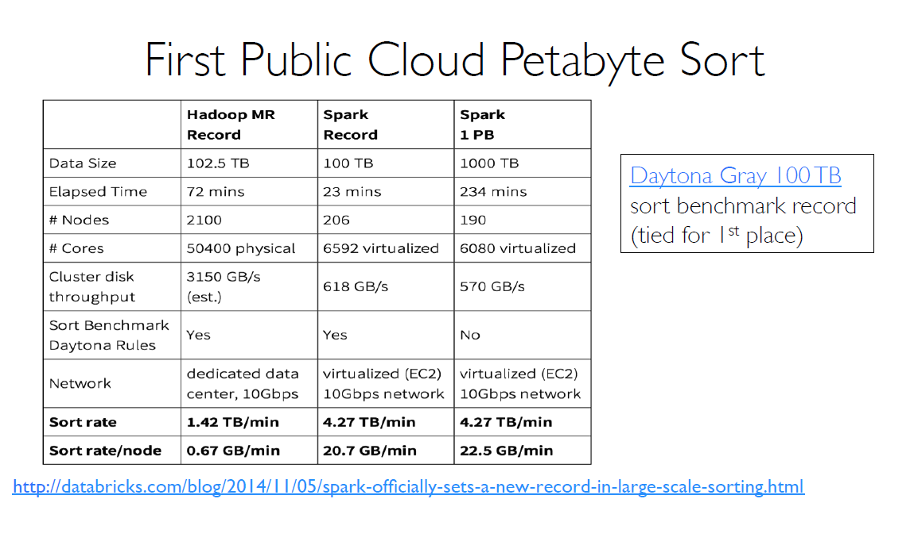
Apache Spark Introduction

Slide 44
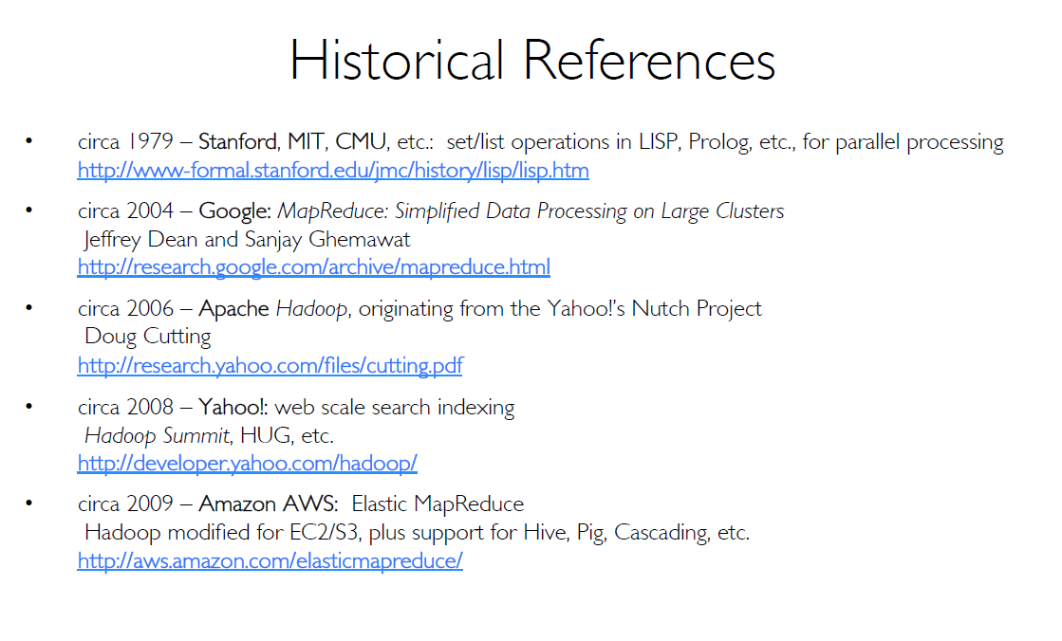
Apache Spark Introduction

