Slide 1
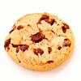
If you give a librarian a cookie . . .

Slide 2
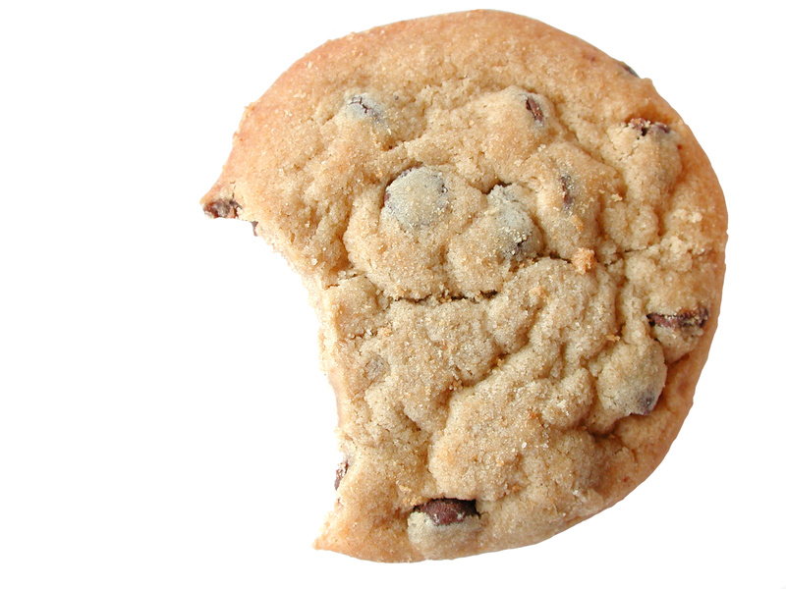
She’ll write a research paper to go with it. . .
Organize your research
Create a thesis and outline
Incorporate your research into the body of your paper.

Slide 3
But first she’ll have to get Organized . . .
Notecards
Highlight
List
Group like things together
Decide what to toss and what to keep
Notes:
I am doing my capstone project on creating the perfect chocolate chip cookie. I research recipes, what people want in a cookie, types of ovens, types of pans, etc.

Slide 4
Then she’ll have to write a thesis statement
The perfect chocolate chip cookie is slightly chewy and requires a quality baking pan, even oven temperature, and balanced chemistry.
One sentence
Goes at the end of the introductory paragraph.
Tells the reader what you’re going to tell them.

Slide 5
And if she writes a thesis statement, she’ll need an outline to go with it
I. Intro with thesis
II. Explanation of research
A. What do people want in a cookie?
B. What kind of baking pans work best?
C. What ovens give the best results
D. Baking chemistry
III. Baking the perfect cookie
IV. Appling the research
Bake time, surface, and temp
Chemistry
Notes:
I. Intro with thesis II. Explanation of research III. Segway into topic/project overview IV. How research can be applied

Slide 6
And if she writes an outline, the paper is almost done!
Butter is where most recipes begin, and it provides several things to the mix. It keeps cookies tender. How butter is incorporated can also affect texture. In the early creaming stages of making a cookie, cool butter is beaten until it's light and fluffy. During the process, some air is incorporated and some of the sugar dissolves in the butter's water phase. This air in turn helps leaven the cookies as they bake, giving them some lift. Melting butter before combining it with sugar and eggs leads to squatter, denser cookies.
Butter is an essential ingredient in chocolate chip cookies. It helps to determine both the texture and flavor of the cookie. When cold butter is beaten with sugar and eggs, air is mixed into the batter resulting in lighter, less dense cookies than would be created using melted butter (Lopez-Alt). Because this is the case, the perfect chocolate chip cookie must be created using cold butter in order to achieve the chewy mouth feel that people desire.

Slide 7
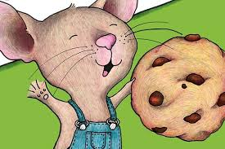
And when the paper is almost done, she’ll have to make sure to . . .
Use in text citations
Format in APA
Proof read!
Eat a cookie ☺

