Slide 1
The DOWN BEAT
Vu Da Sparkles! or Pai In Yo Face!

Slide 2
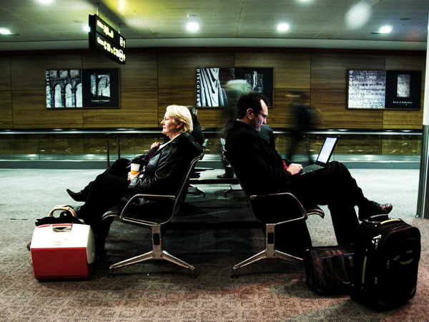
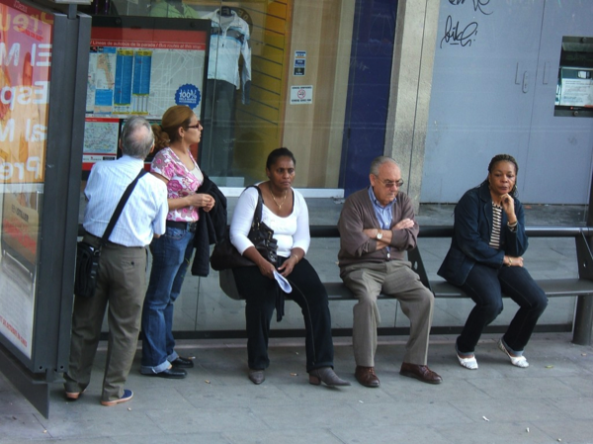
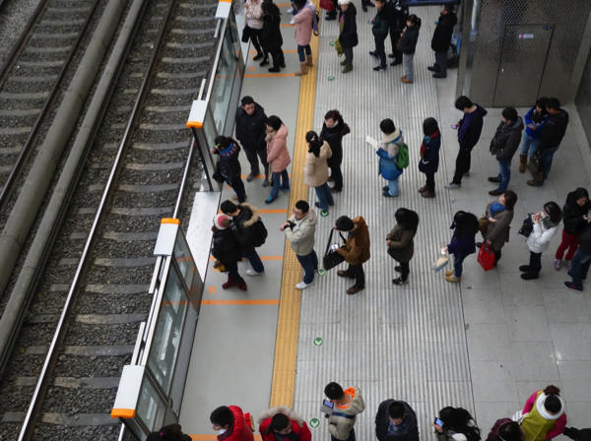
The sitch
FUN FACTOR = 0 ☹

Slide 3
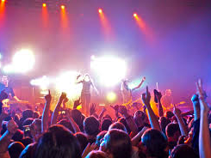
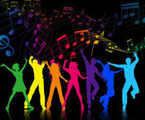
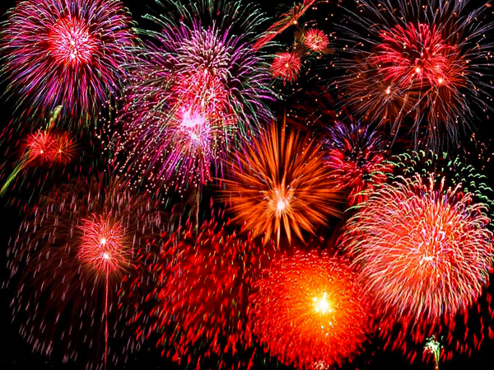
DA FIX
Make magic TOGETHER

Slide 4
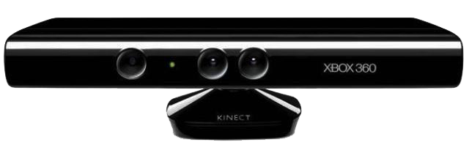

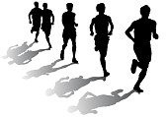
Making it work
Move to keep the beat
Come closer to get louder

Slide 5
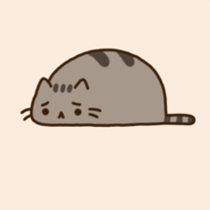
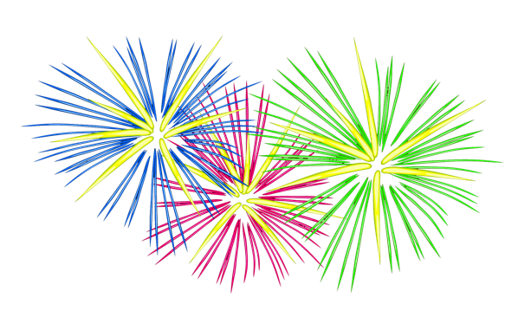
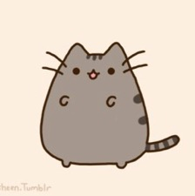
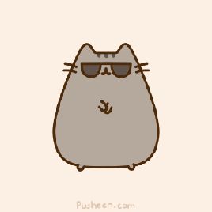
Why Fireworks?
When people dive into a destitute state, often it is because they lack that candle in their heart that drives them to a brighter future.
We show fireworks to kindle within them this lasting, sensational experience of vibrant particles of fire exploding from one’s inner depths.

Slide 6
Party DEmo

Slide 7
Future Work
WORLD DOMINATION
Install The Down Beat in every appropriate venue…
classrooms, offices, inside public transportation
EVEN THE RESTROOM!

