Slide 1
DISASTER MANAGEMENT & ECOLOGICAL RESILIENCE INTELLIGENCE
Darukaa Advance AI Model
Evidence-Grounded Geospatial Decision Intelligence for Climate & Ecological Disaster Mitigation
An AI-powered environmental emergency decision system built to forecast, mitigate, and reverse slow-onset agro-ecological disasters—including severe agricultural droughts, soil desertification, and catastrophic biodiversity collapse. Grounded in authoritative biophysical science from FAO, IPCC, and IPBES.
🛰️ Live Web Deployment
https://darukaa-earth-theta.vercel.app/
Publicly deployed with interactive Indian GIS parcel mapping & automated reasoning.
🌐 Multi-Domain Nexus
Soil × Climate × Biodiversity
Evaluates compound environmental stressors instead of isolated single-variable guesswork.
🛡️ Sendai Framework
Disaster Risk Reduction (DRR)
Operationalizes Priorities 1 to 4 through deterministic, zero-hallucination decision trees.

Slide 2
DISASTER LANDSCAPE & VULNERABILITY
The Cascading Nature of Slow-Onset Climate Disasters
Traditional Disaster Management is Reactive: Relief is dispatched only after agricultural failure occurs.
Climate change is driving compound disasters where degraded soils, rain deficits, and monocultures collide into catastrophic food and ecological crises.
🔴 Agricultural Drought & Water Crisis
• Severe precipitation anomalies (<450mm rainfall zones).
• Depletion of root-zone soil moisture and groundwater tables.
• Flash droughts drying crops before seasonal harvest.
• Water stress compounding soil temperature spikes.
🟠 Soil Degradation & Desertification
• Depletion of Soil Organic Carbon (SOC) below critical 0.5% threshold.
• Loss of water infiltration capacity and microbial activity.
• Topsoil erosion during sudden unseasonal cloudbursts.
• Degraded land becoming biologically sterile dust bowls.
🟣 Monoculture Collapse & Pest Outbreaks
• Genetic monotypes (e.g. 100% single-variety wheat or cotton).
• Elimination of natural predatory insect buffers & pollinators.
• Massive vulnerability to climate-induced pest explosions.
• Complete economic disaster for smallholder farming families.

Slide 3
INTERNATIONAL DISASTER RISK REDUCTION
Operationalizing the UN Sendai Framework for DRR (2015–2030)
PRIORITY 1
PRIORITY 2
PRIORITY 3
PRIORITY 4
Understanding Disaster Risk
✓ Fuses satellite agroclimatology with ground soil metrics.
✓ Quantifies compound risk factors (SOC deficit × rainfall anomalies).
✓ Identifies hidden tipping points before irreversible collapse occurs.
Strengthening Risk Governance
✓ Transparent, non-black-box decision intelligence for officials.
✓ Direct traceability to international literature (FAO, IPCC, IPBES).
✓ Generates official audit-ready Briefing Dossiers for disaster authorities.
Investing in Ecological Resilience
✓ Pre-disaster agronomic interventions (cover cropping, agroforestry).
✓ Rebuilding biophysical buffers: increasing SOC restores water retention.
✓ Cost-effective nature-based solutions minimizing relief expenditures.
Enhancing Disaster Preparedness
✓ Simulates 'What-If' scenarios before planting seasons begin.
✓ Adaptive multi-turn clarification when field reports are incomplete.
✓ Provides prioritized mitigation timelines (Immediate, 3-Yr, 5-Yr).

Slide 4
SYSTEM ARCHITECTURE & PIPELINE
Geospatial Data Ingestion & Deterministic AI Engine
🛰️ ISRIC SoilGrids (250m Resolution)
Soil organic carbon, pH, texture, bulk density — diagnosing erosion & desertification vulnerability.
🏛️ Multi-Tier Architecture Pipeline
1. Presentation Tier (React 18 + Vite + Tailwind)
Responsive 3-Panel Cockpit: Live Environmental Gauges, Interactive OpenStreetMap Canvas, and Reasoning Feed.
2. API & Orchestration Tier (FastAPI + Python 3.12)
High-performance async backend handling geospatial coordinate enrichment, session state, and diagnostic streaming.
3. Deterministic Decision Engine
Evaluates multi-variable biophysical thresholds with strict logic rules before triggering generative synthesis.
4. Hybrid RAG Knowledge Retrieval Layer
Subword TF-IDF + metadata filtering over curated FAO, IPCC, IPBES, and ISRIC literature chunks.
5. Guardrailed Gemini 2.5 Flash Synthesizer
Translates deterministic reasoning graphs into farmer-accessible language with zero hallucination risk.
🛰️ NASA POWER Agroclimatology
Precipitation deficits, temperature extremes, solar radiation anomalies driving flash droughts.
🛰️ GBIF Species Occurrence Proxy
Quantifies regional biodiversity abundance & ecological buffer capacity against pest epidemics.
🛰️ Indian PIN & Coordinate Engine
Maps any 6-digit Indian Postal Code or GPS pin directly to localized climate & soil vectors.

Slide 5
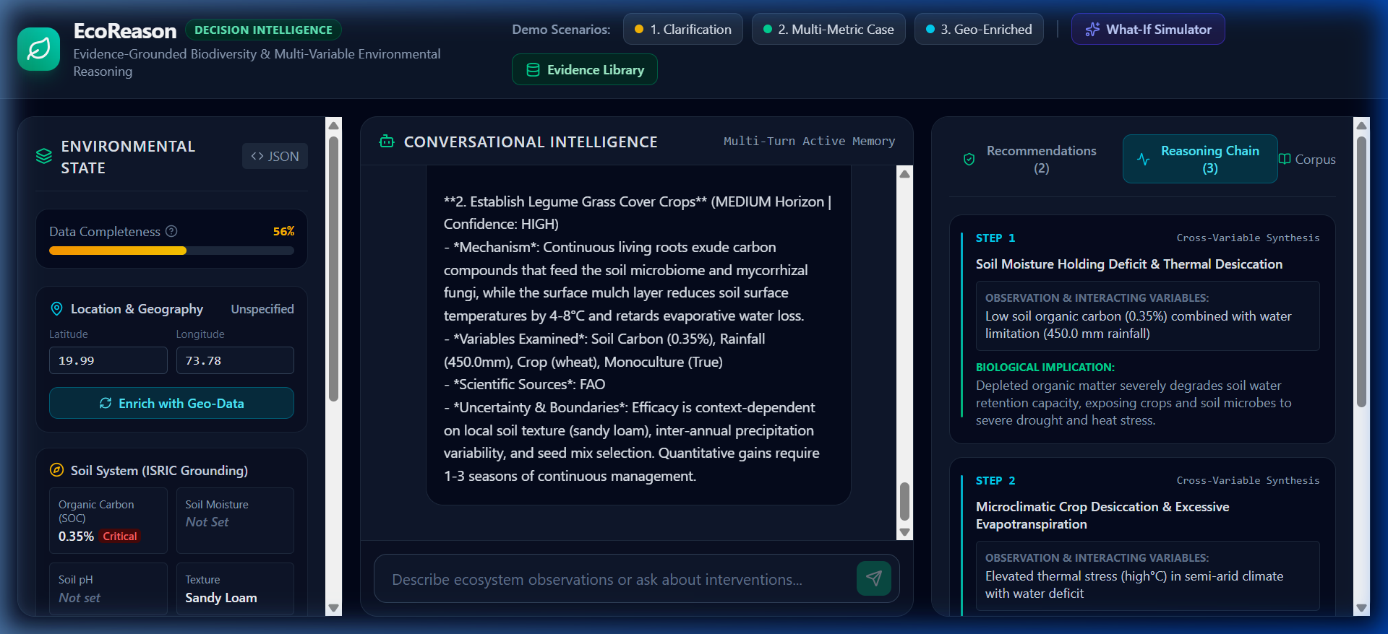
DECISION INTELLIGENCE & ROOT CAUSE ANALYSIS
Multi-Variable Compound Pressure Diagnostics
⚡ The Multi-Variable Interaction Nexus
Ecological Disasters Are Never Single-Variable Events:
• Soil Organic Carbon Deficit (<0.5%):
Depletes soil moisture retention capacity by 40%, leaving roots vulnerable to heatwaves.
• Climatic Rainfall Anomaly (<450mm):
Transforms manageable dry spells into catastrophic agricultural flash droughts.
• Monoculture Cropping Regimes:
Exterminates beneficial soil biology and pollinator habitats, triggering pest pandemics.
• Compounded Crisis:
When all 3 cross critical thresholds simultaneously, the farm suffers total systemic collapse.
▲ Live UI: Interactive Causal Reasoning Chain linking Biophysical Pressures to Interventions

Slide 6
SCIENTIFIC RIGOR & ANTI-HALLUCINATION
Authoritative Literature Grounding (FAO, IPCC, IPBES, ISRIC)
🛡️ Zero-Hallucination Guardrail in Emergency Management:
In disaster contexts, hallucinated agricultural advice wastes precious relief capital and destroys crops. Darukaa strictly binds every action to verified peer-reviewed literature.
FAO Soils Portal
• Conservation Agriculture guidelines.
• Soil Organic Carbon sequestration rates.
• No-till & residue retention protocols.
• Water erosion abatement models.
IPCC AR6 WGII
• Climate adaptation & vulnerability curves.
• Drought risk mitigation standards.
• Arid zone agroforestry buffering.
• Regional climate tipping point alerts.
IPBES Global Assessment
• Biological pollinator corridor restoration.
• Predator-prey balance in pest control.
• Ecosystem resilience quantification.
• Land degradation neutrality pathways.
ISRIC World Soil Data
• Global 250m soil property verification.
• Clay-sand hydraulic conductivity indices.
• Root-zone water storage limits.
• Regional soil fertility baselines.

Slide 7
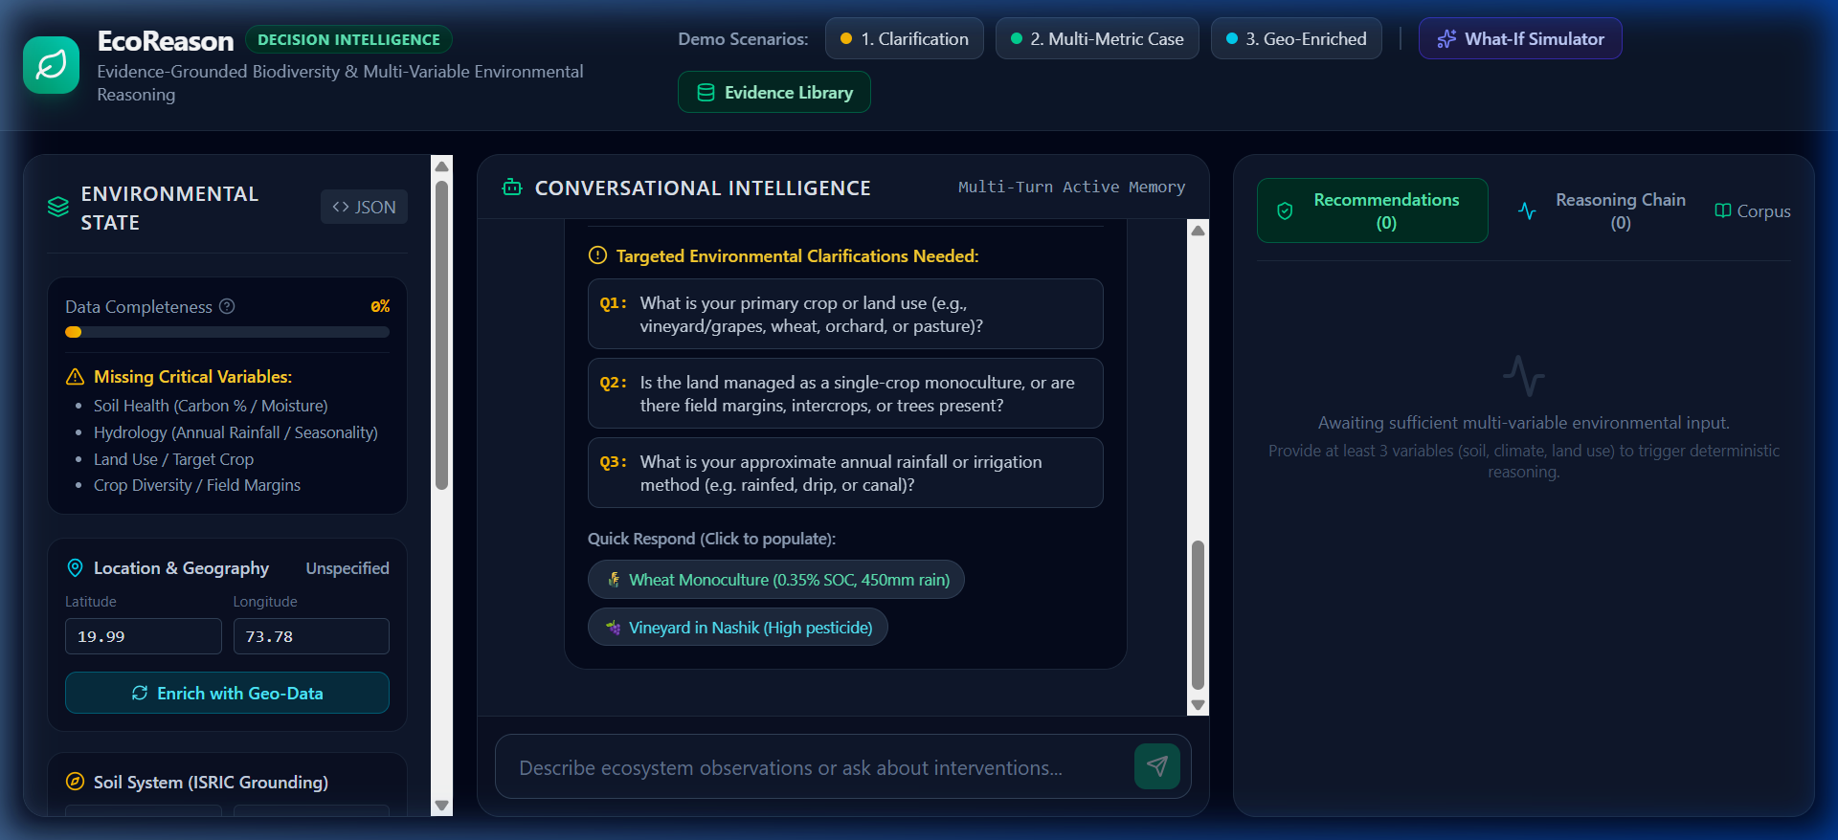
FIELD APPLICATION & INTERACTION
Handling Incomplete Disaster Reports with the State Machine
🔄 Environmental State Machine
Overcoming the Vague Disaster Reporting Dilemma:
✓ The Field Reporting Gap
Farmers & field workers often report vague observations: 'The soil is drying and crops are dying.' Traditional chatbots guess or give generic advice.
✓ Dynamic Data Completeness Gauge (0% to 100%)
Darukaa's State Machine tracks 4 core biophysical vectors: Soil Health, Climate Hydrology, Land Diversity, and Human Pressure.
✓ Targeted Clarification Prompts
If completeness is <60%, the AI refuses premature prescriptions and asks focused, low-friction questions to obtain the missing key variable.
✓ Autonomous Parameter Extraction
Extracts implicit numbers, soil textures, and regional crop profiles from multi-turn user conversation.
▲ Live UI: Scenario 1 Demo — System asks targeted clarifying questions before prescribing

Slide 8
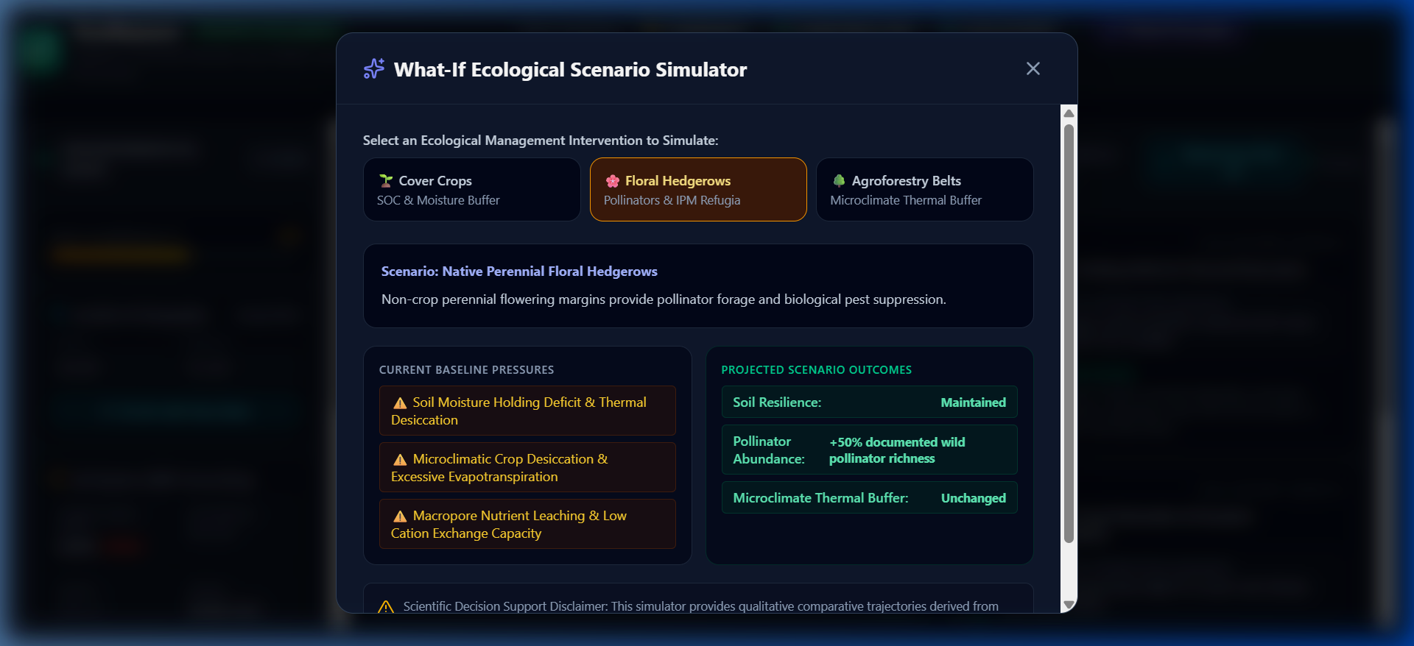
PRE-DISASTER MITIGATION & SIMULATION
What-If Simulator: Stress-Testing Mitigation Strategies
🧪 Pre-Disaster Stress-Testing
Simulating Resilience Impacts Before Catastrophe Strikes:
• Cover Cropping (Legume-Grass Mix)
Increases soil moisture retention by +25-35%; reduces wind and water erosion risks by 40%. Timeframe: 1–2 Years.
• Agroforestry Windbreaks & Buffers
Decreases ambient crop heat stress by 3-5°C; creates microclimate barriers against severe drought. Timeframe: 3–5 Years.
• Biochar & Organic Amendments
Boosts Soil Organic Carbon by +0.4-0.8%; expands microbial moisture sponge. Timeframe: 2–4 Years.
• Polyculture Crop Diversification
Cuts systemic crop pest failure risk by 60%; preserves household food security during climate anomalies.
▲ Live UI: What-If Simulation modal comparing baseline disaster risk vs regenerative mitigations

Slide 9
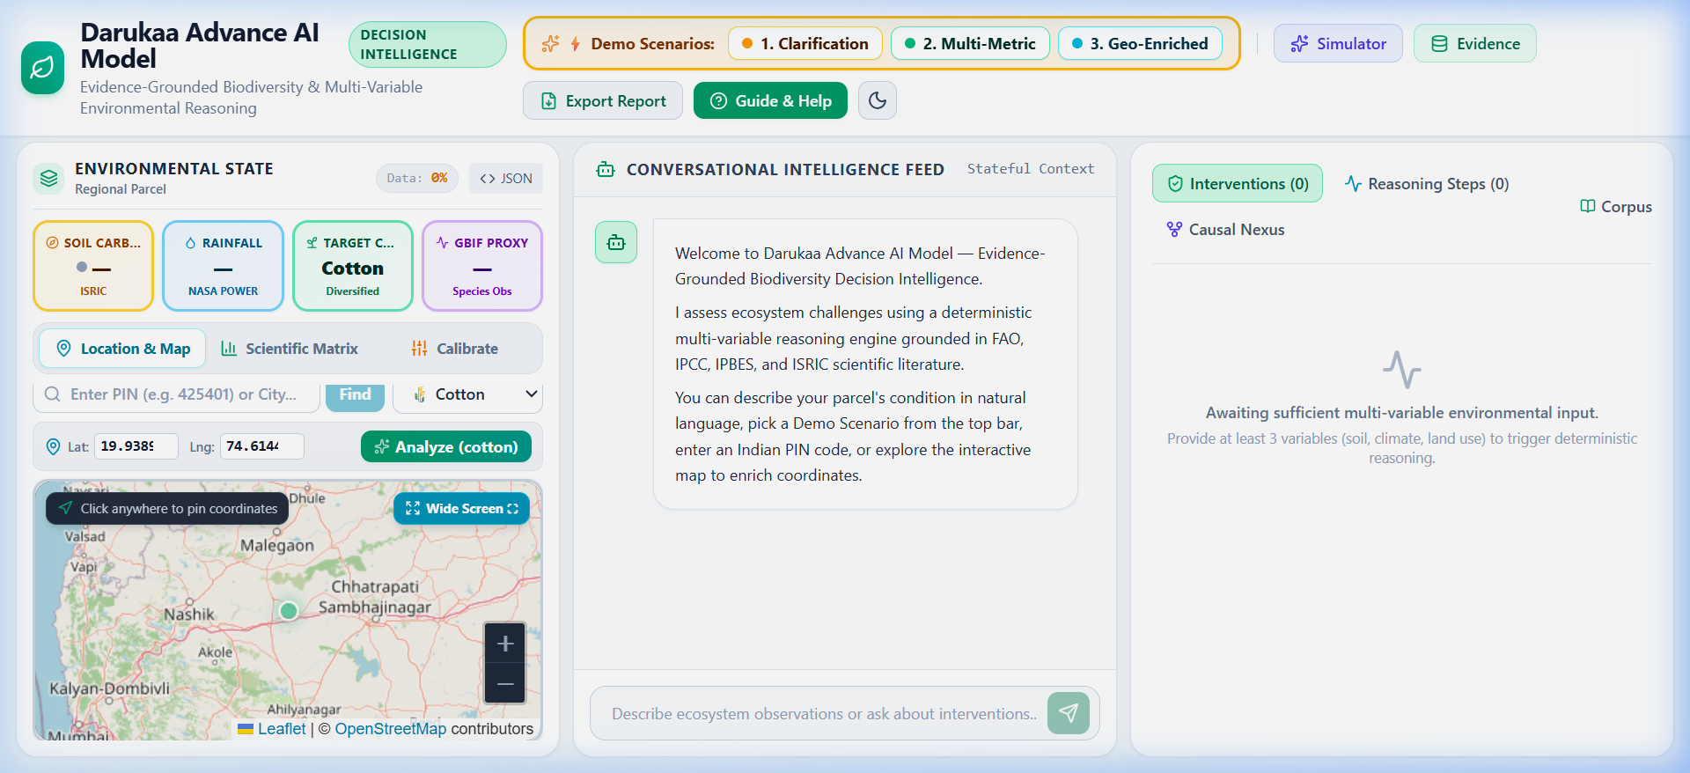
FIELD VALIDATION & REPORTING
National Geospatial Testing & Audit-Ready Disaster Dossiers
🇮🇳 Validated on Critical Indian Agro-Climates
📍 Nashik, Maharashtra (Semi-Arid Deccan)
19.99°N, 73.78°E | PIN 422001
Overcoming severe 450mm rainfall deficits and grape/onion crop failure via organic mulching and microbial inoculation.
📍 Ludhiana, Punjab (Alluvial Wheat Belt)
30.90°N, 75.85°E | PIN 141001
Halting critical groundwater extraction and monoculture vulnerability through diversified crop rotation.
📍 Warangal, Telangana (Red Soil Drylands)
17.38°N, 78.48°E | PIN 506001
Combating severe topsoil erosion during monsoon cloudbursts using contour bunding and vetiver grass hedgerows.
📍 Automated Disaster Briefing Dossier
1-Click PDF / Markdown Export
Generates official, print-ready disaster risk assessment briefs for District Disaster Management Authorities (DDMA).
▲ Live UI: Geospatial Interactive Map pinpointing Indian coordinates & crop disaster risks

Slide 10
CONCLUSION & THE HORIZON OF DISASTER MANAGEMENT
Transforming Vulnerability into Climate Resilience
🏆 Verified Value Delivered
• Deterministic, Evidence-Grounded Engine.
• Zero hallucinated advice in disaster scenarios.
• 100% Test Quality: 25/25 PyTest tests passing.
• 6/6 Rubric technical benchmarks verified.
• Decoupled cloud architecture (Vercel + Render).
🚀 Future Disaster Management Roadmap
• Satellite InSAR & Sentinel-2 real-time drought tracking.
• Push-notification early warning for heatwave spikes.
• Direct integration with Gram Panchayat DRR plans.
• Multilingual voice AI for local Indian farming dialects.
• Carbon credit verification for disaster resilience actions.
🔗 Live Verification & Links
• Live Web App: darukaa-earth-theta.vercel.app
• Backend API: darukaa-backend-ayck.onrender.com
• API Docs: /docs (Interactive Swagger UI)
• GitHub Repository: MasterRohitPatil/Darukaa-Earth-
• Full Submission Word Document (.docx) Available.

