Slide 1
Recurrences & Master Method
Jannatul Maowa
Assistant Professor
Department of Computer Science
Office: D-Building
(3rd floor)
Email: maowa@aiub.edu

Slide 2
The divide- and- conquer design paradigm
• Divide and conquer is just one of several powerful techniques for algorithm design.
• Divide- and- conquer algorithms can be analyzed using recurrences and the master method (so practice this math).
• Can lead to more efficient algorithms

Slide 3
The divide- and- conquer design paradigm
1. Divide the problem (instance) into subproblems.
2. Conquer the subproblems by solving them recursively.
3. Combine subproblem solutions.

Slide 4
The divide- and- conquer design paradigm
Example: merge sort
1. Divide: Trivial (array is halved).
2. Conquer: Recursively sort 2 subarrays.
3. Combine: Linear- time merge.
Recurrence for merge sort
Let T( n ) = Time required for size n
T( n ) =
Sub-problem
Size (n/2)
2
*
T( n / 2)
+
O( n)
Number Of Subproblems
Time required for each Subproblem
Work Dividing and Combining
*
+

Slide 5
The divide- and- conquer design paradigm
Binary search
Find an element in a sorted array:
1. Divide: Check middle element.
2. Conquer: Recursively search 1 subarray.
3. Combine: Trivial.
Recurrence for binary search
T( n) =
1
*
T( n / 2)
+
Θ(1)
Number Of Subproblems
Time required for each Subproblem
Work Dividing and Combining
*
+

Slide 6
Recurrences
Running times of algorithms with recursive calls can be described using recurrences.
A recurrence is an equation or inequality that describes a function in terms of its value on smaller inputs.
For divide and conquer algorithms:
Example: Merge Sort

Slide 7
Solving Recurrences
Repeated (backward) substitution method
Expanding the recurrence by substitution and noticing a pattern (this is not a strictly formal proof).
Substitution method
guessing the solutions
verifying the solution by the mathematical induction
Recursion-trees
Master method
templates for different classes of recurrences

Slide 8
Repeated Substitution
Let’s find the running time of the merge sort
T(n) = 2T(n/2) + n substitute
= 2(2T(n/4) + n/2) + n expand
= 2²T(n/4) + 2n substitute
= 2²(2T(n/8) + n/4) + 2n expand
= 2³T(n/8) + 3n observe pattern
= 2³T(n/2³) + 3n observe pattern
T( n ) = 2^{k}T(n/2^{k}) + kn
= n T(n/n) + n lg n
= n + n lg n
assume 2^{k-1}< n ≤ 2^{k}.
So upper bound for k is
n = 2^{k}
K = log₂n = lg n
T(n) = O(nlgn)

Slide 9
Repeated Substitution Method
The procedure is straightforward:
Substitute, Expand, Substitute, Expand, …
Observe a pattern and determine the expression after the k-th substitution.
Find out what the highest value of k (number of iterations, e.g., lg n) should be to get to the base case of the recurrence (e.g., T(1)).
Insert the value of T(1) and the expression of k into your expression.

Slide 10
Another Example…
assume 2^{k-1}< n ≤ 2^{k}.
So upper bound for k is
n = 2^{k}
K = log₂n = lg n
T(n) = 2T(n/2) + 2n + 3 substitute
= 2(2T(n/4) + n + 3) + 2n +3 expand
= 2²T(n/4) + 4n + 2x3 + 3 substitute
= 2²(2T(n/8) + n/2 + 3) + 4n + 2x3 + 3 expand
= 2³T(n/2³) + 2x3n + 3x(2²⁺2¹⁺2⁰) observe pattern
T(n) = 2^{k}T(n/2^{k}) + 2nk + 3
= 2^{k}T(n/2^{k}) + 2nk + 3 (2^{k}-1)
= nT(n/n) + 2n lg n + 3(n - 1)
= 2n+2n lg n + 3n - 3
= 5n + 2n lg n – 3
T(n) = O(nlgn)

Slide 11
Substitution Method
The substitution method to solve recurrences entails two steps:
Guess the solution.
Use induction to prove the solution.
Example:
T(n) = 4T(n/2) + n

Slide 12
…Substitution Method
T(n) = 4T(n/2) + n
1) Guess T(n) = O(n³), i.e., T(n) is of the form cn³
2) Prove T(n) ≤ cn³ by induction
T(n) = 4T(n/2) + n recurrence
≤ 4c(n/2)³ + n induction hypothesis
= 0.5cn³ + n simplify
= cn³ – (0.5cn³ – n) rearrange
≤ cn³ if c>=2 and n>=1
Thus T(n) = O(n³)

Slide 13
...Substitution Method
Tighter bound for T(n) = 4T(n/2) + n:
Try to show T(n) = O(n²)
Prove T(n) ≤ cn² by induction
T(n) = 4T(n/2) + n
≤ 4c(n/2)² + n
= cn² + n
≤ cn²

Slide 14
...Substitution Method
What is the problem? Rewriting
T(n) = O(n²) = cn² - (something positive)
As T(n) ≤ cn² does not work with the inductive proof.
Solution: Strengthen the hypothesis for the inductive proof:
T(n) ≤ (answer you want) - (something > 0)

Slide 15
...Substitution Method
Fixed proof: strengthen the inductive hypothesis by subtracting lower-order terms:
Prove T(n) ≤ cn² - dn by induction
T(n) = 4T(n/2) + n
≤ 4(c(n/2)² – d(n/2)) + n
= cn² – 2dn + n
= (cn² – dn) – (dn – n)
≤ cn² – dn if d ≥ 1

Slide 16
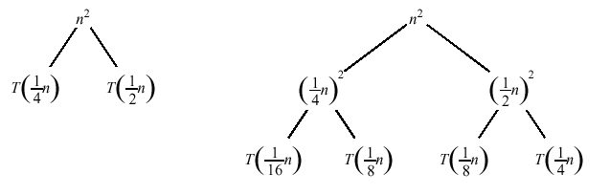
Recursion Tree
A recursion tree is a convenient way to visualize what happens when a recurrence is iterated.
Good for ”guessing” asymtotic solutions to recurrences

Slide 17
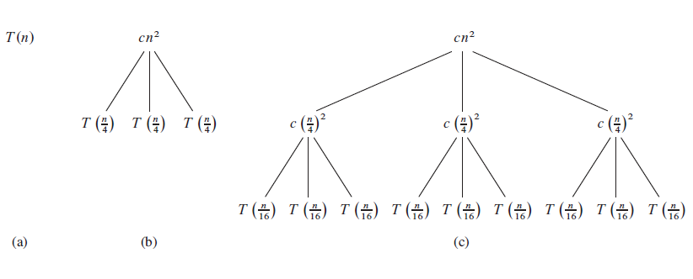

Slide 18
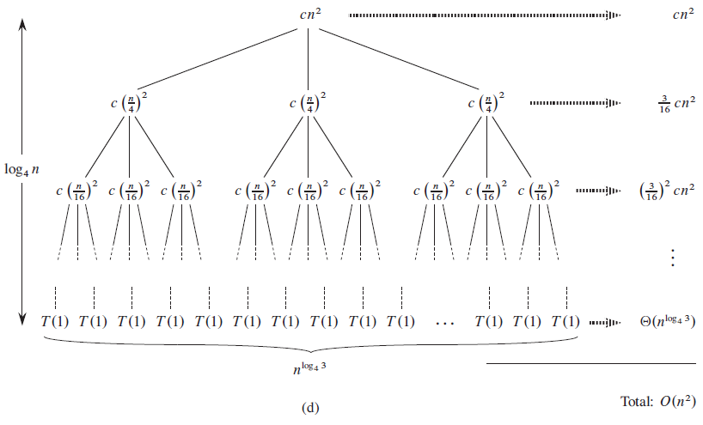

Slide 19
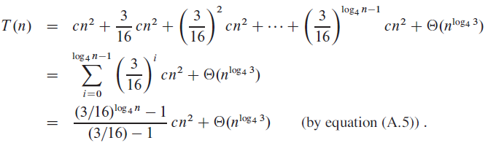
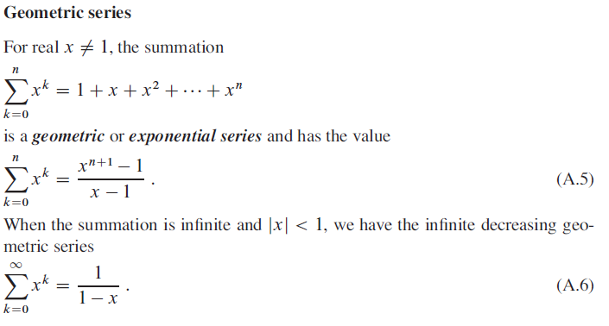

Slide 20
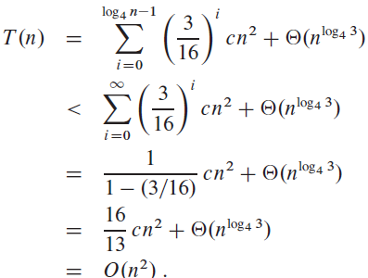

Slide 21
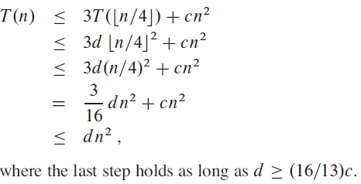
Verify our guess [substitution]

Slide 22
Master Method
The idea is to solve a class of recurrences that have the form
T(n) = aT(n/b) + f(n)
Assumptions: a ≥ 1 and b > 1, and f(n) is asymptotically positive.
Abstractly speaking, T(n) is the runtime for an algorithm and we know that
a number of subproblems of size n/b are solved recursively, each in time T(n/b).
f(n) is the cost of dividing the problem and combining the results. e.g., In merge-sort .

Slide 23
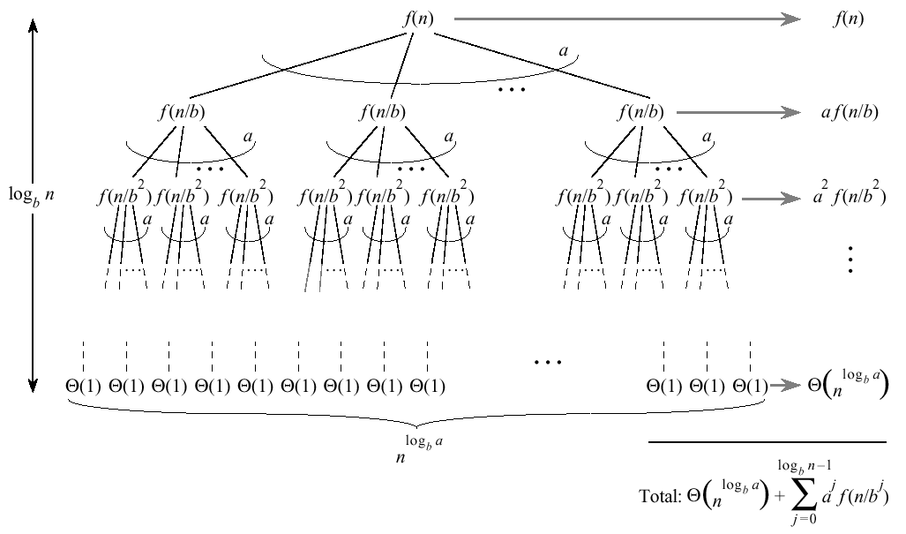
…Master Method
Split problem into a parts. There are log_{b}n levels. There are leaves.

Slide 24
…Master Method
Iterating the recurrence (expanding the tree) yields
T(n) = f(n) + aT(n/b)
= f(n) + af(n/b) + a²T(n/b²)
= f(n) + af(n/b) + a²f(n/b²) + …
a^{log}b^{n-1}f(n/b^{log}b^{n-1}) + a^{log}b^{n}T(1)
T(n) =
The first term is a division/recombination cost (totaled across all levels of the tree).
The second term is the cost of doing all subproblems of size 1 (total of all work pushed to leaves).

Slide 25
Master Method, Intuition
Three common cases:
Running time dominated by cost at leaves.
Running time evenly distributed throughout the tree.
Running time dominated by cost at the root.
To solve the recurrence, we need to identify the dominant term.
In each case compare with

Slide 26
Master Method, Case 1
If for some constant then
f(n) grows polynomially slower than (by factor ).
The work at the leaf level dominates
Cost of all the leaves

Slide 27
Master Method, Case 2
If then
and are asymptotically the same
The work is distributed equally throughout the tree
(level cost)(number of levels)

Slide 28
Master Method, Case 3
If for some constant then
Inverse of Case 1
f(n) grows polynomially faster than
Also need a “regularity” condition
The work at the root dominates
division/recombination cost

Slide 29
Master Theorem, Summarized
Given: recurrence of the form

Slide 30
Strategy
Extract a, b, and f(n) from a given recurrence
Determine n^{log}b ª
Compare f(n) and n^{log}b ª asymptotically
Determine appropriate MT case and apply it
Merge sort: T(n) = 2T(n/2) + Θ(n)
1. a=2, b=2, f(n) = Θ(n)
2. n^{log}2² = n
3. Θ(n) = Θ(n)
➔ Case 2: T(n) = Θ(n^{log}bªlog n) = Θ(n log n)

Slide 31
Examples of Master Method
BinarySearch(A, l, r, q):
m := (l+r)/2
if A[m]=q then return m
else if A[m]>q then
BinarySearch(A, l, m-1, q)
else BinarySearch(A, m+1, r, q)
T(n) = T(n/2) + 1
1. a=1, b=2, f(n) = 1
2. n^{log}2¹ = 1
3. 1 = Θ(1)
➔ Case 2: T(n) = Θ(log n)

Slide 32
...Examples of Master Method
T(n) = 9T(n/3) + n
1. a=9, b=3, f(n) = n
2. n^{log}3⁹ = n²
3. n = Θ(n^{log}3^{9 - ε}) with ε = 1
➔ Case 1: T(n) = Θ(n²)

Slide 33
...Examples of Master Method
T(n) = 3T(n/4) + n log n
1. a=3, b=4, f(n) = n log n
2. n^{log}4³ = n^{0.792}
3. n log n = Ω(n^{log}4^{3 + ε}) with ε = 0.208
➔ Case 3:
regularity condition: af(n/b) <= cf(n) af(n/b) = 3(n/4)log(n/4) <= (3/4)nlog n = cf(n) ;with c=3/4
T(n) = Θ(n log n)

Slide 34
References & Readings
CLRS
Chapter: 4 (4.1-4.3)
4.4 for bedtime reading
Exercises
4.1, 4.2, 4.3
Problems
4-1, 4-4
HSR
Chapter: 3 (3.1-3.6)
Examples: 3.1-3.5
Exercises: 3.1 (1, 2), 3.2 (1, 3-6),

