Slide 1
TYRION
SAMUEL CARNES Eric HOLGUIN

Slide 2

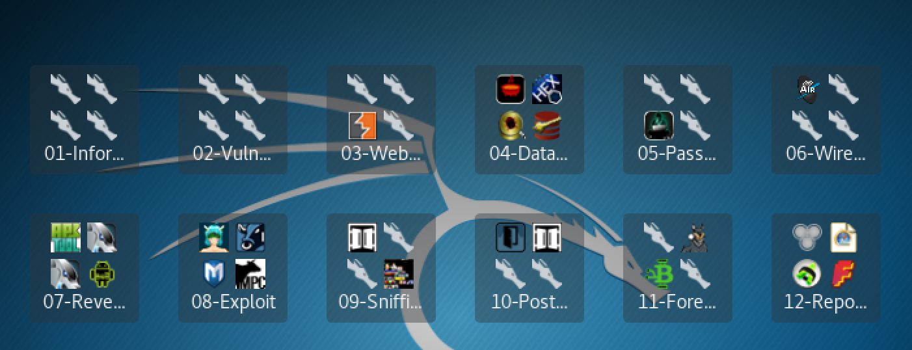



Slide 3
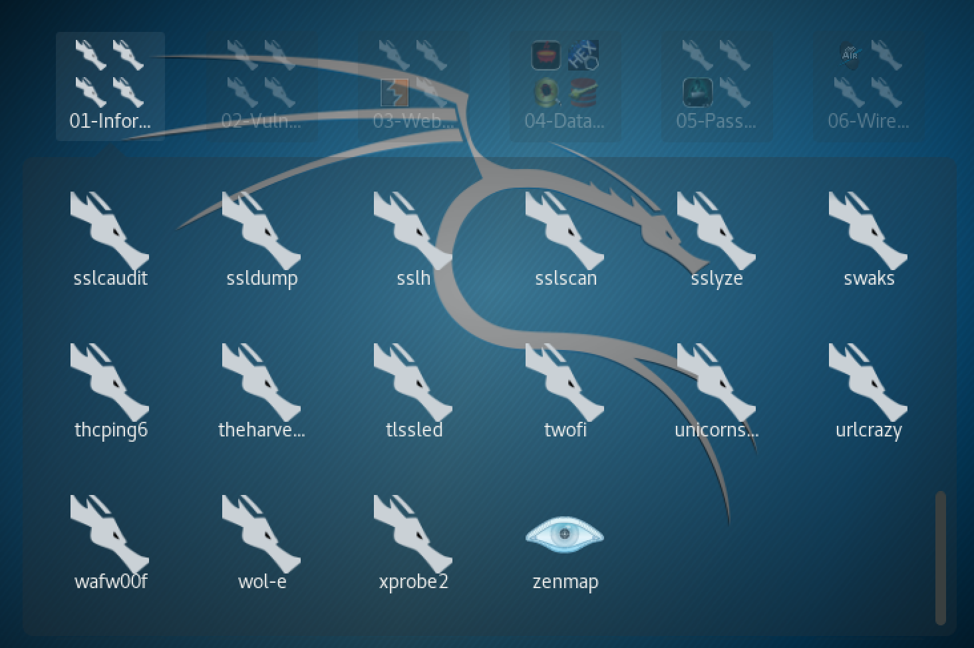


Slide 4
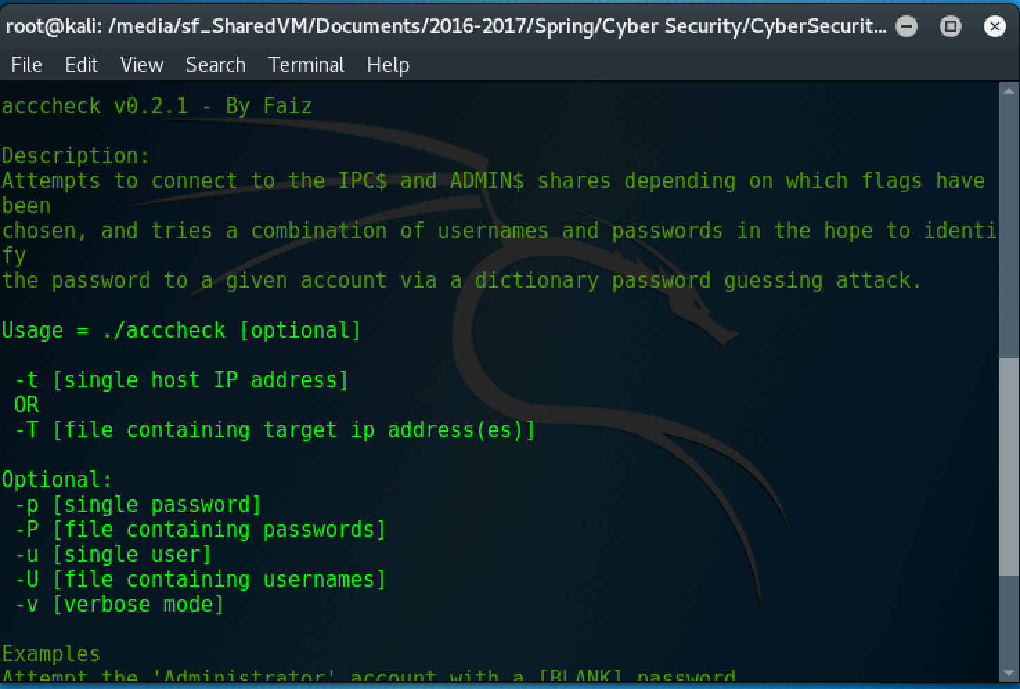
Intimidating. Bland. Hard to see.

Slide 5
THE IDEA…

Slide 6
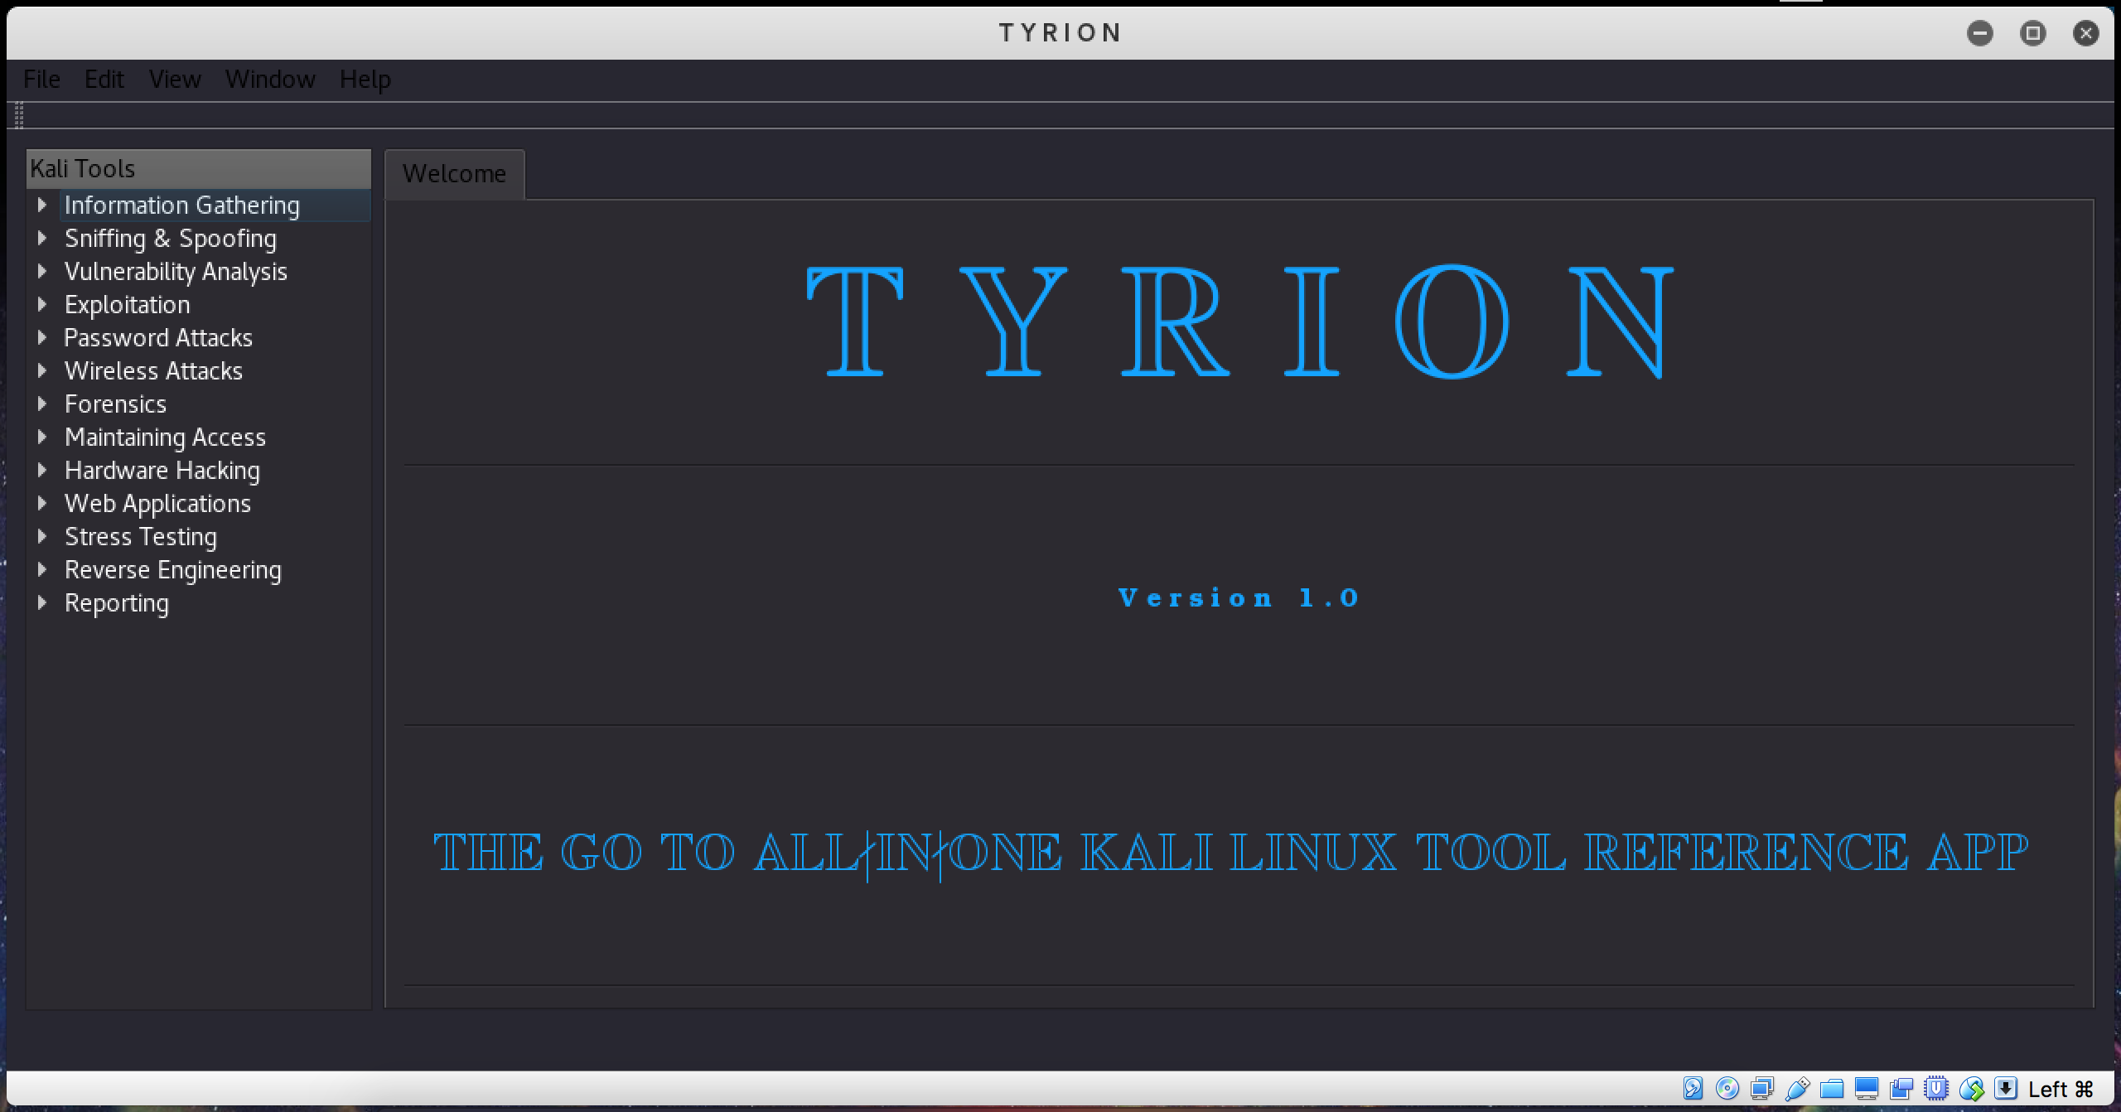

Slide 7
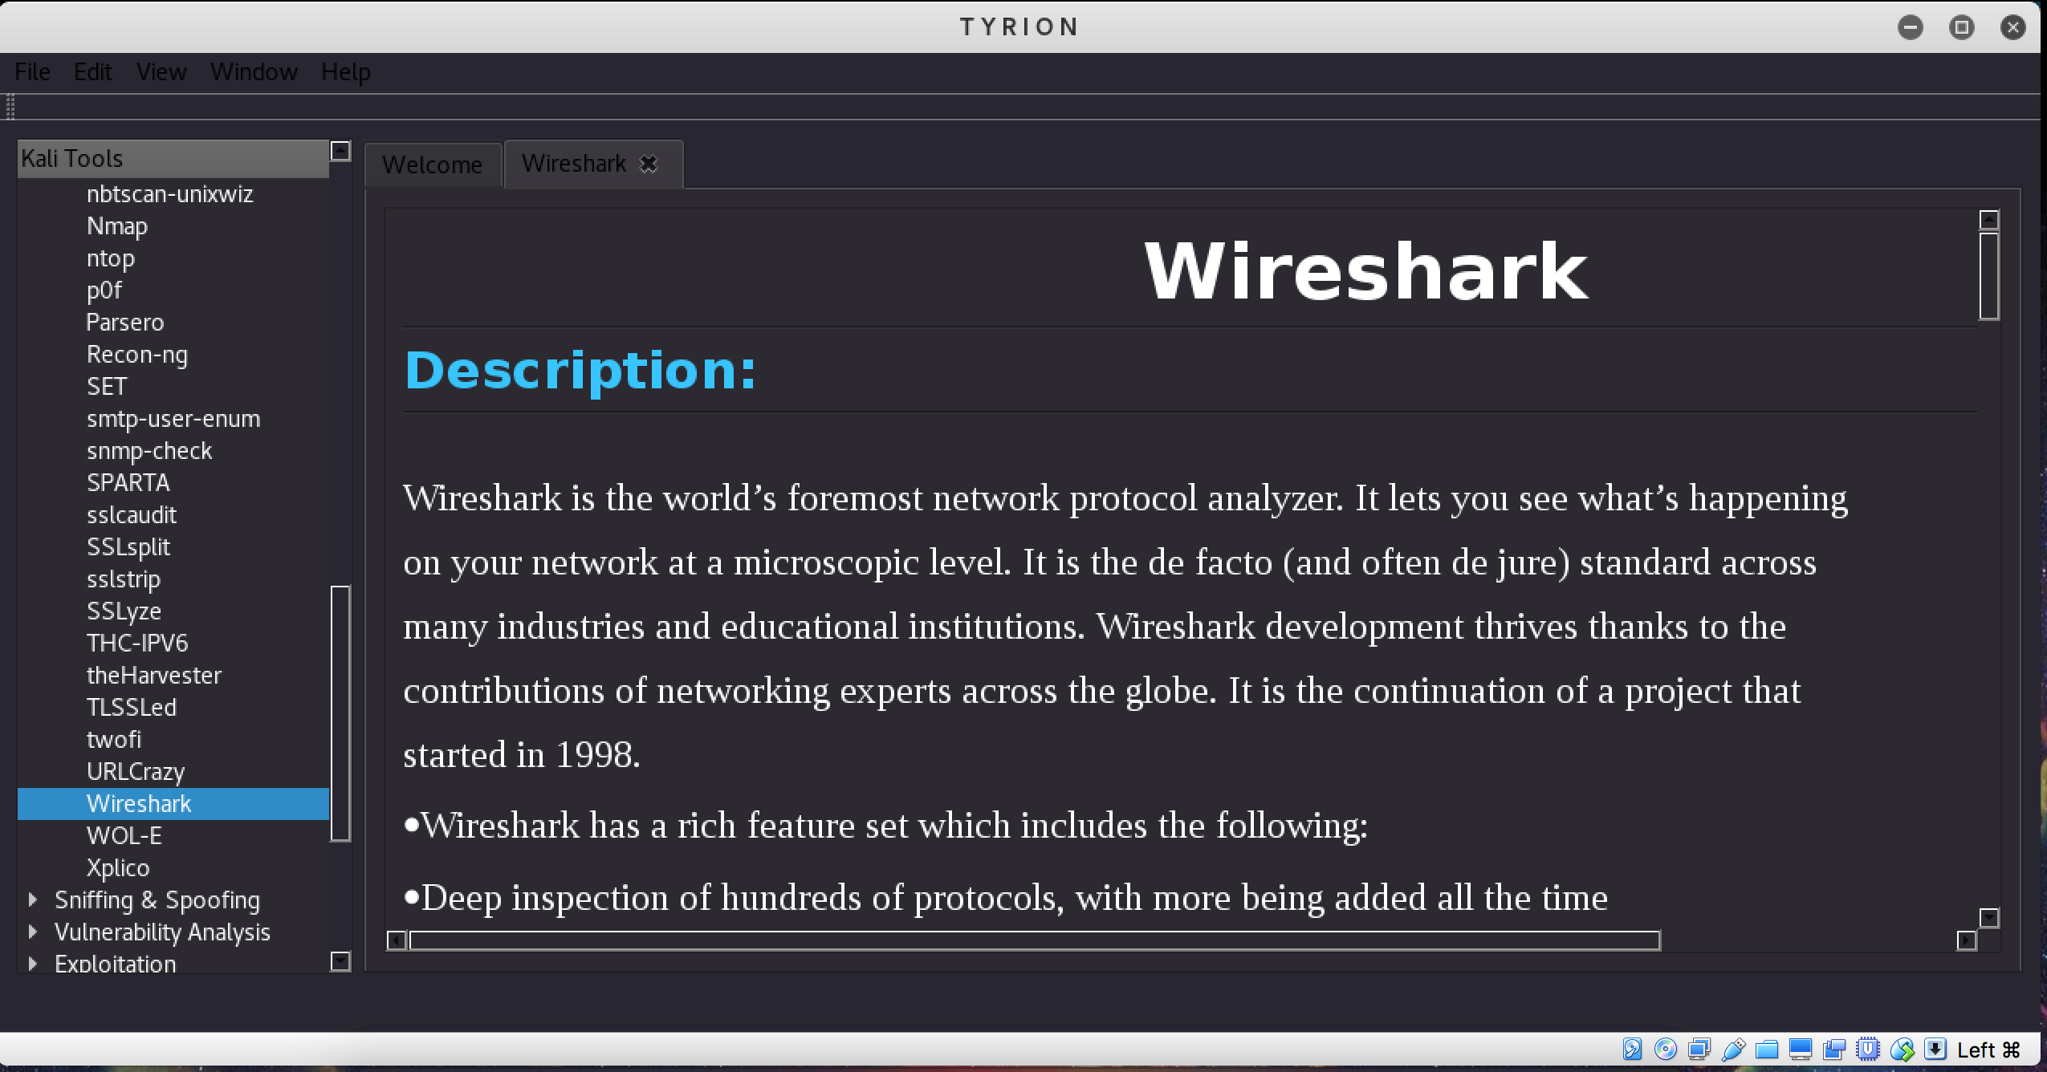

Slide 8
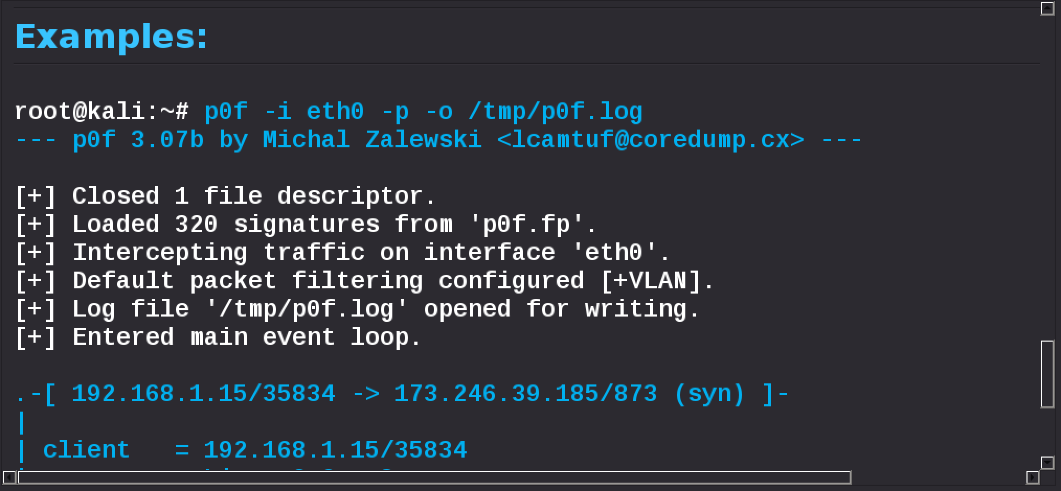

Slide 9


Slide 10
You’re welcome

