Slide 1
Livingstone (L2) in
Integrated Vehicle Health Management
Sandra Hayden, Ann Patterson-Hine and Scott Poll
NASA Ames Research Center

Slide 2
Objectives
Goals of this session are to
  Understand L2 fundamentals
  Learn to use L2
  Learn how to embed L2 in IVHM Architecture

Slide 3
Overview
L2 Fundamentals
  What does L2 do?
  How does it work?
Examples of Modeling with L2
  X-34 and X-37 Models
  How to Develop and Test a Model
  Sample Problem
IVHM System Architectures
  Generic IVHM Architecture
  X-34 and X-37 IVHM Architectures
  What are the interfaces to L2?
  What parameters can be controlled?
  Real-Time Interface Policies
  What are the limitations and challenges?

Slide 4
L2 Fundamentals

Slide 5
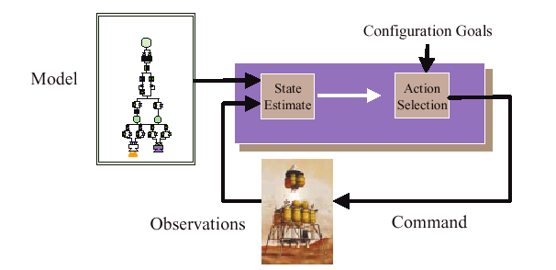
L2 Task
Given:
  A model of a physical system such as a spacecraft
  The actions taken and observations received thus far
  Determine:
    The most likely states of the system - mode identification (MI)
    The commands needed to move to a desirable state - mode recovery (MR)

Slide 6
Basic Assumptions and Ideas
Problem class: POMDP (Partially Observable Markov Decision Processes)
  Outcome of actions is non-deterministic
  The world is only partially observable
  Time is discrete
  Finite number of states and actions => finite domain
Represent problem as a transition system: consists of a set of state variables defining the system’s state space and a set of transition variables between the states in the state space
Incrementally generate an approximate belief state by tracking likely trajectories of system evolution (avoids enumerating entire belief state)
  A trajectory is a set of transition variables that represents a feasible sequence of allowable states
Search the most probable trajectories first
Focus search by using conflicts
  Don’t have to explicitly search all possible assignments to the transition variables if some are known to violate constraints

Slide 7
Diagnosis by Constraint Satisfaction
Model-based diagnosis implements diagnosis as constraint optimization
Constraint problem:
  Assumption Variables
  Assumption variables represent our assumptions about the state of the components of the device
  Observation Variables
  Observations represent the quantities that are observed from the environment (eg sensor values)
  Dependent Variables
  Dependent variables represent other quantities that allow us to conveniently model how the assumptions and observations are related
  Constraints
  Constraints model the behavior of the device’s components and determine what combinations of values of the variables are allowed
Task:
  L2 confirms that commands have the expected effect on spacecraft state, and hypothesizes a diagnosis if divergence occurs
  => Find best assumptions that are consistent with observations & constraints

Slide 8
L2 Design
+-----------------------+
| User or theory reader |
+-----------------------+
|
| Create finite domain of {value_1, value_2, ... value_n}
| Create dependent, assignable or assumption variable
| Create constraint between variables
| Assign variable=value , find_candidates
|
| Temporal: Create dependent, command or observable variable
| Create transitioned variable & corresponding assumption
| Create transition clause between time steps for transitioned variable
| progress, truncate_history
\/
+--------------------+ +--------------------------------+
| T_SYSTEM | <----Assign assumptions ------------ | |
| | <--+-Check consistency ------------| |
| clause-> value map | +- Consistency flag-------------> |conflict-based search procedure |
| | <--+-get_conflicts ----------------| |
| cmd->transition map| +---- Variable value conflicts--> | |
|--------------------| +--------------------------------+
| conflict store |
+--------------------+
| /\
| +-------------------------------------------+
| Create proposition, Create Clause |
| Add clause, Delete clause, Propagate Find conflict | Consistency flag , Conflicting clauses if any
| |
| For Progress: move_support |
| For truncate: add_summary_clause , remove_theory | Summarizing clause
| |
\/ |
+--------------------------------------------------------------------------+
| TMS: A propositional consistency checker with truth maintenance ability |
+--------------------------------------------------------------------------+

Slide 9
CBFS algorithm
function CBFS(X, C, f)
Agenda = {{best-solution(X)}}; Result = 0;
while Agenda is not empty do
Soln = pop(Agenda);
if Soln satisfies C then
Add Soln to Result;
if enough solutions have been found then
return Result;
else
Succs = immediate successors Soln;
else
Conf = a conflict that subsumes Soln;
Succs = immediate successors of Soln not subsumed by Conf;
endif
Insert each solution in Succs into Agenda in decreasing f order;
endwhile
return Result;
end CBFS

Slide 10
Examples of Modeling with L2

Slide 11
Notes on
Modeling with L2
Livingstone requires a Model expressed in the L2 Java-like Model Programming Language (JMPL).
modeling methodology is modular, reusable, compositional, and scalable
  component models may be reused
  composition of modules allows scalability
designer models nominal and failure component modes in accordance with physical behavior
  allows discrimination of multiple nominal and failure modes (open/closed, stuck open/stuck closed) rather than just good/bad
principled rather than process-oriented model
  L2 predicts behavior of components from a ‘first-principles’ generative model
  L2 synthesizes system behavior from component interactions
  as opposed to pre-defined maintenance tests or procedure-oriented rules

Slide 12
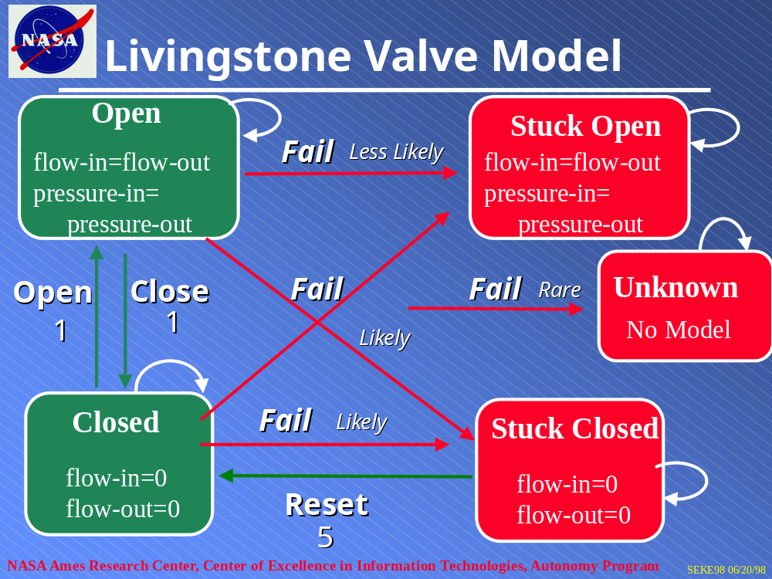

Slide 13
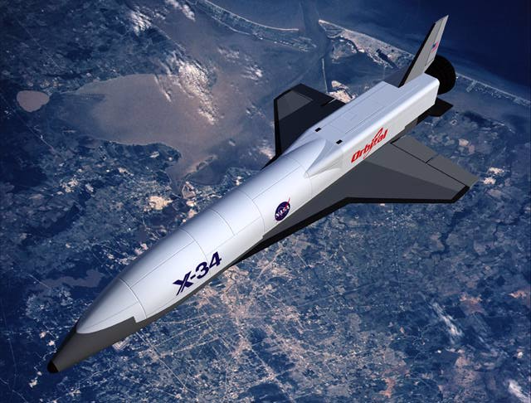
X-34 IVHM Overview
  on-board real-time monitoring and diagnosis
  monitors MPS through all mission phases.
  detailed diagnostics detect degraded performance
  system-level health monitoring integrates information to perform real-time FDIR
  standalone flight-box running VxWorks 5.4 Real-time Operating System
  ground station combines on-board IVHM with enhanced
  explanation/justification
  joint NASA GRC/KSC/ARC collaborative effort

Slide 14
X-34 MPS Model
X-34 Main Propulsion System (MPS) Model Features
  hierarchy and inheritance
  modes and transitions
  failure probabilities
  absolute versus relative values
  scalars vs derivatives
  disjunctions, chattering

Slide 15

X-37 IVHM Overview
  Key aspect: demonstrate safe, integrated operation of IVHM software and flight critical software in a single load module running on one computer
  Show benefits of in-flight IVHM on a reusable launch vehicle
  Monitor and diagnose: electro-mechanical actuators for control surfaces, associated electrical power system components

Slide 16
Problem Exercise
(one hour)

Slide 17
IVHM System Architectures

Slide 18
IVHM Experiment Objectives
Motivation: 400 $M per shuttle mission
  exhaustive preventative maintenance
  invasive maintenance procedures with risk of human error
X-34 and X-37 aim to advance TRL levels of IVHM technology within a flight environment
  goal is to transition from experiment status to RLV baseline design
  benefits sought are reduced turn-around time for RLVs through informed maintenance, on-board fault detection and isolation
  decreased cost of monitoring the health of the vehicle during vehicle check-out and in-flight
  increased reliability by detecting component degradation

Slide 19
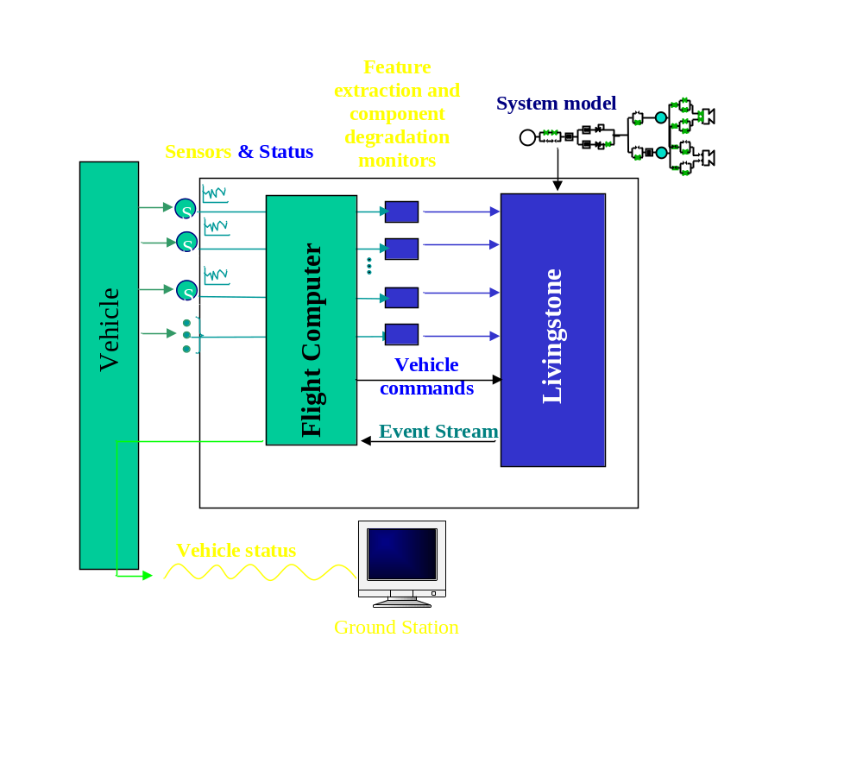
Generic IVHM Architecture

Slide 20
X-37 Experiment Scope
Scope: Models, monitors, interface software, test harness, modifications to L2 for vehicle safety, ground station software
Real-time fault detection and isolation
Diagnosis, not prognosis
Shadow mode only (no reconfiguration commands)
Generate advisory recommendations for ground ops

Slide 21
X-37 Architecture
VMS task
IVHM task
M1
M2
…
Mn
IQR
Sensor values and commands
IQW
Input Queue
Discretized sensor values and commands
VMS
Livingstone
OQR
low rate Output Queue
OQW
Diagnoses
High-rate Output Queue

Slide 22
X-37 Challenges
Limited vehicle resources available to IVHM
  CPU
  Memory
  Telemetry
Rigorous software safety standards
  No dynamic memory
  No recursion
  No anonymous unions
  …

Slide 23
X-37 Statistics-Memory
9 distinct modules, 18 distinct components, 86 component instances
Average of 3.8 modes/component
Flash RAM usage for X-37 flight code
  Livingstone core: 214,520 bytes
  Model (binary): 10519 bytes
  Monitor and Interface code: 21506 bytes
  VxWorks components: 40725 bytes
      287,270 bytes
DRAM usage (queues, search space, etc.)
  1,149,000 bytes

Slide 24
X-37 Statistics-Speed
Basis of speed results: 120 MHz PPC 603e, 66 MHz bus, 64 MB of EDO RAM
  L2SearchMethod = cbfs
  L2MaxCBFSCandidates = 5
  L2MaxCBFSSearchSpace = 1000
  L2MaxCBFSCutoffWeight = 100
  L2MaxHistorySteps = 3
  L2ProgressCmdType = min
  L2NumTrajectoriesTracked = 5
  L2FindCandidateCmdType = prune-search
assign ~ 15 ms
progress ~ 60 ms
fc (consistent) ~ < 1 ms
fc (5 candidates) ~ 1 sec
monitor processing time << L2 processing time

Slide 25
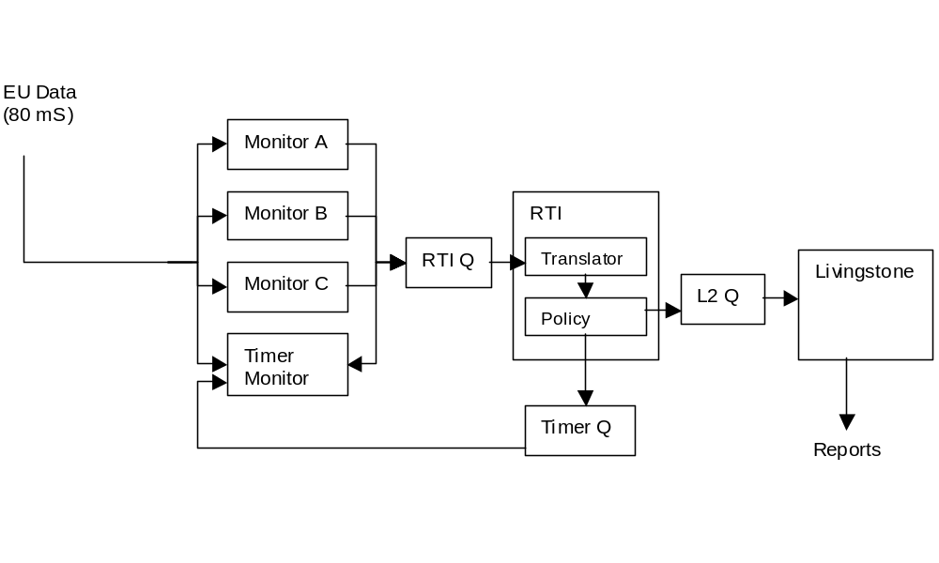
NITEX System Architecture
The NITEX integrated IVHM system architecture consists of L2, Real-Time Interface (RTI), models of the X-34 MPS, monitors and support software.
13 failure scenarios and nominal scenario successfully monitored and diagnosed by integrated system using simulated data
multi-tasking, POSIX IPC, 80ms frame rate

Slide 26
Notes on
System Architecture
partitioning of inference and domain knowledge in architecture
  i.e. diagnostic engine separate from domain-specific models
  facilitates reuse of engine
architecture supports efficient inference through data reduction
  L2 reasons with qualitative rather than quantitative model
  monitors abstract the raw telemetry data to qualitative commands and observations.
Real-Time Interface (RTI) handles timing and translation issues:
  Translator translates monitor values into model variables.
  Policy decides what information to send to L2 and when (using timer monitor and domain latencies).
L2 requires
  discrete input variables with a finite domain.
    Monitors bin data based on domain thresholds.
  commands and observations to be submitted in chronological order
    RTI Policy orders incoming events
tuning of architectural parameters
  timeout latencies and L2 params (CBFS, truncation, maxcandidates, etc.)
  may be context-sensitive based on mission phase
not a distributed architecture but multiple L2s, each modeling local subsystem, could synthesize information using complementary models and a base communication substrate
  e.g. output of propulsion L2 feeds into top-level RLV L2 monitoring and diagnosis
  in this way, some inputs to L2 are provided by monitors and some by lower-level L2 instances.

Slide 27
L2 Application Programming Interface
Setup:
  instantiate Livingstone class:
    for stripped-down flight code: Livingstone livingstone
    for human-readable interactive applications: Livingstone_debug livingstone
  set the modelFilePathname: livingstone.set_file(modelFilePathname)
  read the model file and the configuration parameters: livingstone.read_file()
  create and initialize the tracker: livingstone.create_tracker(); livingstone.initialize_tracker()
Monitor:
  observation assigns the specified value to the specified Observable Variable:
    livingstone.observe(variableIndex, valueIndex)
  command assigns the specified value to the specified Command Variable and progress to the next time step:
    livingstone.command(commandIndex, valueIndex)
  idle sets the currently-installed Candidate to NULL and progress to the next time step:
    livingstone.idle()
Diagnose:
  diagnose sets the currently-installed Candidate to NULL and finds the set of Candidate diagnoses that explain the current observations: livingstone.diagnose()
  install selects the candidate to be true: install(candidateIndex)
Report:
  various reporter methods to get mode and candidate information from L2
    ncandidates(), nfailures(), get_value(variableIndex, timeStep, ok), get_failure(unsigned failureIndex)...

Slide 28
L2 Parameters
L2 has several configuration parameters which determine how to use resources and what algorithms it uses. Specified in configuration file <model>.params
  1. Find-Candidates Style : L2FindCandidatesCmdType = prune-search
    the existing set of candidates can be cleared before searching for new ones. Either there is no clearing ("extend"), only outdated ones are cleared ("prune and search") or all candidates are cleared ("find fresh").
  2. History Length : L2MaxHistorySteps = 3
    maximum number of time steps for which complete information is kept. When this limit is reached, the transition system "truncates" the history and summarizes the truncated information in a assumption “state variable”. A zero value means that there is no truncation.
  3. Maximum Candidates : L2MaxCBFSCandidates = 5
    maximum number of candidate diagnoses returned by a "find candidates" operation for CBFS. A zero value means that there is no upper bound.
  4. Maximum Candidate Rank L2MaxCBFSCutoffWeight = 100
    maximum "rank" of candidate diagnoses returned by a "Find Candidates" tracker operation.
  5. Maximum Search Space : L2MaxCBFSSearchSpace = 1000
    maximum number of nodes searched by CBFS. A negative value means that there is no upper bound.
  6. Progress Style : L2ProgressCmdType = full|min
    select Full Progress or Minimal Progress. Minimal Progress is an optimization requiring model optimization.
  7. Search Method : L2SearchMethod = cbfs|cover
    select the Conflict-Directed Best-First Search (CBFS) or conflict coverage tracker.

Slide 29
Real-Time Interface (RTI) Policies
RTI performs four functions:
  Translator translates the monitor information format into a format that is understood by the Livingstone model.
  Policy uses the timing information associated with the events to package the data into discrete Livingstone time steps.
  Policy decides when to request diagnoses from Livingstone.
  Policy decides when to downlink Livingstone information to the ground.
Policies for Timing
  Transients:
    After an event occurs, wait for transient period to elapse before sending observations to L2.
  Out of Order Events
    a. Retain only the latest observation corresponding to a particular measurement within a Time Segment.
    b. When timer expirations arrive, debuffer all Time Segments with end times less than or equal to the timer expiration. For persistence, copy all of the observations in the time segment to the next time segment.

Slide 30
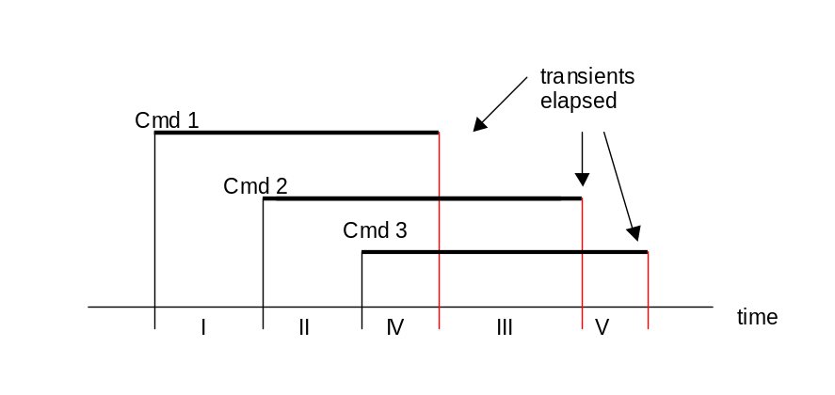
RTI Policies (cont)
  Transient Periods and Overlapping Commands
    When a command is issued that falls within the transient period of another command:
      The command introduces a new Time Segment (TS) (start and end).
      In each TS, unassign all potentially “unstable” observations (ie. Those observations that can be affected by the pending commands and whose settling times have not yet elapsed).
    If command 3 is issued within TS II, TS II must be divided into two time segments, and another time segment created at the end. In this case the observations related to command 1 should be unassigned in TS I, observations related to commands 1 and 2 should be unassigned in TS II, observations related to commands 2 and 3 should be unassigned in TS IV, and the observations related to command 3 should be unassigned in TS III. Again all observations apply in TS V.

Slide 31
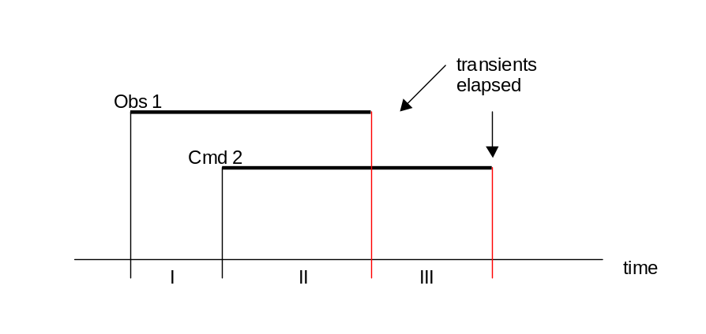
RTI Policies (cont)
  Transient Periods and Spontaneous Observations
    When the transient period of an observation is interrupted by a command, introduce time segments in the same way as overlapped transient periods for commands.
    In TS I all observations that can be related in some way to observation 1 would be set to unknown. In TS II, only the observations related to command 2 would be set to unknown. In TS III all observations apply.
  Policy for Requesting a Diagnosis
    issue a findCandidates after every time step.
  Policy for Requesting Reports
    Downlink every observation and command that is placed on the L2 queue.
    Downlink a diagnosis every time a timer expiration is received.

Slide 32
L2 IVHM Challenges
modeling domains
  knowledge acquisition
  some physical domains are harder to discretize than others
  systems with storage capacity
  systems that degrade with time
transition limitations
  commanded only, can’t transition on an observation
  failure transition probabilities are all equal
transient latencies
  rti contains domain-specific timing information, separate from the model
  => timed model transitions?
  suboptimal to wait for transitions to pass
    could monitor their progress?
    could do some work in the mean time
polymorphism
  currently define pressureLineSensor, ventLineSensor etc
  function-in-structure
restart requires initial state specification
  multiple possible initial states
  checkpointing

Slide 33
Backup slides

Slide 34
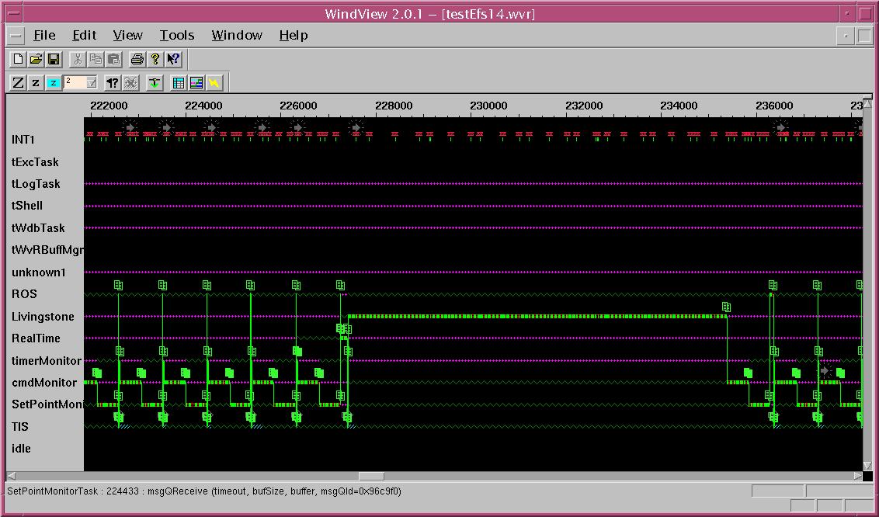
RxU Task Behavior

Slide 35
Monitors
Monitor Types:
  command monitor notifies L2 of command received
  setpoint monitor notifies L2 of observations received
    for sensor observations
    for pressure differentials deduced from observations (rate monitors)
  timer monitor notifies L2 of elapsed time (for RTI policy)
  valvetimer detects performance degradation such as slow valve response. Not in R1.
Monitors bin (classify) sensor data into categories used by the L2 model
  nominal or anomalous e.g. low, nominal, high or aboveThreshold, belowThreshold
  sensor status array is updated if persistence criteria is satisfied
    each sensor has its own confidence and persistence thresholds and each bin has a counter
    persistence (required to enter a bin)
    confidence + 1 (minimum required to stay in a bin)
  data smoothing and line-fitting for noise resilience
  some sensor failures detected
    upper and lower reasonableness limits and rate of change check
    failure of either check results in increment in persistence of data loss bin
    if data loss is established, the previous bin is retracted and unknown reported.

