Slide 1
Final Project
CS521 SiCheng Yi

Slide 2

Project Target
Create a program to provide users with the calorie increase and decrease of diet and exercise. The program is divided into four parts:
1. Add calories by the user's input.
2. Display the current calorie situation and exercise time.
3. Choose a sport, count the time and motion of the sport.
4. Print a report to a file.

Slide 3
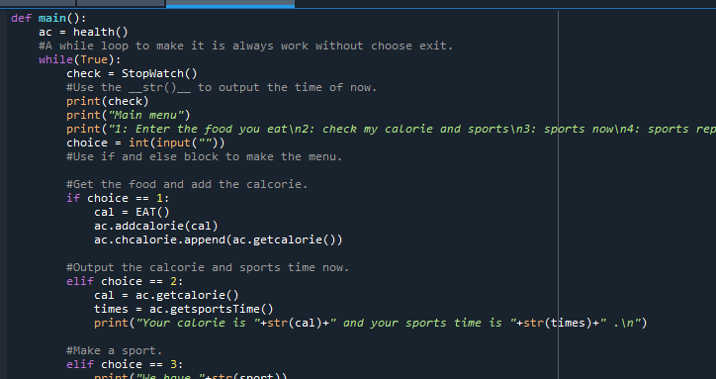
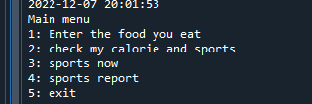
Make The Menu
Use the ‘while’ to make a loop just stop when choose exit.
Use if else to make the option

Slide 4
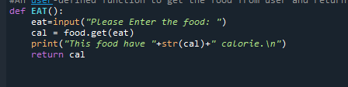

Add food and calorie
Use the food as a key and it’s calorie is the value.
Def a function “EAT()” to return the calorie.
Here is the output.

Slide 5


Check my calorie and sports.
Just output the until now final calorie and sports time.
Here is the output:

Slide 6
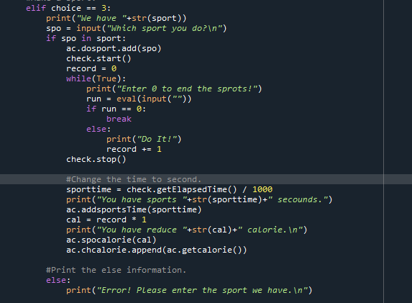


Sports Now
Choose a sport from tuple and start the sport.
This function should use Motion sensing device， I just use enter a number without 0 to representative do one time.

Slide 7
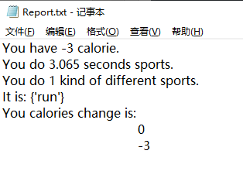
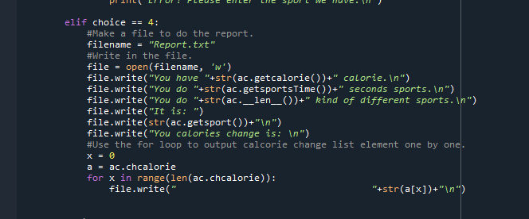
Make the report
Make a file and open then write the report in it.

Slide 8
Thank You!

