Slide 1
Lab 1 Walkthrough

Slide 2
Relational Database Introduction
In the early 70s E.F. Codd introduced a model he termed the relational model.
That model was deemed useful, but the current hardware could not support a database that uses the relational model.
Today, however, relational databases are in widespread use.
Knowledge of relational databases is generally considered foundational to the myriad of database-centric technologies.

Slide 3
Introduction to SQL
The Structured Query Language (SQL) is the de-facto query language for modern relational database management systems (RDBMS).
All major, modern RDBMS support SQL. Database developers, administrators, and even software applications access RDBMS through the use of SQL.
Familiarity with SQL is essential for working with and understanding modern RDBMS.

Slide 4
Nature of SQL
SQL is a declarative language, where the developer specifies what he/she wants without specifying the details of how to perform the logic.
Example:
SELECT first_name FROM person
WHERE last_name = ‘Smith’

Slide 5
Contrast to SQL
This is in contrast to an imperative language where the developer specifies how to perform the logic with a sequence of commands.
Modern imperative languages support control flow constructs, if conditionals, loops, variables, and functions/procedures.

Slide 6
Contrast of SQL to Java
Set<Person> personSet = getPersonSet();
List<String> firstNames =
new ArrayList<String>();
for (Person person : personSet)
{
if (person.getLastName().equals(“Smith”))
{
firstNames.add(person.getFirstName());
}
}

Slide 7
Another Key Differentiator
SQL is designed to work primarily, and naturally, with sets of data, more specifically, tables (two-dimensional structures) of data.
Modern imperative languages such as C#, Java, Visual Basic, and C are designed to work with many different forms of data, and are not especially designed to work with data sets naturally.

Slide 8
Origins of SQL
Modern SQL Originated in the late 70s from both IBM and Oracle corporation.
There are now several standards developed by the ANSI and ISO organizations for SQL, usually specified as SQL/year, with SQL/92 perhaps the most prominent.

Slide 9
SQL References
Oracle
https://docs.oracle.com/database/121/SQLRF/toc.htm
SQL Server
https://docs.microsoft.com/en-us/sql/t-sql/language-reference?view=sql-server-2017
Postgres
https://www.postgresql.org/docs/10/static/index.html
Others
https://www.w3schools.com/sql/default.asp
https://www.techonthenet.com/sql/index.php

Slide 10
Preparing for Lab 1
Download and install Oracle, SQL Server, or Postgres by following one of the installation guides available in Syllabus -> Materials and Resources.
Read the textbook and lecture SQL Readings.
Follow along with the Lab 1 explanations document.
Insert screenshots and explanations into your lab submission.

Slide 11
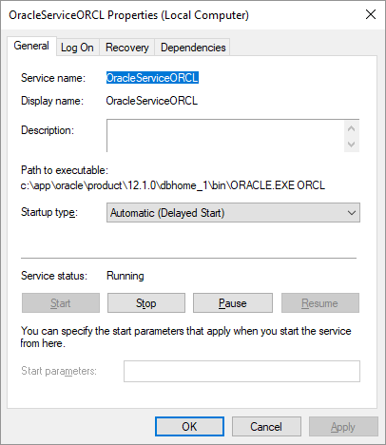
Oracle Service Control
Windows 7/8:
Control Panel => Administrative Tools => Services
Windows 10:
Windows Key, R
Type in “services.msc”
The following services matter:
OracleServiceORCL or OracleServiceXE
OracleOraDB12Home1TNSListener

Slide 12
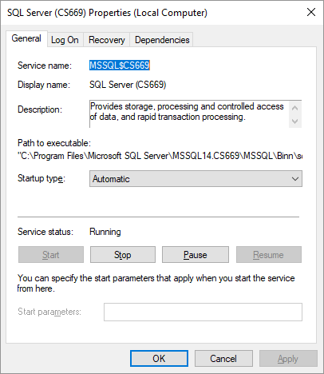
SQL Server Service Control
Windows 7/8:
Control Panel => Administrative Tools => Services
Windows 10:
Windows Key, R
Type in “services.msc”
The following services matter:
SQLEXPRESS

Slide 13
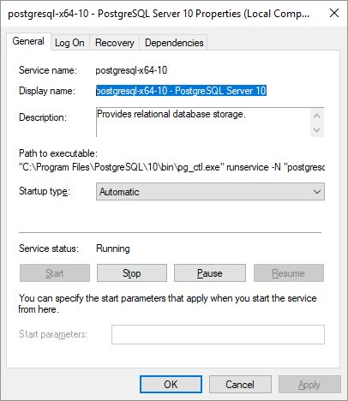
Postgres Service Control
Windows 7/8:
Control Panel => Administrative Tools => Services
Windows 10:
Windows Key, R
Type in “services.msc”
The following services matter:
postgresql-x64-10

Slide 14
Managing Your Database
Oracle
https://localhost:5500/em
SQL Server
SQL Server Management Studio
Postgres
http://127.0.0.1:64737/browser

Slide 15
Taking Screenshots
Windows
Built-In Snipping Tool
MWSnap ➔ http://www.mirekw.com/winfreeware/mwsnap.html
PicPick Free ➔ https://picpick.app/en/download/
Mac
Use built-in command. See http://support.apple.com/en-us/HT201361
Make sure to capture only the relevant portion of the screen.

Slide 16
Lab Structure
Lab 1 is structured with two sections – absolute fundamentals and more precise data handling.
Before completing each step, read through its explanation in the explanation document.

Slide 17
Tables
Tables are data containers
Tables enforce a structure
Tables have columns

Slide 18
Create a Table
CREATE TABLE TableName(
Column1 Datatype1,
Column2 Datatype 2…);
Example:
CREATE TABLE Person
(person_id DECIMAL(12),
first_name VARCHAR(256),
last_name VARCHAR(256));

Slide 19
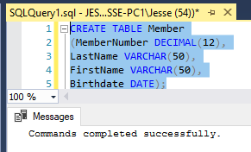
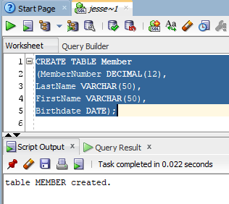
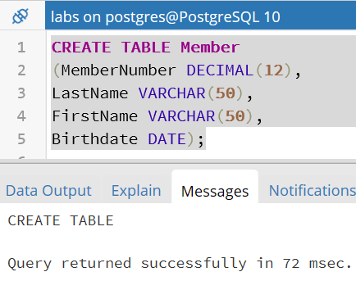
Create Table DB Execution
Oracle
SQL Server
Postgres

Slide 20
Add Data to a Table
INSERT INTO TableName (column1, column2…)
VALUES (Value1, Value2, …);
Example:
INSERT INTO Person (person_id, first_name, last_name)
VALUES (1, 'John', 'Smith');

Slide 21
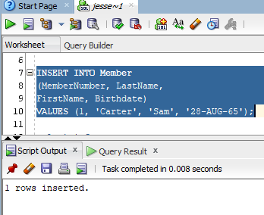
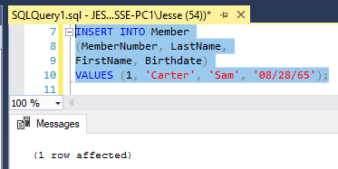
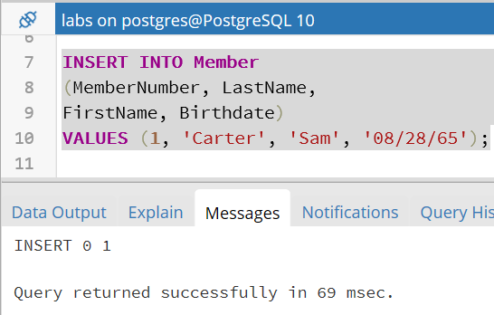
Add Data DB Execution
Oracle
Postgres
SQL Server

Slide 22
Retrieve All Data From a Table
SELECT *
FROM TableName;
Example:
SELECT *
FROM Person;

Slide 23
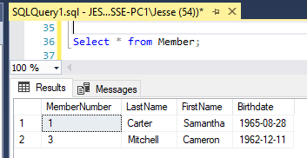
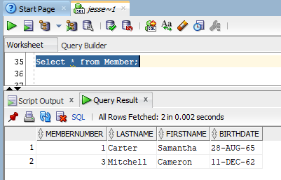
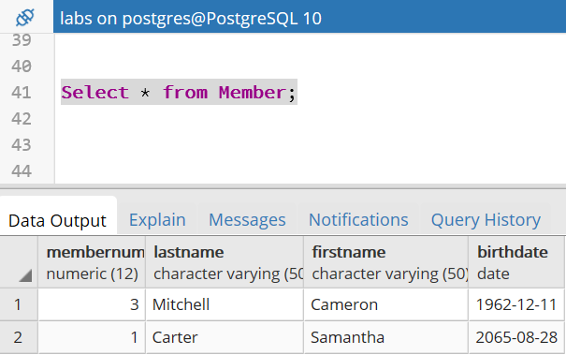
Retrieve Data DB Execution
Oracle
SQL
Server
Postgres

Slide 24
Retrieve Some Data From a Table
SELECT columnX, columnY
FROM TableName
WHERE columnZ = Value;
Example:
SELECT first_name, last_name
FROM Person
WHERE person_id = 3;

Slide 25
Modify Data in a Table
UPDATE TableName
SET columnX = Value
WHERE columnY = AnotherValue;
Example:
UPDATE Person
SET last_name = 'Glass’
WHERE person_id = 1;

Slide 26
Remove Data from a Table
DELETE FROM TableName
WHERE column = Value;
Example:
DELETE FROM Person
WHERE person_id = 2;

Slide 27
Drop a Table
DROP TABLE TableName;
Example:
DROP TABLE Person;

Slide 28
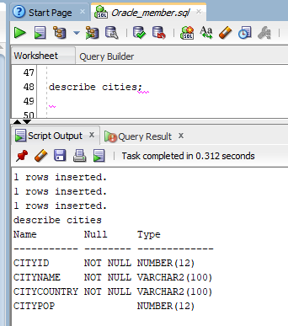
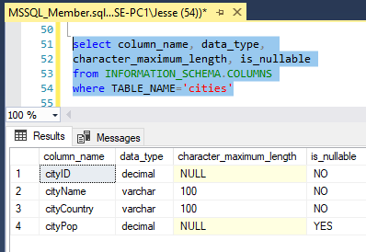
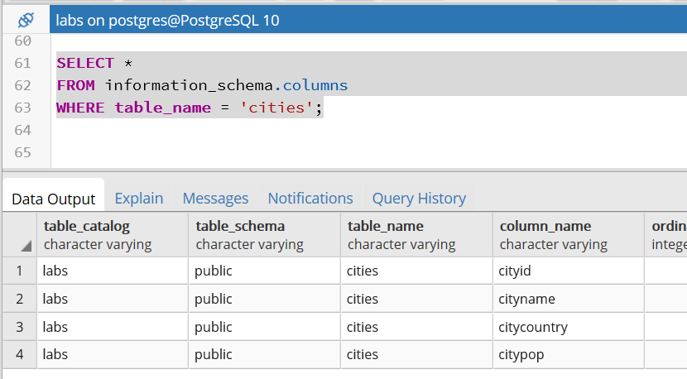
Describe Table DB Execution
Oracle
SQL Server
PostGresQL

Slide 29
Summary
Relational databases are the most popular kind of database today.
All modern relational databases support the Structured Query Language (SQL) for database and data administration.
SQL is a declarative language, where the developer specifies what he/she wants without specifying the details of how to perform the logic.
SQL is designed to work naturally with tables (two-dimensional structures) of data.

Slide 30
Summary
Download and install Oracle, SQL Server, or Postgres by following one of the installation guides available in Syllabus -> Materials and Resources.
Insert your screenshots and explanations into the submission template for submission.
Make sure to capture only the relevant portion of the screen when taking screenshots.

Slide 31
Summary
You learn the following SQL constructs in lab 1:
Creating a table
Inserting some data
Updating some data
Deleting some data
Dropping a table

Slide 32

End

