Slide 1
Predicting Bullying Victims in Schools
Leveraging the 2013 National Crime Victimization Survey
SiCheng Yi, Amina Bauyrzhan
Notes:
‹#›

Slide 2
Outline
Objective: Utilizing the 2013 school crime supplement of the National Crime Victimization Survey dataset to predict bullying victims.
Approach: Structured methodology involving data preprocessing, feature selection, and model evaluation.
Tool of Choice: R, packages: ROSE, caret, e1071, randomForest, class, knitr, ggplot2, rpart, pROC.
Key Focus: Exploring multiple classification algorithms, emphasizing accuracy as the primary evaluation metric

Slide 3
About Dataset
Source: 2013 School Crime Supplement of the National Crime Victimization Survey (NCVS)
Derived from a comprehensive set of questions on students' experiences with and perceptions of crime and safety within school environments.
Explores various aspects such as preventive measures, after-school activities, school rules enforcement, presence of weapons, drugs, alcohol, gang-related activities, bullying, hate-related incidents, and fear of victimization.
Dataset Name: project_dataset.csv
Further processed from the original dataset (4947 tuples, 204 attributes) to focus on the dependent variable "o_bullied" indicating instances of reported bullying.

Slide 4
Data Preprocessing and Feature Selection
Cleaning: Addressing missing values and outliers.
Normalization: Scaling features for uniformity.
Encoding: Converting categorical data into numerical format.
Feature Selection: Identifying Key Predictors
Method: Utilized Random Forest for feature importance analysis.
Outcome: Identified top 20 features impacting bullying prediction.
Significance: Streamlined model by focusing on most influential variables.

Slide 5
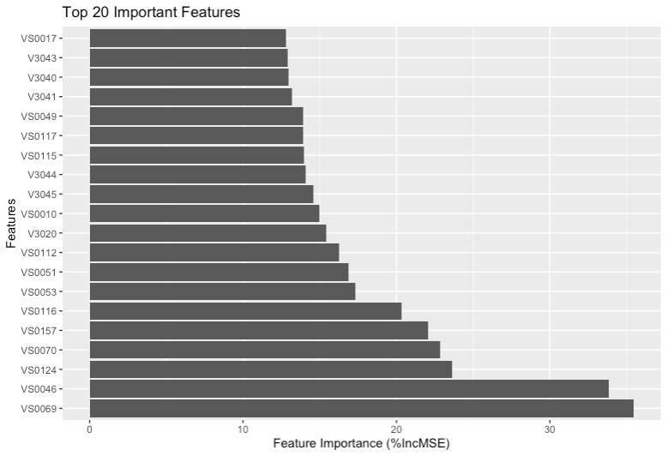
Feature Selection with Random Forest
Importance of Feature Selection: Crucial role in enhancing analysis quality and efficiency.
Methodology: Utilizing Random Forest algorithm for its robustness and ability to handle high-dimensional datasets.
Metrics: %IncMSE and IncNodePurity to quantify feature importance.
Figure 1. Feature Importance of top 20 variables

Slide 6
Classification Models
Logistic Regression
Type: Linear model for binary classification.
Characteristics: Predicts the probability of occurrence of an event by fitting data to a logistic curve.
Suitability: Good for understanding the influence of several independent variables.
Decision Tree
Type: Tree-like model of decisions.
Characteristics: Uses a tree-like graph to model decisions and their possible consequences.
Suitability: Easy to interpret and can handle both numerical and categorical data.
Random Forest
Type: Ensemble of Decision Trees.
Characteristics: Operates by constructing multiple decision trees during training and outputting the class that is the mode of the classes of individual trees.
Suitability: Reduces overfitting in decision trees and improves accuracy.

Slide 7
Classification Models
Support Vector Machine (SVM)
Type: Supervised learning model.
Characteristics: Identifies a hyperplane in an N-dimensional space that distinctly classifies the data points.
Suitability: Effective in high dimensional spaces and in cases where the number of dimensions is greater than the number of samples.
k-Nearest Neighbors (k-NN)
Type: Non-parametric method.
Characteristics: Classifies data points based on how their neighbors are classified.
Suitability: Simple and effective, good for data with little or no information about distribution.
Naive Bayes
Type: Probabilistic classifier.
Characteristics: Applies Bayes' theorem with the assumption of independence between every pair of features.
Suitability: Performs well in multi-class prediction and when the assumption of independence holds.

Slide 8
Model Evaluation Metrics
True Positive Rate (TPR): Also known as Sensitivity or Recall, this metric assesses the proportion of actual bullying cases correctly identified by the model.
False Positive Rate (FPR): It measures the rate at which non-bullying cases are incorrectly classified as bullying.
Precision: Precision quantifies the accuracy of the model's positive predictions and is especially important when minimizing false positives is crucial.
F-measure: The F-measure combines precision and recall, offering a balanced assessment of a model's performance.
Receiver Operating Characteristic (ROC) Area: This metric reflects the ability of the model to distinguish between classes across different thresholds.
Matthews Correlation Coefficient (MCC): MCC provides a balanced measure of classification performance, taking into account both true and false positives and negatives.
Kappa statistic: Kappa measures the agreement between the model's predictions and the actual outcomes, correcting for chance agreement

Slide 9
Model Evaluation: Logistic Regression
 | TPR | FPR | Precision | Recall | F_measure | ROC_Area | MCC | Kappa
Class 0 | 0.7504078 | 0.4140579 | 0.5859421 | 0.1336245 | 0.518602 | NA | 0.297188 | 0.2617226
Class 1 | 0.8663755 | 0.6037898 | 0.3962102 | 0.7504078 | 0.518602 | 0.6312929 | 0.297188 | 0.2617226
Wt. Average | 0.8087940 | 0.5095821 | 0.4904179 | 0.4441559 | 0.518602 | NA | 0.297188 | 0.2617226

Slide 10
Model Evaluation: Decision Tree
 | TPR | FPR | Precision | Recall | F_measure | ROC_Area | MCC | Kappa
Class 0 | 0.6580087 | 0.2706522 | 0.7293478 | 0.4139738 | 0.7161366 | NA | 0.3793739 | 0.3720597
Class 1 | 0.5860262 | 0.2144703 | 0.7855297 | 0.6580087 | 0.7161366 | 0.685778 | 0.3793739 | 0.3720597
Wt. Average | 0.6217677 | 0.2423663 | 0.7576337 | 0.5368378 | 0.7161366 | NA | 0.3793739 | 0.3720597

Slide 11
Model Evaluation: Random Forest
 | TPR | FPR | Precision | Recall | F_measure | ROC_Area | MCC | Kappa
Class 0 | 0.8054577 | 0.2102564 | 0.7897436 | 0.1930131 | 0.7966913 | NA | 0.595151 | 0.5950111
Class 1 | 0.8069869 | 0.2118863 | 0.7881137 | 0.8054577 | 0.7966913 | 0.7975503 | 0.595151 | 0.5950111
Wt. Average | 0.8062276 | 0.2110770 | 0.7889230 | 0.5013601 | 0.7966913 | NA | 0.595151 | 0.5950111

Slide 12
Model Evaluation: Support Vector Machine
 | TPR | FPR | Precision | Recall | F_measure | ROC_Area | MCC | Kappa
Class 0 | 0.7489583 | 0.3283804 | 0.6716196 | 0.2104803 | 0.6779821 | NA | 0.4146539 | 0.4083195
Class 1 | 0.7895197 | 0.3807063 | 0.6192937 | 0.7489583 | 0.6779821 | 0.7044067 | 0.4146539 | 0.4083195
Wt. Average | 0.7693797 | 0.3547249 | 0.6452751 | 0.4815874 | 0.6779821 | NA | 0.4146539 | 0.4083195

Slide 13
Model Evaluation: k-Nearest Neighbors
 | TPR | FPR | Precision | Recall | F_measure | ROC_Area | MCC | Kappa
Class 0 | 0.7062058 | 0.2536302 | 0.7463698 | 0.3266376 | 0.7387017 | NA | 0.4501286 | 0.4479969
Class 1 | 0.6733624 | 0.2256675 | 0.7743325 | 0.7062058 | 0.7387017 | 0.7238475 | 0.4501286 | 0.4479969
Wt. Average | 0.6896702 | 0.2395519 | 0.7604481 | 0.5177385 | 0.7387017 | NA | 0.4501286 | 0.4479969

Slide 14
Model Evaluation: Naive Bayes
 | TPR | FPR | Precision | Recall | F_measure | ROC_Area | MCC | Kappa
Class 0 | 0.48428291 | 0.6481481 | 0.3518519 | 0.9170306 | 0.6168283 | NA | -0.1053753 | -0.06812141
Class 1 | 0.08296943 | 0.1507321 | 0.8492679 | 0.4842829 | 0.6168283 | 0.4661187 | -0.1053753 | -0.06812141
Wt. Average | 0.28223393 | 0.3977145 | 0.6022855 | 0.6991554 | 0.6168283 | NA | -0.1053753 | -0.06812141

Slide 15
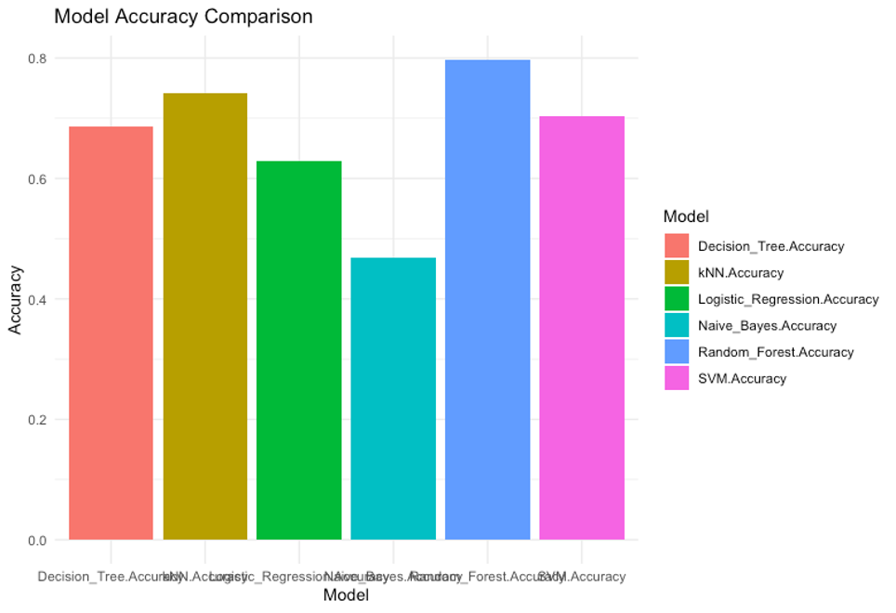
Best Model Determination
Table 1. Model Accuracy Comparison
Model | Accuracy
Logistic_Regression | 0.6296618
Decision_Tree | 0.6864701
Random_Forest | 0.7974848
SVM | 0.7038161
kNN | 0.7241977
Naive_Bayes | 0.4687771
The model with the highest accuracy was selected as the best model for predicting bullying victims.
After evaluating the performance of all models, we found that the Random Forest model achieved the highest accuracy among the candidates.

Slide 16
Conclusion
Key Findings: Random Forest emerges as the best-performing model with 79.75% accuracy.
Real-world Impact: Applicability in improving school safety and addressing bullying-related concerns.
Structured Approach: Demonstrating the effectiveness of a systematic data science methodology.

Slide 17
Any Questions?

Slide 18
Thank You!

