Slide 1
Group Members
Names: SID:
Yifan Zhang 704946973
Hui Wang 205036597

Slide 2
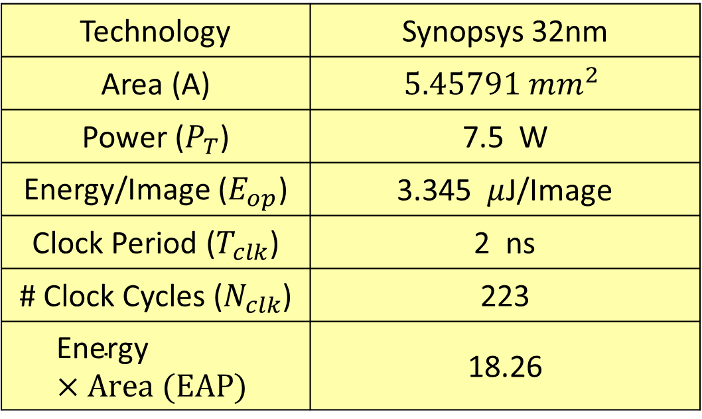
Technology | Synopsys 32nm
Area (A) | $$5.45791 {mm}^{2}$$
Power ($P_{T}$) | 7.5 W
Energy/Image ($E_{op}$) | 3.345 $μ$J/Image
Clock Period ($T_{clk}$) | 2 ns
# Clock Cycles ($N_{clk}$) | 223
$$\text{Energy}×Area (EAP)$$ | 18.26
Successfully synthesized our design (see Image_Classifier.vg file and Image_Classifier.sdf file)
Successfully verified post synthesis (sdf annotate) with 100% accuracy

Slide 3
Architecture Optimizations
Algorithm: The algorithm was built on SumofProduct block consist of 4 multiplier and 3 adders. Then when the input is ready, the neuron block takes in all the inputs to the internal register array. Every clock cycle, the register array shifted, and only first 4 sets of data will be fed into the SOP block. After 210 cycles, the result will be stabilized and fed into Image_Classifier top block.
Multiplier Numbers: Tried 320, 160, 80, 40-multipliers versions of Image Classifiers. Only 40-Multiplier version passed the synthesis. Others failed due to memory out problem.
EAP Reduction: EAP largely depends on how many multipliers we used. More multipliers used, larger area and power. While using too few multiplier will largely increase the processing time which largely increase the total power. So we choose a number of multiplier not too small and not too large to pass the synthesis.

