Slide 1
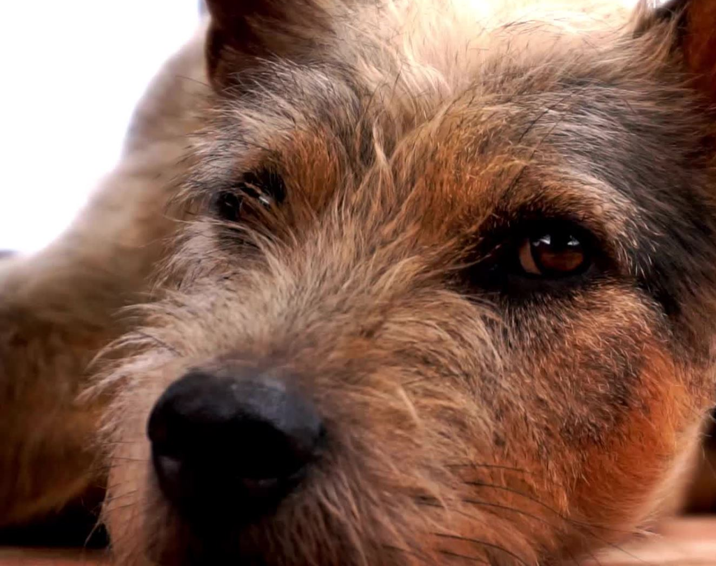
Dog Behavior Classification with Time Series Movement Dataset
Final Project of CIS 5450
Yufa, Yixiao, Dominik

Slide 2
Introduction

Slide 3
Background
Dog Behavior Analysis Dataset from Kaggle competition:
https://www.kaggle.com/datasets/arashnic/animal-behavior-analysis/data
How the dataset was obtained:
https://www.sciencedirect.com/science/article/pii/S0168159121001805
Original dataset contains 2 files:
DogMoveData.csv
DogInfo.xlsx

Slide 4
Background
Authors of the dataset collected a series of dog movement data to predict the behaviors of dogs.
Time series multi-features classification problem.
Possible applications:
Using model as an index of wellbeing and health status of the animal, for example, by detecting stress and pain-related behaviors.
Analysis would improve dog owners’ understanding of dog behaviors and reactions, such as suffering from separation anxiety while alone at home.

Slide 5
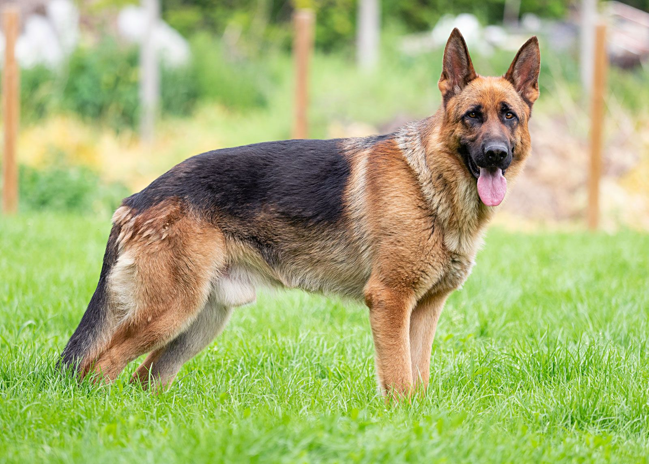



Movement dataset collection and setting
2 types of sensor on x, y, z axes: Accelerator and Gyroscope
2 sensor position: back and neck
Total 12 types of movement data:
ABack x, y, z
ANeck x, y, z
GBack x, y, z
GNeck x, y, z
Time difference: 0.01 sec

Slide 6
Other data settings
DogID: numerical identifier of the dog
Behavior labels: Dogs are instructed to do several static and dynamic tasks sequentially, alternating between them. Then the actual behavior of the dogs during the assigned tasks were annotated using video recordings. Only segments longer than one second and unambiguous were included in the annotation.
Static behaviors: Lying on chest, Sitting, Standing
Dynamic behaviors: Walking, Trotting, Galloping, Sniffing
Dog info: biological info of dogs, such as Breed, Weight, Age months, Gender, NeuteringStatus

Slide 7
Final schema
'DogID', 'TestNum', 't_sec',
'ABack_x', 'ABack_y', 'ABack_z', 'ANeck_x', 'ANeck_y', 'ANeck_z',
'GBack_x', 'GBack_y', 'GBack_z', 'GNeck_x', 'GNeck_y', 'GNeck_z',
'Task', 'Behavior_1', 'Behavior_2', 'Behavior_3', 'PointEvent',
'Breed', 'Weight', 'Age months', 'Gender','NeuteringStatus'

Slide 8
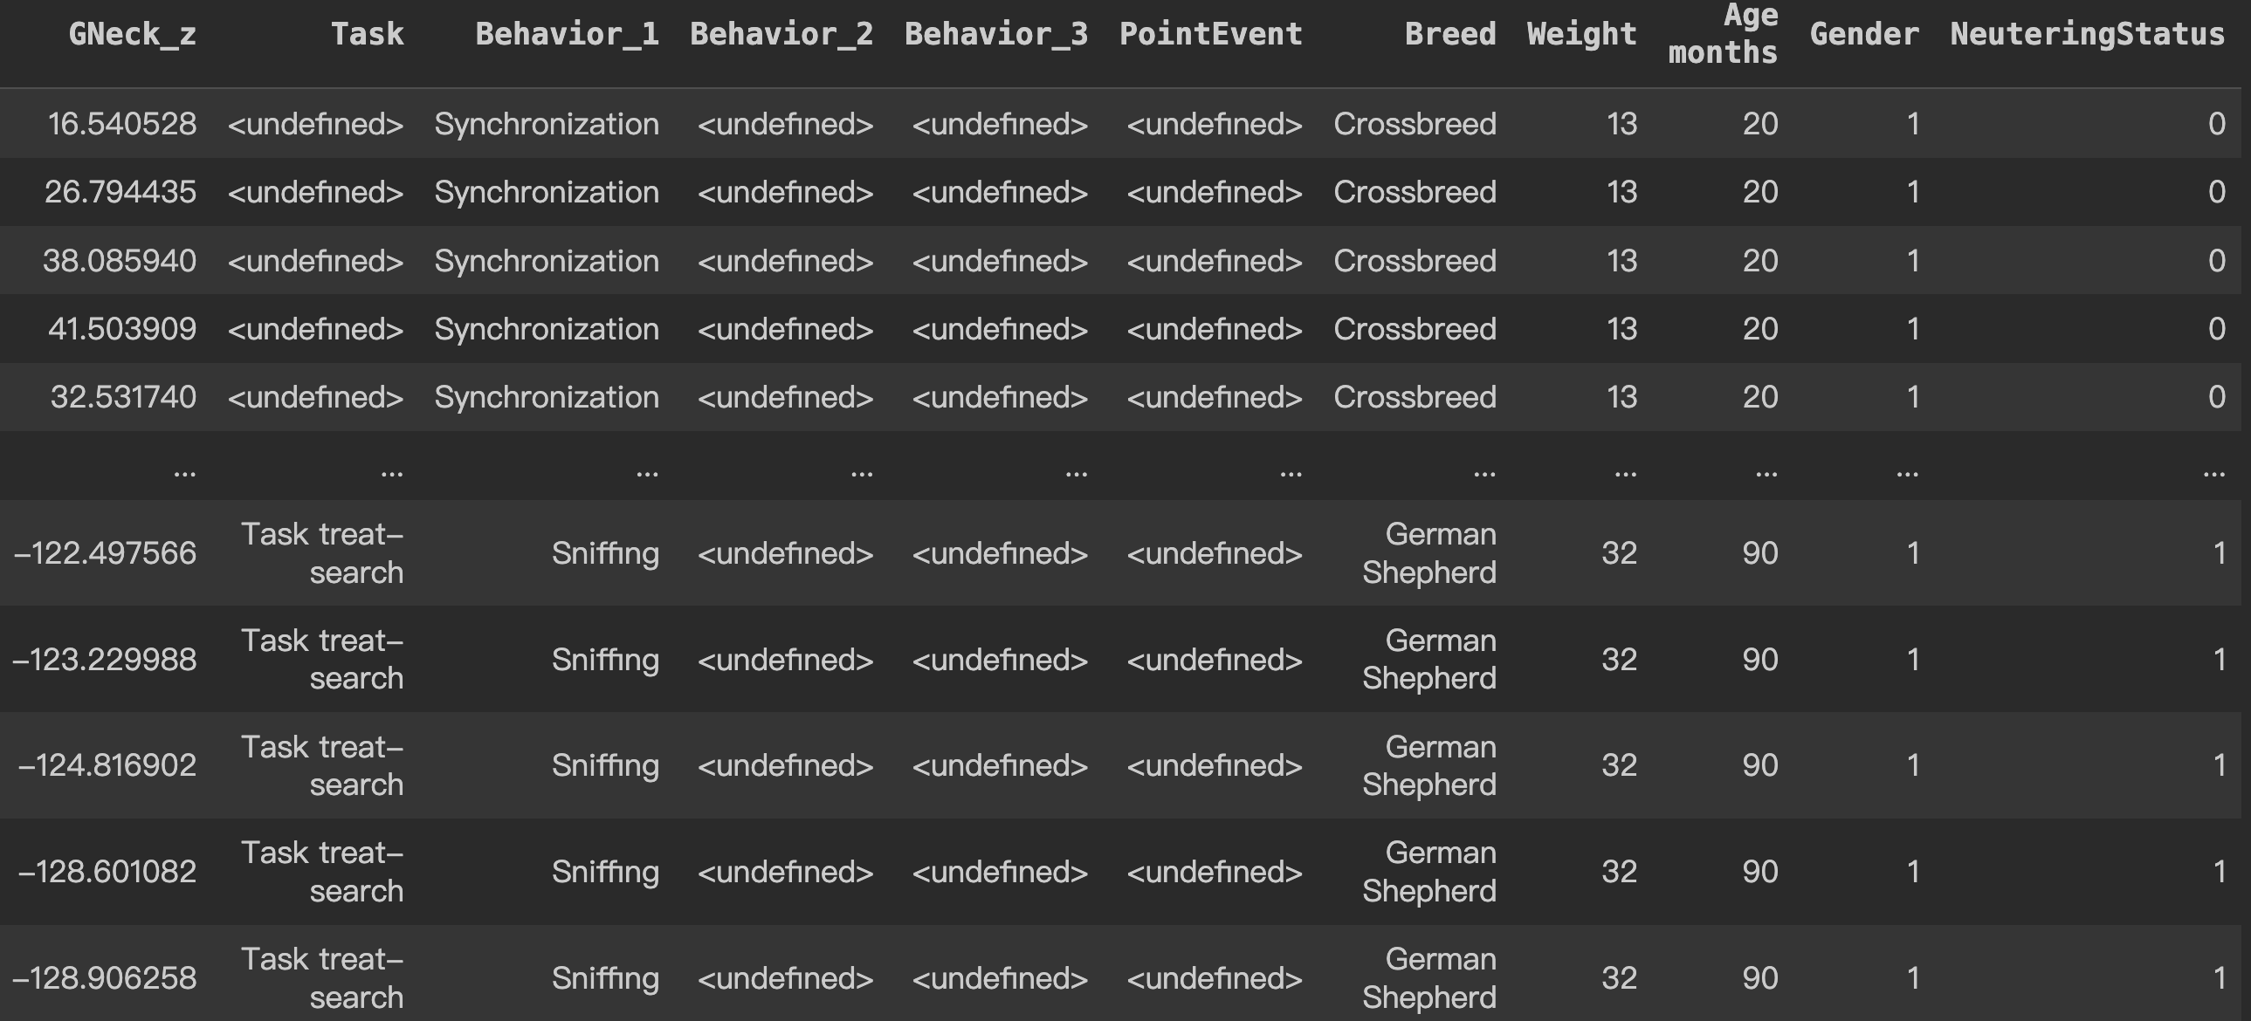
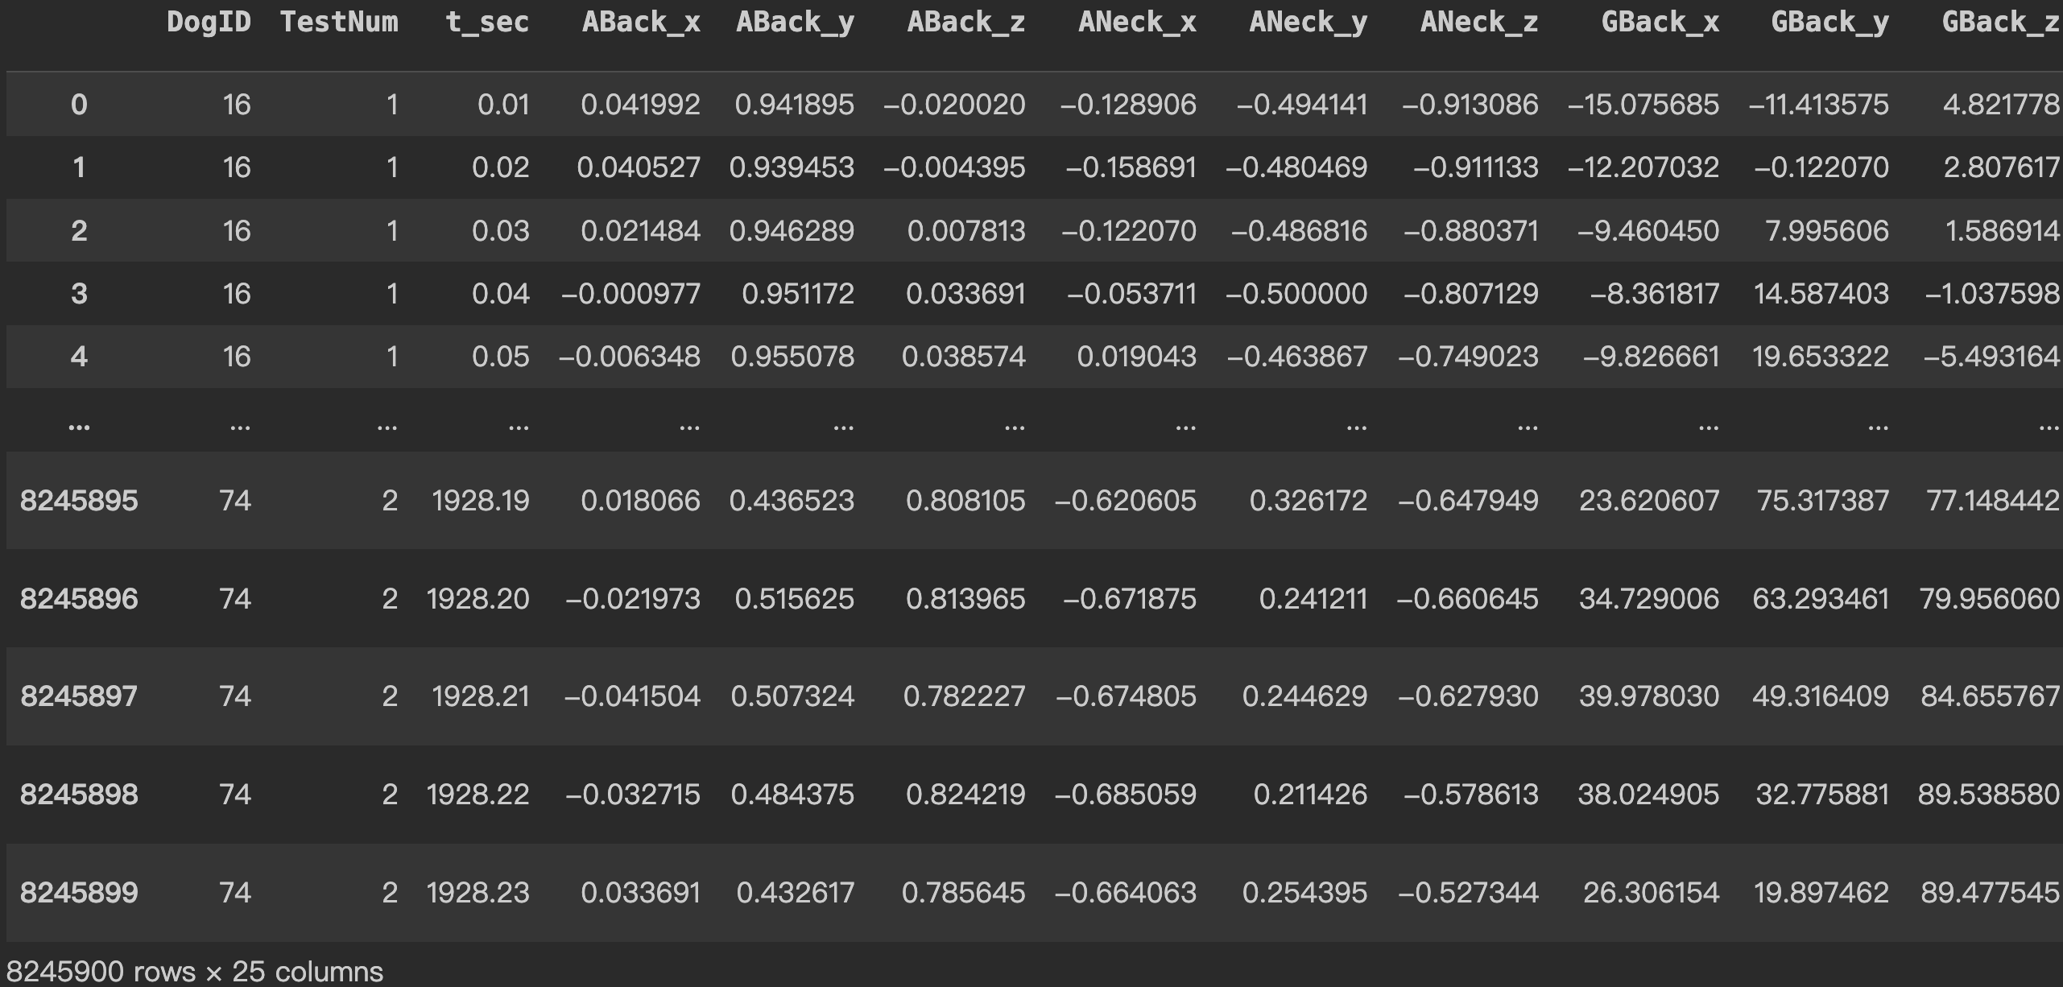
Raw data dataframe

Slide 9
EDA

Slide 10
Data Cleaning
Handle undefined data: remove rows with "<undefined>" values in Behavior columns ("Behavior_1", "Behavior_2", and "Behavior_3").
Remove rows with "Synchronization" values.

Slide 11
Feature Engineering
In EDA, we combined acceleration detected on both back and neck into one single value "Accel_Magnitude".
A_Back_x, A_Neck_x
A_Back_y, A_Neck_y
A_Back_z, A_Neck_z
Accel_Magnitude
To see relationship between movement and dog info more clearly!
In Modelling, we resampled the 'Behavior' data: combined 'Drinking' & 'Eating', 'Jumping & Pacing', 'Playing & Tugging' and 'Standing' & Sitting & Lying chest'.
To obtain a balanced training dataset!

Slide 12
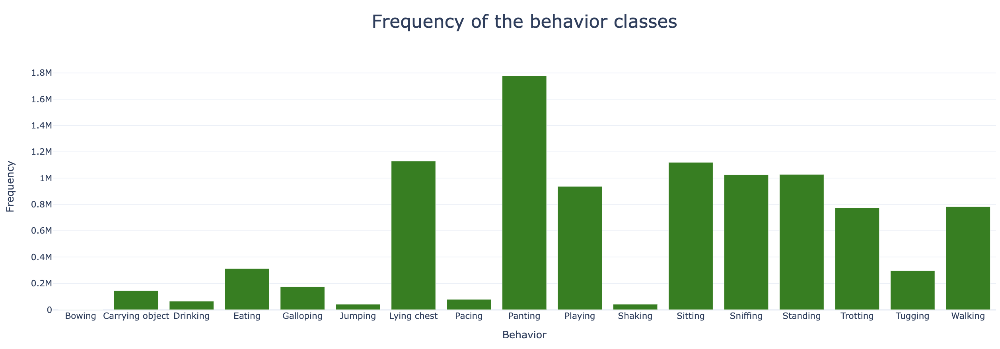
Frequency of the behavior class
>1.7m
<0.002m
Uneven distribution
The 'Bowing' behavior is present in only 1540 time steps, compared to over 1.7 million time steps for the 'Panting' behavior.

Slide 13
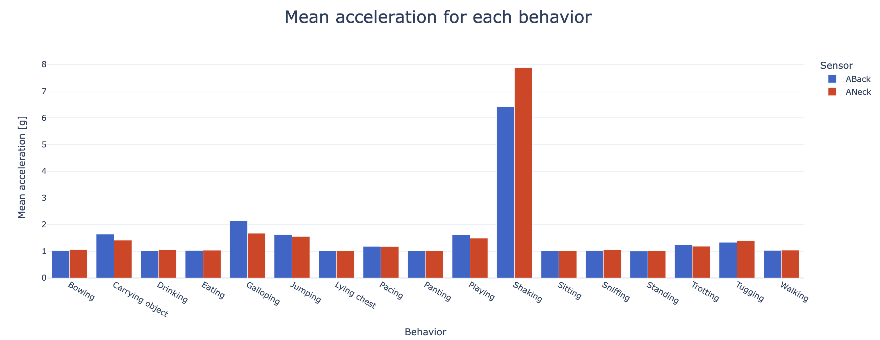
Mean acceleration for each behavior
----detected by back & neck sensor
neck has a smaller mass and moment of inertia from
a physics standpoint
Similar pattern detected by both sensors
When shaking, the neck experiences higher mean accelerations
Shaking has notably high mean acceleration values
more vigorous movement

Slide 14
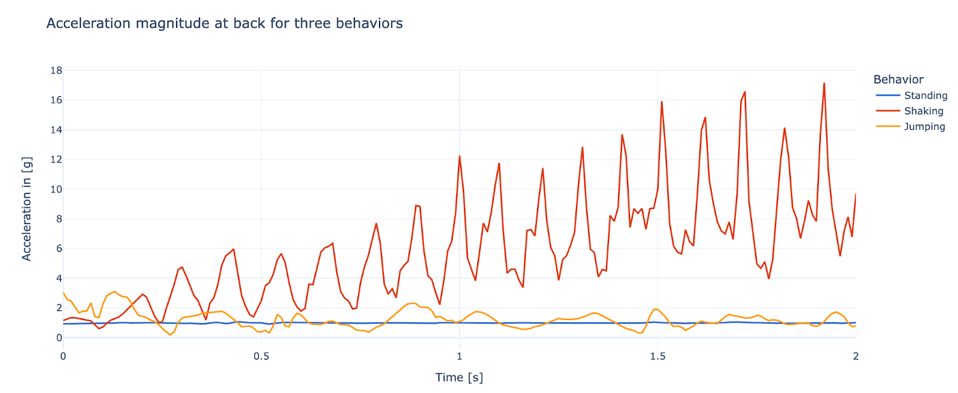
Acceleration magnitude in 2 seconds as example
---- 3 behaviors detected by back sensor
The shaking movement is periodic and gets larger in acceleration magnitude over time.
The jumping behavior shows irregular development of the acceleration over time.

Slide 15
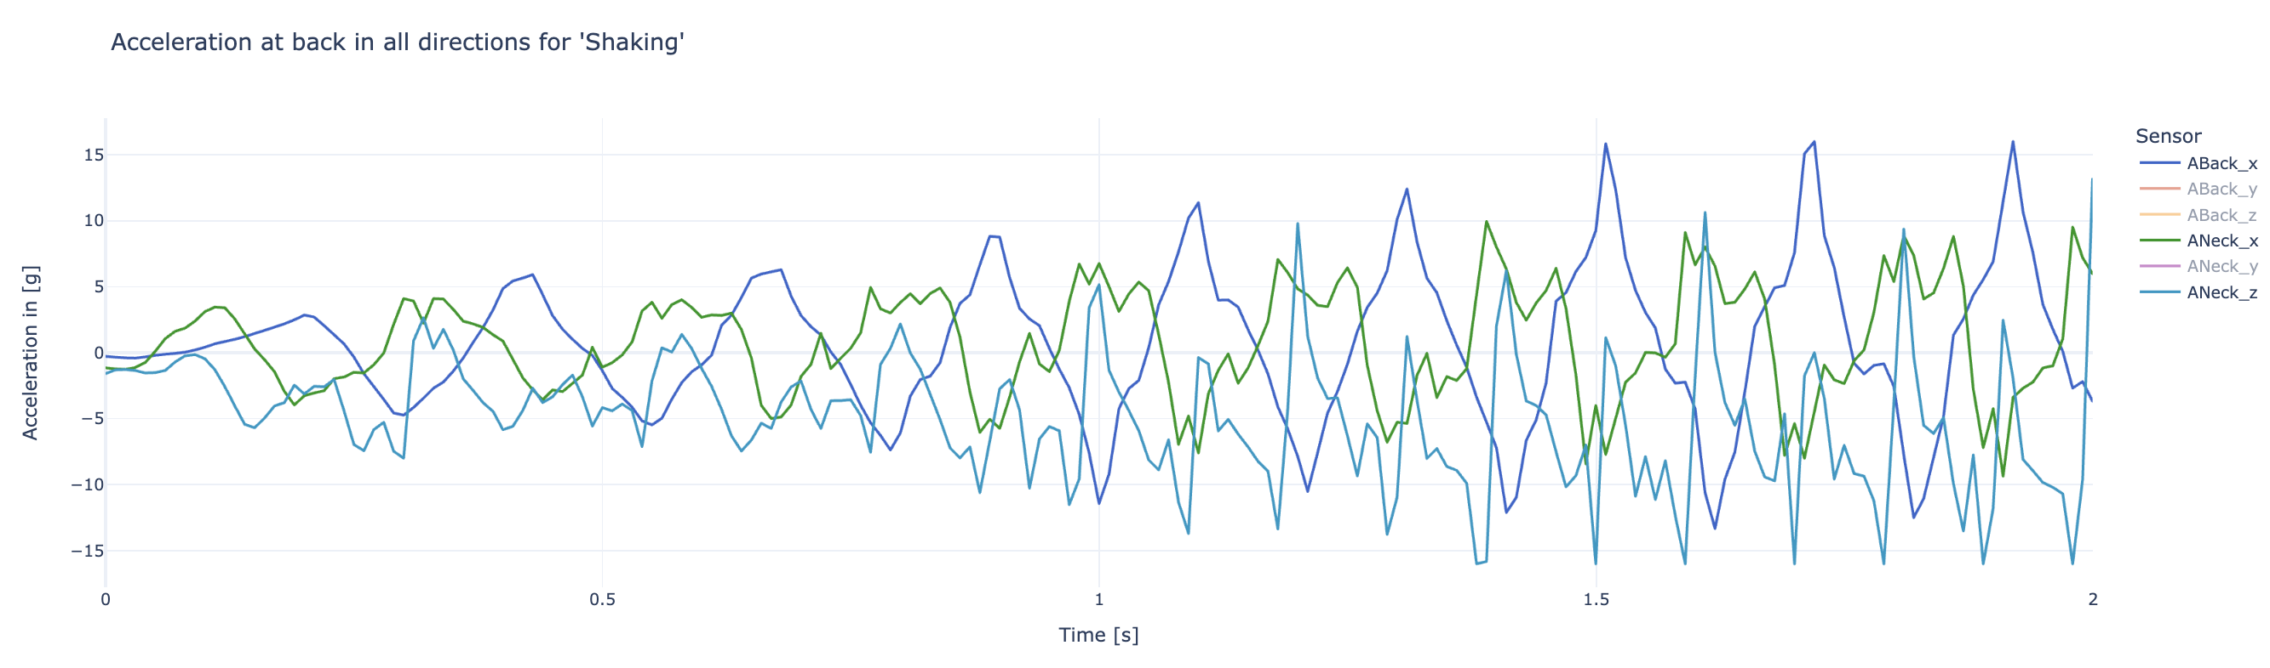
Acceleration magnitude for 'Shaking'
----detected by back & neck sensor
Sensors have some redundant information.
'ABack_x', 'ANeck_x' and 'ANeck_z' captures most distinct fluctuations.

Slide 16
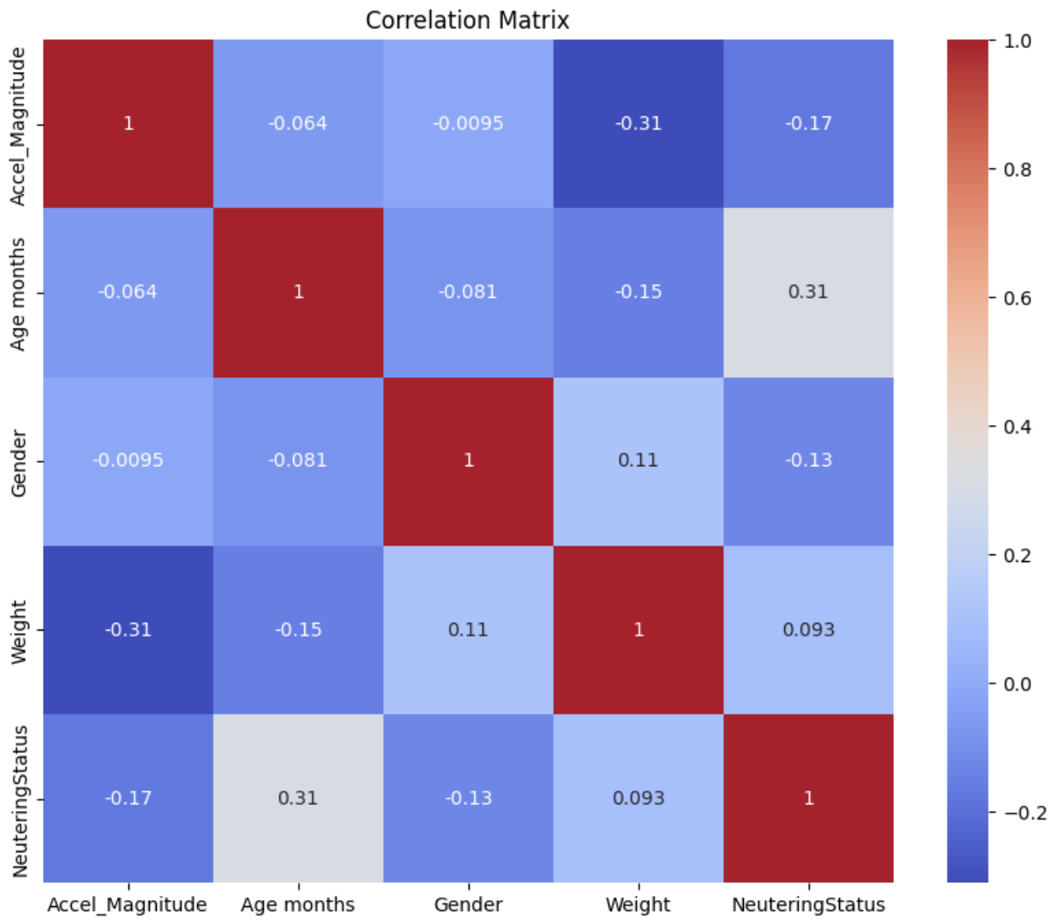
Correlation Matrix of Total Acceleration Magnitude & Dog Info
No strong linear relationship between most pairs of variables.
A moderate negative correlation (approx. -0.31) between 'Weight' and 'Accel_Magnitude'.
heavier dogs are less likely to engage in behaviors that involve high acceleration.

Slide 17
Modeling

Slide 18
Modeling
6 Models
Decision Tree (Baseline)
Random Forest
Multilayer Perceptron (MLP)
Gated Recurrent Unit Neural Network (GRU)
Convolutional Neural Network (CNN)
Bigger Convolutional Neural Network with Residuals (ResNet)

Slide 19
Training Data
Features:
ABack_x, ABack_y, ABack_z, ABack
ANeck_x, ANeck_y, ANeck_z, ANeck
Classes:
“Drinking or Eating”, “Galloping”, “Jumping or Pacing”, “Playing or Tugging”, “Shaking”, “Sniffing”, “Standing or Sitting or Lying chest”, “Trotting”, “Walking”
RobustScaler
PCA (Reduced to 3 sensor features)
Resampling (Sub+Supersampling)

Slide 20
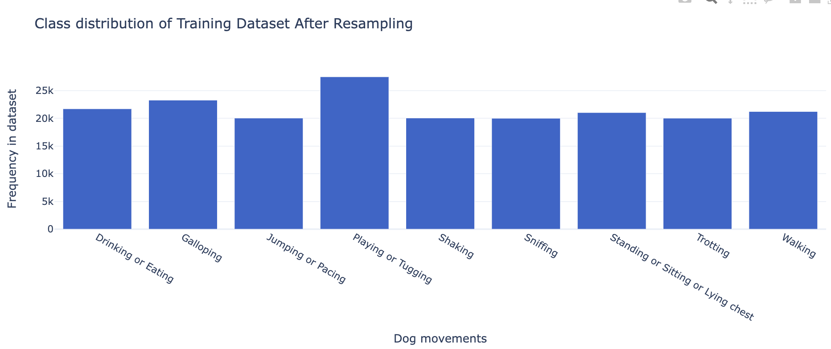
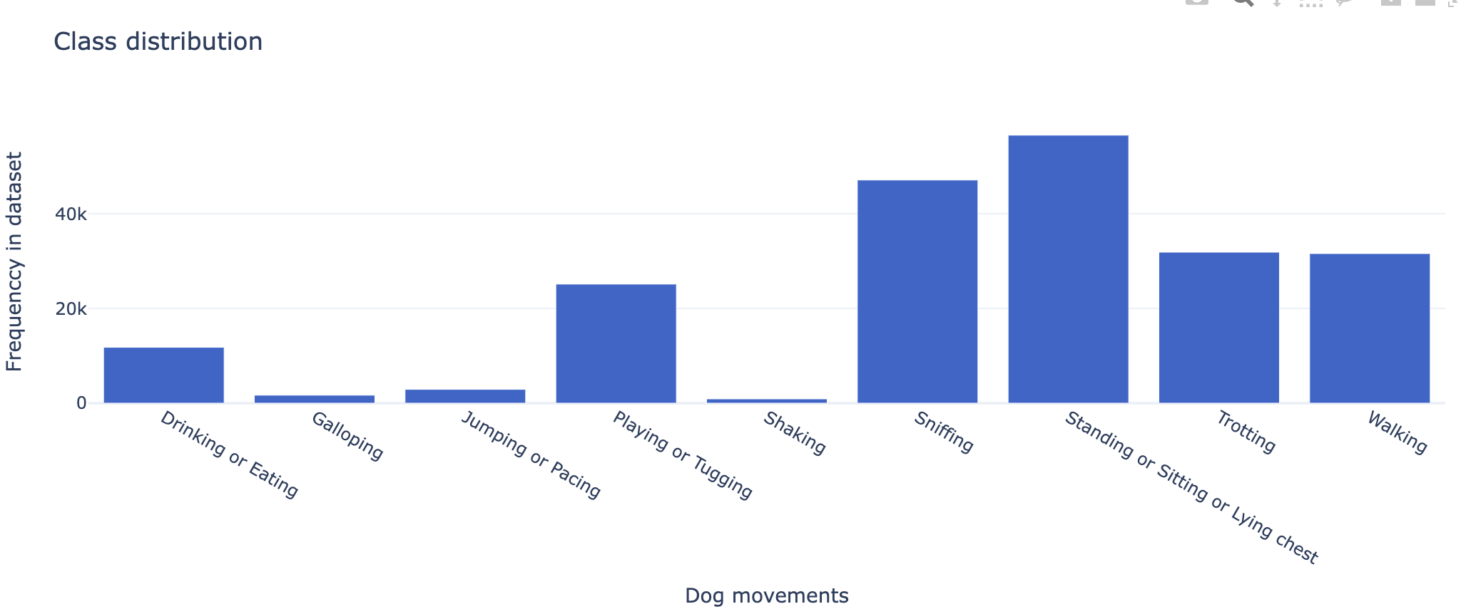
Class Resampling

Slide 21
Results
Model | Accuracy on test dataset | Training time
Decision Tree | 65.5 % | 163 s
Random Forest | 72.9 % | 604 s
MLP | 81.9 % | 80 s
GRU | 93.6 % | 119 s
CNN | 85.5 % | 83 s
ResNet | 92.8 % | 114 s
Higher accuracy than 91.4 % with SVM in the original paper.

Slide 22
Our project can benefit dog owners:
Health Monitoring: The correlation between weight and acceleration magnitude could be used to monitor a dog's health and fitness. A sudden change in this relationship might indicate health issues.
Tailored Exercise: Owners can tailor exercise to suit their dog's weight and age to ensure their pet is getting appropriate levels of activity.

Slide 23
Overall Learning Experience
It is critical to resample dataset to get a uniform data distribution. If we just use the original dataset, the accuracy will be stuck around 80%.
Hands-on data analysis experience help a lot, e.g. BatchNorm is very important; otherwise the model will always have very low accuracy.

