Slide 1
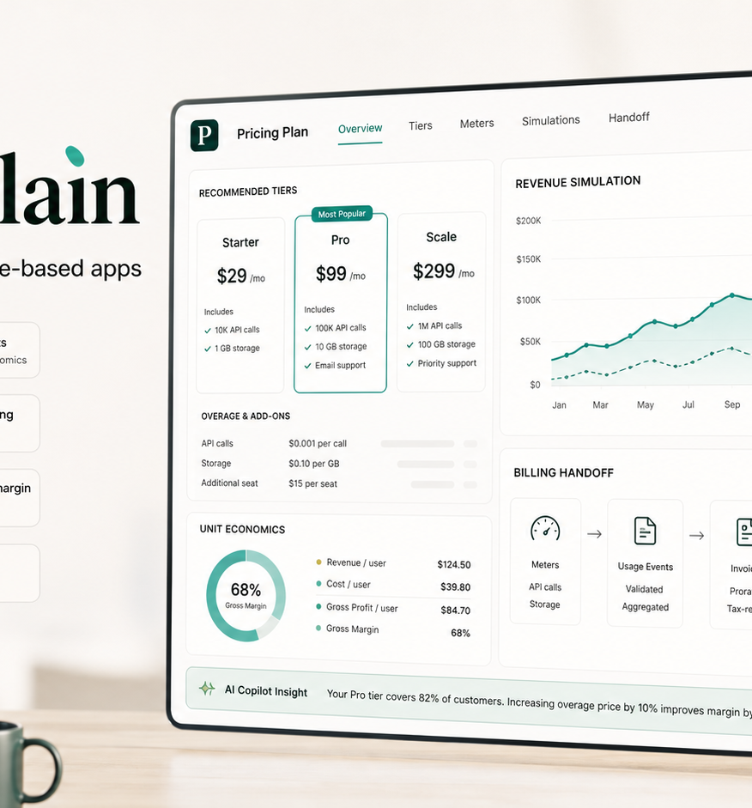
Priceplain
AI pricing copilot for vibe-coded apps
Turns app ideas, usage costs and growth assumptions into pricing tiers, metering events, revenue simulation and a Solvimon-ready handoff.
Encode Vibe Coding Hackathon
Live demo: priceplain.vercel.app
priceplain.vercel.app
01

Slide 2
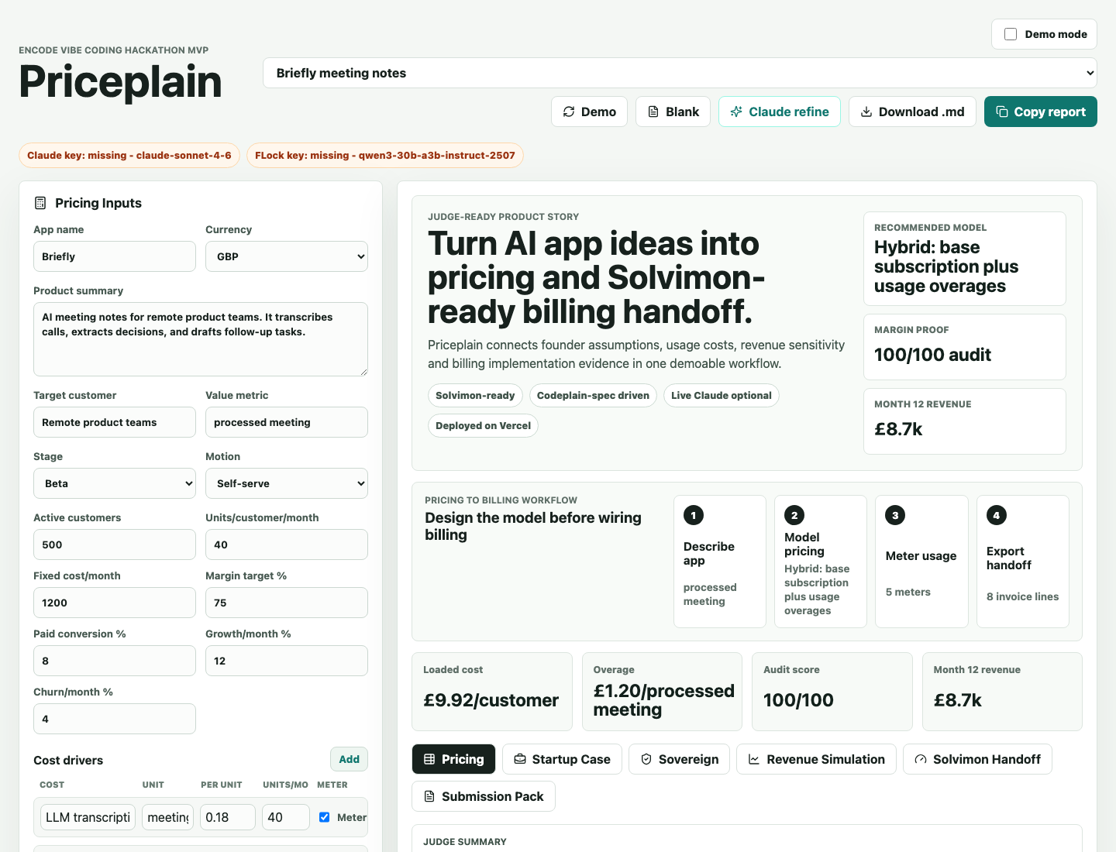
PRICEPLAIN
Fast apps. Slow pricing.
-
AI costs move with tokens, media, storage and third-party APIs.
-
Guessed unlimited plans can destroy gross margin after launch.
-
Founders need value metrics and metering decisions before checkout.
-
Billing teams need handoff objects, not another generic pricing prompt.
Before
Margin
pricing reaches billing
risk visible early
priceplain.vercel.app
02

Slide 3
PRICEPLAIN
From rough app idea to pricing handoff.
Priceplain focuses on the planning layer before a founder wires billing, checkout or quote-to-cash.
1
Describe
3
Meter
Founder enters product, customer, value metric and cost drivers.
Suggested events become billing and analytics assumptions.
2
Model
4
Export
Engine produces tiers, limits, overages and margin checks.
Handoff JSON packages plans, invoice items and implementation notes.
Decision support first. Billing implementation second.
priceplain.vercel.app
03

Slide 4
PRICEPLAIN
Built for Solvimon and Codeplain.
Solvimon
Codeplain
-
Hybrid and usage-based pricing
-
Product MVP spec in .plain
-
Value metric and meter events
-
Pricing-engine rules in .plain
-
Plans, invoice items and credits
-
Acceptance tests in .plain
-
JSON handoff for checkout work
-
Spec-driven demo evidence
Primary tracks: Solvimon + Codeplain. Secondary fit: Vercel deployment and optional FLock-aligned sovereign review.
priceplain.vercel.app
04

Slide 5
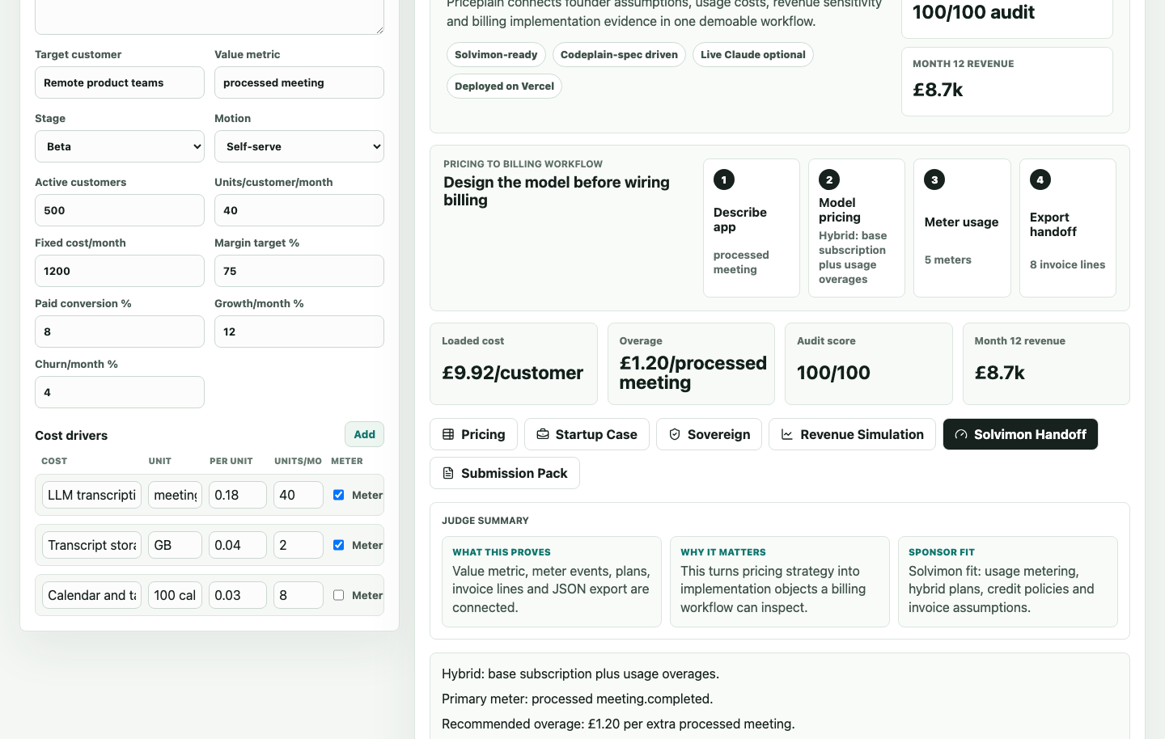
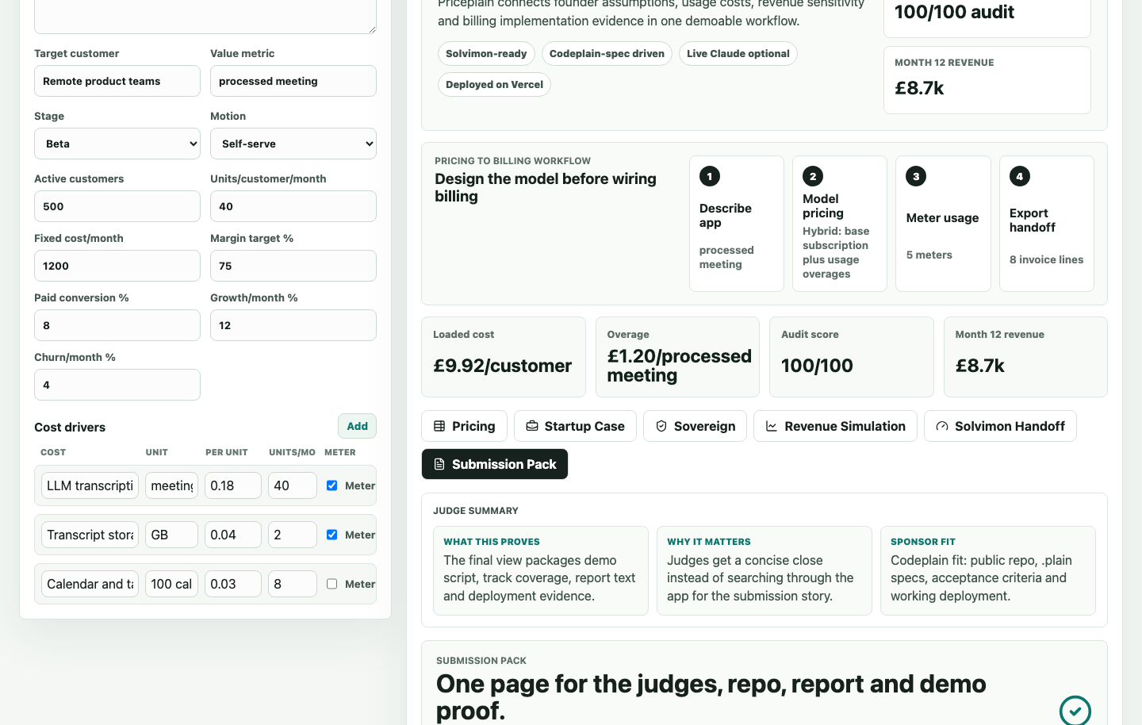
PRICEPLAIN
Demo proof: pricing to billing.
Three screens matter in the judge flow: pricing economics, Solvimon handoff, and submission evidence.
Solvimon handoff
Submission pack
priceplain.vercel.app
05

Slide 6
PRICEPLAIN
Business potential: sell the decision.
Customer
Revenue path
-
AI SaaS founders with variable model/API costs.
-
Free pricing audit to capture demand.
-
Teams launching on Vercel before pricing is settled.
-
Paid saved workspaces and export reports.
-
Product teams migrating towards usage-based billing.
-
Billing templates and Solvimon handoff support.
Different because it links value metric, usage cost, pricing tiers, overages, margin risk and billing objects in one workflow.
priceplain.vercel.app
06

Slide 7
PRICEPLAIN
OpenAI-style pricing planning.
The same questions apply to larger AI platforms: what is metered, what is included, where credits fit, and how margins change as usage scales.
Meter
Tokens, runs, seats, storage, media, API calls
Package
Free limits, credits, service tiers, enterprise plans
Stress test
Model-cost changes, high-usage users, churn, conversion
Handoff
Billing events, invoice lines, plan rules, audit notes
Guardrail: this is a planning use case for companies like OpenAI, not a claim that OpenAI uses or validated Priceplain.
priceplain.vercel.app
07

Slide 8
What happens after the hackathon
-
Create a live Solvimon checkout adapter from the handoff JSON.
-
Run founder interviews and collect pricing-page conversion signals.
-
Add saved workspaces, benchmark presets and collaboration history.
-
Build audit trails for AI pricing decisions in regulated teams.
Ask: judge Priceplain as the planning layer that helps AI builders answer what to charge, what to meter, and whether the model can make money.
Demo: priceplain.vercel.app | Code: github.com/MasteraSnackin/Priceplain
08

