Slide 1
Priceplain
ENCODE VIBE CODING HACKATHON
Solvimon + Codeplain
AI pricing copilot for founders turning vibe-coded apps into paid products.
Live demo: priceplain.vercel.app

Slide 2
The launch gap: built fast, priced late
What founders hit
AI prototypes are now quick to ship, but pricing is still a guess. Model, storage and API costs make unlimited plans risky.
The hard question is not just what to charge. It is what to meter, where to cap usage, and whether the margin survives real customers.
Why sponsors should care
Solvimon rewards business potential, not a clever demo alone. Priceplain sits before billing implementation and turns founder assumptions into objects a usage-based billing workflow can inspect.
The Codeplain angle is explicit: product rules and acceptance tests are written as .plain specs.

Slide 3
What Priceplain does
1. Model pricing
Generate Free, Starter, Growth and Scale tiers from usage costs, fixed costs, margin target, conversion, churn and growth.
2. Meter usage
Create value metrics, billing events, overage rules, credit policies and invoice-line assumptions.
3. Prove viability
Run revenue simulation, stress-test costs and export a judge-ready Markdown and JSON handoff.

Slide 4
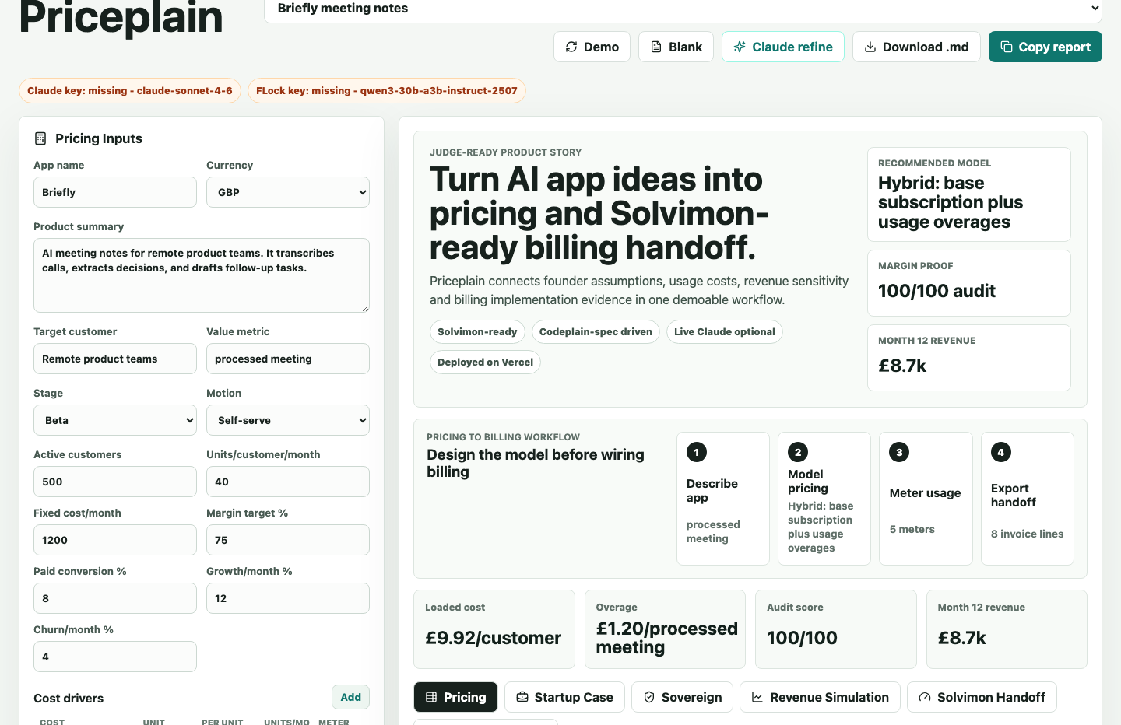
The product is already live and demoable
Pricing workspace: tiers, cost drivers, margin score and shareable demo presets.

Slide 5
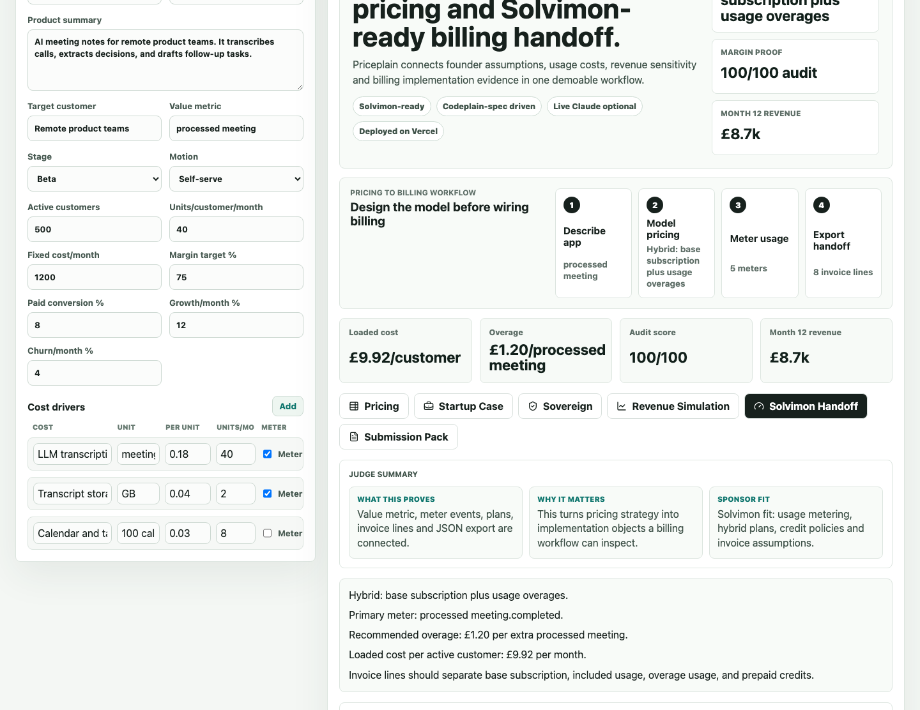
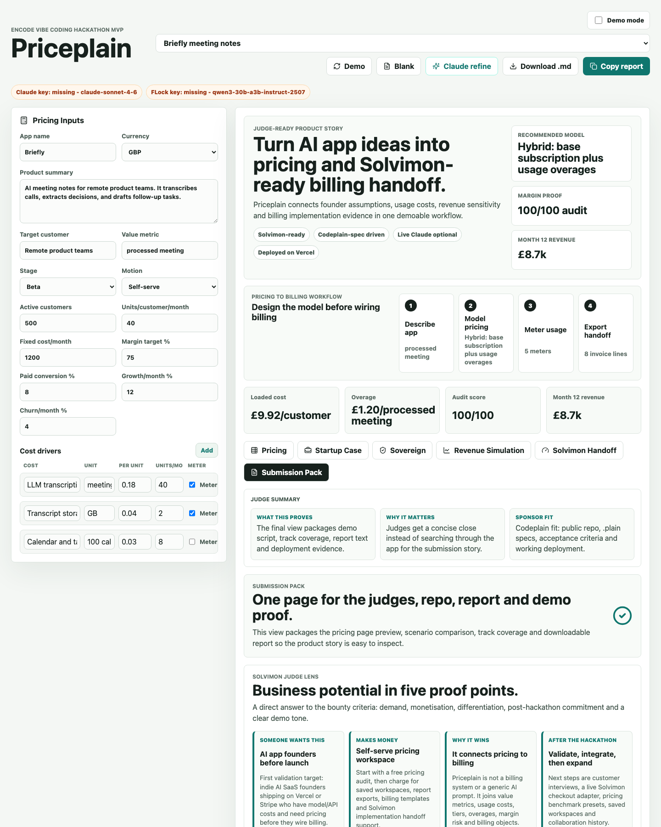
Solvimon proof: pricing becomes billing handoff
Priceplain turns the business decision into implementation evidence: value metric, meters, plans, invoice items, credit policies, compact developer object and exportable JSON.
It is not claiming to be a live Solvimon integration. The MVP proves the planning and handoff layer before checkout or quote-to-cash work.
Solvimon Handoff
Meters, plans and invoice items are visible.
Submission Pack
Judge lens, export text and demo proof.

Slide 6
Business potential in five proof points
Target buyer: indie AI SaaS founders moving from prototype to paid launch.
Monetisation: free audit, then paid workspaces, reports, billing templates and implementation handoff support.
Difference: Priceplain joins value metric, usage costs, tiers, overages, margin risk and billing objects in one workflow.
Why someone wants this
Why we keep building
Founders need pricing before they wire billing.
Usage costs can quietly erase margin.
The output is immediately useful.
Next: customer interviews, live Solvimon checkout adapter, saved workspaces and pricing benchmarks.
Primary tracks: Solvimon and Codeplain. Secondary proof: Vercel deployment and optional FLock governance review.

Slide 7
Demo links and submission
Live demo
priceplain.vercel.app
Code
github.com/MasteraSnackin/Priceplain

