Slide 1
Notes:
Most planners treat fastest as best. At midday, that can miss the journey-time and direct-sun trade-off that ShadeRoute makes visible. The gentle animation emphasises the contrast; it is an illustration, not product or field evidence.
[Sources]
- Animated derivative of a user-supplied image, received 15 August 2026; deterministic colour motion only, used as an illustrative opener.

Slide 2
FRONTLINE LONDON
2–3 MINUTE PRODUCT DEMO
Walk with less direct sun.
ShadeRoute compares journey time with modelled clear-sky exposure before people set off.
Notes:
ShadeRoute is a mobile-first walking planner for people who need to reduce direct-sun exposure. It is designed for heat-vulnerable people and carers, and for frontline or outdoor workers making repeated journeys. In the next two minutes, I’ll show how someone plans a route, compares the trade-off and watches shade move through the day.
[Sources]
- ShadeRoute local application and README.md, accessed 15 August 2026.

Slide 3
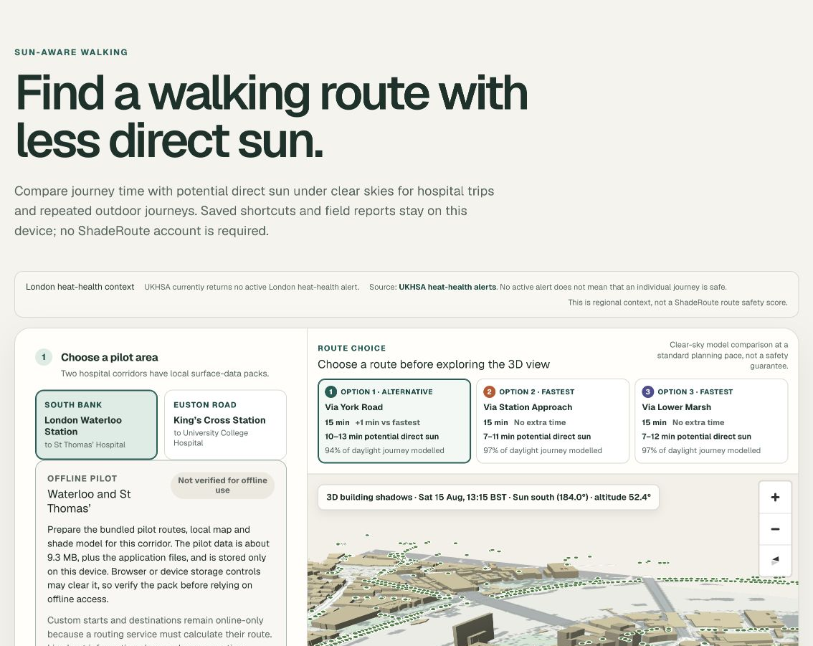
Same walk time. Different sun exposure.
Most route planners optimise time. ShadeRoute adds another decision: how much of the walk may be in direct sun under clear skies?
UKHSA highlights older adults, young children, pregnancy, certain medicines, and heart, breathing, kidney or mobility conditions. Potential users include responders, delivery and aid workers in long outdoor roles.
Planning support · not a medical or safety score
SHADE ROUTE · FRONTLINE LONDON
03
Notes:
The problem is not simply finding the shortest walk. Two alternatives can take roughly the same time but pass through different street canyons, open spaces and shadows. UKHSA identifies older adults, young children, pregnant women, people with heart, lung, kidney or mobility conditions, and people taking certain medicines as being at higher risk in hot weather. Potential frontline pilot users include emergency responders, delivery workers, aid workers and others who spend long periods outside or wear heavy equipment. This is audience rationale, not a medical recommendation.
[Sources]
- https://www.gov.uk/guidance/heat-summary-supporting-vulnerable-people-for-all-users — UKHSA higher-risk groups and outdoor/manual workers; accessed 15 August 2026.
- https://www.cdc.gov/niosh/heat-stress/about/ — direct sun, exertion, clothing/PPE and worker heat-stress factors; accessed 15 August 2026.
- ShadeRoute local application screenshot overview.png, captured 15 August 2026.

Slide 4
SHADE MATTERS
Full sun: up to ~8°C
higher heat index.
NWS: heat index assumes shade and light wind
Upper bound: shaded 28°C → sun ~36°C
Apparent heat, not an 8°C air rise; water and rest still matter
Notes:
ShadeRoute does not claim to lower the air temperature. The US National Weather Service says heat-index values assume shady, light-wind conditions, and full sunshine can increase that apparent value by up to 15°F — about 8°C. So 28°C to roughly 36°C is a deliberately upper-bound illustration, not a fixed conversion. Official thermometers are shielded from direct sunlight; the displayed air temperature therefore is not the same as the radiant heat a person receives in full sun. In practice the difference varies with cloud cover and solar angle or time of day, wind or air movement, humidity, clothing/PPE, and physical effort or walking speed. CDC/NIOSH lists direct sun exposure, indoor radiant heat sources, dehydration, physical exertion, clothing/PPE, advanced age and pregnancy as heat-stress factors, and notes that dizziness and fatigue may contribute to injuries. Its workplace guidance recommends cool recovery areas, potable water, hydration and rest. Shade can reduce one environmental heat load, but it does not prevent dehydration or replace water, rest, acclimatisation or medical advice.
[Sources]
- https://www.weather.gov/safety/heat-index — heat-index assumptions and the up-to-15°F full-sun adjustment; accessed 15 August 2026.
- https://www.weather.gov/rah/edu2 — thermometers should be shielded from direct sunlight and other sources of measurement error; accessed 15 August 2026.
- https://www.cdc.gov/niosh/heat-stress/about/ — worker heat-stress factors, dehydration and fatigue-related injury risk; accessed 15 August 2026.
- https://www.cdc.gov/niosh/heat-stress/recommendations/ — cool recovery areas, potable water, hydration and rest controls; accessed 15 August 2026.

Slide 5
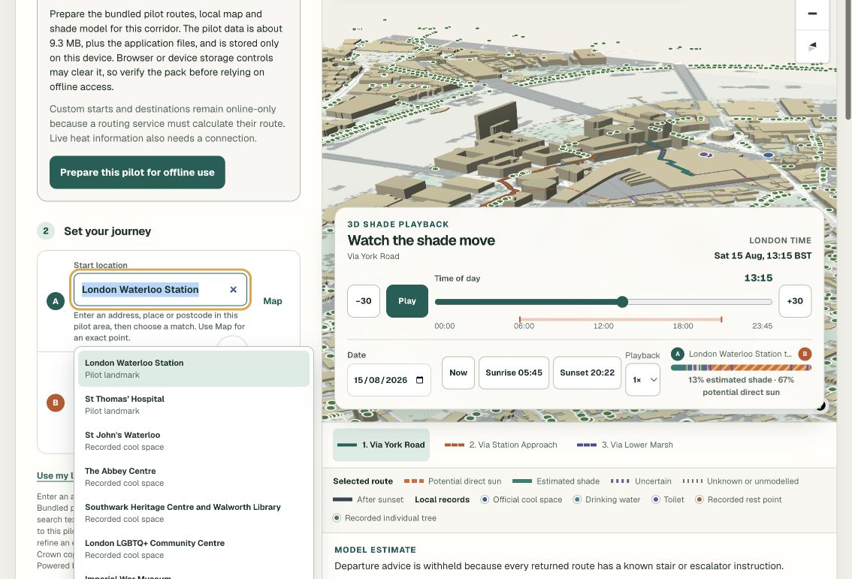
Plan the journey in three steps.
01
Enter locations
Type a place or postcode, choose on the map, or use the device location.
02
Set the journey
Choose London time, audience, modelled pace and any known-step preference.
03
Compare alternatives
Review time, potential direct sun, sensitivity and model coverage together.
SHADE ROUTE · FRONTLINE LONDON
04
Notes:
The workflow is deliberately familiar. First, enter the start and destination, choose a result, use the current location, or place an exact point on the map. Second, set the London departure time and journey needs. Third, compare up to three real walking alternatives. ShadeRoute never treats unconfirmed text as a location, and custom points remain inside the selected pilot area.
[Sources]
- ShadeRoute local application screenshot planner-map.png, captured 15 August 2026.
- ShadeRoute LocalPlaceSearch and route-planning interface, accessed 15 August 2026.

Slide 6
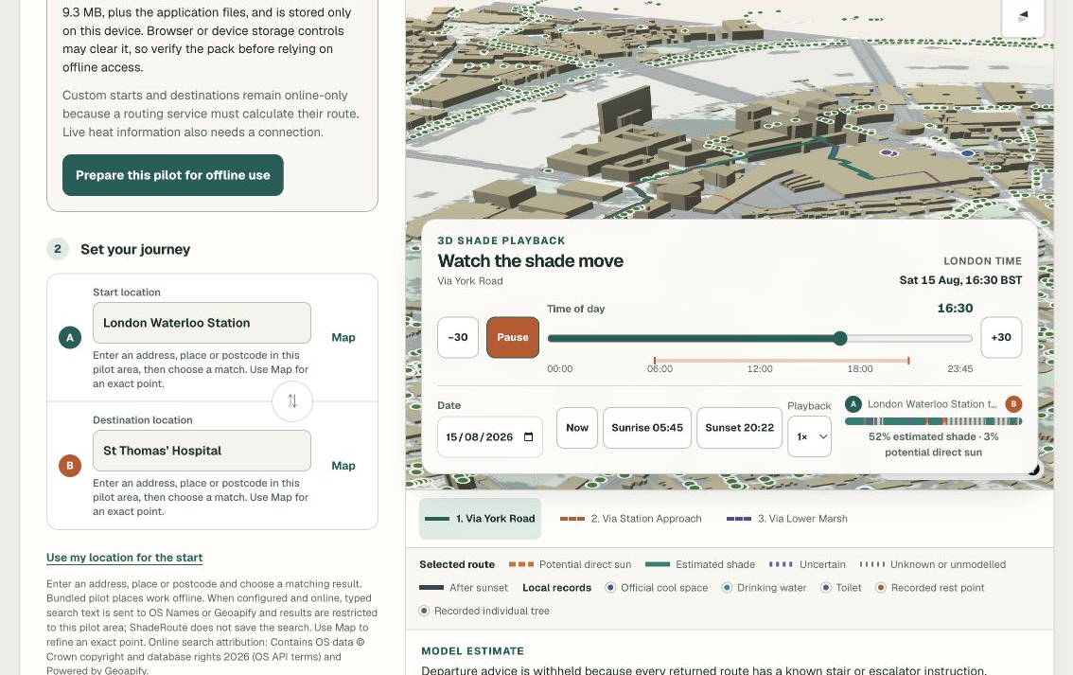
The map shows shade moving through the day.
Drag the time slider — or press play — and the 3D scene updates with the sun.
3D buildings and ground shadows
Route sections coloured by exposure
Unknown and uncertain sections stay visible
SHADE ROUTE · FRONTLINE LONDON
05
Notes:
This is the centrepiece. The 3D map uses local building and surface data, then changes the displayed shadows as the departure time moves. The selected route is broken into potential sun, estimated shade, uncertain and unknown sections. That means the visual is useful without pretending the model knows more than it does. The route cards remain available if 3D is not usable.
[Sources]
- ShadeRoute local application screenshot moving-shade.png, captured during time playback on 15 August 2026.
- ShadeRoute local model and interface copy, accessed 15 August 2026.

Slide 7
Stops, future insight and limited offline use.
01
Available now
Selected water, GLA cool spaces, toilets and benches where data exists.
02
Future city insight
Public buildings, medical help and shade-gap analysis are future only.
03
Prepared offline pack
Pilot map + model stay available; live services stay online-only. Not emergency navigation.
SHADE ROUTE · FRONTLINE LONDON
06
Notes:
The current pilot can surface selected water, GLA cool spaces, toilets, benches or rest points and public-tree records where data exists. Public buildings and medical-assistance stops are future categories that require authoritative data and governance. Privacy-reviewed aggregate analysis may later help city teams identify potential shade gaps, but the methodology would need validation and shared analytics or identifiable journey collection are not enabled. A user-prepared offline pack can keep the selected pilot's bundled app, map and model available without a live connection in supported browsers. Custom routing and live context remain online-only. Power-cut, evacuation and wider emergency use are not validated; ShadeRoute is reference-only planning support, not emergency navigation.
[Sources]
- ShadeRoute local route-context, offline-pack and privacy interfaces; accessed 15 August 2026.
- ShadeRoute README.md and pilot documentation; accessed 15 August 2026.
- https://www.cdc.gov/niosh/heat-stress/recommendations/ — cool areas, water, hydration and rest controls; accessed 15 August 2026.

Slide 8
NEXT STEP
Take ShadeRoute
into the field.
Two London hospital corridors
Carer + outdoor-worker task testing
Field calibration before stronger claims
Notes:
The next step is a controlled field pilot, not a broader product claim. Start with the two existing London hospital corridors. Test whether carers and outdoor workers can understand the route trade-off and use the map controls. Then collect the pre-specified fixed-point and complete-walk observations before making stronger accuracy claims. Keep clear-sky exposure, incomplete coverage, access limits and reference-only use visible throughout.
[Sources]
- ShadeRoute README.md and current local application; accessed 15 August 2026.
- ShadeRoute validation/README.md and header-only observation templates; accessed 15 August 2026.

