Slide 1

Trace
Studying shelf browsing
before checkout
EAT_HACK
Retail Futures
Notes:
Trace is a local webcam experiment for the part of shopping that happens before checkout. I built it to explore whether broad shelf gaze estimates can give retailers useful evidence about browsing.
Sources
https://github.com/MasteraSnackin/trace-eat-hack/blob/0229052/README.md
Cover: AI-generated conceptual illustration, not a photograph of an installed system.

Slide 2
The gap before checkout
Sales records show
what shoppers bought.
Which shelf areas receive
sustained estimated gaze?
Does that pattern change
when the shelf changes?
Browsing leaves
questions.
Could it help a retailer choose
what to test next?
Notes:
A receipt records what someone bought. It leaves questions about what they browsed first. Trace starts with a narrower question: which broad shelf zones receive sustained estimated gaze, and how does that pattern change?
Sources
https://github.com/MasteraSnackin/trace-eat-hack/blob/0229052/README.md#description
https://github.com/MasteraSnackin/trace-eat-hack/blob/0229052/README.md#path-to-trend-forecasting

Slide 3
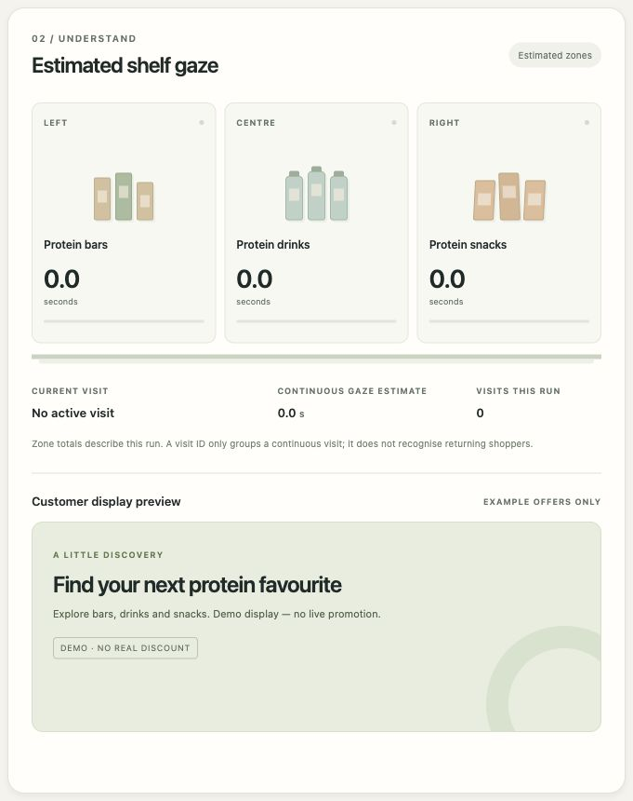
One webcam, three shelf zones
Left, centre or right
Trace estimates gaze towards a broad
shelf zone and accumulates dwell.
Temporary visits
Tracks group observations without
identifying a person. Unclear views
stay unassigned.
The operator enters shelf measurements.
Shoppers do not complete a calibration routine.
Camera off. No shopper observations.
Notes:
The operator enters the shelf measurements. A webcam estimates gaze towards three zones, groups observations into temporary visits and measures dwell. Unclear observations remain unassigned. This real interface capture has the camera off and contains no shopper observations.
Sources
https://github.com/MasteraSnackin/trace-eat-hack/blob/0229052/README.md#features
https://github.com/MasteraSnackin/trace-eat-hack/blob/0229052/README.md#current-limits
https://github.com/MasteraSnackin/trace-eat-hack/blob/0229052/docs/screenshots/readme-shelf-gaze-2026-10-03.jpg

Slide 4
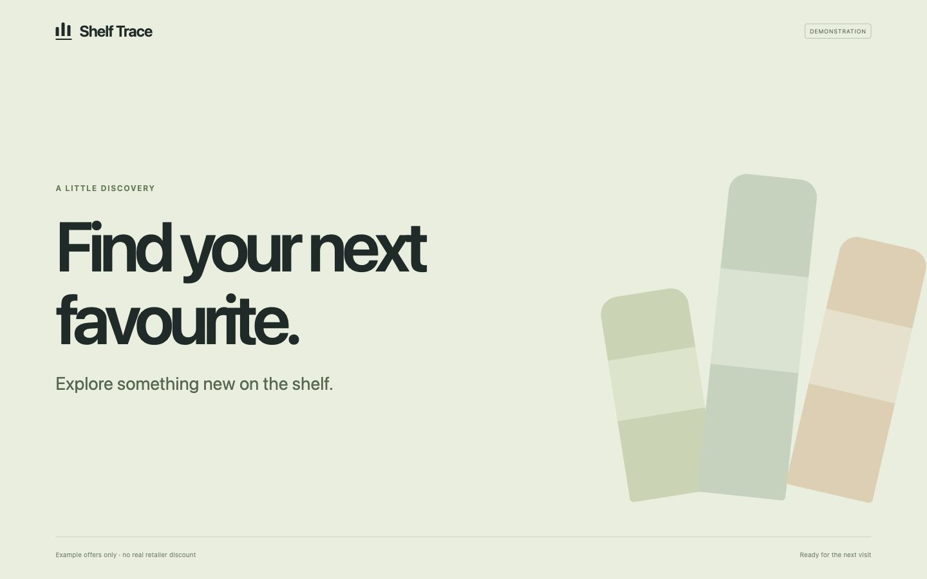
A separate screen for example offers
Sustained
estimated gaze
can trigger an
example offer.
The default dwell
threshold is 1.5 seconds.
Unclear or stale views
clear the zone offer.
Watch the interface tour
Idle interface capture. Offers are examples and cannot be redeemed.
Notes:
Sustained estimated gaze can trigger an example offer on a separate screen. The default threshold is one and a half seconds. These captures show the real interfaces with the camera off. They demonstrate the controls, rather than physical gaze accuracy.
Sources
https://github.com/MasteraSnackin/trace-eat-hack/blob/0229052/README.md#features
https://github.com/MasteraSnackin/trace-eat-hack/blob/0229052/README.md#customer-display
https://github.com/MasteraSnackin/trace-eat-hack/blob/0229052/docs/screenshots/readme-customer-idle-2026-10-03.jpg
https://github.com/MasteraSnackin/trace-eat-hack/blob/main/docs/videos/trace-ui-walkthrough.mp4

Slide 5
Processing stays on one computer
Built for EAT_HACK
01
Webcam and operator browser
Local Python service
Shelf geometry
Temporary visit logic
Operator and customer views
Captures a frame for the local service.
02
Local Python service
Runs OpenVINO and maps gaze to the shelf.
03
Temporary visit state
Pre-existing work
Accumulates dwell and selects an example offer.
Open Model Zoo models
and the upstream gaze demo
04
Customer display
Polls the API for the current message.
Explore the system map
No external inference service after setup
Notes:
Processing runs on the local computer. I built the service, shelf geometry, visit logic and interfaces for EAT_HACK. The pretrained Open Model Zoo models and upstream gaze demo existed beforehand and are credited in the repository.
Sources
https://github.com/MasteraSnackin/trace-eat-hack/blob/0229052/ARCHITECTURE.md
https://github.com/MasteraSnackin/trace-eat-hack/blob/0229052/README.md#contributing
https://github.com/MasteraSnackin/trace-eat-hack/blob/0229052/model-provenance.json
https://masterasnackin.github.io/trace-eat-hack/#focus=state-api&reach=downstream

Slide 6
Software evidence and physical validation
68
19
Still to measure
Physical shelf gaze accuracy
and performance across
real browsing conditions.
Python tests
JavaScript tests
Passed in the recorded software review
on 3 October 2026
Product recognition, purchases
and returning-customer
identification are not implemented.
Browser checks cover setup, reset,
restart and display recovery.
Notes:
The recorded software checks include 68 Python tests, 19 JavaScript tests and browser recovery scenarios. Physical shelf accuracy still needs measurement. Trace does not currently recognise products, detect purchases or identify returning customers.
Sources
https://github.com/MasteraSnackin/trace-eat-hack/blob/0229052/docs/AUDIT.md#automated-and-model-verification
https://github.com/MasteraSnackin/trace-eat-hack/blob/0229052/docs/AUDIT.md#browser-verification
https://github.com/MasteraSnackin/trace-eat-hack/blob/0229052/README.md#current-limits

Slide 7
A proposed path to forecasting
First target: next week's share of estimated gaze time by shelf zone
01
02
03
04
Validate
Record
Compare
Evaluate
Measure accuracy
and unassigned views
at known shelf targets.
Save daily aggregates.
Log shelf changes
and displayed offers.
Add UK search interest
and retailer sales
when available.
Test later periods
against a forecast
using last week’s value.
Future work. Forecasting, saved history and external data connections are not implemented.
Notes:
Forecasting is proposed work. First, validate and save comparable daily measurements. Then account for shelf changes and compare against search interest or sales. Test on later periods and keep extra signals only if they improve on a simple baseline.
Sources
https://github.com/MasteraSnackin/trace-eat-hack/blob/0229052/README.md#path-to-trend-forecasting
https://github.com/MasteraSnackin/trace-eat-hack/blob/0229052/README.md#current-limits

Slide 8
The next experiment
A labelled
shelf trial
Explore Trace
Public repository
Interactive system map
Test known gaze targets across distance,
lighting, glasses and occlusion.
Report zone accuracy and unassigned
observations before testing a forecast.
Local prototype
EAT_HACK Retail Futures
Notes:
The next step is a labelled shelf trial across realistic conditions. That will tell us whether the measurements are reliable enough to use, before asking whether they improve a forecast. The code and interactive system map are public.
Sources
https://github.com/MasteraSnackin/trace-eat-hack/blob/0229052/README.md#roadmap
https://github.com/MasteraSnackin/trace-eat-hack/blob/0229052/docs/RESEARCH.md
https://github.com/MasteraSnackin/trace-eat-hack
https://masterasnackin.github.io/trace-eat-hack/#focus=state-api&reach=downstream

