Slide 1

Introduction to coding your world

Slide 2

The Internet of Things

Slide 3

The Internet of Things

Slide 4

The Internet of Things
Code

Slide 5

The Internet of Things
Code

Slide 6
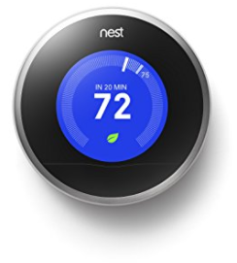

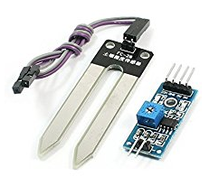
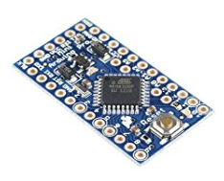
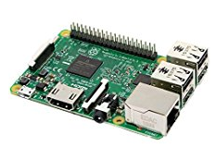
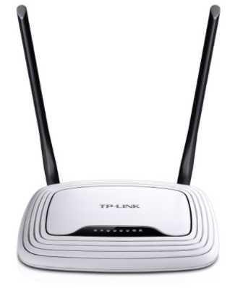
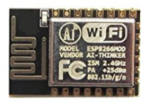
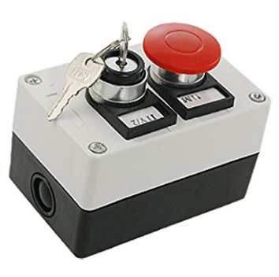

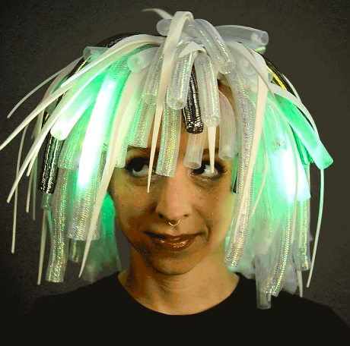
Hardware

Slide 7
Network

Slide 8
Code
Arduino /
ESP8266
C/C++
MQTT
Raspberry Pi
Linux
NodeJS / Javascript
C/C++
Python
MQTT

Slide 9
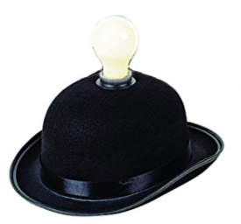

MQTT - IoT Message Protocol
Clients
Broker

Slide 10
#SheCodesNow

Slide 11

Install NodeJS
Visit http://NodeJS.org
Click the download button

Slide 12
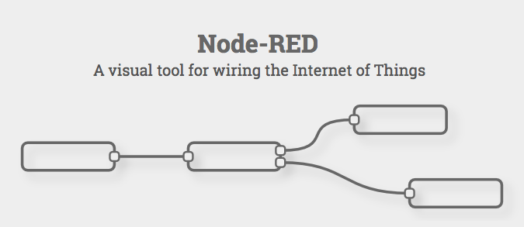
Install
Node-Red
$ sudo npm install -g node-red
$ node-red
…
Server now running at http://127.0.0.1:1880/

Slide 13
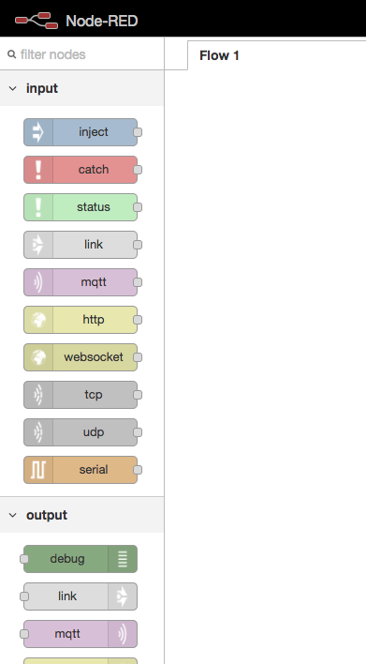
Node-Red Interface
Inputs
Outputs
Functions
Others…
Drag / Drop / Connect

Slide 14
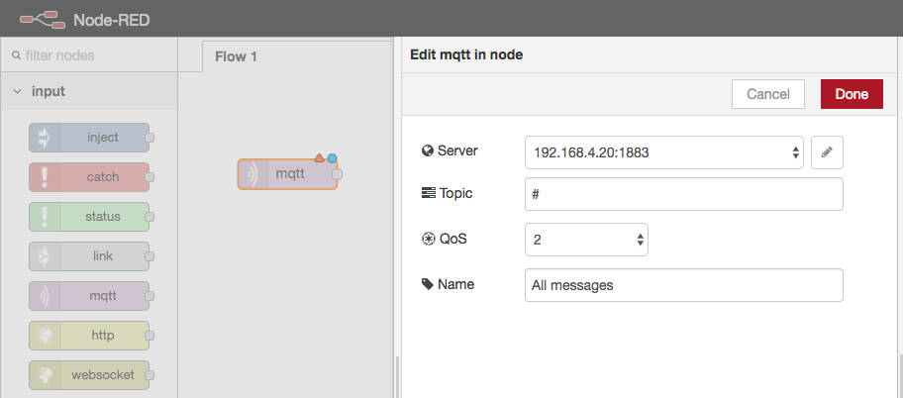
Add an MQTT Input Node

Slide 15
Working Session
Publishing and running flows
Flows with code
Custom nodes
Open source nodes & flows
Flows used in this meetup

Slide 16
Overview
Build your thing
Connect it to MQTT
Add smarts with node-red flows
Connect to the internet with node-red

Slide 17
Next steps
Instructables.com
Local Makerspaces

