Slide 1



Problem Theme Student Outreach & Application Tracking System
Team No 14

Slide 2
Problem Statement brief:
Hard to track students: Manual forms and links make it slow and confusing.
No insight on progress: Hard to see who is interested, registered, or completed.
Data scattered: Information is in many places; admins can’t see it all at once.
Limits impact: Katalyst struggles to reach more students and maximize STEM (Science,Technology, Engineering, and Mathematics) opportunities.
2
August 20, 2024

Slide 3
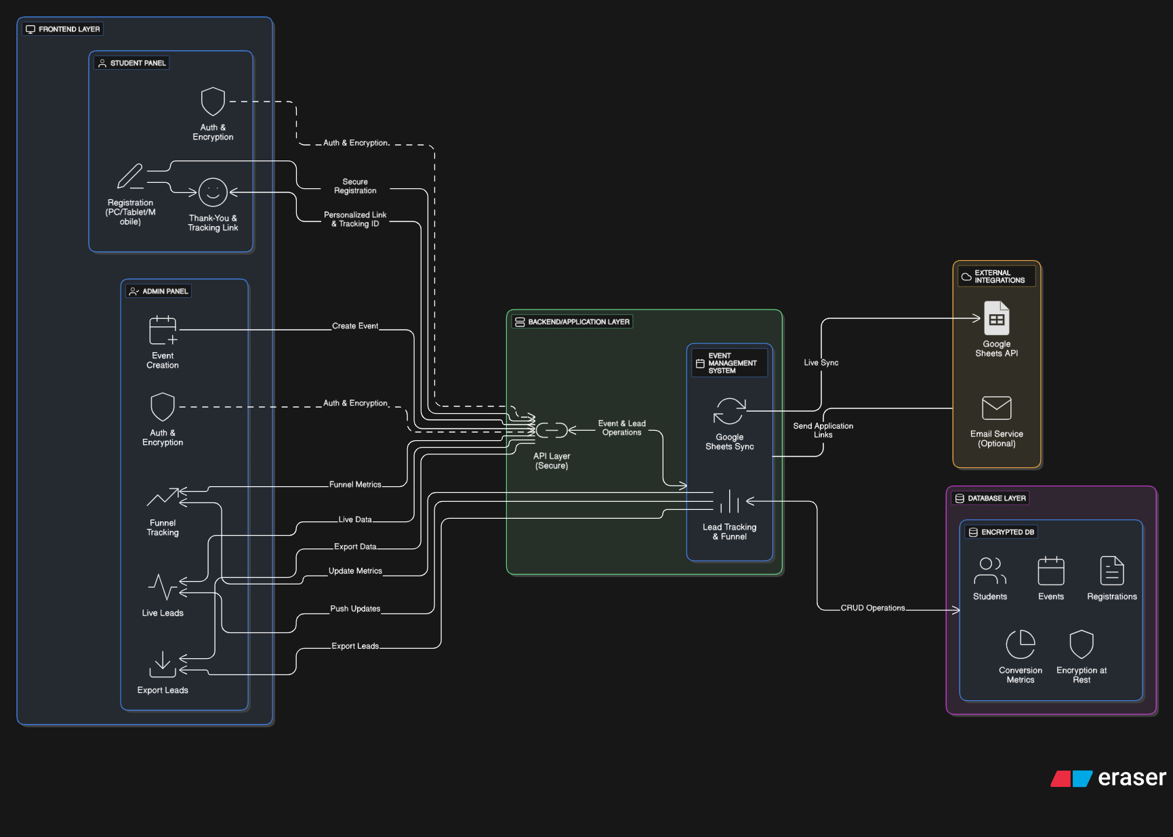
Solution Overview:
3
August 20, 2024

Slide 4
USP’s
Data-driven decisions replace guesswork in outreach strategy.
Enriched UI/UX – Autofill details in Application form and required fields reducing errors and manual efforts , Prevention of fraud and duplicate entries.
Smart Admin Control – Analytics-driven dashboards make event planning and lead management effortless

Slide 5
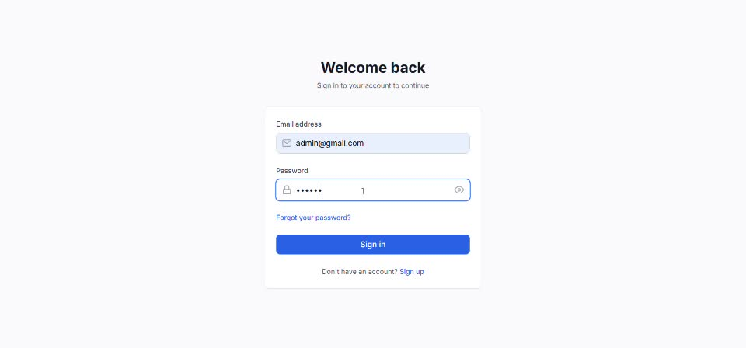
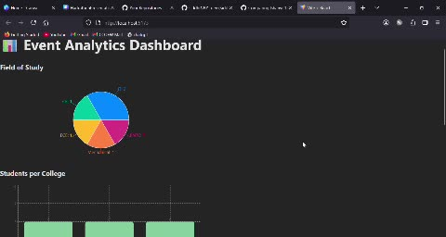
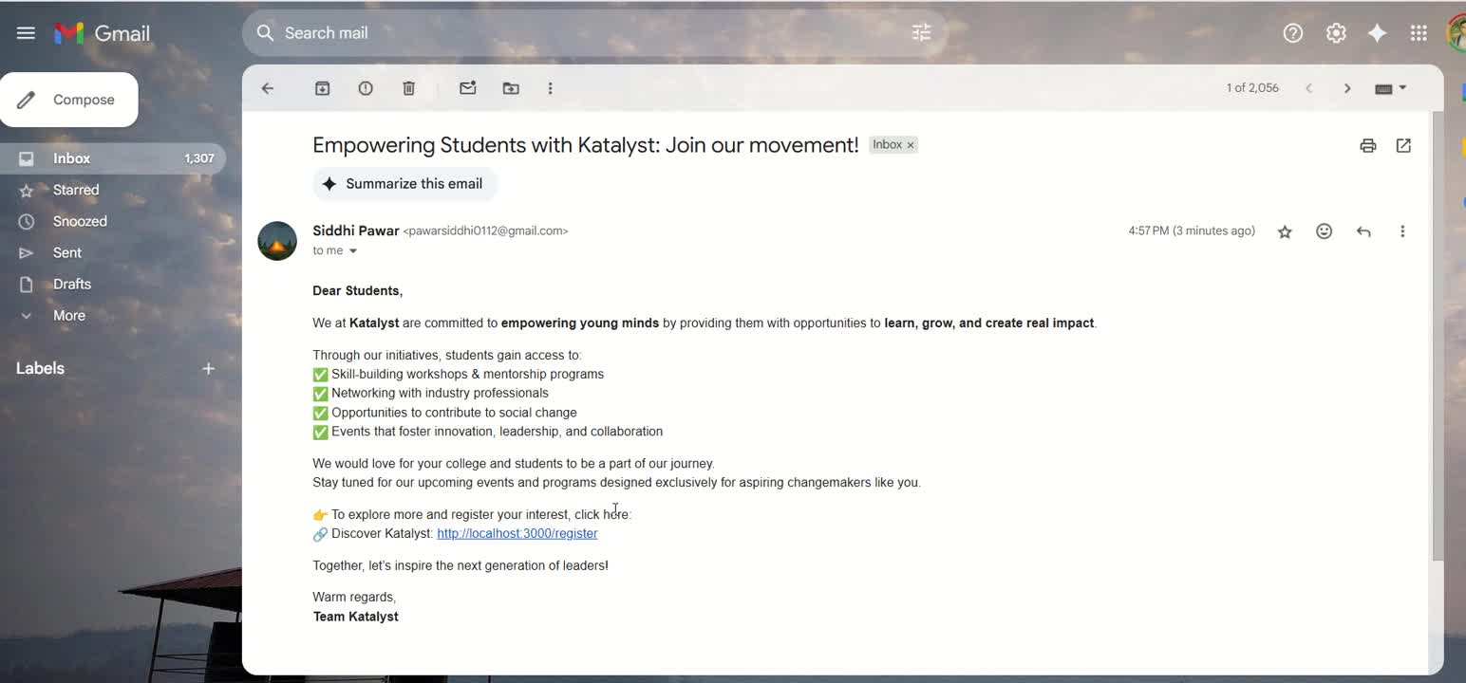
Demo/Prototype
4
August 20, 2024

Slide 6





Technology Stack
Frontend
Backend
•GitHub - https://github.com/Mastercard-Code-For-Change-2-0/Team-14
5
August 20, 2024

Slide 7
Impact
Streamlined Outreach: Effortlessly track student engagement and event performance.
Higher Conversions: Monitor student journey from Interested → Registered → Completed.
Real-Time Insights: Live dashboards and Google Sheets sync for instant data.
Scalable & Secure: Handles multiple events with responsive UI and protected student data.
Future scope
Nationwide Engagement: Seamless integration with social media, emails, and event platforms to expand reach across urban and rural areas.
Alumni Connect: Alumni mentor newcomers, creating a chain reaction of growth and multiplying STEM opportunities.
Intelligent Feedback Insights: Use AI-driven sentiment analysis on student feedback to improve future events.
6
August 20, 2024

Slide 8
Q&A
7
August 20, 2024

