Slide 1

Problem : A Student Outreach and Application Tracking System
Team No : 17
Sanshey (E&TC)
Sahil Sanas ()
Arsh Singh (IT)
Suswan Joglekar ()
Shubham Rade ()
Saumya Jain (E&TC)
Harshita Mahakalkar (AI&DS)
Ruchita Kakade (AI&DS)

Slide 2
Problem Statement brief:
Data scattered across forms and spreadsheets → no single source of truth.
Time-consuming for NGO staff to manage and consolidate information.
Error-prone (duplicates, missing data, wrong entries).
Difficult to track conversions from registration → application → selection.
No automated reminders, so students may miss events.
Attendance verification is manual

Slide 3
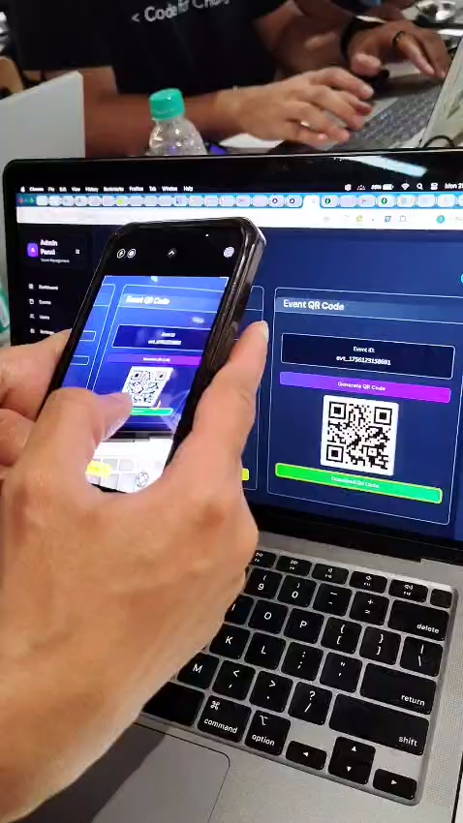
Demo/Prototype

Slide 4
Impact of System
Encrypting PII Data – Student information is stored securely, ensuring privacy and compliance with data protection standards.
Personalized Application and Event Links to Email Inboxes – Each student gets a unique link via email, avoiding duplicate registrations and making access simple.
QR Code Access, Better Outreach – Events can be joined quickly by scanning QR codes, boosting participation and outreach.
Automated Attendance Tracking (Interested, Registered, Applied) – Attendance reports are generated directly from Zoom/Teams, reducing manual effort and improving accuracy.

Slide 5
Technology Stack
Frontend - Next JS, Clerk(Auth)
Backend - Node.js , Express
Database - MongoDB

Slide 6
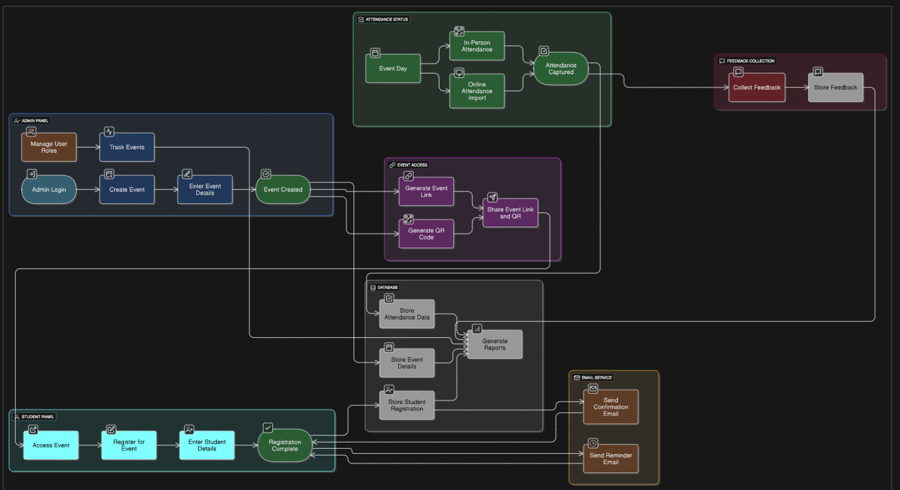
Solution Overview:

Slide 7
Q&A

