Slide 1

Problem Theme 1/2/3
Team #19

Slide 2
Problem Statement brief:
Problem Statement – Manual Co-ordination of Donation Matching
Build a platform to connect donors and receivers for kind donations.
Business need Seva Sahayog Foundation requires a digital portal to facilitate donations between -> Donors: individuals, corporates, institutions AND Receivers: NGOs, schools, hostels, old-age homes, community organizations
The platform should enable:
Donors → list available items
Receivers → post their requirements
Seamless matching & transparent transactions without manual delays

Slide 3
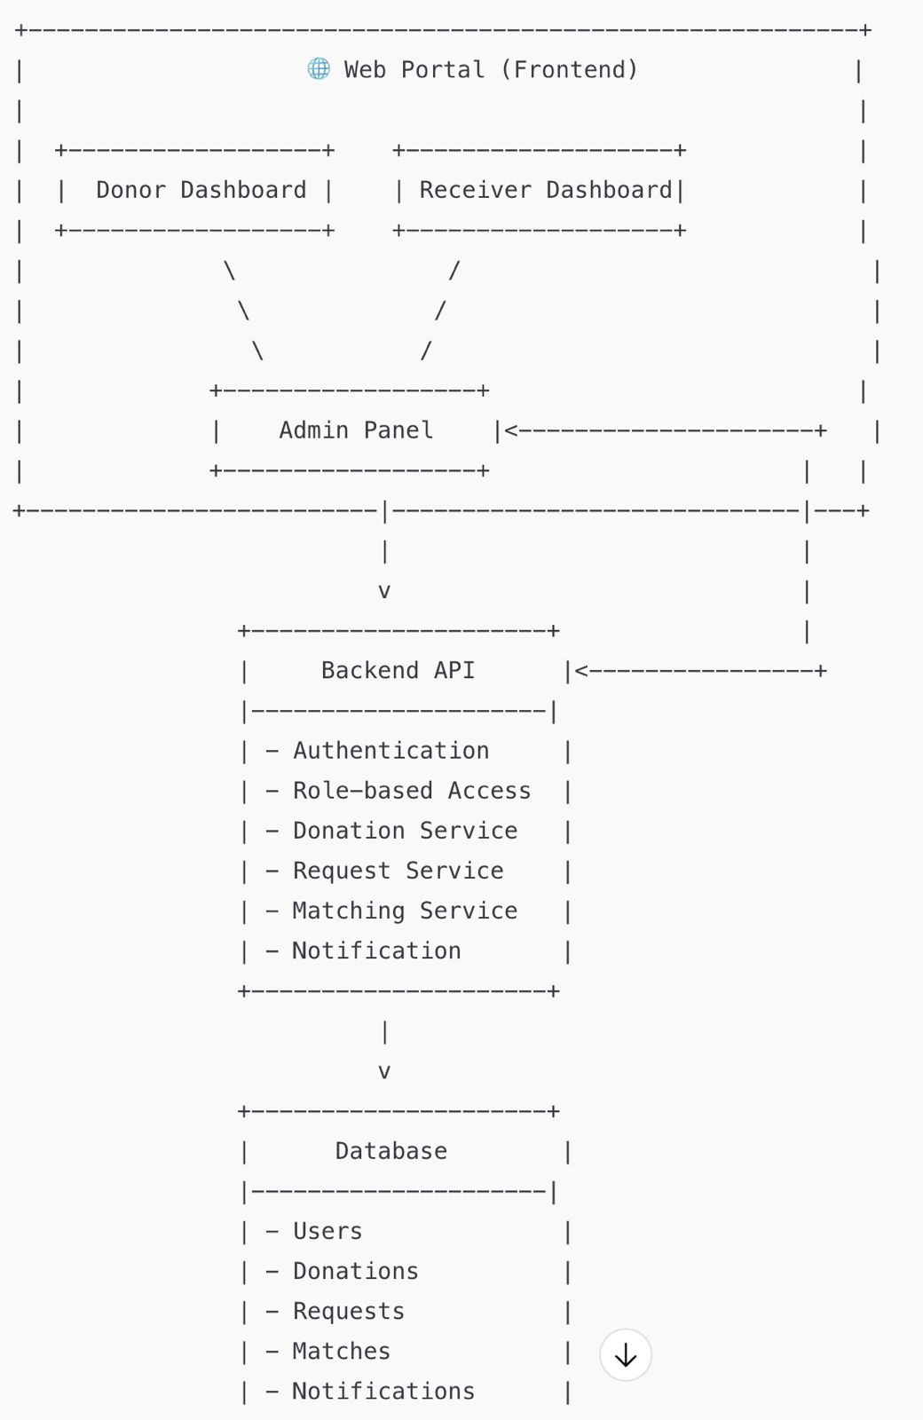
Solution Overview:

Slide 4
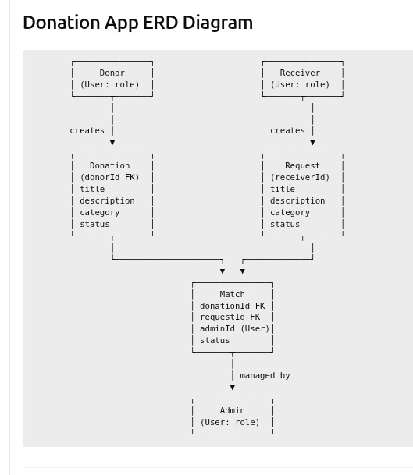
ERD DIAGRAM

Slide 5
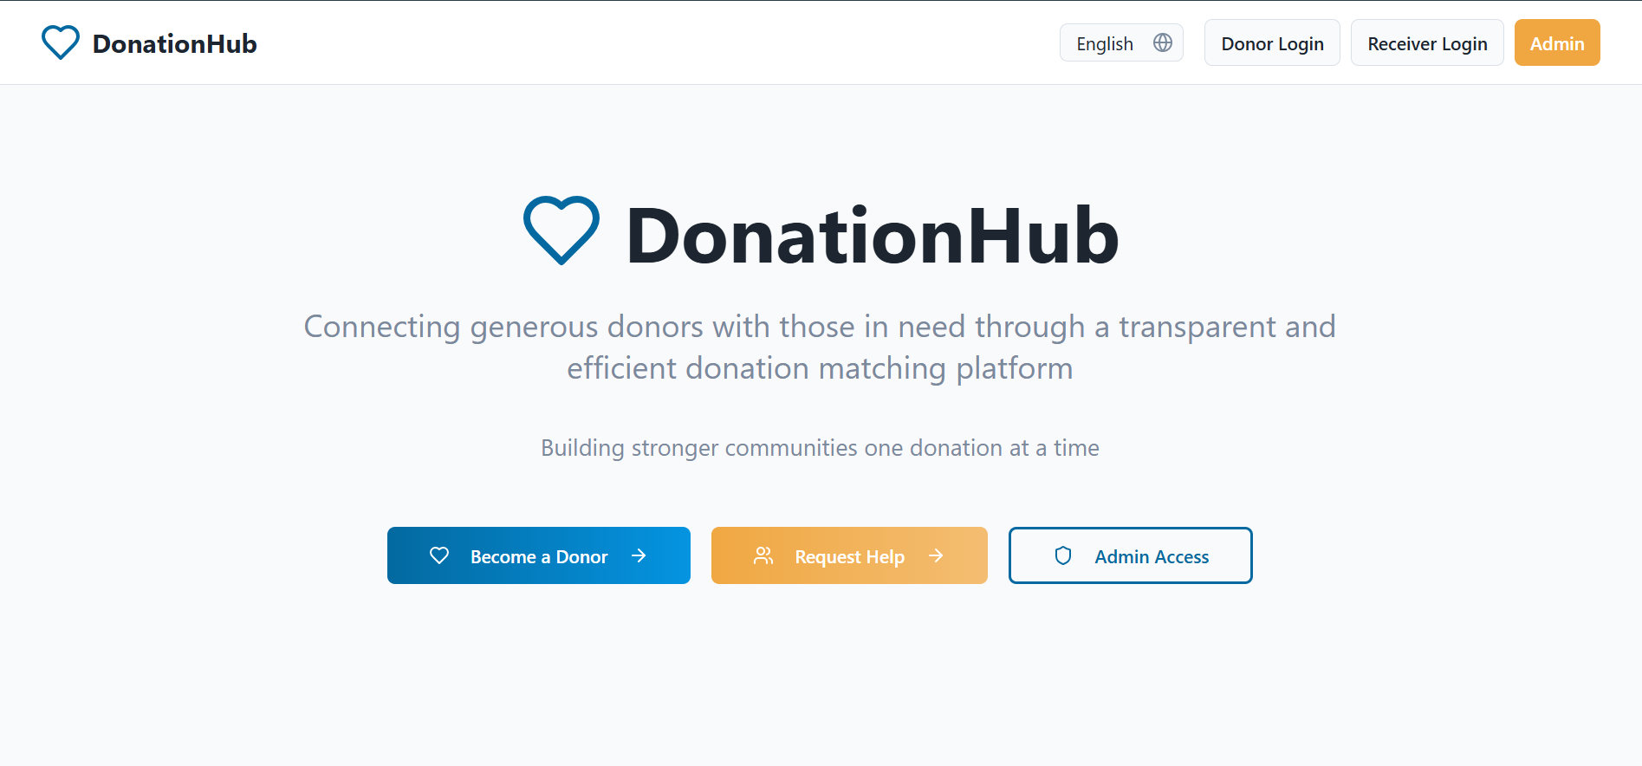
Demo/Prototype

Slide 6
Impact/Future scope
Future Scope (Slide Bullets – for PPT)
📱 Mobile App (React Native) for easy access
🌏 Multilingual support for wider reach
🤖 AI-based smart matching of donors & receivers
📊 Analytics dashboard → track donations & impact
💳 Payment gateway integration (future monetary donations)
🏢 Partnerships with NGOs & corporates

Slide 7
Tech Stack
Frontend (React.js)
Responsive and interactive UI - Donor, Receiver & Admin dashboards
Backend (Node.js + Express)
Business logic & REST APIs - Handles authentication & validation
Database (MongoDB – Local) - Stores users, donations,

Slide 8
Q&A

