Slide 1



Student Outreach and
Event Management System
Team 23
For Katalyst

Slide 2
Problem Statement
Students feel lost and disconnected in the process.
Katalyst struggles to see which events truly work.
Together, this weakens the impact of its STEM mission.
2

Slide 3
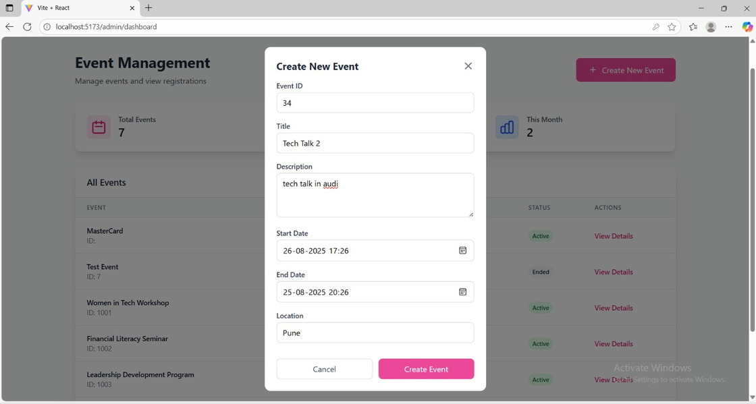
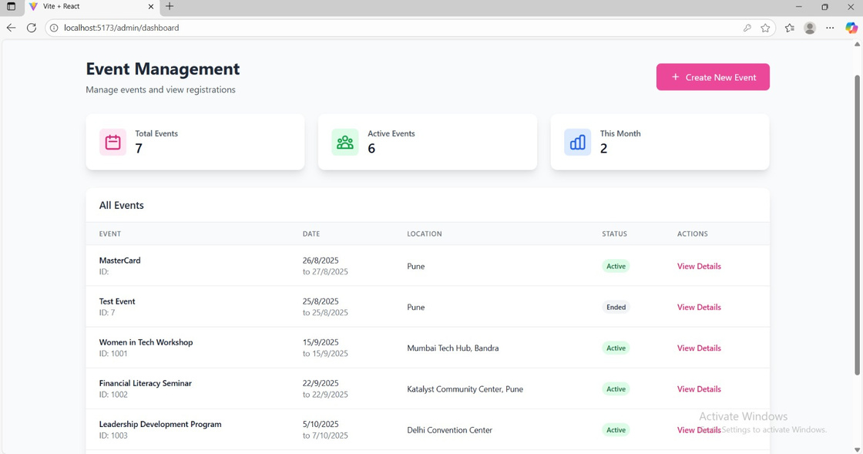
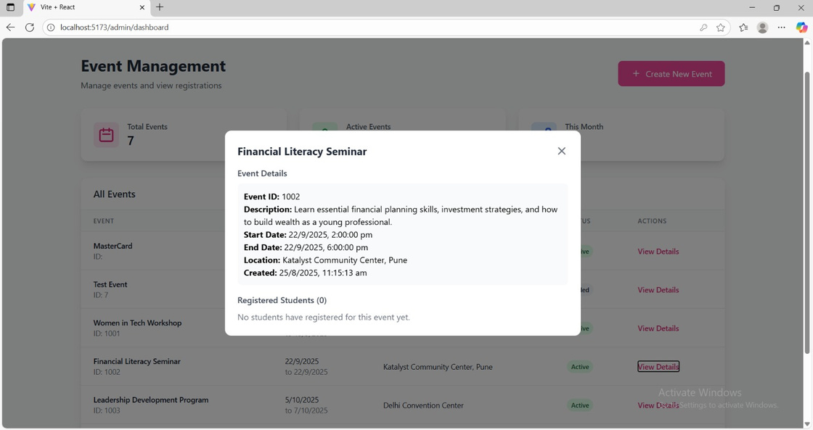
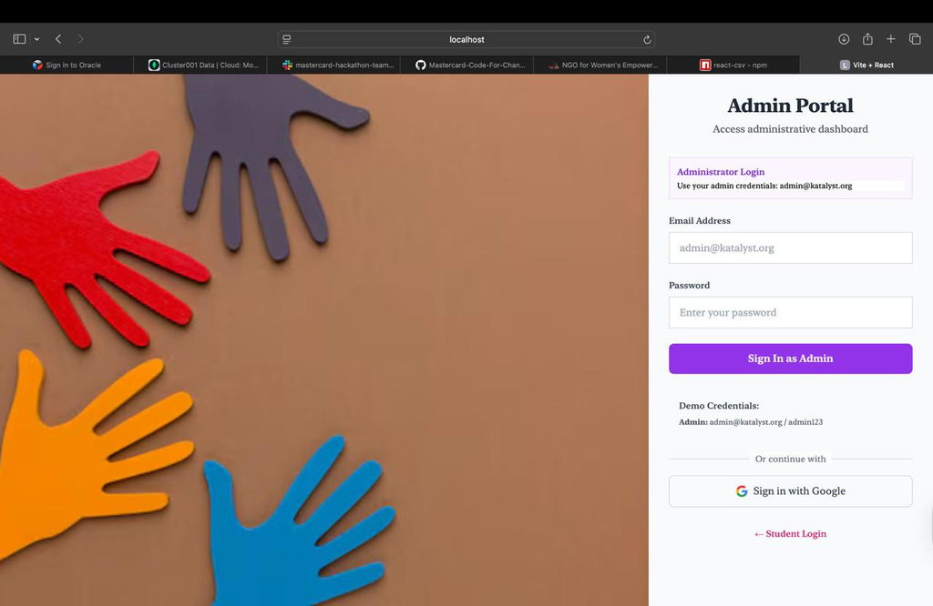
Demo/Prototype

Slide 4
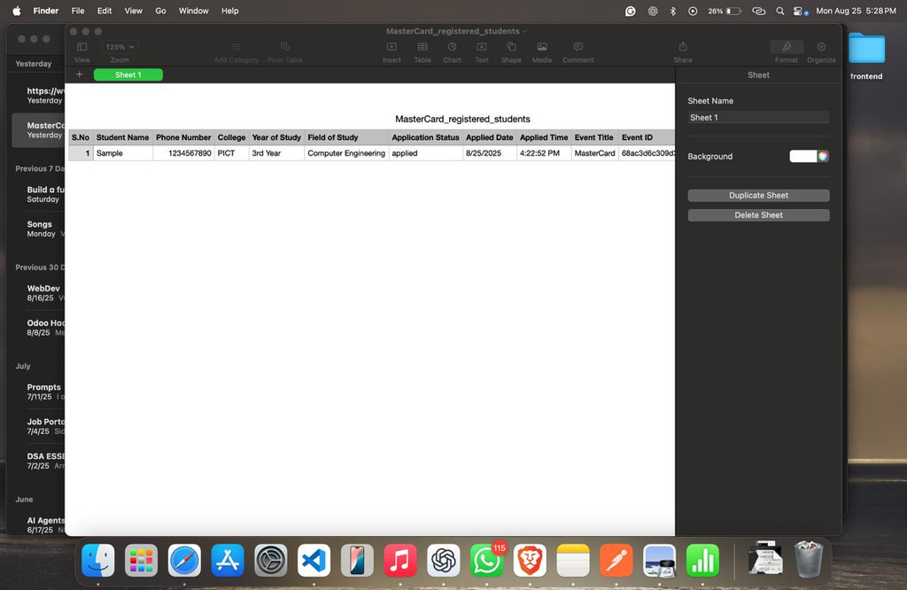
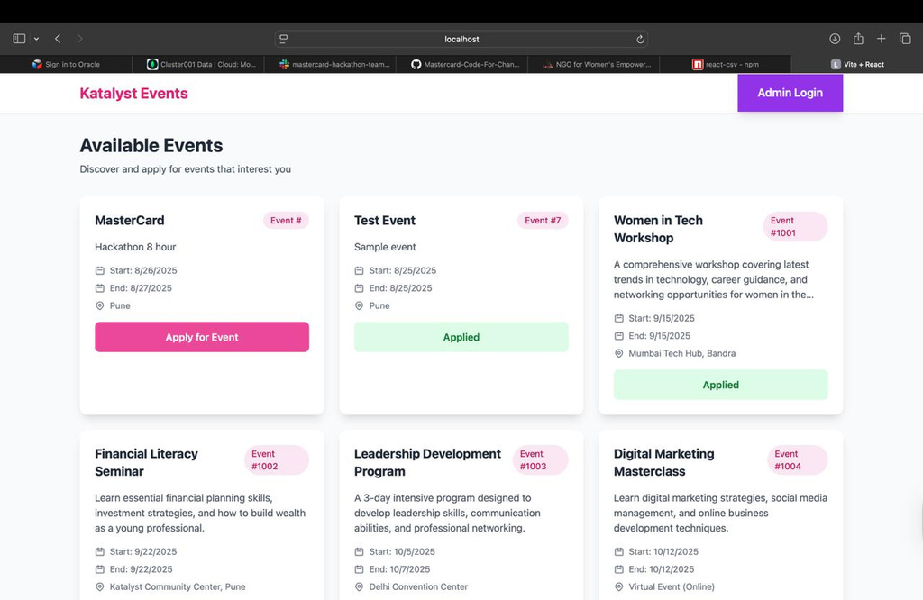
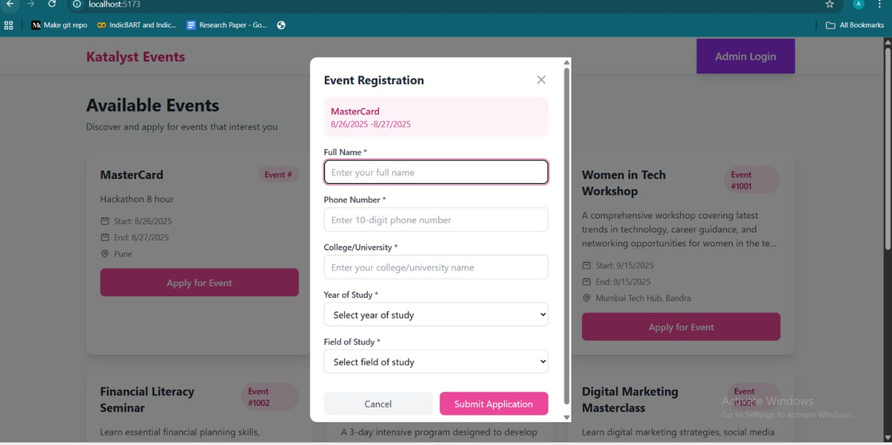

Slide 5
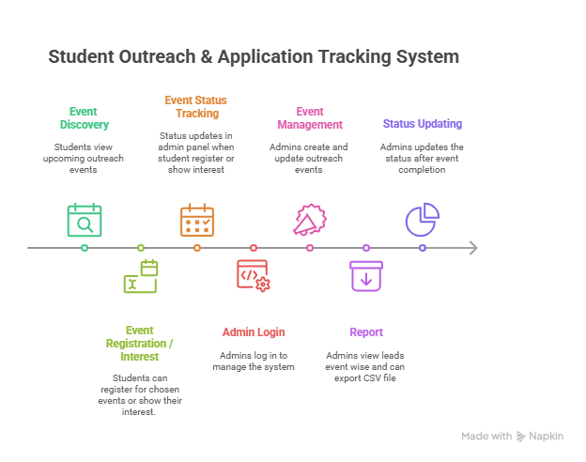
Solution Overview:
3

Slide 6
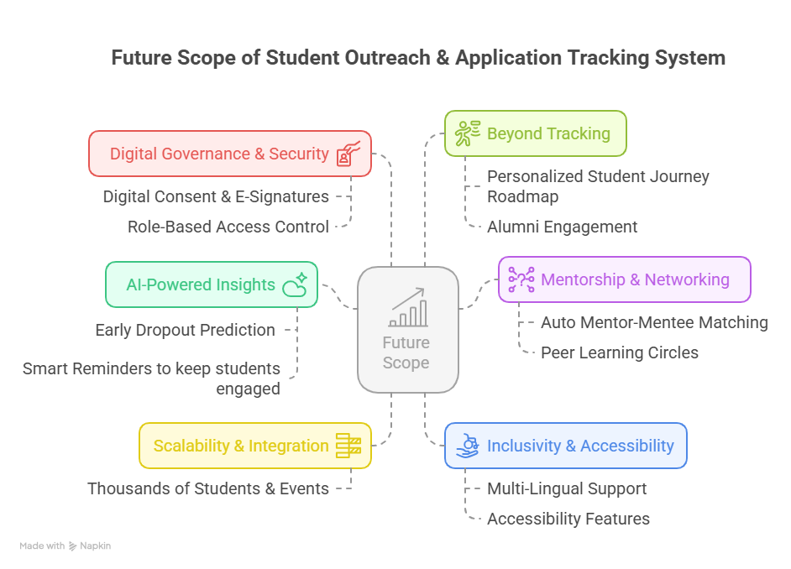
6

Slide 7



Technology Stack
React.js → Built a clean, responsive student & admin interface.
Node.js + Express → Handled backend APIs & event management logic.
MongoDB → Stored Student data, Admin data ,Event Data ,Received Applications with timestamps for easy tracking.
Tailwind CSS → Designed a modern, mobile-friendly UI.
GitHub Repository Link
5

Slide 8
Q&A
7
August 20, 2024

