Slide 1

Problem Theme – Katalyst NGO
Design a student outreach and application tracking system
Team 8

Slide 2
Problem Statement
Katalyst conducts annual outreach and enrollment drives to empower young women from low-income communities to pursue careers in STEM. However, its current student outreach and enrollment tracking process is heavily manual, relying on generic event links and paper-based forms. While this approach helps capture basic student interest.
Problems
Track the performance of individual outreach events.
Monitor the complete journey of potential candidates from first interaction to final enrollment.
Provide real-time, accurate, and consolidated data to stakeholders.

Slide 3








Technology Stack
Front-End
Back-End
Database

Slide 4
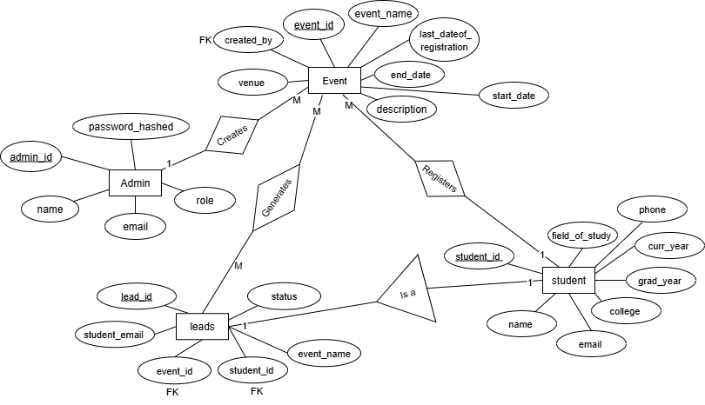
Solution Overview
ER-Diagram

Slide 5
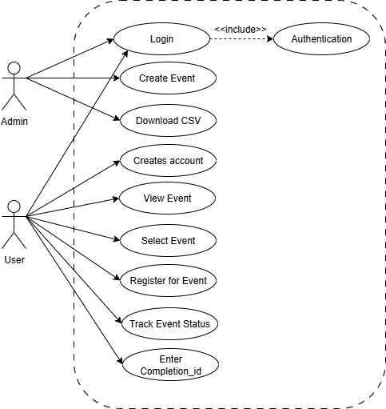
Solution Overview
Use-Case Diagram

Slide 6
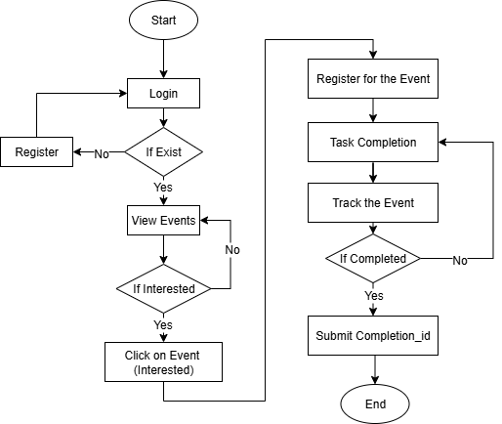
Solution Overview
Flowchart Diagram

Slide 7
Demo/Prototype
https://github.com/Mastercard-Code-For-Change-2-0/Team-8/blob/main/Screen%20Recording%202025-08-25%20171956.mp4
Admin Flow -
Create Events
View Leads
Export CSV
Track Conversion
User Flow -
Register for Events
Responsive UI
Non – Functional Requirements
AES – Used to store sensitive data of user in database encryption.
JWT – Used for authentication in web-apps.
Responsive UI

Slide 8
Q&A

