Slide 1

Build a Career Tracking Platform for Skilled Youth
Team No. 9
Anaya Patil Sejal Band Ankita Dagade Anushka Kondkar Paramjeet Singh Ayush Vaidya Gaurav Pilania Prathamesh Chinchole

Slide 2

Problem Statement Brief:
Y4D is taking a lot of initiative and effort in upskilling young aspirants, but a major gap exists in post-placement tracking.
Key Challenges:
Inability to track long-term impact
Lack of centralized platform
Manual data collection methods
Absence of a structured digital mechanism
Expectation:
Build a solution for outgoing students and Y4D administrators to create/update/track the impact Y4D has created in students’ professional careers.

Slide 3
Solution Overview:
Centralized Beneficiary Database with their career progression.
Smart Automated data capture to keep relevant data via Admin Triggers:
Periodic profile review requests via SMS, email, with rewards.
Auto sync via professional career network portals (e.g. Naukri.com, LinkedIn) with beneficiary consent.
Year-on-year growth tracking based on company tier.
Alumni engagement and their career advice for new joiners.
Admin dashboard with real time analytics and reporting.
Key Features :
Multi Tenancy support scalability.
Admin Portal to Manage Overall System & Triggers For Periodic Data Upgrade with incentives.
Clerk Module to Support Single And Bulk Student Registration.
Student Module to Manage Profile and Career Advice for juniors , to view their fellows & Organization Progress.

Slide 4
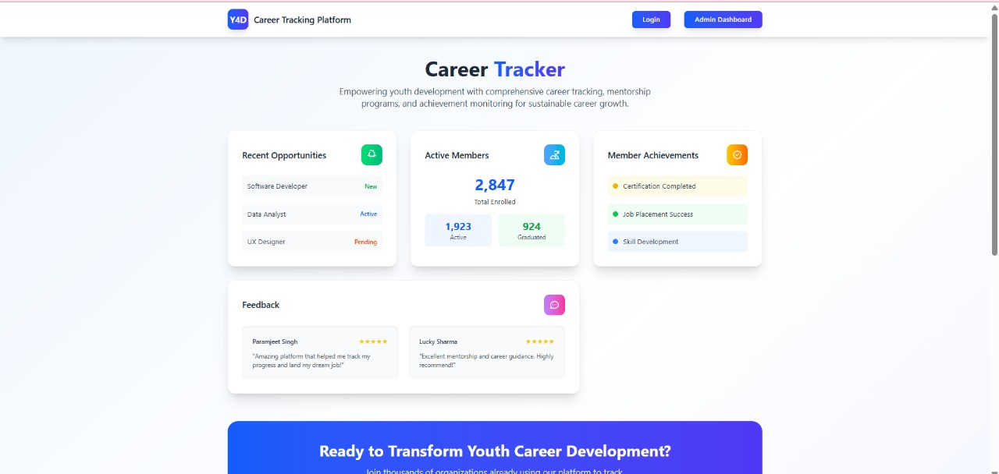
Landing Page

Slide 5
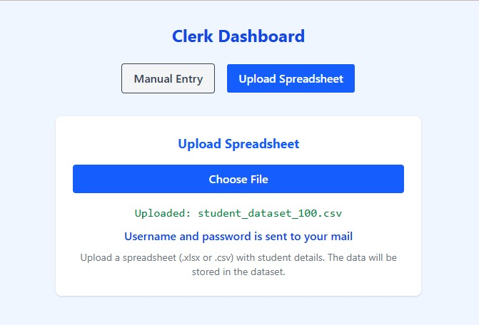
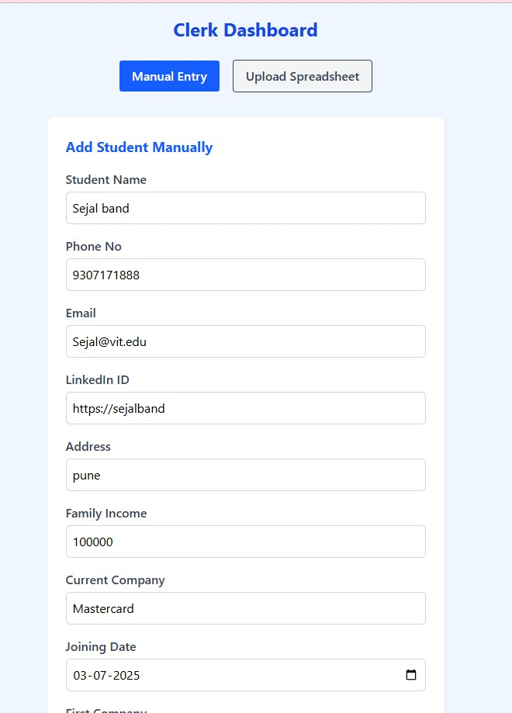
Clerk Dashboard

Slide 6
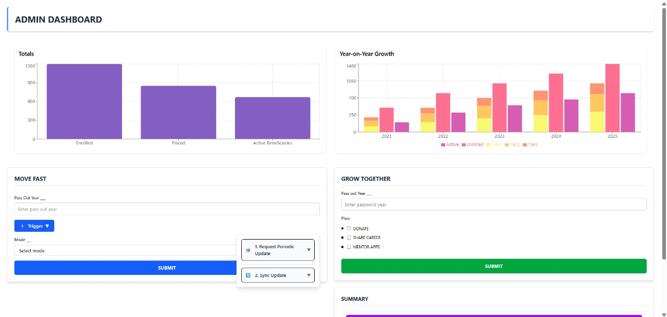
Admin Dashboard

Slide 7
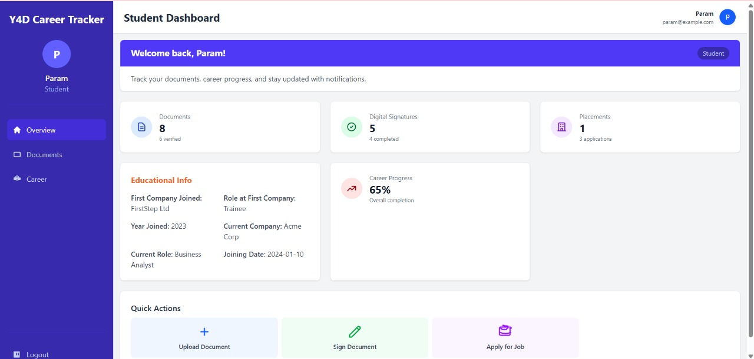
Student Dashboard

Slide 8
Demo/Prototype

Slide 9
Technology Stack , Security & Privacy
Frontend : React.js, Vite
Backend Application Layer : Node.js, Express.
Database : Mongo DB
Security :
Password based system login.
Data in transit secured with https (TLS 1.2).
Data at rest :
Password stored as Hash value only.
DB Level data encryption and Field level encryption planned in future scope.
Privacy :
During Enrolment Admin will get Consent to use beneficiary contact details and carrier site public ID for message broadcasting and data refresh.
https://github.com/Mastercard-Code-For-Change-2-0/Team-9

Slide 10
Impact & Future scope :
Impact
For Students
Continuous career support
Access to alumni network & opportunities
For Institution
Strong evidence of student success (for marketing & accreditations)
Data-driven placement improvement
Stronger alumni relations
For Recruiters/Partners
Verified, updated talent pipeline
Easier collaboration for placements
Future Scope
AI Driven Analytics & Chat Bot.
Full Integrations With Career Site to maintain up to date beneficiary tracking and career update.

Slide 11
Q&A

