Slide 1
CREDIT CARD DEFAULTS PREDICTION
Master_Neuron

Slide 2
Objective
The objective of this presentation is to showcase the end-to-end machine-learning pipeline for credit card default prediction. We will demonstrate the process from data collection and preprocessing to model training and prediction. By the end of this presentation, you will understand how the pipeline works and its potential benefits in predicting credit card defaults accurately.

Slide 3
Benefits
Improved Risk Assessment: By utilizing machine learning algorithms, we can identify high-risk customers and make more informed decisions on credit approvals and limits, reducing the risk of defaults.
Enhanced Customer Experience: Accurate prediction of credit defaults enables proactive communication with customers to provide suitable financial solutions, leading to better customer satisfaction.
Cost Savings: Identifying potential defaulters early on allows for targeted collection efforts, minimizing losses and reducing operational costs.

Slide 4
Data Sharing Agreement
To ensure compliance with data protection regulations and maintain data privacy, we adhere to a robust data sharing agreement. Our data sharing agreement specifies the terms and conditions under which data is shared with stakeholders, ensuring responsible data usage and confidentiality.

Slide 5
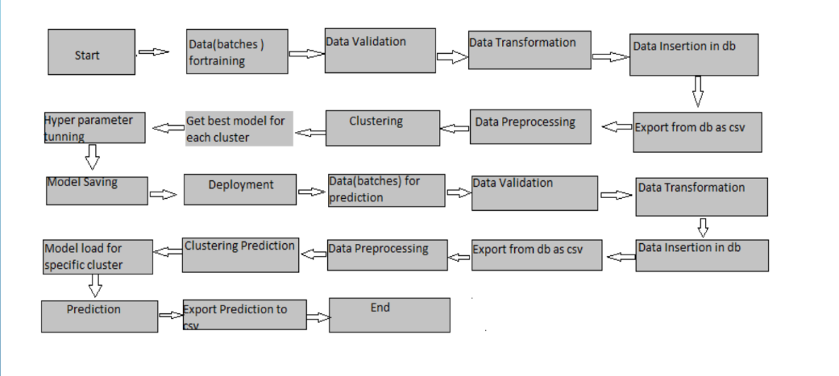
Architecture

Slide 6
Data Validation and Data Transformation
Data Collection: We collect credit card transaction data from various sources, including transaction history, customer demographics, and payment details.
Data Validation: The collected data undergoes thorough validation to check for missing values, outliers, and inconsistencies. Any discrepancies are addressed to ensure data quality.
Data Transformation: We perform data transformation techniques such as one-hot encoding, scaling, and normalization to make the data suitable for model training.

Slide 7
Data Insertion in Database
The preprocessed data is inserted into a database for easy access and retrieval during model training and prediction phases. A reliable database management system ensures efficient data storage and retrieval.

Slide 8
Model Training
Feature Selection: We identify the most relevant features from the preprocessed data to create an effective model.
Model Building: Using machine learning algorithm such as SVM, we build a predictive model for credit card default.
Model Evaluation: If necessary, the trained model uses accuracy, precision, recall, and F1-score metrics to assess its performance and fine-tune hyperparameters.

Slide 9
SVM
Effective in High-Dimensional Spaces: SVM performs well even in cases where the number of features is greater than the number of samples, making it suitable for complex datasets.
Robust against Overfitting: SVM uses regularization parameters to control overfitting, resulting in more generalized models.
Versatility: SVM can handle both linear and non-linear classification tasks through the use of various kernel functions.

Slide 10
Model Selection
We evaluate multiple models to determine the most suitable one for credit card default prediction based on their performance and efficiency.

Slide 11
Prediction
Using the selected model, we make predictions on new data to assess the likelihood of credit card defaults for individual customers. This enables us to take proactive measures to manage credit risk effectively.

Slide 12
Conclusion
In conclusion, our machine learning pipeline for credit card default prediction offers significant benefits in risk assessment, customer experience, and cost savings. By following strict data sharing agreements and employing robust data validation techniques, we ensure responsible and accurate predictions, aiding financial institutions in making informed decisions for sustainable growth and improved customer satisfaction.

