Slide 1
Mastering
Digital Design
with SystemVerilog on FPGAs
Slides by John Wickerson
Lecture 3

Slide 2
This lecture
Pulse-width modulation (PWM)
Finite state machines (FSMs)
The analogue add-on card

Slide 3
This lecture
Pulse-width modulation (PWM)
Finite state machines (FSMs)
The analogue add-on card

Slide 4
DAC
Digital-to-analogue conversion (DAC) can be done using a string of resistors.
Here is a 3-bit DAC. It uses 2³ = 8 resistors.
When the digital input is 5, we close (only) switch sw5, which means VDAC is ⅝Vref.
Vref
R
sw7
R
sw6
R
sw5
R
sw4
VDAC
R
sw3
output
buffer
R
sw2
R
sw1
R
sw0

Slide 5
DAC
1
in[2]
MUX
1
0
in[1]
MUX
MUX
1
0
1
0
in[0]
MUX
MUX
MUX
MUX
1
0
1
0
1
0
1
0
Vref
R
sw7
R
sw6
R
sw5
R
sw4
VDAC
R
sw3
output
buffer
R
sw2
R
sw1
R
sw0

Slide 6
DAC via PWM
DAC can also be done using digital components, via pulse-width modulation (PWM).
triangle wave
data in
PWM signal
+ low pass filter

Slide 7
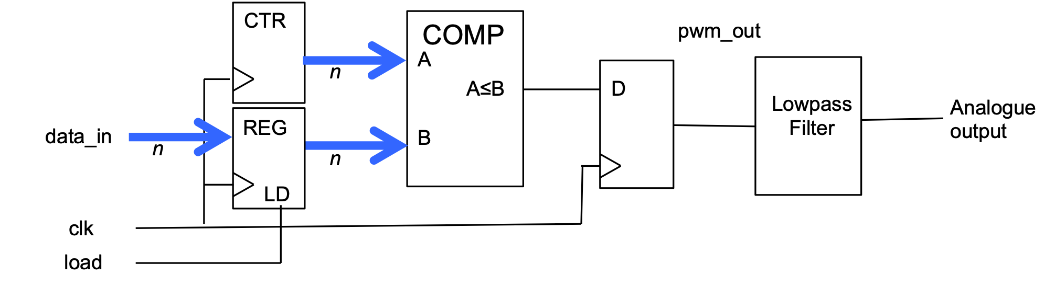
DAC via PWM
DAC can also be done using digital components, via pulse-width modulation (PWM).

Slide 8






DAC via PWM
always_ff @(posedge clk)
if (load == 1’b1) d <= data_in;
always_ff @(posedge clk) begin
count <= count + 1'b1;
if (count > d)
pwm_out <= 1'b0;
else
pwm_out <= 1'b1;
end
endmodule
module pwm (
input logic clk,
input logic [9:0] data_in,
input logic load,
output logic pwm_out
);
logic [9:0] d = '0;
logic [9:0] count = '0;

Slide 9
This lecture
Pulse-width modulation (PWM)
Finite state machines (FSMs)
The analogue add-on card

Slide 10
This lecture
Pulse-width modulation (PWM)
Finite state machines (FSMs)
The analogue add-on card

Slide 11
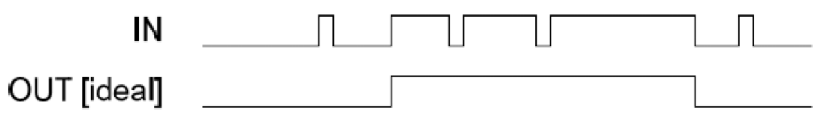
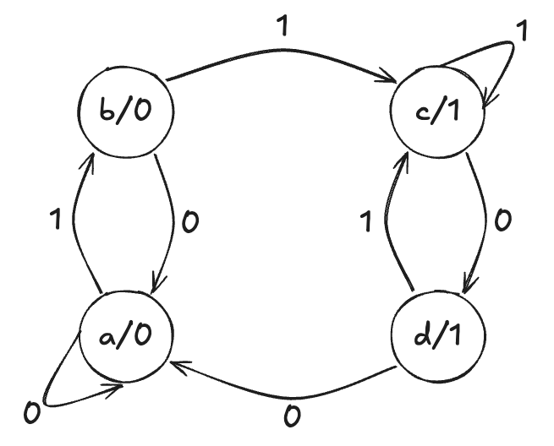
Example 1: denoiser
Task:
state | meaning | output
a | "definitely low" | 0
b | "maybe rising" | 0
c | "definitely high" | 1
d | "maybe falling" | 1

Slide 12
Mealy machines
output
input
combinational logic
state
register
current state
combinational logic
next state

Slide 13
Moore machines
output
input
combinational logic
state
register
combinational logic
current state
next state

Slide 14
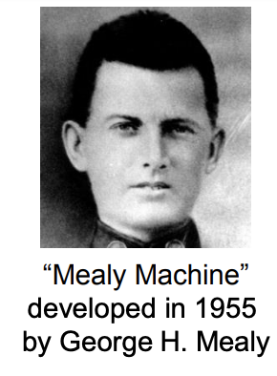
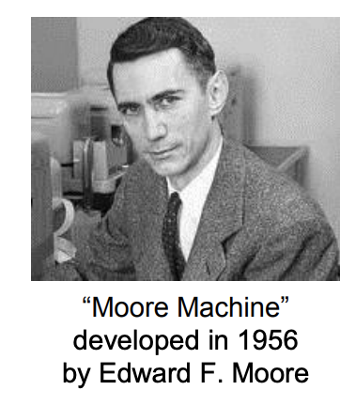
Mealy vs Moore
Mealy machines are a bit more complicated to design.
Moore machines tend to require more states.
Outputs of Moore machines are delayed.
Named after George Mealy (1927–2010) and Edward Moore (1925–2003).

Slide 15
Implementing the FSM
state | meaning | output
a | "definitely low" | 0
b | "maybe rising" | 0
c | "definitely high" | 1
d | "maybe falling" | 1

Slide 16
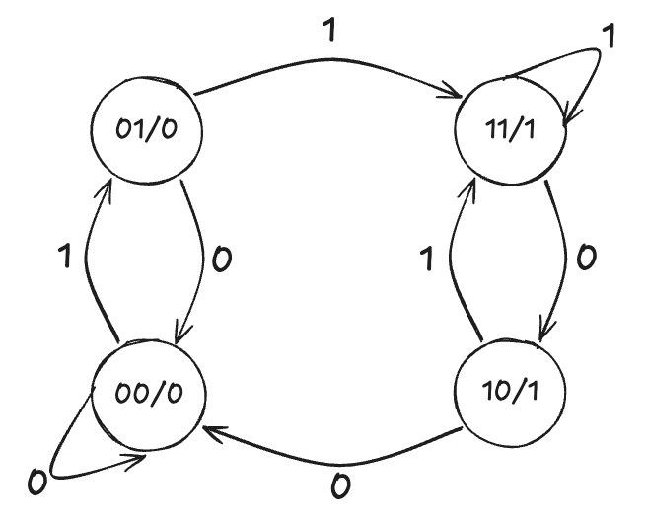
Implementing the FSM
Try to make the output value and the state number similar.
Try to change one bit of the state number per transition.
If two parts of the FSM have identical transitions, try to give the corresponding states similar numbers
state | meaning | output
00 | "definitely low" | 0
01 | "maybe rising" | 0
11 | "definitely high" | 1
10 | "maybe falling" | 1

Slide 17
Implementing the FSM
state s[1:0] | meaning | output out | inputin | next state ns[1:0]
00 | "definitely low" | 0 | 0 | 00
 |  |  | 1 | 01
01 | "maybe rising" | 0 | 0 | 00
 |  |  | 1 | 11
11 | "definitely high" | 1 | 0 | 10
 |  |  | 1 | 11
10 | "maybe falling" | 1 | 0 | 00
 |  |  | 1 | 11

Slide 18
Implementing the FSM
assign out = s[1];
assign ns[1] = s[1] & s[0] | in & (s[0] | s[1]);
state s[1:0] | meaning | output out | inputin | next state ns[1:0]
00 | "definitely low" | 0 | 0 | 00
 |  |  | 1 | 01
01 | "maybe rising" | 0 | 0 | 00
 |  |  | 1 | 11
11 | "definitely high" | 1 | 0 | 10
 |  |  | 1 | 11
10 | "maybe falling" | 1 | 0 | 00
 |  |  | 1 | 11
ns[1] | in=0 | in=1
s=00 | 0 | 0
s=01 | 0 | 1
s=11 | 1 | 1
s=10 | 0 | 1

Slide 19
Implementing the FSM
assign out = s[1];
assign ns[1] = s[1] & s[0] | in & (s[0] | s[1]);
assign ns[0] = in;
state s[1:0] | meaning | output out | inputin | next state ns[1:0]
00 | "definitely low" | 0 | 0 | 00
 |  |  | 1 | 01
01 | "maybe rising" | 0 | 0 | 00
 |  |  | 1 | 11
11 | "definitely high" | 1 | 0 | 10
 |  |  | 1 | 11
10 | "maybe falling" | 1 | 0 | 00
 |  |  | 1 | 11
ns[0] | in=0 | in=1
s=00 | 0 | 1
s=01 | 0 | 1
s=11 | 0 | 1
s=10 | 0 | 1

Slide 20
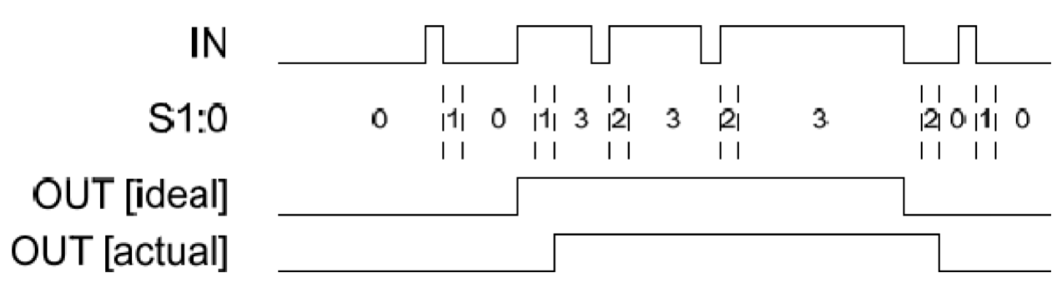
assign out = s[1];
assign ns[1] = s[1] & s[0] | in & (s[0] | s[1]);
assign ns[0] = in;
state s[1:0] | meaning | output out | inputin | next state ns[1:0]
00 | "definitely low" | 0 | 0 | 00
 |  |  | 1 | 01
01 | "maybe rising" | 0 | 0 | 00
 |  |  | 1 | 11
11 | "definitely high" | 1 | 0 | 10
 |  |  | 1 | 11
10 | "maybe falling" | 1 | 0 | 00
 |  |  | 1 | 11
ns[0] | in=0 | in=1
s=00 | 0 | 1
s=01 | 0 | 1
s=11 | 0 | 1
s=10 | 0 | 1

Slide 21
One-hot encoding
"One-hot" means "exactly one bit of a binary number is 1".
One-hot encoding uses more bits, but can lead to simpler logic.
Exercise. Re-implement the FSM using one-hot encoding. Is the logic simpler?
state | encoding as a binary number | one-hot encoding
a | 00 | 0001
b | 01 | 0010
c | 11 | 0100
d | 10 | 1000

Slide 22
Automated FSM Design
module denoiser (
output logic out,
input logic in, clk, rst
);
typedef enum logic [3:0] {
sA = 4'b0001,
sB = 4'b0010,
sC = 4'b0100,
sD = 4'b1000
} state_t;
state_t s = sA;
always_ff @(posedge clk) begin
if (rst) s <= sA;
else begin
case (s)
sA: if (in) s <= sB
sB: if (in) s <= sC;
else s <= sA;
sC: if (!in) s <= sD;
sD: if (in) s <= sC;
else s <= sA;
default: s <= sA;
endcase
end
end
We usually design FSMs at a higher level of abstraction.
declare
states
calculate
next state
always_comb begin
case (s)
sC, sD: out = 1'b1;
default: out = 1'b0;
endcase
end
endmodule
calculate output

Slide 23
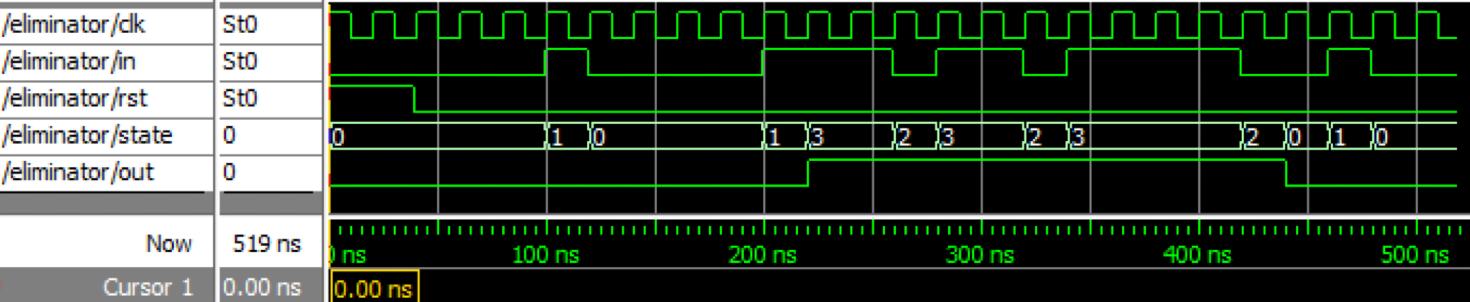
The result

Slide 24
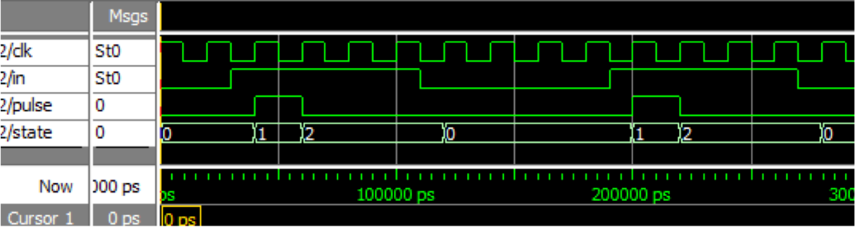
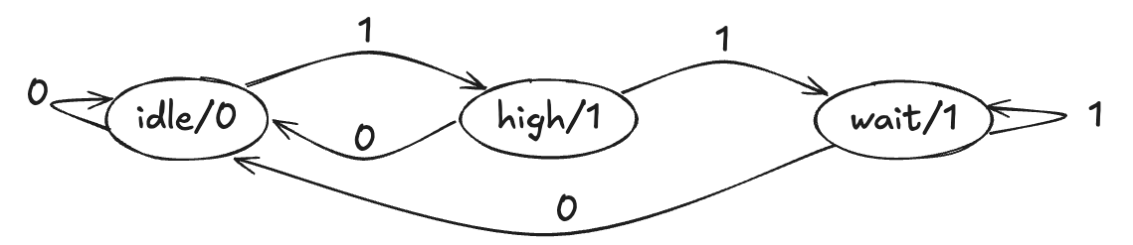
Example 2: pulser
Task: Whenever the input rises, output a 1-cycle pulse.

Slide 25
Example 2: pulser
module pulser (
output logic out,
input logic in, clk
);
typedef enum logic [1:0] {
sIDLE = 2'b00,
sHIGH = 2'b01,
sWAIT = 2'b10
} state_t;
state_t s = sIDLE;
always_ff @(posedge clk) begin
case (s)
sIDLE: if (in) s <= sHIGH;
sHIGH: if (in) s <= sWAIT;
else s <= sIDLE;
sWAIT: if (!in) s <= sIDLE;
endcase
end
always_comb begin
case (s)
sHIGH: out = 1'b1;
default: out = 1'b0;
endcase
end
endmodule
declare
states
calculate
next state
calculate output

Slide 26
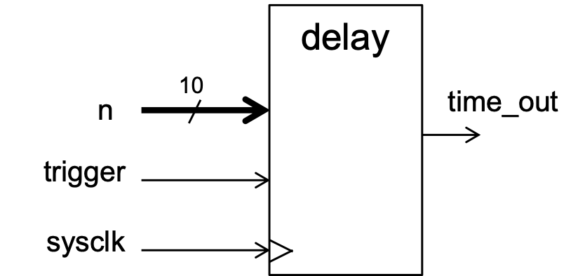
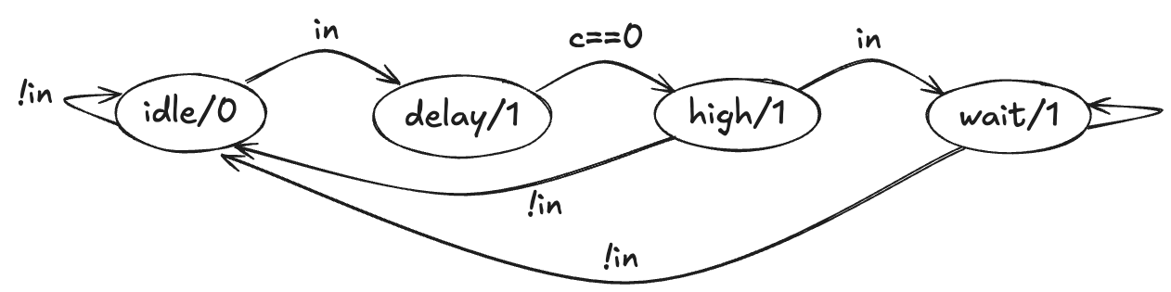
Example 3: delayer
Task: when the 'trigger' input rises, wait for n cycles, then produce a 1-cycle pulse.
Assume n>0

Slide 27
module delayer (
output logic out,
input logic in,
input logic [9:0] n,
input logic clk
);
typedef enum logic [1:0] {
sIDLE = 2'b00,
sDELA = 2'b01,
sHIGH = 2'b11,
sWAIT = 2'b10
} state_t;
state_t s = sIDLE;
logic [9:0] c = '0;
always_ff @(posedge clk) begin
case (s)
sIDLE: if (in) begin
if (n == '0) s <= sHIGH;
else begin
c <= n - 1'b1;
s <= sDELA;
end
end
sDELA: if (c == '0) s <= sHIGH;
else c <= c - 1'b1;
sHIGH: if (in) s <= sWAIT;
else s <= sIDLE;
sWAIT: if (!in) s <= sIDLE;
default: s <= sIDLE;
endcase
end
always_comb begin
case (s)
sHIGH: out = 1'b1;
default: out = 1'b0;
endcase
end
endmodule

Slide 28
This lecture
Pulse-width modulation (PWM)
Finite state machines (FSMs)
The analogue add-on card

Slide 29
This lecture
Pulse-width modulation (PWM)
Finite state machines (FSMs)
The analogue add-on card

Slide 30
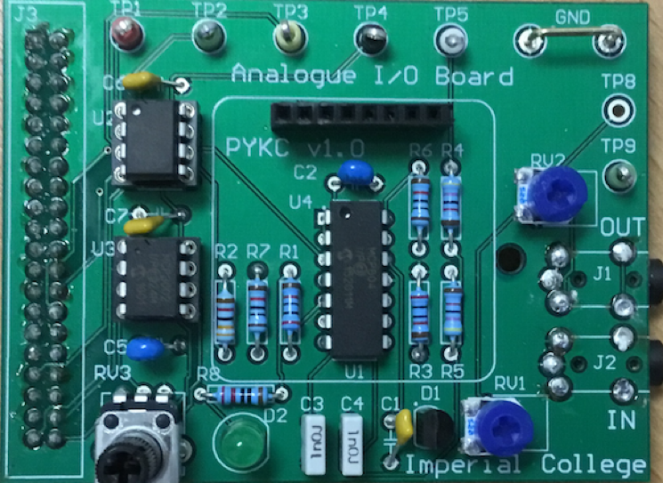
The analogue I/O card
Provides analogue inputs and outputs.
Contains an ADC, a DAC, a low-pass filter, and an op-amp.
Will be used for parts 3 and 4 of the experiment.

Slide 31
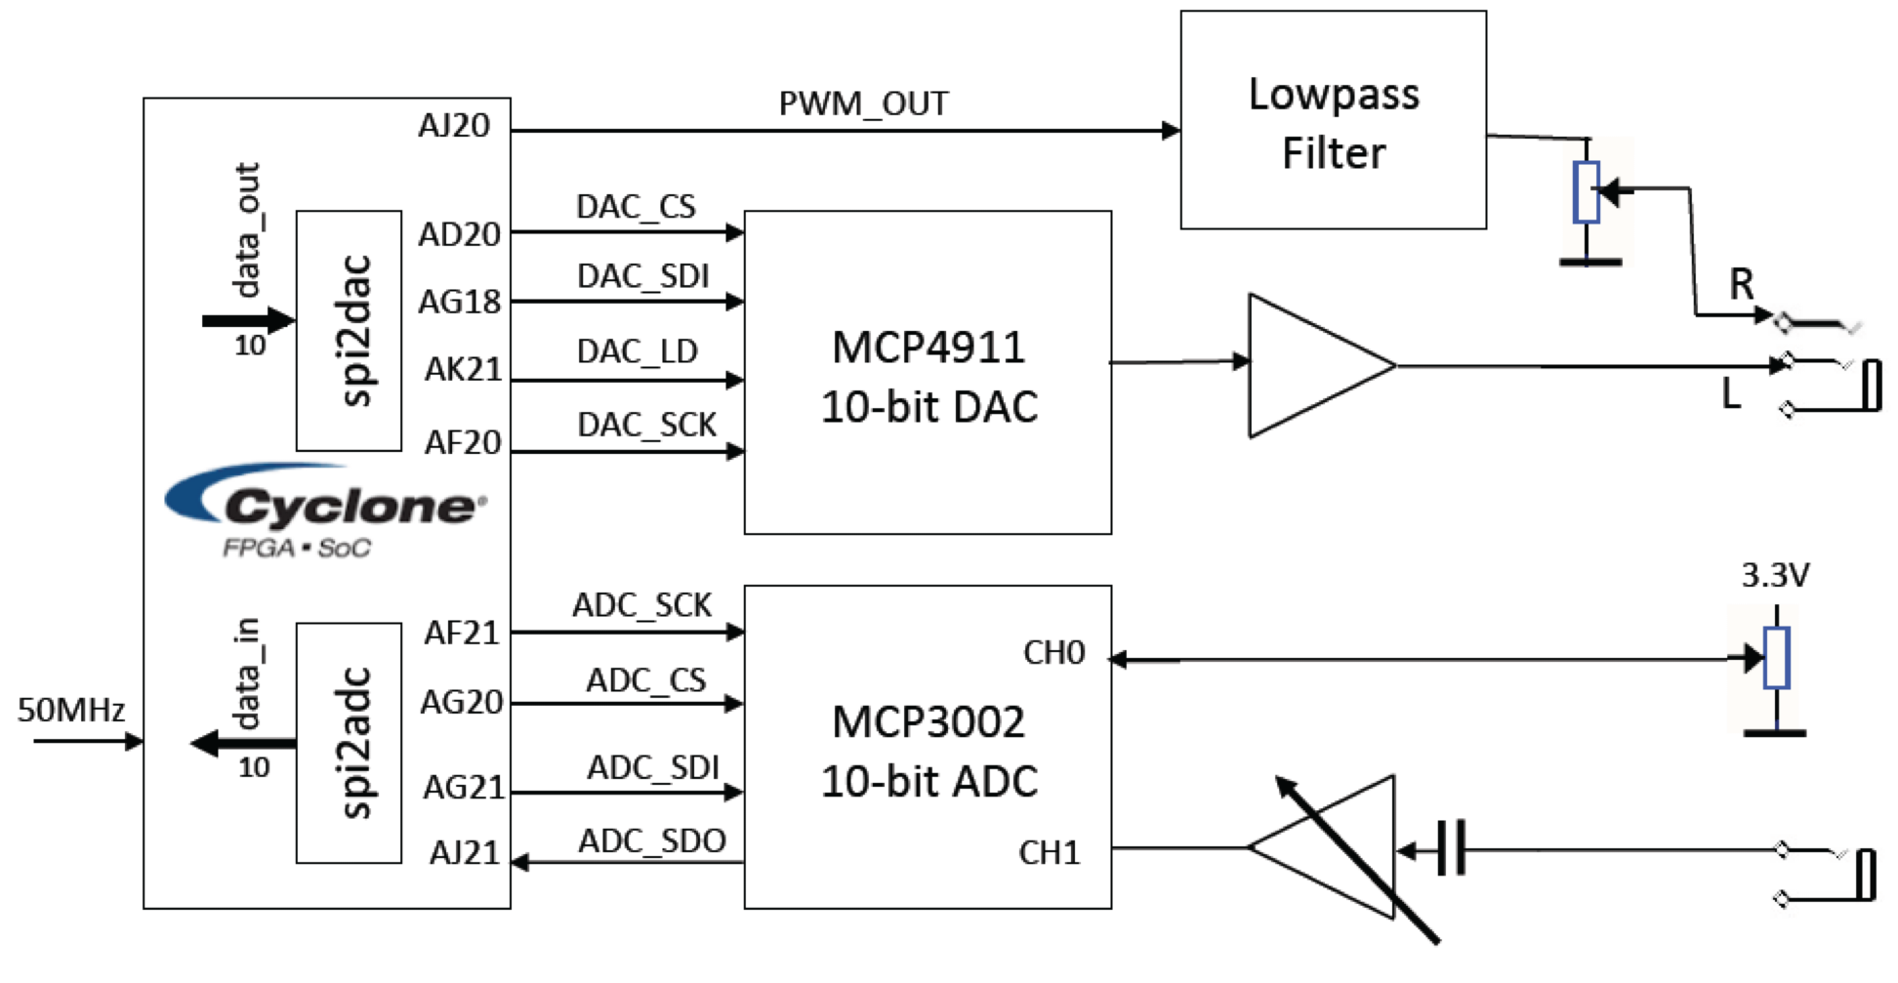
Schematic

Slide 32
Series-parallel interface for DAC
To send a value to the DAC, 16 bits are transmitted serially.
Chip select (SC) going low means the start of transmission.
Then serial data in (SDI) takes the following sequence of values.
bit | name | interpretation
15 |  | always 0
14 | BUF | whether Vref is buffered
13 | ¬GA | high = 1x gain, low = 2x gain
12 | ¬SHDN | high = normal, low = shutdown
11–2 |  | the 10 bits of actual data
1–0 |  | these are ignored

Slide 33
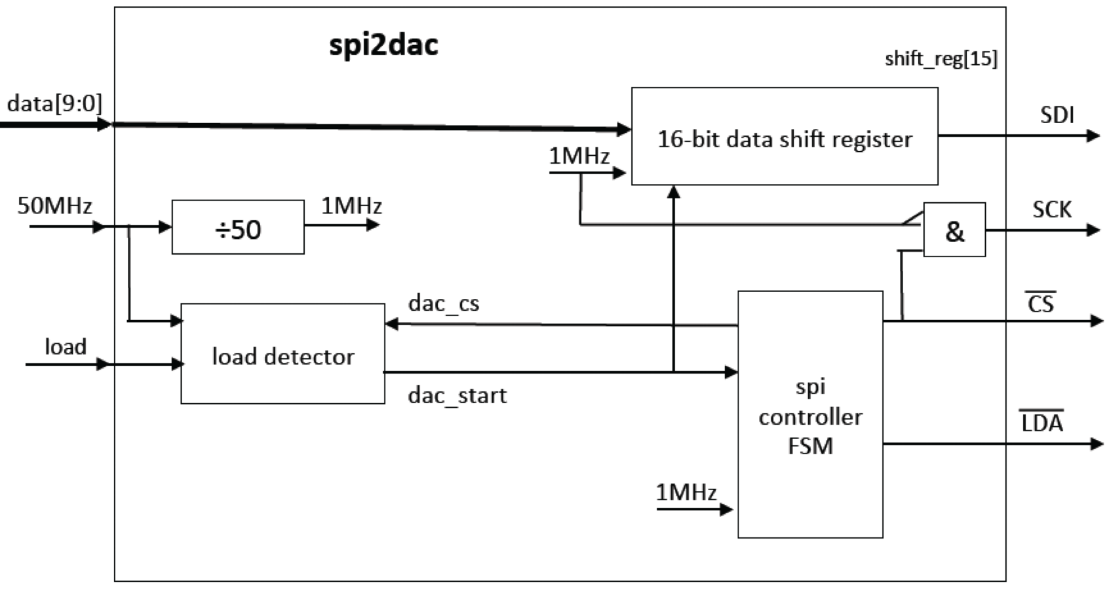
spi2dac
More on this circuit next week!

