Slide 1
Mastering
Digital Design
with SystemVerilog on FPGAs
Slides by John Wickerson
Lecture 4

Slide 2
This lecture
The design of the spi2dac module
How the ADC works
Wrapping up

Slide 3
This lecture
The design of the spi2dac module
How the ADC works
Wrapping up

Slide 4
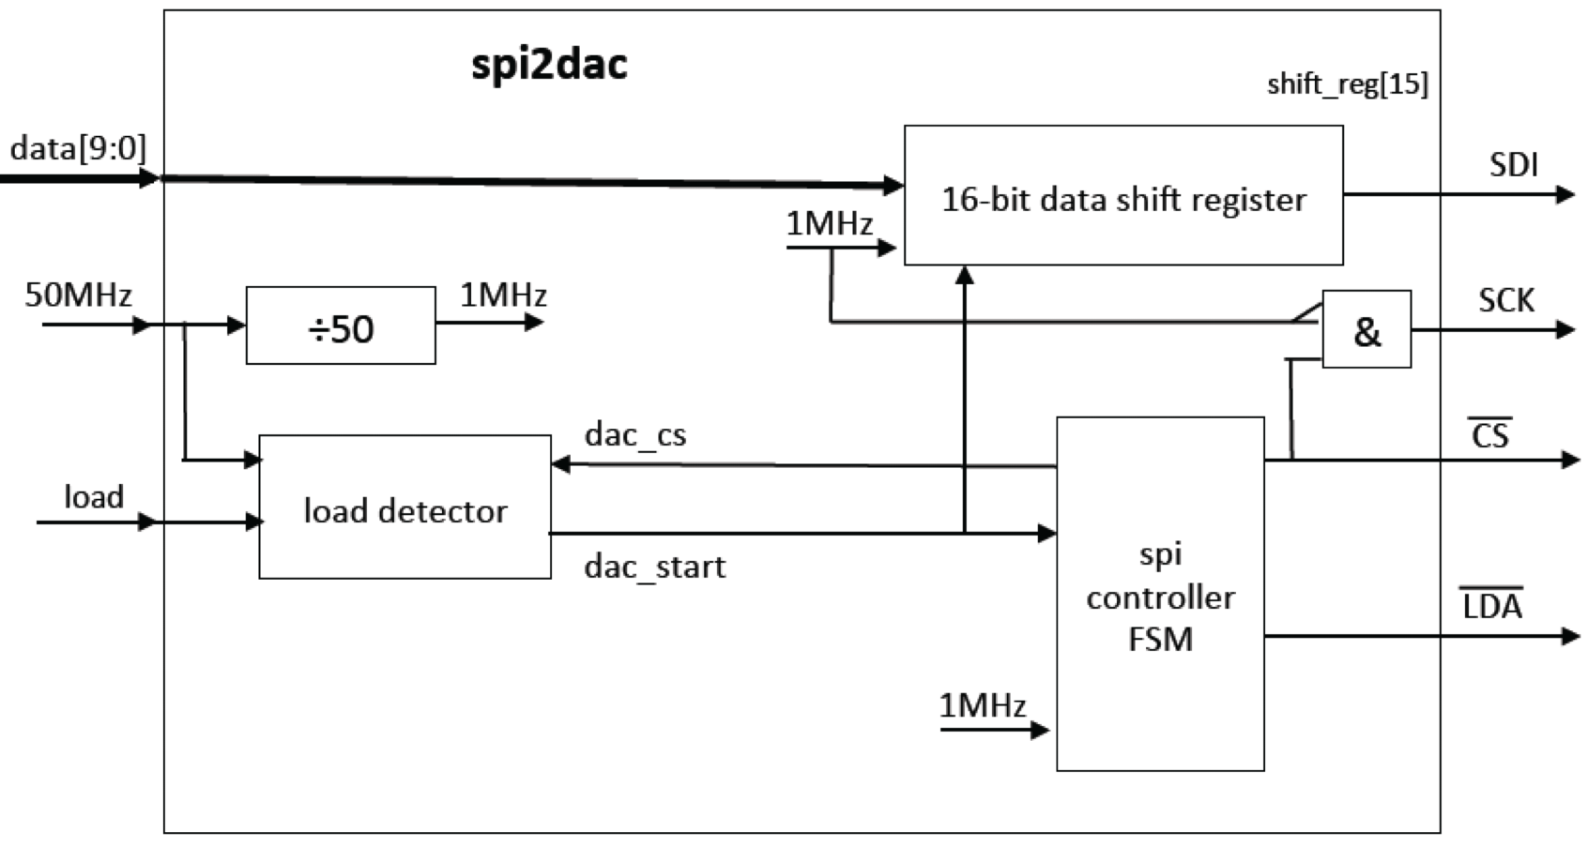
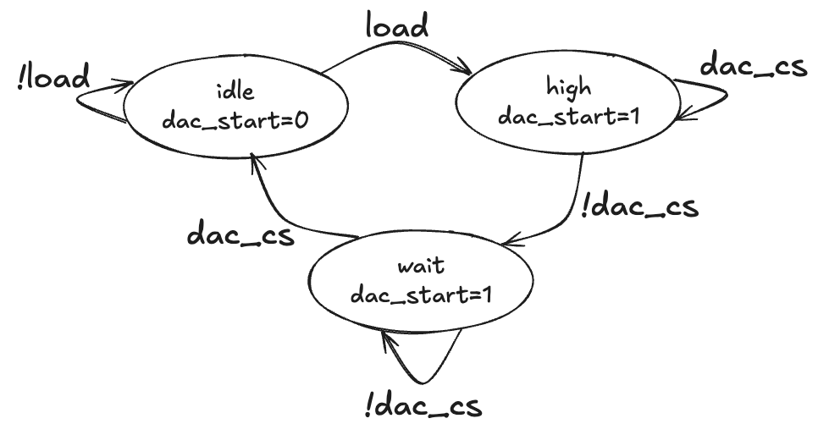
spi2dac
parameter logic [4:0] TC = 5'd24;
logic [4:0] ctr;
always_ff @(posedge clk_50MHz) begin
if (ctr == 5'd0) begin
ctr <= TC;
clk_1MHz <= ~clk_1MHz;
end else begin
ctr <= ctr - 1'b1;
end
end

Slide 5
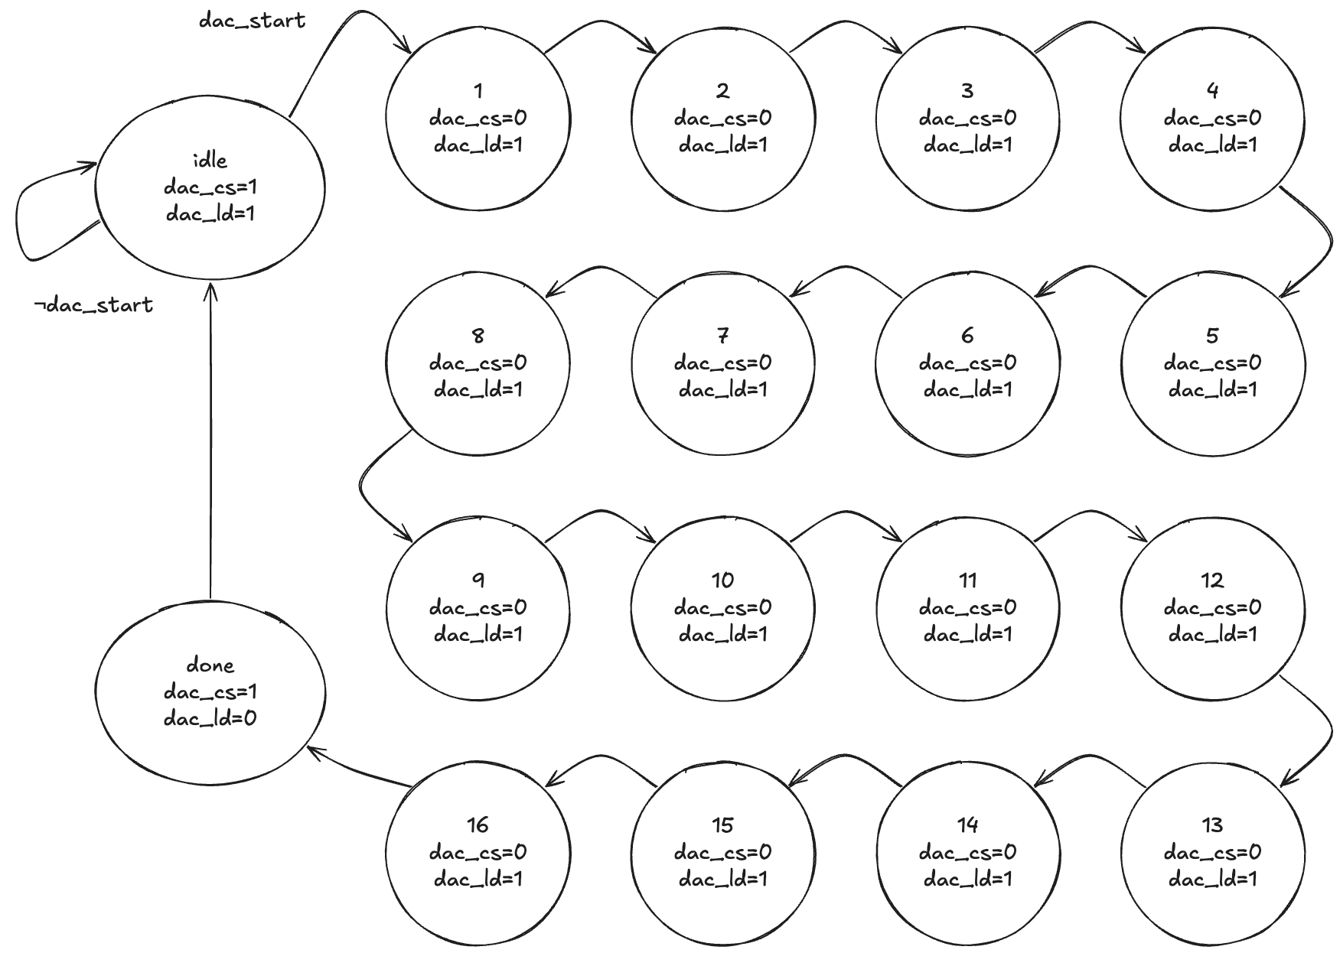
spi2dac
parameter TC = 5'd24;
reg [4:0] ctr;
always @ (posedge clk_50MHz)
if (ctr==0) begin
ctr <= TC;
clk_1MHz <= ~clk_1MHz;
end else ctr <= ctr - 1'b1;

Slide 6
spi2dac
logic [4:0] state;
always_ff @(posedge clk_1MHz) begin
case (state)
5'd0: begin
if (dac_start == 1'b1)
state <= state + 1'b1;
end
5'd17: state <= 5'd0;
default: state <= state + 1'b1;
endcase
end
always_comb begin
case (state)
5'd0: {dac_cs, dac_ld} = 2'b11;
5'd17: {dac_cs, dac_ld} = 2'b10;
default: {dac_cs, dac_ld} = 2'b01;
endcase
end
parameter TC = 5'd24;
reg [4:0] ctr;
always @ (posedge clk_50MHz)
if (ctr==0) begin
ctr <= TC;
clk_1MHz <= ~clk_1MHz;
end else ctr <= ctr - 1'b1;
parameter logic BUF = 1'b1;
parameter logic nGA = 1'b1;
parameter logic nSHDN = 1'b1;
logic [3:0] cmd;
logic [15:0] sreg;
assign cmd = {1'b0, BUF, nGA, nSHDN};
always_ff @(posedge clk_1MHz) begin
if ({dac_start, dac_cs} == 2'b11)
sreg <= {cmd, data_in, 2'b00};
else
sreg <= {sreg[14:0], 1'b0};
end
assign dac_sck = !clk_1MHz & !dac_cs;
assign dac_sdi = sreg[15];

Slide 7
This lecture
The design of the spi2dac module
How the ADC works
Wrapping up

Slide 8
This lecture
The design of the spi2dac module
How the ADC works
Wrapping up

Slide 9
ADC using SAR
successive
approximation
register
sample & hold
9.4V
control logic
Vin
1 | 0 | 0 | 0
+
-
out
VDAC
DAC
8V
Vref

Slide 10
ADC using SAR
successive
approximation
register
9.4V
sample & hold
9.4V
control logic
Vin
1 | 0 | 0 | 0
+
-
out
VDAC
DAC
8V
16V
Vref

Slide 11
ADC using SAR
successive
approximation
register
sample & hold
9.4V
control logic
Vin
1 | 1 | 0 | 0
+
-
out
VDAC
DAC
12V
16V
Vref

Slide 12
ADC using SAR
successive
approximation
register
sample & hold
9.4V
control logic
Vin
1 | 0 | 1 | 0
+
-
out
VDAC
DAC
10V
16V
Vref

Slide 13
ADC using SAR
successive
approximation
register
sample & hold
9.4V
control logic
Vin
1 | 0 | 0 | 1
+
-
out
VDAC
DAC
9V
16V
Vref

Slide 14
ADC using SAR
successive
approximation
register
sample & hold
9.4V
control logic
Vin
1 | 0 | 0 | 1
+
-
out
VDAC
DAC
9V
16V
Vref

Slide 15
ADC using SAR
successive
approximation
register
5.5V
sample & hold
5.5V
control logic
Vin
1 | 0 | 0 | 0
+
-
out
VDAC
DAC
8V
16V
Vref

Slide 16
ADC using SAR
successive
approximation
register
5.5V
sample & hold
5.5V
control logic
Vin
0 | 1 | 0 | 0
+
-
out
VDAC
DAC
4V
16V
Vref

Slide 17
ADC using SAR
successive
approximation
register
5.5V
sample & hold
5.5V
control logic
Vin
0 | 1 | 1 | 0
+
-
out
VDAC
DAC
6V
16V
Vref

Slide 18
ADC using SAR
successive
approximation
register
5.5V
sample & hold
5.5V
control logic
Vin
0 | 1 | 0 | 1
+
-
out
VDAC
DAC
5V
16V
Vref

Slide 19
ADC using SAR
successive
approximation
register
5.5V
sample & hold
5.5V
control logic
Vin
0 | 1 | 0 | 1
+
-
out
VDAC
DAC
5V
16V
Vref

Slide 20
ADC using SAR
An N-bit ADC takes N cycles to convert one sample
Low power consumption
Simple design with small circuit area
Low latency
More advanced designs are more efficient when the sampling rate is above 10MHz or N > 16.

Slide 21
This lecture
The design of the spi2dac module
How the ADC works
Wrapping up

Slide 22
Module aims
To ensure that all MSc students reach a common competence level in RTL design using FPGAs in a hardware description language.
To act as a revision exercise for those already competent in Verilog and FPGAs.

Slide 23
Grading
This lab is part of the Coursework component of the MSc course.
You must pass this component, but it does not count towards your final MSc grade.
This lab
Coursework
Exams
Project

Slide 24
Assessment
Assessment will be via a 15-minute oral interview. This will assess:
  how many parts of the experiment you have completed,
  the extent to which you have understood the underlying principles of digital design, and
  whether you have used a logbook (electronic or paper) to help you learn through planning and reflection.
Please have your equipment set up and ready to demo.

Slide 25
Admin
Final two labs: Tuesday 9th & 16th Nov at 0900–1200.
Vivas: how about in the week beginning Monday 22nd Nov?

