Slide 1
Mastering
Digital Design
with Verilog on FPGAs
Slides by John Wickerson
Lecture 2

Slide 2
This lecture
Arithmetic and logical operators in Verilog
Clocked circuits
Shift registers
Converting from binary to binary-coded decimal (BCD)

Slide 3
Arithmetic and Logical Operators in Verilog

Slide 4
Integer Arithmetic
Integer arithmetic without carries:
Integer arithmetic with carry-in and carry-out:
module add32 (a, b, sum);
input[31:0] a, b;
output[31:0] sum;
assign sum = a + b;
endmodule
module add32_carry (a, b, cin, sum, cout);
input[31:0] a, b;
input cin;
output[31:0] sum;
output cout;
assign {cout, sum} = a + b + cin;
endmodule
What is the width of the +-operator?

Slide 5
Boolean operators
Bitwise operators:

Slide 6
Boolean operators
Bitwise operators:
~(4'b0101) = {~0,~1,~0,~1}

Slide 7
Boolean operators
Bitwise operators:
~(4'b0101) = {~0,~1,~0,~1}

Slide 8
Boolean operators
Bitwise operators:
~(4'b0101) = {~0,~1,~0,~1} = {1,0,1,0}

Slide 9
Boolean operators
Bitwise operators:
~(4'b0101) = {~0,~1,~0,~1} = {1,0,1,0} = 4'b1010

Slide 10
Boolean operators
Bitwise operators:
~(4'b0101) = {~0,~1,~0,~1} = {1,0,1,0} = 4'b1010
4'b0101 & 4'b0011 = 4'b0001

Slide 11
Boolean operators
Bitwise operators:
~(4'b0101) = {~0,~1,~0,~1} = {1,0,1,0} = 4'b1010
4'b0101 & 4'b0011 = 4'b0001

Slide 12
Boolean operators
Bitwise operators:
~(4'b0101) = {~0,~1,~0,~1} = {1,0,1,0} = 4'b1010
4'b0101 & 4'b0011 = 4'b0001
Logical operators:

Slide 13
Boolean operators
Bitwise operators:
~(4'b0101) = {~0,~1,~0,~1} = {1,0,1,0} = 4'b1010
4'b0101 & 4'b0011 = 4'b0001
Logical operators:
!(4'b0101) = 0

Slide 14
Boolean operators
Bitwise operators:
~(4'b0101) = {~0,~1,~0,~1} = {1,0,1,0} = 4'b1010
4'b0101 & 4'b0011 = 4'b0001
Logical operators:
!(4'b0101) = 0

Slide 15
Boolean operators
Bitwise operators:
~(4'b0101) = {~0,~1,~0,~1} = {1,0,1,0} = 4'b1010
4'b0101 & 4'b0011 = 4'b0001
Logical operators:
!(4'b0101) = 0
Reduction operators:

Slide 16
Boolean operators
Bitwise operators:
~(4'b0101) = {~0,~1,~0,~1} = {1,0,1,0} = 4'b1010
4'b0101 & 4'b0011 = 4'b0001
Logical operators:
!(4'b0101) = 0
Reduction operators:
&(4'b0101) = 0 & 1 & 0 & 1

Slide 17
Boolean operators
Bitwise operators:
~(4'b0101) = {~0,~1,~0,~1} = {1,0,1,0} = 4'b1010
4'b0101 & 4'b0011 = 4'b0001
Logical operators:
!(4'b0101) = 0
Reduction operators:
&(4'b0101) = 0 & 1 & 0 & 1

Slide 18
Boolean operators
Bitwise operators:
~(4'b0101) = {~0,~1,~0,~1} = {1,0,1,0} = 4'b1010
4'b0101 & 4'b0011 = 4'b0001
Logical operators:
!(4'b0101) = 0
Reduction operators:
&(4'b0101) = 0 & 1 & 0 & 1 = 1'b0

Slide 19
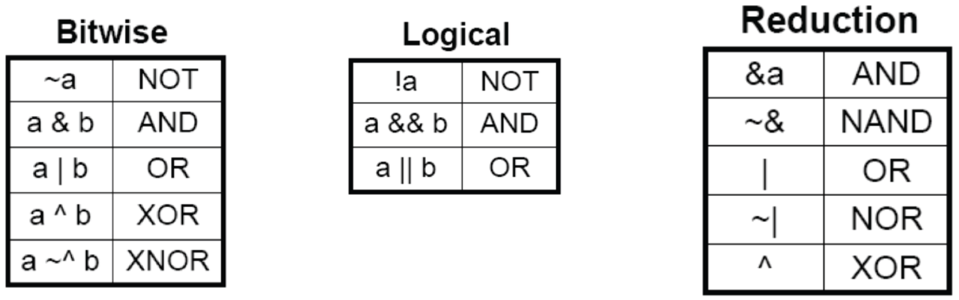
Boolean operators
What is the difference between ~a and !a?

Slide 20
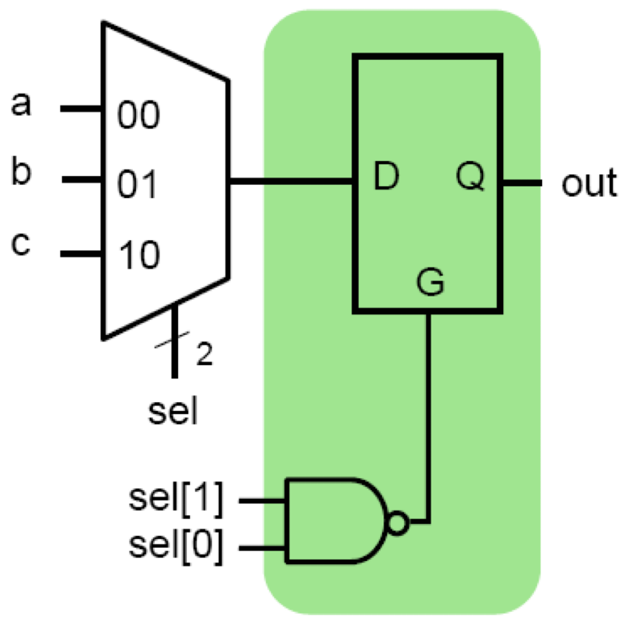
Incomplete specification
If out is not assigned in an always block, the previous value must be retained.
module maybe_mux_3to1
(a, b, c, sel, out);
input[1:0] sel;
input a, b, c;
output out;
reg out;
always @*
begin
case (sel)
2'b00: out = a;
2'b01: out = b;
2'b10: out = c;
endcase
end
endmodule

Slide 21
Incomplete specification
If out is not assigned in an always block, the previous value must be retained (a latch).
module maybe_mux_3to1
(a, b, c, sel, out);
input[1:0] sel;
input a, b, c;
output out;
reg out;
always @*
begin
case (sel)
2'b00: out = a;
2'b01: out = b;
2'b10: out = c;
endcase
end
endmodule

Slide 22
Incomplete specification
Could fix by preceding with a default assignment...
module maybe_mux_3to1
(a, b, c, sel, out);
input[1:0] sel;
input a, b, c;
output out;
reg out;
always @*
begin
out = 1'bX;
case (sel)
2'b00: out = a;
2'b01: out = b;
2'b10: out = c;
endcase
end
endmodule

Slide 23
Incomplete specification
Could fix by preceding with a default assignment...
... or by using a default case.
module maybe_mux_3to1
(a, b, c, sel, out);
input[1:0] sel;
input a, b, c;
output out;
reg out;
always @*
begin
case (sel)
2'b00: out = a;
2'b01: out = b;
2'b10: out = c;
default: out = 1'bX;
endcase
end
endmodule

Slide 24
An ALU
F[2:0] | R
{0,0,0} | A + B
{0,0,1} | A + 1
{0,1,0} | A - B
{0,1,1} | A - 1
{1,0,X} | A * B
A[31:0]
B[31:0]
F[2:0]
R[31:0]

Slide 25
An ALU
F[2:0] | R
{0,0,0} | A + B
{0,0,1} | A + 1
{0,1,0} | A - B
{0,1,1} | A - 1
{1,0,X} | A * B
module mux32two (a, b, sel, out);
input sel;
input[31:0] a, b;
output[31:0] out;
assign out = sel ? b : a;
endmodule
module alu (A, B, F, R);
input[31:0] A, B;
input[2:0] F;
output[31:0] R;
wire [31:0] w1,w2,w3,w4,w5;
mux32two add_mux (B, 32'd1, F[0], w1);
mux32two sub_mux (B, 32'd1, F[0], w2);
add32 (A, w1, w3);
sub32 (A, w2, w4);
mul16 (A[15:0], B[15:0], w5);
mux32three (w3, w4, w5, F[2:1], R);
endmodule
A[31:0]
B[31:0]
32'd1
32'd1
0 1
0 1
F[0]
w1
w2
F[2:0]
+
-
*
module mux32three (a, b, c, sel, out);
input[1:0] sel;
input[31:0] a, b, c;
output[31:0] out;
reg[31:0] out;
always @*
begin
case (sel)
2'b00: out = a;
2'b01: out = b;
2'b10: out = c;
default: out = 32'bX;
endcase
end
endmodule
w3
w4
w5
00 01 10
F[2:1]
module add32 (a, b, out);
input[31:0] a, b;
output[31:0] out;
assign out = a + b;
endmodule
module mul16 (a, b, out);
input[15:0] a, b;
output[31:0] out;
assign out = a * b;
endmodule
R[31:0]
module sub32 (a, b, out);
input[31:0] a, b;
output[31:0] out;
assign out = a - b;
endmodule

Slide 26
Clocked circuits

Slide 27
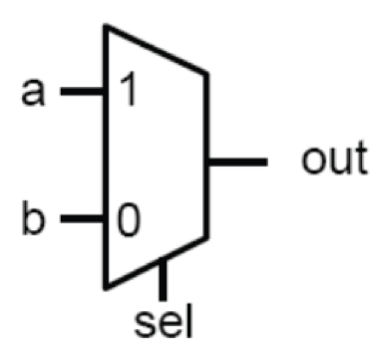
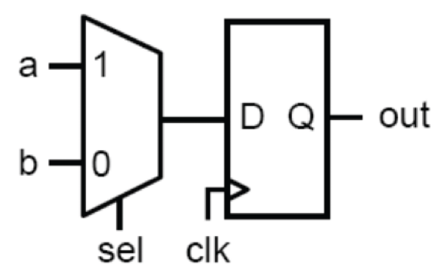
Sequential logic
module comb (a, b, sel, out);
input a, b;
input sel;
output out;
reg out;
always @ (a or b or sel)
begin
if (sel) out = a;
else out = b;
end
endmodule
module seq (a, b, sel, clk, out);
input a, b;
input sel, clk;
output out;
reg out;
always @ (posedge clk)
begin
if (sel) out = a;
else out = b;
end
endmodule

Slide 28
Flip flop vs latch
Latch:
Flip flop:
D
D
Q
G
Q
G
Gate
D
D
Q
clk
clk
Q

Slide 29
Defining a flip flop
module dff (d, rst, clk, q);
input d, rst, clk;
output q;
reg q;
always @ (posedge clk)
begin
if (!rst) q <= 1'b0;
else q <= d;
end
endmodule
Note that you can have multiple always blocks with the same sensitivity list. They'll be run in parallel, so watch out for races!
D
Q
rst
clk

Slide 30
Blocking vs non-blocking assignment
Two different types of procedural assigments:
always @*
begin
a = b & c;
b = a + c;
end
The second statement is blocked from executing until the first statement has finished.
always @*
begin
a <= b & c;
b <= a + c;
end
All assignments performed in parallel.

Slide 31
Blocking vs non-blocking assignment
in
D
Q
q1
D
Q
q2
D
Q
out
clk
module sr_v1 (in, clk, out);
input in, clk;
output out;
reg q1, q2, out;
always @ (posedge clk)
begin
q1 = in;
q2 = q1;
out = q2;
end
endmodule
module sr_v2 (in, clk, out);
input in, clk;
output out;
reg q1, q2, out;
always @ (posedge clk)
begin
q1 <= in;
q2 <= q1;
out <= q2;
end
endmodule

Slide 32
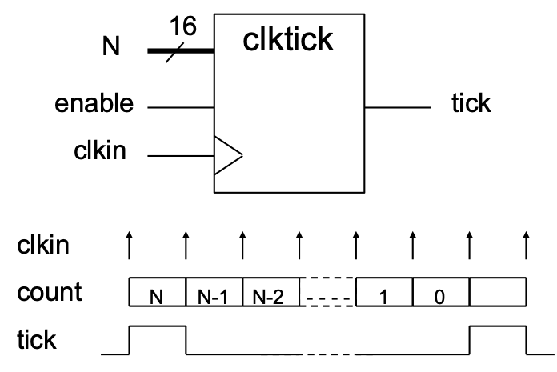
A flexible clock tick
module clktick (clkin, enable, N, tick);
parameter N_BIT = 16;
input clkin; // clock input
input enable; // low => clkin ignored
input[N_BIT-1:0] N; // pulse every N+1 cycles
output tick;
reg[N_BIT-1:0] count;
reg tick;
initial tick = 1'b0;
always @ (posedge clkin)
if (enable == 1'b1)
if (count == 0) begin
tick <= 1'b1;
count <= N;
end else begin
tick <= 1'b0;
count <= count - 1'b1;
end
endmodule

Slide 33
A flexible clock tick
module clktick (clkin, enable, N, tick);
parameter N_BIT = 16;
input clkin; // clock input
input enable; // low => clkin ignored
input[N_BIT-1:0] N; // pulse every N+1 cycles
output tick;
reg[N_BIT-1:0] count;
reg tick;
initial tick = 1'b0;
always @ (posedge clkin)
if (enable == 1'b1)
if (count == 0) begin
tick <= 1'b1;
count <= N;
end else begin
tick <= 1'b0;
count <= count - 1'b1;
end
endmodule

Slide 34
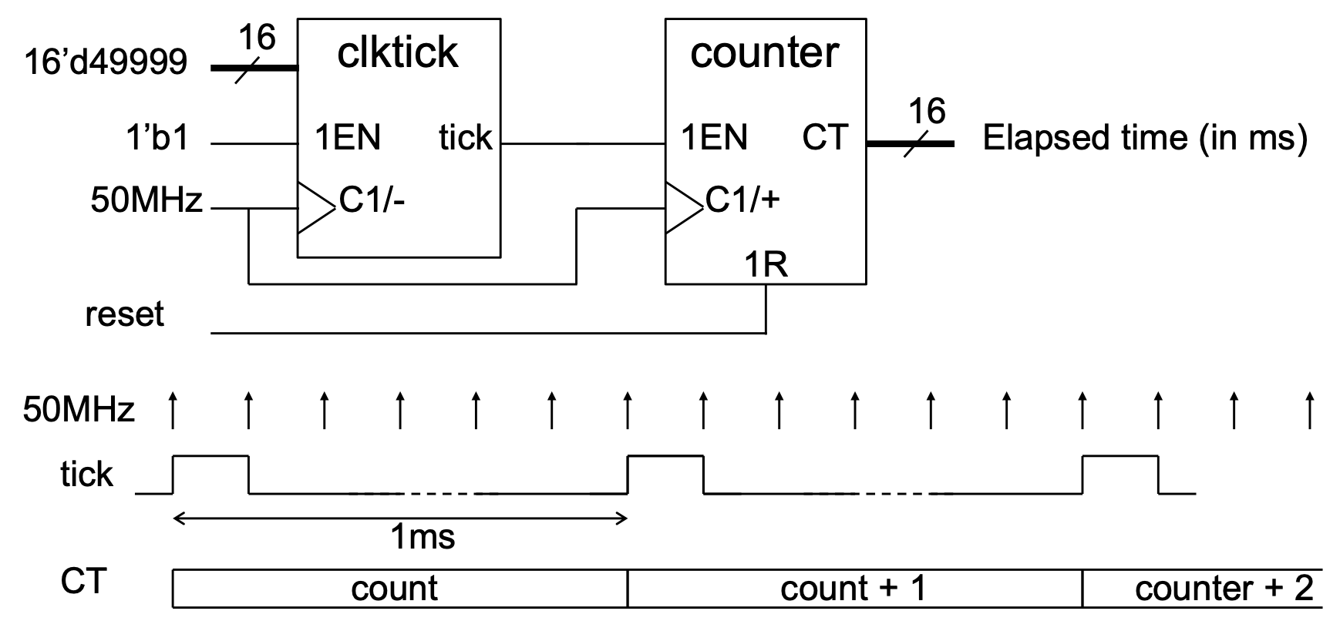
Cascading counters
By connecting our clock tick module in series with a counter module, we can count milliseconds:

Slide 35
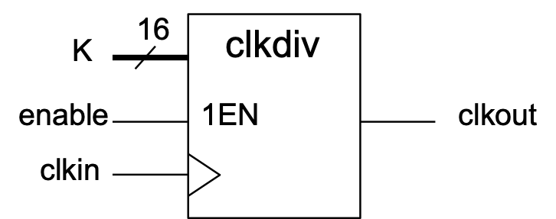
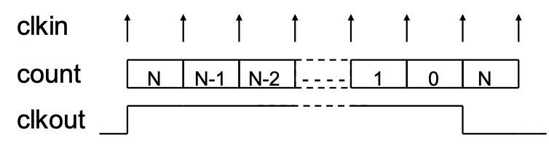
A clock divider
module clkdiv (clkin, enable, K, clkout);
parameter K_BIT = 16;
input clkin; // clock input
input enable; // low => clkin ignored
input[K_BIT-1:0] K;
output tick; // F_out = F_in / (2*(K+1))
reg[K_BIT-1:0] count;
reg clkout;
initial clkout = 1'b0;
always @ (posedge clkin)
if (enable == 1'b1)
if (count == 0) begin
clkout <= ~clkout; // toggle output
count <= K;
end else
count <= count - 1'b1;
endmodule

Slide 36
Shift registers

Slide 37
A shift register
sreg[4]
data_in
D
Q
sreg[1]
D
Q
sreg[2]
D
Q
sreg[3]
D
Q
data_out
clk
module sreg4 (data_out, data_in, clk);
output data_out;
input data_in, clk;
reg[4:1] sreg;
initial sreg = 4'b0;
always @ (posedge clk) begin
sreg[4] <= sreg[3];
sreg[3] <= sreg[2];
sreg[2] <= sreg[1];
sreg[1] <= data_in;
end
assign data_out = sreg[4];
endmodule

Slide 38
A shift register
sreg[4]
data_in
D
Q
sreg[1]
D
Q
sreg[2]
D
Q
sreg[3]
D
Q
data_out
clk
module sreg4 (data_out, data_in, clk);
output data_out;
input data_in, clk;
reg[4:1] sreg;
initial sreg = 4'b0;
always @ (posedge clk)
sreg <= {sreg[3:1], data_in};
assign data_out = sreg[4];
endmodule

Slide 39
Linear feedback shift register
D
Q
D
Q
D
Q
D
Q
1
0
0
0
clk

Slide 40
Linear feedback shift register
D
Q
D
Q
D
Q
D
Q
0
1
0
0
clk

Slide 41
Linear feedback shift register
D
Q
D
Q
D
Q
D
Q
0
0
1
0
clk

Slide 42
Linear feedback shift register
D
Q
D
Q
D
Q
D
Q
1
0
0
1
clk

Slide 43
Linear feedback shift register
D
Q
D
Q
D
Q
D
Q
1
1
0
0
clk

Slide 44
Linear feedback shift register
D
Q
D
Q
D
Q
D
Q
0
1
1
0
clk

Slide 45
Linear feedback shift register
D
Q
D
Q
D
Q
D
Q
1
0
1
1
clk

Slide 46
Linear feedback shift register
D
Q
D
Q
D
Q
D
Q
0
1
0
1
clk

Slide 47
Linear feedback shift register
D
Q
D
Q
D
Q
D
Q
1
0
1
0
clk

Slide 48
Linear feedback shift register
D
Q
D
Q
D
Q
D
Q
1
1
0
1
clk

Slide 49
Linear feedback shift register
D
Q
D
Q
D
Q
D
Q
1
1
1
0
clk

Slide 50
Linear feedback shift register
D
Q
D
Q
D
Q
D
Q
1
1
1
1
clk

Slide 51
Linear feedback shift register
D
Q
D
Q
D
Q
D
Q
0
1
1
1
clk

Slide 52
Linear feedback shift register
D
Q
D
Q
D
Q
D
Q
0
0
1
1
clk

Slide 53
Linear feedback shift register
D
Q
D
Q
D
Q
D
Q
0
0
0
1
clk

Slide 54
Linear feedback shift register
D
Q
D
Q
D
Q
D
Q
1
0
0
0
clk
This LFSR corresponds to the polynomial 1 + x³ + x⁴. Other LSFRs are possible, with different polynomials.

Slide 55
Linear feedback shift register
module lfsr4 (data_out, clk);
output[4:1] data_out;
input clk;
reg[4:1] sreg;
initial sreg = 4'b1;
always @ (posedge clk)
sreg <= {sreg[3:1], sreg[4] ^ sreg[3]};
assign data_out = sreg;
endmodule

Slide 56
Binary to BCD

Slide 57
Binary to BCD
 | binary-coded decimal (BCD) |  |  | 8-bit binary
 | hundreds | tens | units
 |  |  |  | 0111 | 1100
shift: |  |  | 0 | 1111 | 100
shift: |  |  | 01 | 1111 | 00
shift: |  |  | 011 | 1110 | 0
shift: |  |  | 0111 | 1100
add 3: |  |  | 1010 | 1100
shift: |  | 1 | 0101 | 100
add 3: |  | 1 | 1000 | 100
shift: |  | 11 | 0001 | 00
shift: |  | 110 | 0010 | 0
add 3: |  | 1001 | 0010 | 0
shift: | 1 | 0010 | 0100

Slide 58
0
0
0
0
0
0
0
0
0
0
0
B[7:0]
0
adjust
adjust
adjust
0
adjust
adjust
adjust
0
adjust
adjust
adjust
0
adjust
adjust
adjust
0
adjust
adjust
adjust
0
adjust
adjust
adjust
0
adjust
adjust
adjust
0
BCD[2]
BCD[1]
BCD[0]

Slide 59
0
0
0
0
0
0
0
0
0
0
0
B[7:0]
0
adjust
adjust
adjust
0
adjust
adjust
adjust
0
adjust
adjust
adjust
0
adjust
adjust
adjust
0
adjust
adjust
adjust
0
adjust
adjust
adjust
0
adjust
adjust
adjust
0
BCD[2]
BCD[1]
BCD[0]

Slide 60
0
0
0
0
0
0
0
0
0
0
0
B[7:0]
0
adjust
adjust
adjust
0
adjust
adjust
adjust
0
adjust
adjust
adjust
0
adjust
adjust
adjust
0
adjust
adjust
adjust
0
adjust
adjust
adjust
0
adjust
adjust
adjust
0
BCD[2]
BCD[1]
BCD[0]

Slide 61
0
0
0
0
B[7:0]
0
0
0
adjust
0
adjust
0
adjust
0
adjust
adjust
0
adjust
adjust
0
BCD[2]
BCD[1]
BCD[0]

Slide 62
0
0
0
0
B[7:0]
adjust
adjust
adjust
adjust
adjust
adjust
adjust
BCD[2]
BCD[1]
BCD[0]

Slide 63
0
0
0
0
B[7:0]
adjust
adjust
adjust
adjust
adjust
adjust
adjust
BCD[2]
BCD[1]
BCD[0]

Slide 64
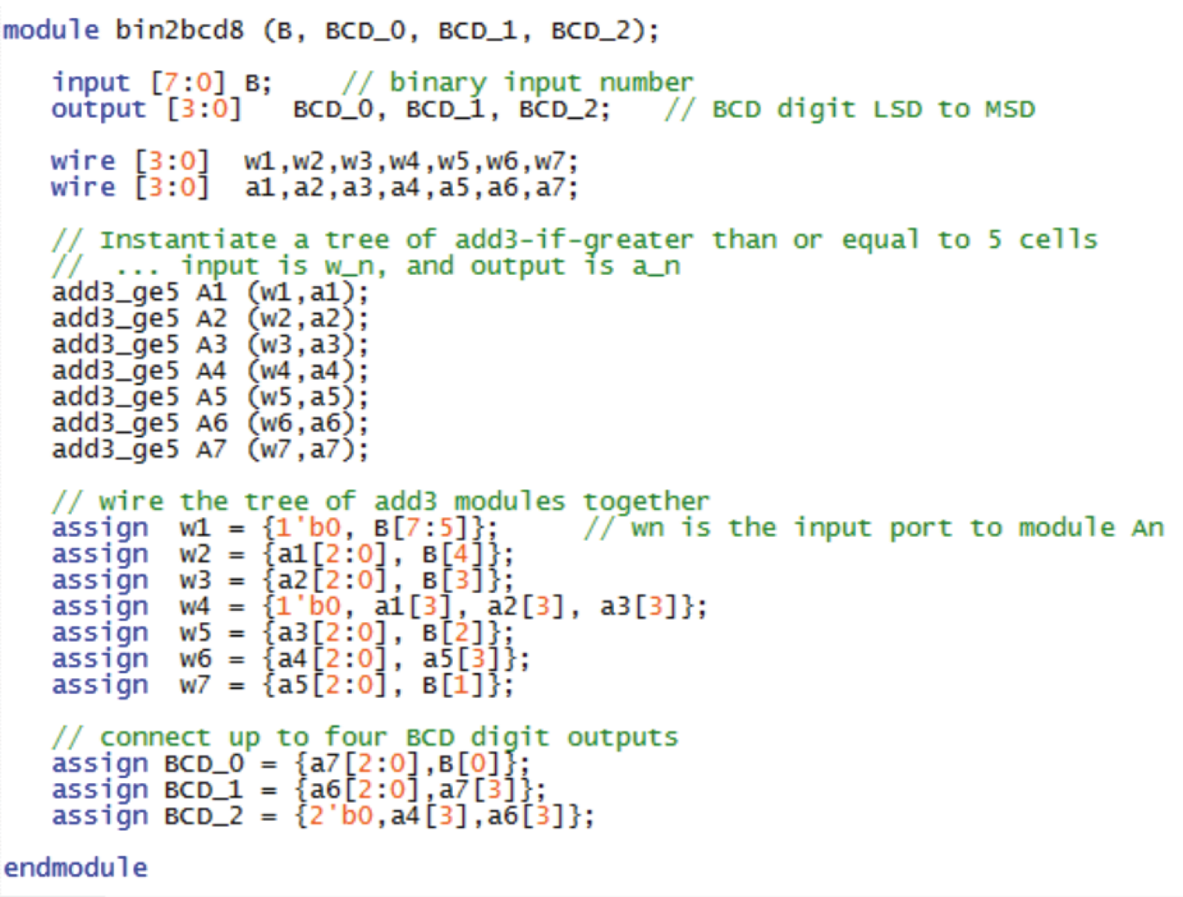
Binary to BCD

Slide 65
This lecture
Arithmetic and logical operators in Verilog
Clocked circuits
Shift registers
Converting from binary to binary-coded decimal (BCD)

Slide 66
Backup Bin2BCD Proof
1. What each step must compute
Read the binary input from left to right. Appending a bit
b ∈ {0, 1} to a prefix of value V gives
V′ = 2V + b
Example: appending 1 to binary 111 gives binary 1111.
15 = 2 × 7 + 1
Each step must therefore double the current value and add
the next input bit, keeping the result in BCD.

Slide 67
Backup Bin2BCD Proof
2. Why adding 3 works for one digit
Let d ∈ {0, …, 9} be a decimal digit and c ∈ {0, 1} the incoming
bit: the next input bit for units, or a carry for other digits.
Required: digit = (2d + c) mod 10, carry = ⌊(2d + c) / 10⌋
If d < 5
0 ≤ 2d + c ≤ 9, so a normal shift gives the correct digit
and no carry. No adjustment is needed.
If d ≥ 5
Add 3 before shifting: 2(d + 3) + c = 2d + c + 6.
This lies between 16 and 25, so the 4-bit group carries 1.
The remaining digit is 2d + c + 6 − 16 = 2d + c − 10.
Why 3? (16 − 10) / 2 = 3

