Slide 1
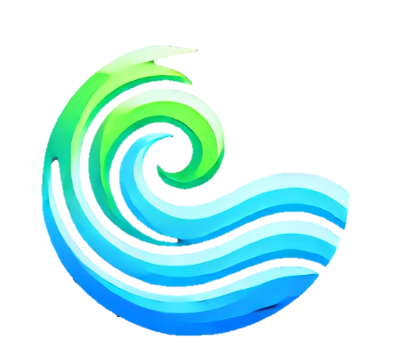
ClearFlow
Hydro Hackers – Arjun, Elliot, Stefan
Notes:
Hello everyone, so we've created a prototype app called ClearFlow. It aims to be a user facing interface, while still providing useful data analytic insights to enterprises.

Slide 2
Our Goals
Notify and bring awareness to water quality levels in rivers
Provide insights into health risks and solutions
Notes:
Read the slide.

Slide 3
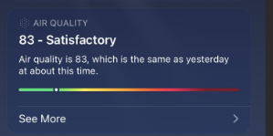
Case Study 1: Apple
Apple’s Weather app uses real-time air quality data to provide an intuitive and pleasing Air Quality Index
Notes:
Our inspiration comes from the Weather app in Apple devices. People can check the air quality and create informed decisions from that, like wearing a mask.

Slide 4
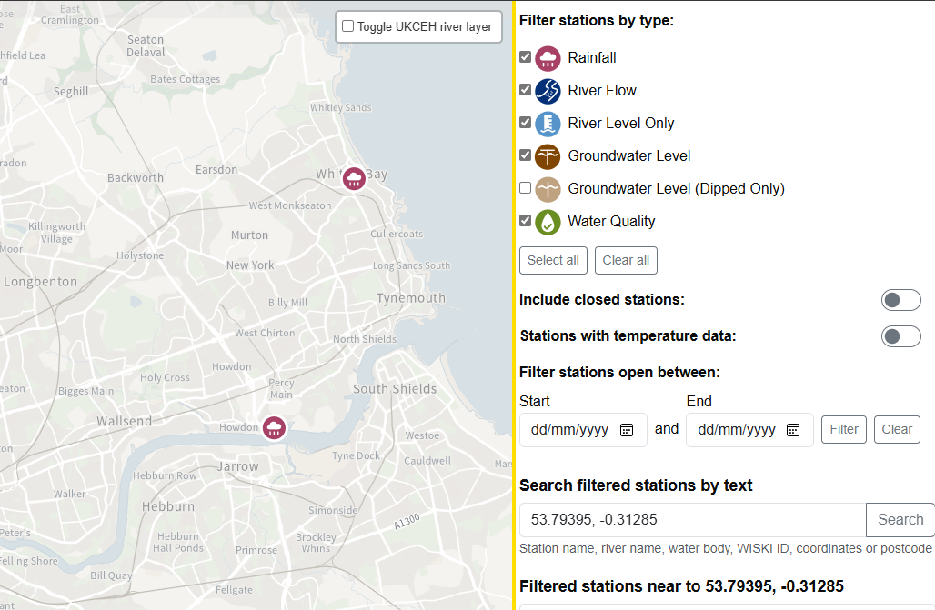
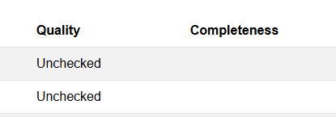
Case Study 2: DEFRA Hydrology Explorer
DEFRA has a similar tool but it’s not as straightforward or regularly checked
Notes:
While researching, we tried to find similar alternatives that operate in the UK. There is one for the Americas abroad and an official government version from DEFRA that already exists. However, after looking at DEFRA's site, it's clear that it's not regularly maintained. While it does show measuring stations, the status for most of them are "Unchecked". To say the least, it's not very accessible to the average person either.

Slide 5
How it works
Data sourced from the official government DEFRA hydrology API
Factors considered:
Temperature
Date
Dissolved Oxygen
pH
Turbidity
Nitrates
Notes:
Using DEFRA's API, we can retrieve real time data about your local river. Information includes things like pH, nitrates, temperature, and more. In accordance with expected, healthy levels, we can feed that data into an algorithm that gives a number from 0 to 100, indicating water quality where 100 is perfect.

Slide 6
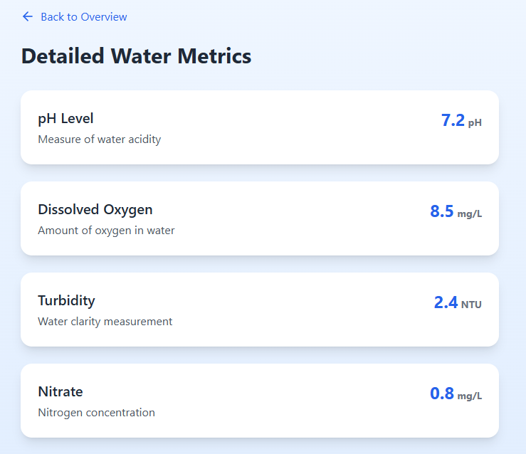
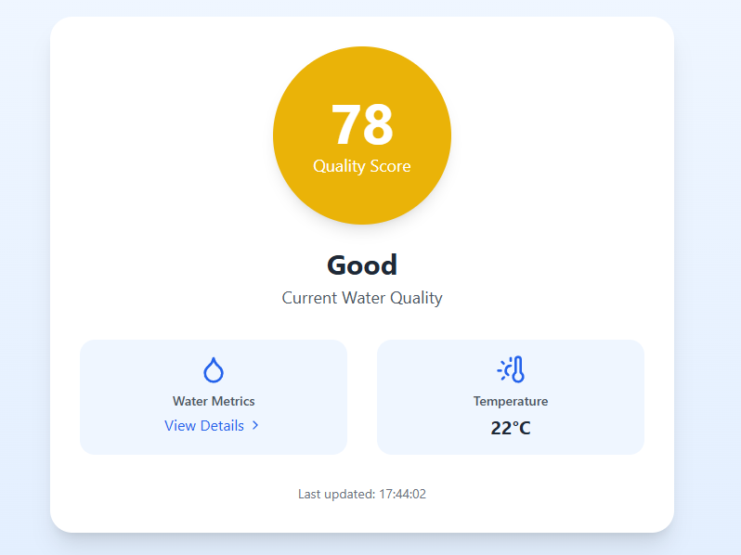
Interface
A mobile, user focused application that displays the water quality score, and additional metrics including water hardness.
Notes:
Users can download this app on their mobile devices, and it's mainly to be more transparent and clearer with the public. It displays the water quality score, and additional aspects relating to the water, in a visually appealing and intuitive way.

Slide 7
However, there are limitations…
Not all measurements are provided
Some stations may be closed, or out of date
Notes:
While official data from the government is trusted, it’s not as abundant. For example, a measuring station might not measure nitrate levels or the station is closed.
However, the algorithm is very flexible. Data from citizen scientists is vast and can easily be fed into the algorithm with ease. It’s very likely that their data includes things that aren’t mandated to be measured, like calcium carbonate data which can give an idea of water hardness and the geology of the area.
The initial approach aims to serve as a proof of concept of calculating a score. A single heuristic score can be very powerful in getting the right people in the right place to fix problems with our waterways. We can target low quality areas and attempt to reach a threshold for certain green areas for preservation.
So essentially, it serves as an accreditation agency.

Slide 8
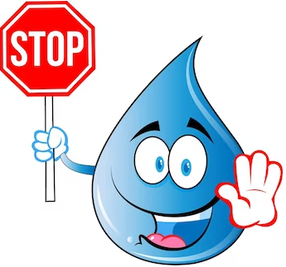
From Limitations to Innovations
Use citizen scientist data
Algorithm is flexible
Citizen scientist date may include additional data
Calcium carbonate
Target low quality areas
Threshold for certain green areas for preservation
Accreditation agency
Notes:
While official data from the government is trusted, it’s not as abundant. For example, a measuring station might not measure nitrate levels or the station is closed.
However, the algorithm is very flexible. Data from citizen scientists is vast and can easily be fed into the algorithm with ease. It’s very likely that their data includes things that aren’t mandated to be measured, like calcium carbonate data which can give an idea of water hardness and the geology of the area.
The initial approach aims to serve as a proof of concept of calculating a score. A single heuristic score can be very powerful in getting the right people in the right place to fix problems with our waterways. We can target low quality areas and attempt to reach a threshold for certain green areas for preservation.
So essentially, it serves as an accreditation agency.

Slide 9
One more thing…
ML can be used to forecast measurements
Allowing for simulations and investigation into improving water quality
Notes:
To appeal to enterprises, we have also created a machine learning model that is able to accurately predict future measured levels and therefore future water quality scores. This allows companies to identify weak spots in their treatment systems, to then simulate and analyse how changing different aspects can affect the quality of the water.

Slide 10
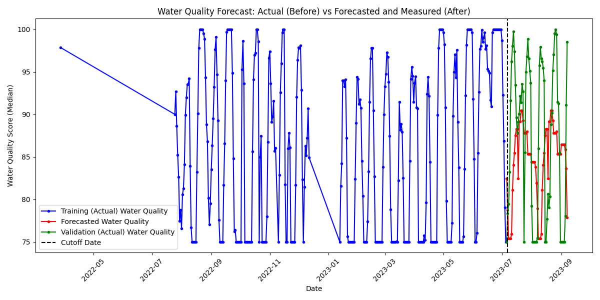
Example Model
Not the best, but a good start…
Notes:
This is how our current model performs with the data given by DEFRA. It provides more conservative estimates which help motivate further improvements.

Slide 11
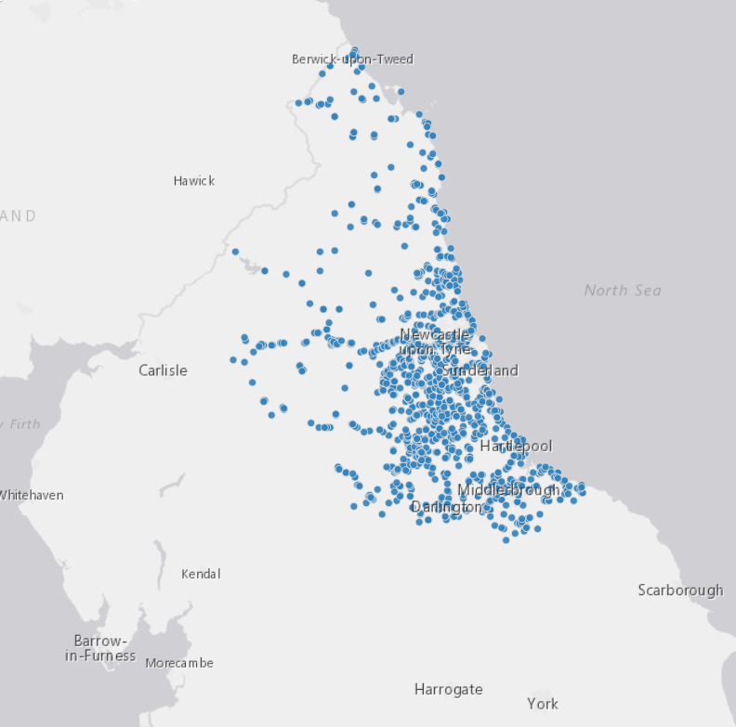
Visualising the data
Using ArcGIS we can create layered maps, coloured coded featured, interactive pop-ups and heatmaps for visualising our data analysis.

Slide 12
ClearFlow
Notes:
Conclusions, Q&A. View FaQ below:
Why? It’s designed more towards environmentally conscious people. A bad river ecosystem can have large knockoff effects. A bad ecosystem could harm freshwater and wetland species (both fish and plants/flora) causing an increase flood risk (water absorption, soil stabilisation, buffer zones, biodiversity), take away from the economy (fisheries) and agricultural services. A cleaner system puts less stress on treatment plants, and some rural people may use their local river for drinking as well. It’s a way for water companies to keep themselves in check. How would you feel knowing that unhealthy, possibly E-coli ridden water, is used to irrigate crops, ingested by fish, which are eventually ingested by you? Not to mention other factors that aren’t currently in the scope of this investigation like microplastics.
> Source: Water pollution: How clean are the UK's rivers and lakes? - BBC News

