Slide 1
Digital humanities

Slide 2
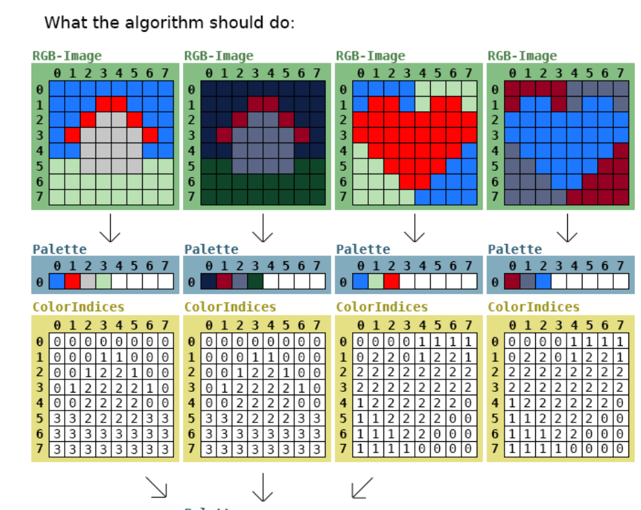
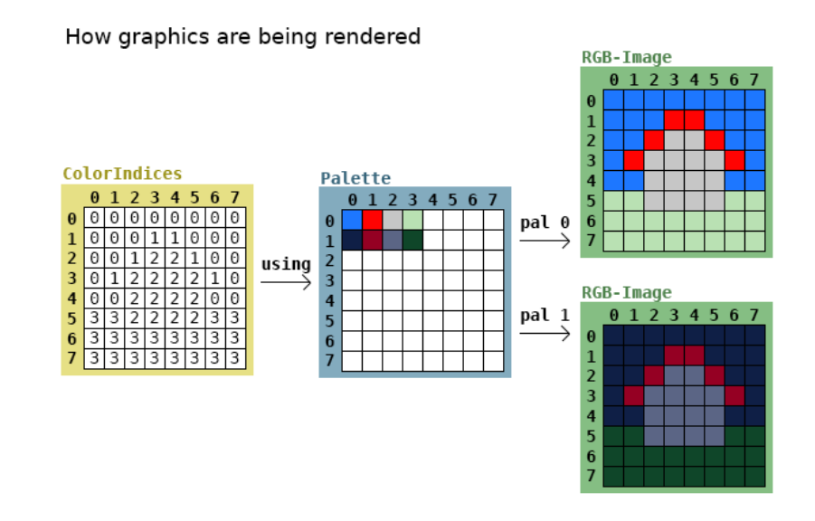
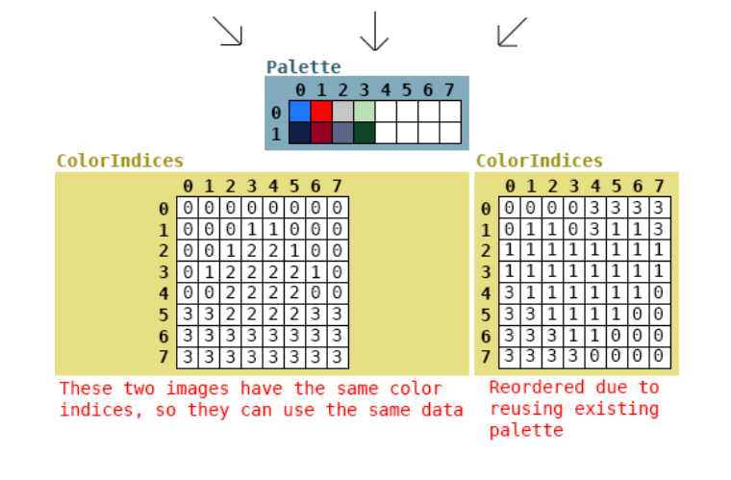
Color Palette
https://stackoverflow.com/questions/46410132/algorithm-for-many-images-and-their-color-palettes

Slide 3
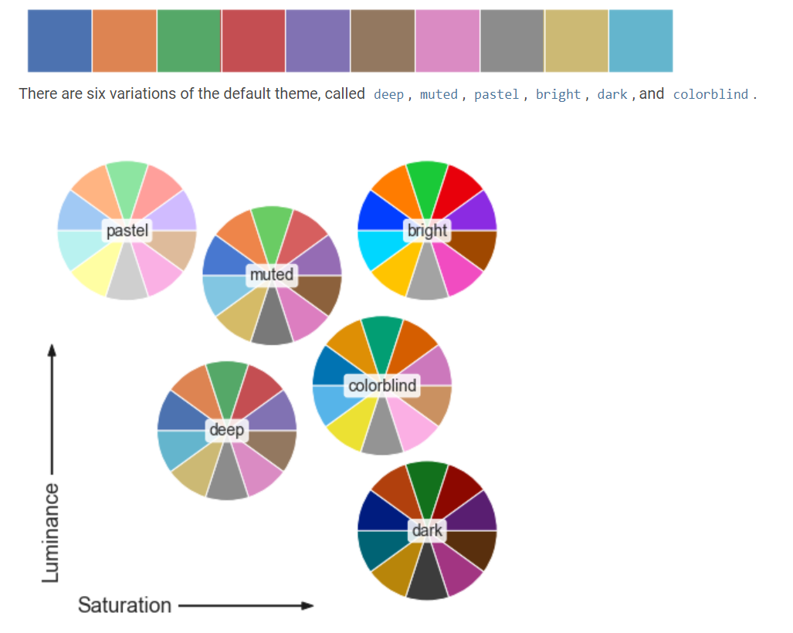
seaborn
https://seaborn.pydata.org/tutorial/color_palettes.html

Slide 4
colormap

