Slide 1
Color Rules

Slide 2
Pick a neutral: black or brown, black and gray, black and white, black and white and gray, black and brown, white and brown, gray or brown, white and gray
Pick a basic color: green or red or yellow or purple, green and light green, blue and light blue, dark blue and blue and light blue
Pick two basic colors: blue and light purple (analoguos), blue and small desaturate orange (complementary), blue, green
Pick accent colors: red, purple, yellow, orange
Pick based on seasons: pick dark-cool in winter, pick dark-warm in autumn, pick bright-cool in summer, pick bright-warm in spring

Slide 3
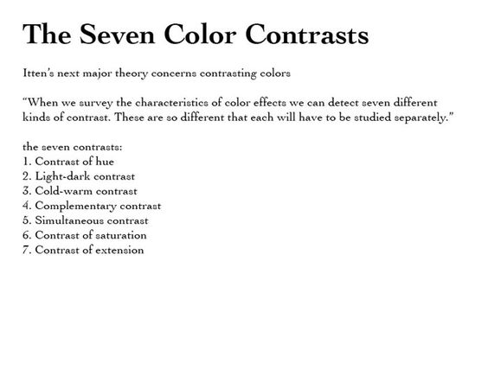

Slide 4
