Slide 1
FilmColors project

Slide 2
Data
Database on Azure
Dataset: 170’000 images
Screenshots aus unseren Filmanalysen (auf VIAN)
Bilder von der Timeline of Historical Film Colors: https://filmcolors.org/
VIAN WebApp: http://ercwebapp.westeurope.cloudapp.azure.com/
Github repository: https://github.com/ghalter/VIAN
Segments and labels
Images have labels
2 years of work
programming languages: jquery, bootstrap, HTML5
Possible already to segment out foreground/background and body parts etc.

Slide 3
Compare histograms (color distribution of an image)
Superpixel = mean LAB value of an object, bottom-up hierarchical clustering
Color contrast is incorporated in a color scheme (commonality)
i.e. color scheme gaudy = a colorful picture, corresponding color contrast is «contrast of hue» = at least 3 different hues present in the picture
Task 1: to define mathematically the color constrast categories/concepts (from color space transform it to semantic space) and determine similarity among them
Refer to academic papers that are mostly about the HSV space, but we use LAB plots
VIAN WebApp sind alle diese Begriffe schon mit Bildern erklärt.
Task 2: automatic classification of images into all color contrasts and color schemes to the extent that systemization is possible, machine learning: deep learning to use, search images which have same classification
Color palette extracted from segment
Interpolation to an extended color palette is not in Flückiger’s interest
Classification of images can only happen if we have categories that are fixed – color palettes, if they are extracted from images, are inifinite in number, hence they are not categories, in such a case only transformation can happen such as colorization. However, color themes are fixed categories because they are one-level higher up than color palettes

Slide 4
Test group
Give a 5-star rating (see O’Donovan et al. Train regressor to predict ratings for novel color themes)

Slide 5
Color palette
Extracted from film segment
Evolves per segment
Color contrast
High
Indetermined
Low
Reversal
Silhouettes
Strong
Weak
Hue
Lightness
Saturation
Background
Foreground
Figure
Object
Cold-warm
Saturation
Light-dark
Contrasts of hue
Contrast of extension
Simultaneous contrast
Successive contrast
Complementary
Split complementary
Split primaries
Aerial perspective
Color scheme
Gaudy
Hyperchrome
Monochrome
Restrictive
Muted
Pastel
Tone on tone
Black and white
Color spectrum
Saturated
Desaturated
Warm
Cold
Dark
light

Slide 6
Definitions/Terminology and Classification
Artistic vs. Scientific color models
Itten: color star (artistic)
Colorwheel (artistic) are symmetric
LAB (scientific) are curved; used in the VIAN app
Segment vs. Screenshot
Color scheme is a generalization of a color palette
Color contrast is the rule goverining the pick of colors of a color scheme

Slide 7
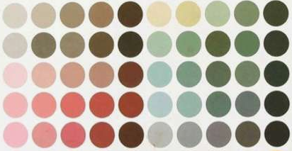
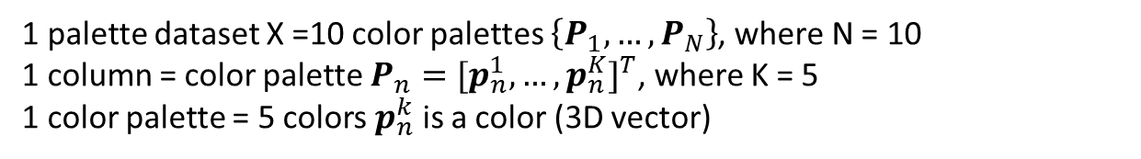
1 palette dataset X =10 color palettes $\left\{P_{1}, …,P_{N}\right\}$, where N = 10
1 column = color palette $P_{n}={[p_{n}^{1}, …,p_{n}^{K}]}^{T}$, where K = 5
1 color palette = 5 colors $p_{n}^{k}$ is a color (3D vector)

