Slide 1
Tasks

Slide 2
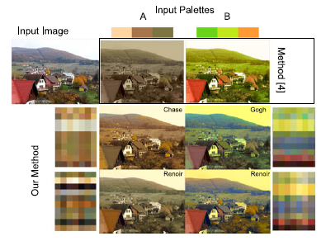
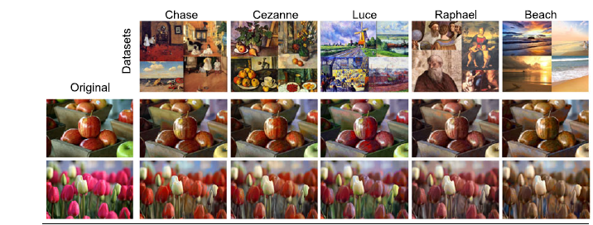
Image conversion (color transfer)
Image/Photo recolorization
Based on color palette, color data set, color theme, color schemes, etc.
Method A: color palette, where P =1 color palette with K=3 colors
Method B: color data set, where P =7 color palettes with K=10 colors

Slide 3
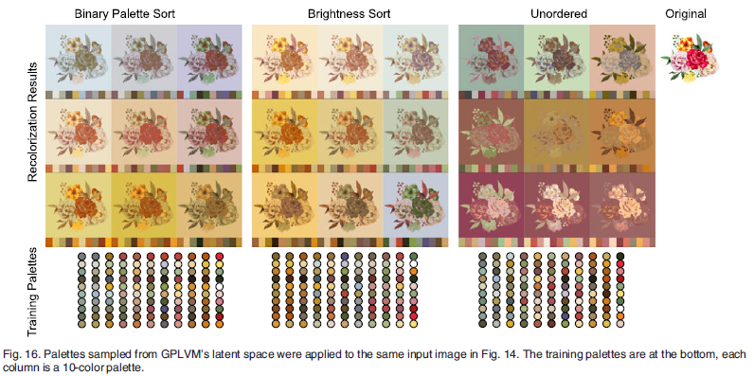
Image recolorization
BPS – reds stay red, blues stay blue; other techniques do not
Palette extracted from source image
Index colors of color palette
Get k more other color palettes by interpolating
Match similar color per index for each color palette

Slide 4
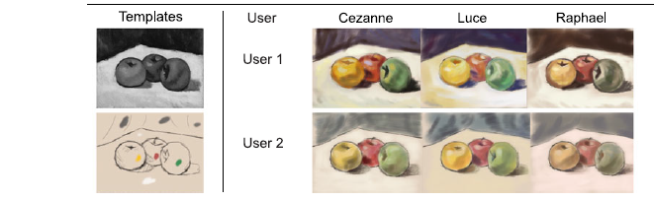
Image/Photo colorization

Slide 5
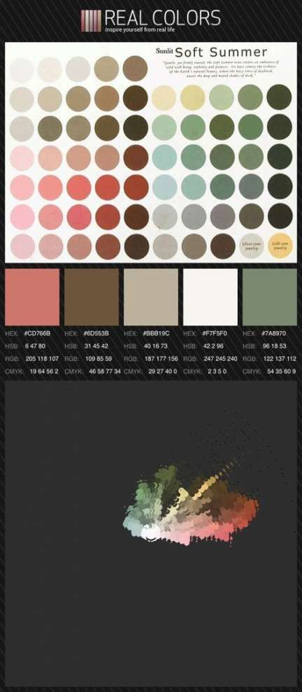
Image classification
Categories:
Color themes: light-dark, saturated-desaturated
Color contrasts: amalgam of other concepts
Color harmony: complementary, split complementary
Color seasons: spring, summer

Slide 6
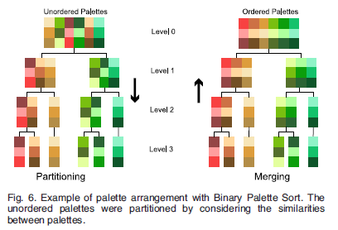
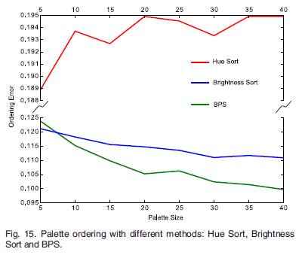
Color palette sorting
Ordering Performance = mean distance between the colors in two consecutive palettes, averaged over all palettes in a dataset
Methods:
Binary Palette Sort (BPS) Algorithm, +BPS interpolation– reds stay red, blues stay blue; other techniques do not
Brightness Sort, -bad if not bright
Hue Sort, -bad if no hues
Color distance inversely proportional to size of palette K

Slide 7


Color palette interpolation
Predicting compatible colors for query palette – recover missing colors of a palette
completion

Slide 8
Color prediction
= color harmony discovery
Given 1,2,3,4 colors (with 4…1 missing colors) from an unordered palette, predict/reconstruct the original palette of 5 colors
Training/test set
Completion performance: average MHD distance (predict-real) as prediction error

Slide 9
Image color compression
http://www.askaswiss.com/2017/07/how-to-compress-color-spaces-using-k-means.html

