Slide 1
Color Palettes
Pattern Recognition and Classification for Image Conversion

Slide 2
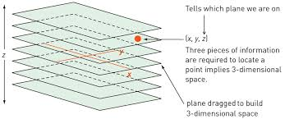
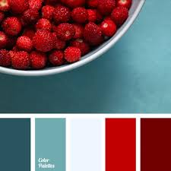
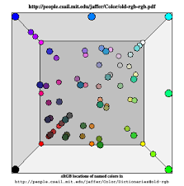
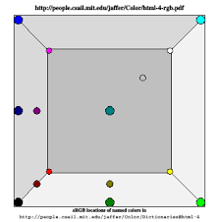




Pattern Recognition
Pattern recognition:
Find function XYZ or area underlying all data points (=closure); for example,
all planes in a 25 pixel interval starting from a cube’s square side contain all colors in the color palette
Task 1: Extend a given color palette to all possible palette colors
3
Color palette name: red-blue
Number of color patches: 5
1
Next, add more data points by extrapolating from function XYZ
1 2 3 4 5
4
Red-blue color palette
Same color patches are data points in the color cube
2
Red-blue color palette
New number of color patches: 10
Result: number of color patches has increased, the color palette is ideally fully defined
5
Not in Prof. Flückiger’s interest – still doable?
1 2 3 4 5 6 7 8 9 10

Slide 3


Classification
Task 2: Classify an image into a set of given color palettes
1
3
Question: Which color palette can we classify this image into?
2
Derive superpixels through generalization of colors for each object in the image
Find nearest neighbor color palette
via minimization of a distance metric
Answer: C, the image can be classified into the red-blue color palette category
C.
Following object recognition/
image segmentation, make superpixel color patches:
A.
B.
C.
4
Determine best-ranked (highest F1-score) machine learning classifier for image classification ([semi-]supervised learning)

Slide 4


Image Conversion
Task 3: Given a color palette, determine the best color combinations
Shuffle color swatches pairwise (or n-wise) to get all color combinations without repetition
$$C\left(n,k\right)=\frac{n!}{k!\left(n−k\right)!}$$
$$C\left(5,2\right)=\frac{5!}{2!3!}=\frac{5x4x3x2}{2x3x2}=\frac{120}{12}=10$$
1
Wisdom of the crowd: ask people to
Rank color combinations
Like/dislike color combinations
And do image conversion
1
5
8
10
OK
OK
OK
OK
2
6
9
OK
OK
1
3
7
Image conversion:
1
4

Slide 5
Prof. Flückiger’s proposal

Slide 6
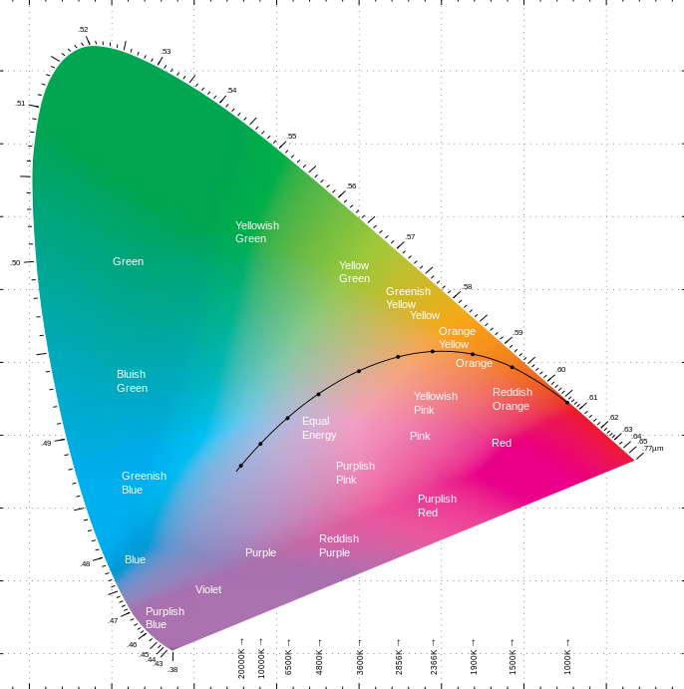
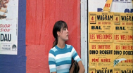
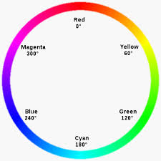
Pattern Recognition
Pattern recognition:
Definition: hues differ if XYZ (HSV to LAB space – scientific color space)
Challenge: Find underlying rule that defines the color contrast concept mathematically.
Task 1: Define all given color contrast (belonging to a color scheme) categories in scientific color space
3
Color contrast: «contrast of hues» (concept)
Definition: at least 3 different hues present in an image
Color scheme: «gaudy»
Definition: a colorful scheme
1
1 blue 2 red 3 teal 4 yellow
Mapping:
Map each color contrast (25) to its color scheme (15)
4
Result: global view of all color contrasts defined in LAB space
>60°
2
Pattern recognition:
Definition: hues differ at an angle of 60° on the color wheel (color wheel – artistic color space)
Definition:
A color palette is an instatiation of a color scheme. A color contrast conceptualizes the color scheme.

Slide 7



Classification
3
Classifier: Apply color contrast rule from pattern recognition to the color scheme of the image, find the closest fitting rule
Answer: C, the image can be classified into the gaudy color scheme category, check with label of image if it’s correct
Task 2: Classify an image/segment into a color contrast (color scheme) with a querytool (web interface)
2
Derive superpixels through generalization of colors for each object in the image
1
Question: Which color contrast can we classify this image into?
Math function for «gaudy» on LAB
A.
B.
C.
warm
Determine best-ranked (highest F1-score) machine learning classifier (kNN, CNN etc.) for multi-class image classification (supervised learning)
Following object recognition/
image segmentation, make superpixel color patches (color palette):
4
pastel
gaudy
Error analysis: identify images where a discrepancy between between predicted and real classification labels occur and reiterate
Rule: 1 image can only be classified into 1 color contrast/ scheme.
5
Is this rule correct?

Slide 8
Application
Task 3: Develop a querytool (web interface) as part of VIAN for searching images by category – color contrasts explorer

Slide 9
Q&A

Slide 10
keywords
Image color analysis
Machine learning
Color palette
Color scheme
Color contrast
colorization

