Slide 1

COMP9444 · Neural Networks and Deep Learning
Project 077 · Text-to-SQL Generation
SQL Prompt
Generation from
Natural Language
Queries
Team KKKKK
Member 1 Mingyuan Xu (z5707025) Data preprocessing
Member 2 Ruoyu Jiang (z5546234) T5-small baseline
Member 3 Hangji Liu (z5660625) Model improvement
Member 4 Yihan Zhou (z5676668) Training and evaluation
Member 5 Chenghao Ruan (z5617856) Integration and reproducibility
Notes:
第1页：开场。说明项目是 COMP9444 Project 077，主题是把自然语言问题转换成 SQL。这里不用讲技术细节，只要告诉老师每个人负责一部分，后面会按问题、数据、方法、结果和整合来讲。

Slide 2
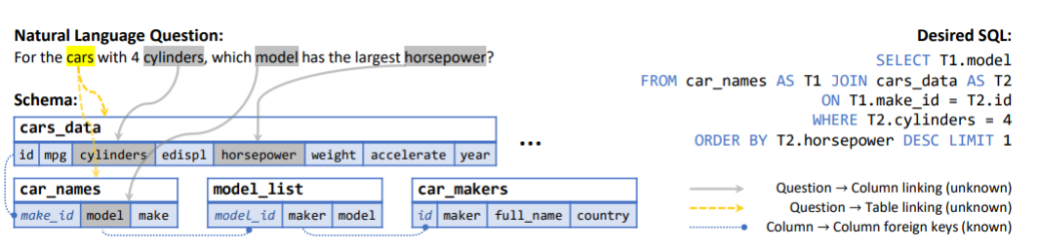
Motivation: make databases accessible through language
Why this matters: many useful databases require SQL knowledge, which is a barrier for non-technical users. Text-to-SQL lets users ask a question in English and obtain a query that can retrieve the required data.
Our goal: fine-tune sequence-to-sequence models that map a natural-language question and schema context to a precise SQLite query.
Example task: natural language question + schema links → desired SQL.
Presenter: Member 1 - Mingyuan Xu (z5707025) | COMP9444 Project 077
2
Notes:
第2页：讲动机。重点说 SQL 对普通用户有门槛，我们的模型让用户用英文问问题，系统生成 SQL。图里展示的是输入问题、数据库 schema，以及输出的 desired SQL。

Slide 3
Problem Statement
Task definition: given a natural-language query plus database schema information, generate a syntactically and semantically accurate SQL statement.
Hard parts: the model must link words in the question to tables and columns, handle joins and aggregation, and avoid producing SQL that looks valid but answers the wrong question.
Challenge
Why it matters
Schema linking
Choose the correct tables and columns from the prompt
Query structure
Generate joins, filters, ordering, aggregation and nested queries
Evaluation
Exact string match can reject semantically equivalent SQL
Reproducibility
All modules must share the same split, seed and run commands
Presenter: Member 1 - Mingyuan Xu (z5707025) | COMP9444 Project 077
3
Notes:
第3页：定义问题。老师要看到清楚的问题陈述。自然语言加 schema 是输入，SQL 是输出。难点包括 schema linking、join、aggregation、nested query，以及评估时严格 exact match 不等于真正语义正确。

Slide 4
Literature Review: what previous Text-to-SQL work teaches us
Seq2SQL: frames SQL generation as structured sequence prediction and shows that decoding choices affect final queries.
SQLNet: highlights that equivalent condition order can make strict sequence matching difficult.
RAT-SQL: emphasises explicit schema linking and relation-aware encoding for complex database schemas.
T5 / FLAN-T5: supports a text-to-text formulation, so the same framework can read schema + question and generate SQL text.
Schema
linking
central challenge
Text-to-text
simple baseline
Strict EM
use with caution
Related methods referenced in the project brief and team reports: Seq2SQL, SQLNet, RAT-SQL, T5/FLAN-T5.
Presenter: Member 1 - Mingyuan Xu (z5707025) | COMP9444 Project 077
4
Notes:
第4页：文献综述。不要长篇解释论文，只讲它们给我们项目的启发：SQL 生成可以当序列任务；严格字符串匹配有局限；复杂 schema 需要更好的 schema linking；T5 系列适合 text-to-text。

Slide 5
Dataset and preprocessing
Dataset: SQL Generator No CoT from Hugging Face. Each example contains an English natural-language question and a target SQL query.
Cleaning: remove duplicate rows, trim prompt text, extract SQL from markdown code blocks, and keep the final columns as prompt and SQL.
Split and tokenisation: use random seed 42 and an 80/10/10 split. Prompts are tokenised to a maximum of 512 tokens and SQL targets to 256 tokens.
9,397
7,517
cleaned examples
training
940
940
validation
test
Step
Output for later members
load_raw_dataset()
Raw CSV from AI4DS/sql_generator_no_cot
clean_dataset()
prompt + sql columns
split_dataset()
train / validation / test
tokenize_dataset()
input_ids, attention_mask, labels
build_dataloaders()
PyTorch DataLoaders for training and evaluation
Presenter: Member 1 - Mingyuan Xu (z5707025) | COMP9444 Project 077
5
Notes:
第5页：讲数据和预处理。重点数字是 9397 条样本，7517/940/940 划分。强调 Member 1 的工作让后续 baseline、training、evaluation 可以直接使用 DataLoader。

Slide 6
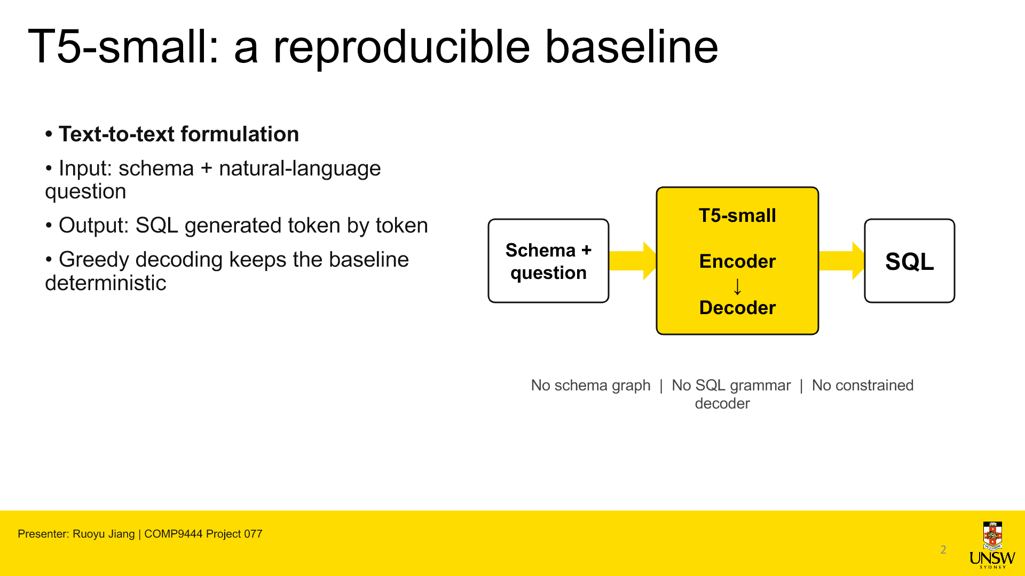
Why T5-small is our baseline
My contribution begins with the baseline choice. We use T5-small because text-to-SQL can be formulated as a text-to-text task.
How it works: the encoder reads the database schema together with the natural-language question. The decoder then generates the SQL query token by token.
Why this model: T5-small is pretrained, computationally manageable on Kaggle, and straightforward for the whole team to reproduce.
Why it is a useful baseline: it has no built-in schema graph or SQL grammar. Later prompt, schema-aware input and decoding improvements can therefore be compared against a simple and transparent reference.
Presenter: Member 2 - Ruoyu Jiang (z5546234)
6
Notes:
All speaking copy is intentionally visible on this reading-friendly slide.
[Sources]
- Local baseline implementation: team_repo/src/baseline.py
- T5 architecture visual inherited from the polished project deck

Slide 7
A controlled and reproducible training setup
Training objective: I use token-level cross-entropy loss and ignore padding labels, so padded positions do not contribute to the gradient.
Optimisation: the pretrained T5-small parameters are fine-tuned with AdamW, a learning rate of 5e-5, and batch size 4. Inputs are limited to 512 tokens and SQL targets to 256 tokens.
Checkpoint selection: I train for 10 epochs with random seed 42, evaluate validation loss after every epoch, and save the checkpoint with the lowest validation loss.
Inference: greedy decoding with one beam keeps prediction simple and deterministic. This setup gives later methods the same clear reference point.
10 epochs
5e-5 learning rate
4 batch size
512 → 256
input / target token limits
seed 42 · one-beam greedy
Presenter: Member 2 - Ruoyu Jiang (z5546234)
7
Notes:
All speaking copy is intentionally visible on this reading-friendly slide.
[Sources]
- team_repo/src/baseline.py
- team_repo/results/baseline_training_log.csv

Slide 8
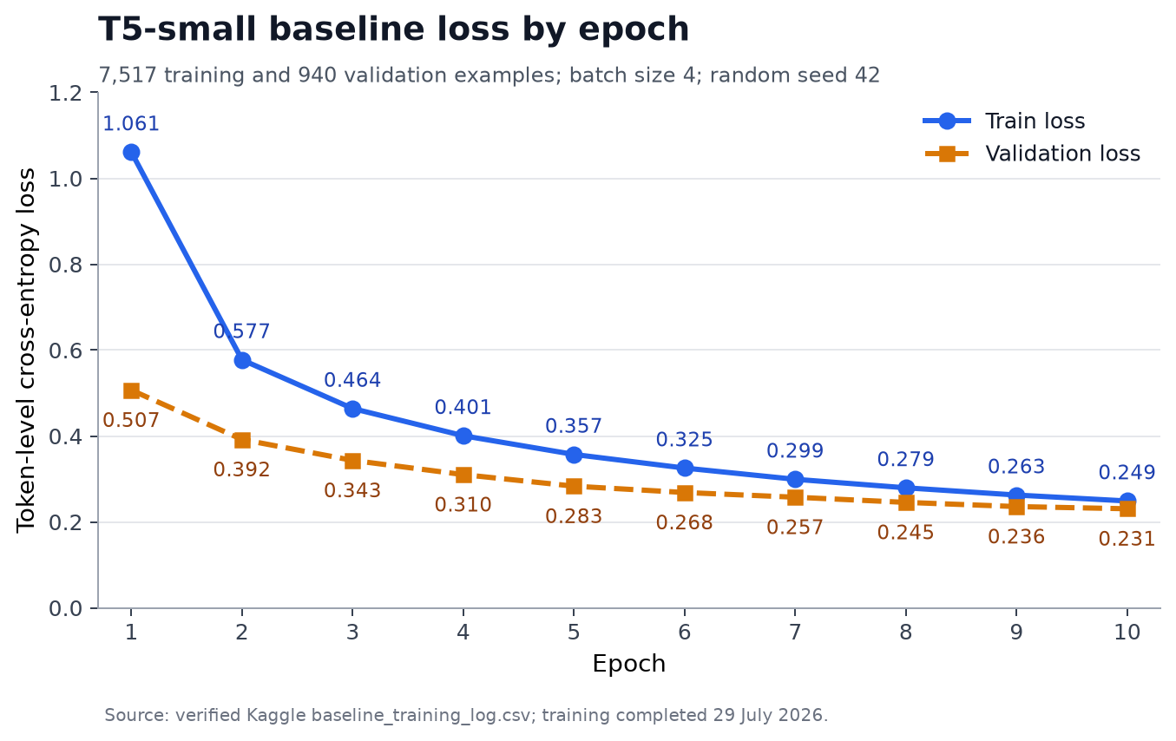
Ten epochs reach 10.96% strict exact match
10.96%
103 / 940 normalised exact matches
The loss curves decrease steadily. Training loss falls from 1.061 to 0.249, while validation loss falls from 0.507 to 0.231.
Because validation loss is lowest at epoch 10, I select the epoch-10 checkpoint. There is no obvious loss-curve evidence of overfitting.
Exact match improves from 7.55% at epoch 5 to 10.96% at epoch 10, a gain of 3.40 percentage points. However, this does not prove complete convergence.
Presenter: Member 2 - Ruoyu Jiang (z5546234)
8
Notes:
All speaking copy is intentionally visible on this reading-friendly slide.
[Sources]
- team_repo/results/baseline_training_log.csv
- team_repo/results/baseline_full_summary.json
- team_repo/docs/experiments/figures/member2_baseline_loss.png

Slide 9
What the baseline reveals
What the model learns: T5-small captures common SQL syntax and some simple filters, joins and repeated query patterns.
Where it fails: schema linking and precise aggregation remain difficult. The model may select the wrong table or column, misuse aliases, or generate an incomplete filter.
Representative example: the prediction uses COUNT(category_id), while the reference requires COUNT(DISTINCT category_id). The SQL is close, but its meaning is different.
How to interpret 10.96%: our metric uses strict normalised exact match. Equivalent SQL strings can still be counted as wrong, and we cannot report execution accuracy because the populated databases are unavailable.
My contribution and next step: I implemented the T5-small baseline, selected the training configuration, produced the checkpoint, and analysed the results. The baseline and improved prompts should now be compared with the same epochs, random seed and test rows.
Presenter: Member 2 - Ruoyu Jiang (z5546234)
9
Notes:
All speaking copy is intentionally visible on this reading-friendly slide.
[Sources]
- team_repo/results/baseline_predictions.csv
- team_repo/results/baseline_full_summary.json

Slide 10
What was missing in the baseline?
Long schemas
Relevant tables or columns may be truncated. If the prompt exceeds the token limit, the model may never see the most useful schema information.
Greedy decoding
Only one generation path is kept. A locally likely token can lead to a weaker final SQL query.
T5-small
Limited capacity for complex schema reasoning. It may struggle to connect the question with the correct tables, columns, joins and conditions.
Presenter: Member 3 - Hangji Liu (z5660625) | COMP9444 Project 077
10
Notes:
Member 3 explains the baseline limitations that motivate the improved method.
[Sources]
- Member3_Model_Improvement_Presentation(2).pptx
- team_repo/docs/report/member3_improvement.md

Slide 11
What did I change?
INPUT
MODEL
DECODING
Schema-aware input
Rank relevant tables and columns before tokenisation, so useful schema tokens appear earlier in the input.
FLAN-T5-base
Use a stronger instruction-tuned sequence-to-sequence model to better follow the natural-language-to-SQL task.
Beam 8 + reranking
Generate eight candidate paths, then use schema-aware reranking to prefer SQL grounded in the available tables and columns.
Presenter: Member 3 - Hangji Liu (z5660625) | COMP9444 Project 077
11
Notes:
Member 3 implementation changes: schema-aware input, FLAN-T5-base and Beam 8 plus schema reranking.
[Sources]
- Member3_Model_Improvement_Presentation(2).pptx
- team_repo/docs/report/member3_improvement.md
- team_repo/results/member3/v3_full_run/README_CN.md

Slide 12
Why can this approach work?
Preserve relevant context
Important schema tokens appear earlier, reducing truncation risk. Useful schema information is less likely to disappear during tokenisation.
Follow the instruction
FLAN-T5-base is better suited to natural-language-to-SQL prompting. Its larger capacity also helps with complex relationships.
Explore alternatives
Beam Search keeps several promising SQL generation paths. This reduces the risk of committing too early to one wrong token.
Prefer grounded SQL
Reranking favours candidates that reference the provided schema. Unknown tables or columns receive penalties.
Presenter: Member 3 - Hangji Liu (z5660625) | COMP9444 Project 077
12
Notes:
Member 3 model-improvement result. The result is reported as strict normalised exact match on the same 940-example test set.
[Sources]
- Member3_Model_Improvement_Presentation(2).pptx
- team_repo/results/member3/v3_full_run/README_CN.md
- team_repo/results/baseline_full_summary.json

Slide 13
Did the model improve?
The combined method improves strict exact match
103 → 133 → 166 exact matches on the same 940-example test set. Normalised Exact Match is strict: the prediction must match the reference after normalisation.
+63
+6.70 pp
correct queries
vs. baseline
Schema rerank: prefer grounded SQL candidates.
Presenter: Member 3 - Hangji Liu (z5660625) | COMP9444 Project 077
13
Notes:
Member 3 rationale for the combined improvement.
[Sources]
- Member3_Model_Improvement_Presentation(2).pptx
- team_repo/docs/report/member3_improvement.md

Slide 14
What are the limitations?
The improvement is real, but the metrics need careful interpretation.
The final gain comes from a combined system.
A separate ablation study would be needed to isolate each component's contribution.
Therefore, Exact Match and SQL Validity should be interpreted together.
Strict Exact Match
SQL Validity ≠ correctness
Equivalent SQL can still receive different string-level scores. Different aliases or condition order may express the same logic but fail exact match.
90.32% parses with sqlglot, but valid syntax does not prove correct semantics. A query may parse while using the wrong table, column or condition.
Presenter: Member 3 - Hangji Liu (z5660625) | COMP9444 Project 077
14
Notes:
Member 3 limitations and hand-off.
[Sources]
- Member3_Model_Improvement_Presentation(2).pptx
- team_repo/docs/report/member3_improvement.md
- team_repo/results/member3/v3_full_run/README_CN.md

Slide 15
Training and evaluation framework
Shared training utilities: device-safe batch handling, training and validation loops, optional gradient clipping, early stopping, history tracking and checkpoint support.
Checkpointing: atomic best/latest checkpoint writes, CPU-safe loading, optimizer-state migration, and resume continuity.
Evaluation: generation under model.eval() and torch.no_grad(), decoded predictions, alignment checks, throughput, normalised exact match, SQL validity and error analysis.
Metric / check
Interpretation
Raw exact match
Strict string match before normalisation
Normalised exact match
Lowercase, collapse spaces, remove trailing semicolon
SQLGlot / SQL validity
Does the SQL parse; not full semantic correctness
Heuristic error labels
wrong table, wrong column, join, aggregation, filter errors
Presenter: Member 4 - Yihan Zhou (z5676668) | COMP9444 Project 077
15
Notes:
第8页：Member 4 讲训练和评估框架。重点不是新模型，而是共享训练、checkpoint、early stopping、evaluate_model、SQL validity 和 error analysis。提醒老师 SQL validity 只说明能不能 parse，不代表语义完全正确。

Slide 16
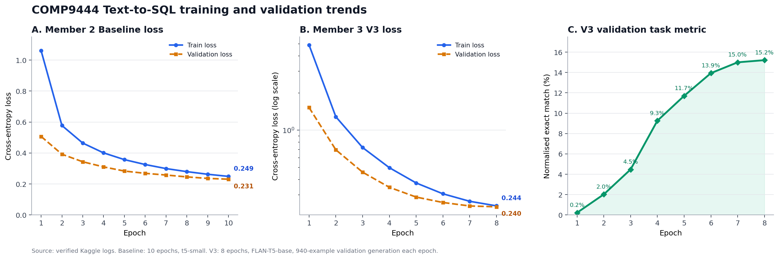
Results and analysis
Main finding: the V3 system improves strict exact match on the same 940-example test set, from 10.96% to 17.66%.
Validity analysis: 849/940 V3 Beam + Schema predictions parse under SQLGlot, giving a 90.32% syntactic validity rate.
Important caution: exact match and SQL validity are diagnostic metrics. Valid syntax may still select the wrong table, column, filter or aggregation, and equivalent SQL may still fail exact match.
System
Normalised EM
SQLGlot validity
Baseline greedy
103/940 (10.96%)
829/940 (88.19%)
V3 Beam + schema rerank
166/940 (17.66%)
849/940 (90.32%)
Presenter: Member 4 - Yihan Zhou (z5676668) | COMP9444 Project 077
16
Notes:
第9页：讲结果。先讲主结果：baseline 10.96%，V3 greedy 14.15%，V3 Beam + schema rerank 17.66%。再讲 SQLGlot validity：最终 90.32%。最后一定要说这不是 execution accuracy，语法有效不代表一定回答正确。

Slide 17
Integration and reproducibility
My contribution: I converted the starter main.py into a unified command-line entry point that connects the baseline, improvement, evaluation and test modules without changing their internal implementations.
Why it helps: the project can be reproduced and demonstrated from one interface, reducing manual execution errors and preserving each member's module independence.
1 file
main.py modified
170
Command
Purpose
tests passed
python -m src.main --help
Show the unified project menu
python -m src.main baseline --help
Forward to Member 2 baseline options
1
python -m src.main improvement --help
Forward to Member 3 improvement options
python -m src.main evaluate --help
Forward to Member 4 evaluation options
test skipped
python -m src.main test
Run the integrated project test suite
Presenter: Member 5 - Chenghao Ruan (z5617856) | COMP9444 Project 077
17
Notes:
第10页：这是你的个人贡献页。你要说：我没有乱改其他人的模型代码，而是修改 main.py，把 baseline、improvement、evaluate、test 整合成一个统一入口。170 passed 不是模型准确率，是软件测试通过数量。

Slide 18
Discussion and conclusion
Strengths: the final workflow is modular, reproducible and testable. The improved method increases strict exact match and SQL validity compared with the baseline.
Weaknesses: schema linking and exact aggregation remain difficult. Strict exact match can penalise semantically equivalent SQL, while SQL validity does not prove semantic correctness.
Future work: add execution accuracy with populated databases, stronger schema linking, ablation studies for each improvement component, and safer constrained SQL decoding.
10.96%
baseline EM
17.66%
final V3 EM
90.32%
V3 SQL validity
Questions?
Presenter: Member 5 - Chenghao Ruan (z5617856) | COMP9444 Project 077
18
Notes:
第11页：收尾。总结强项、弱点和未来工作。最后强调最终 improved method 比 baseline 有提升，但 exact match 和 SQL validity 都有局限。最后说 Thank you, we are happy to take questions.

