Slide 1

Dependable Cloud Computing with OpenStack
Johannes Eschrig, Sven Knebel, Nicco Kunzmann
HPI Cloud Symposium "Operating the Cloud"
Hasso-Plattner-Institut Potsdam, 03.11.2015
(http://www.alphasandesh.com/blog/wp-content/uploads/2012/12/smtp-server.jpg)

Slide 2
Dependable Cloud Computing with OpenStack
Mission: Create an OpenStack in the Box
Goal: Create an OpenStack system for evaluation the dependability of fault tolerance mechanisms in OpenStack
2 Main Tasks:
Reproducible environment with OpenStack system
Experiments for testing the dependability of OpenStack

Slide 3
Requirements
Simple setup
Small setups complicated enough for thorough testing
Easy to simulate failures
Fast turnaround
Works on limited hardware
Easy to use for future (student) projects
Multiple nodes/small cluster
Potential for customization/extension to compare different setups
Reproducibility of experiments

Slide 4

DevStack
Development environment for OpenStack
Multi-Node possible, but made for single node
Custom configuration scripts
Documentation for multi-node and high-availability setups scarce
Hard to extend for new use cases
Can DevStack dependability experiments be generalized to OpenStack?

Slide 5






Commercial Distributions
Have comfortable installers for cluster-deployments
Integrate with system management tools
(Ubuntu Juju, RedHat Spacewalk, …)
Setup “production-grade” configurations
Require many nodes → high hardware demands
High-availability features built in
A lot of pre-configuration not intended for user change
→ Results can‘t be generalized, hard to modify

Slide 6

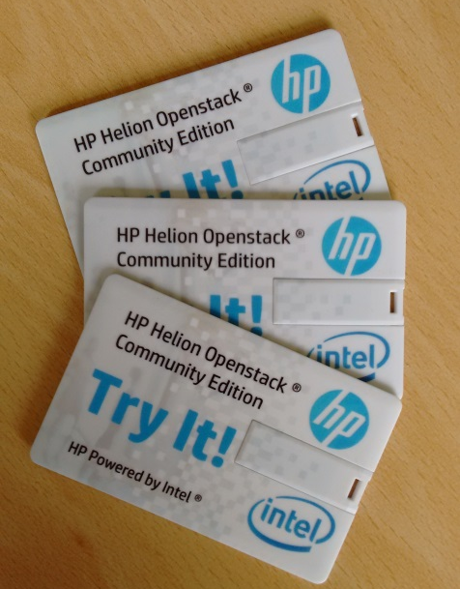
HP Helion Community Edition
Has all-in-one demo mode
Nodes are created as Virtual Machines
Great idea, but
Install takes a long time
Doesn‘t survive reboot of host machine
Install uses Triple-O
Elegant, but hard to understand
Not documented enough for us

Slide 7
Our Own Setup
All-in-one “cluster” with virtualized nodes
Very simple
Minimum interesting number of nodes and services
Leaves room for modifications/extensions
Install process based closely on official OpenStack install docs
Integration with experimentation framework

Slide 8
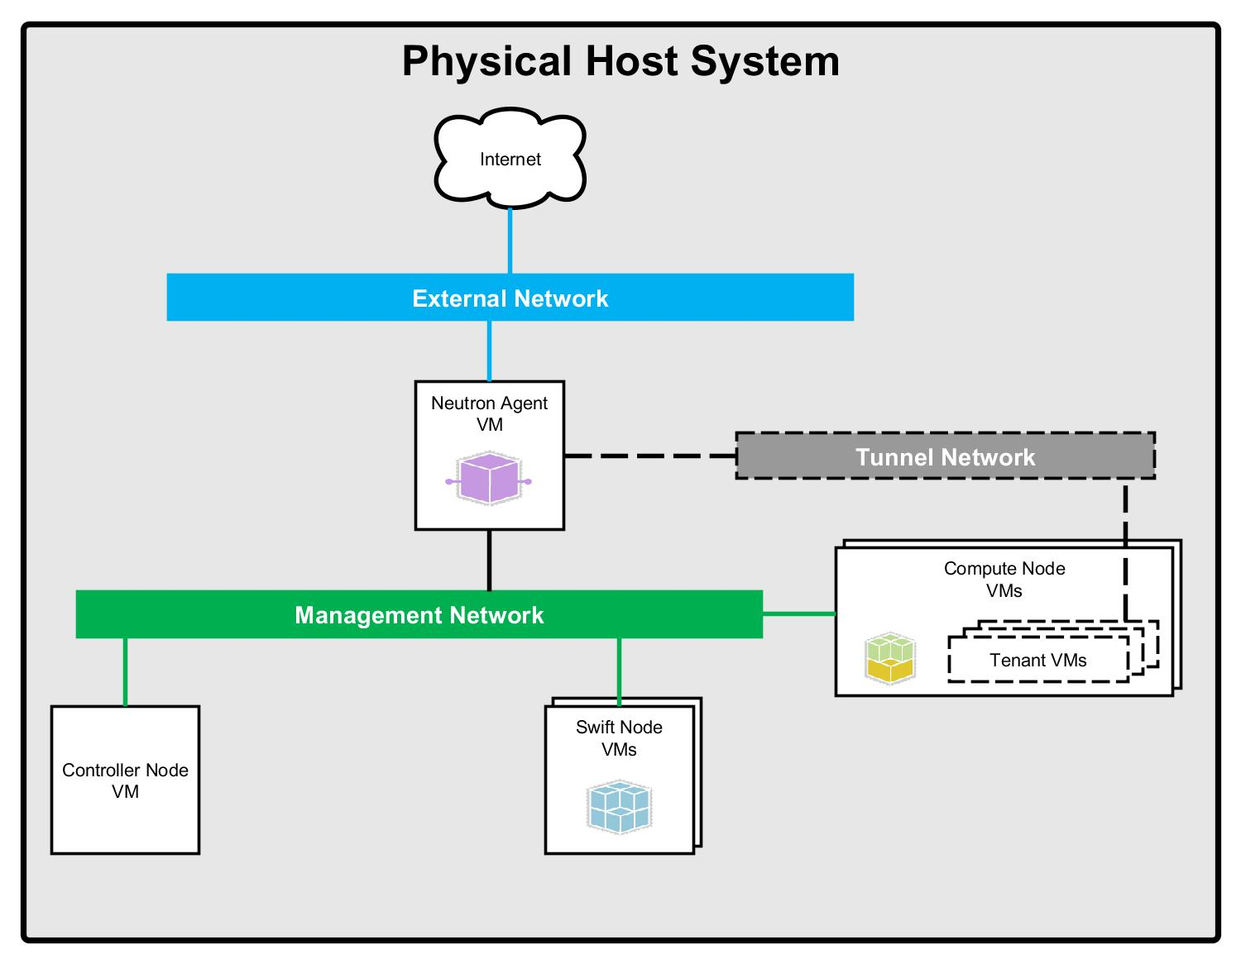
Reproducible Test Environment (Our OpenStack Architecture)
Notes:
Extensible
Nested Virtualization

Slide 9
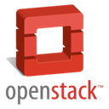



OpenStack Installation
Virtual machines using KVM
Widely supported
Nested virtualization
Virtual Machines and networks are managed using libvirt
Virtual networks implemented as Linux bridges
Installation using
Bash scripts to create Virtual Machines
cloud-init to inject configuration in Virtual Machines
Ansible to set up OpenStack on Virtual Machines

Slide 10
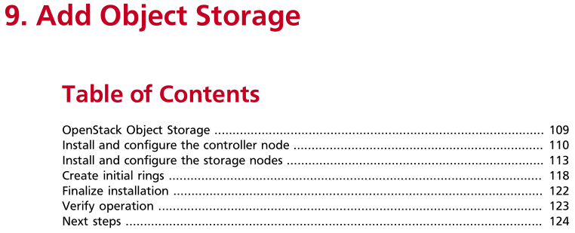
OpenStack Installation Ansible
+
Ansible Playbook:
installation/playbooks/
09_Add_Object_Storage/
02_Install_and_configure_the_controller_node/
02_install_and_configure_the_controller_node_components.yml
Corresponding documentation:

Slide 11
OpenStack Installation Ansible
+
Ansible hosts file
[controller]
root@192.168.100.11
[network]
root@192.168.100.21
[compute]
root@192.168.100.31
root@192.168.100.32
[objectstorage]
root@192.168.100.41
root@192.168.100.42

Slide 12
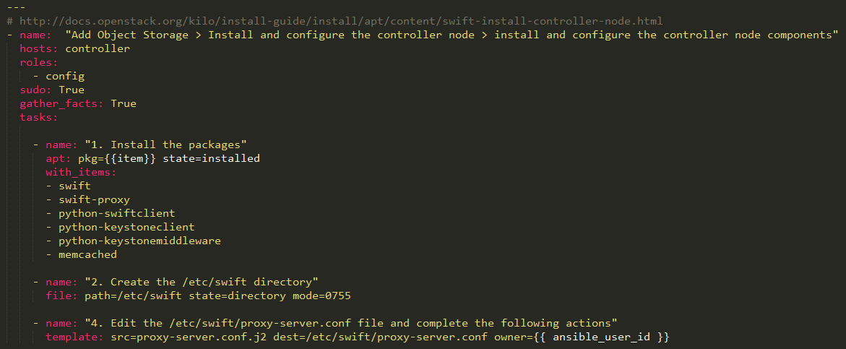
OpenStack Installation
+
02_install_and_configure_the_controller_node_components.yml

Slide 13
OpenStack Installation Ansible
Installation took 15m 28s.
To use the Horizon Web interface visit http://controller/horizon/
Logins are
user: "demo" password: "demo"
user: "admin" password: "admin"
as specified in the configuration.
To use SSH execute
ssh ubuntu@compute1
ssh ubuntu@compute2
ssh ubuntu@controller
ssh ubuntu@network
ssh ubuntu@object1
ssh ubuntu@object2

Slide 14

OpenStack Installation Results
Full installation in 10-20 minutes
Snapshot and restore all virtual nodes
Package versions can be frozen to allow installing the same set up
“Light” setup runs on normal (8 GB RAM, quadcore) workstation
Full setup (2 compute and 2 Swift nodes) on 64 GB RAM, 16 Core workstation

Slide 15
Experiments on OpenStack
Experiments vs Tests?
Tests have a clear success/failure condition
Experiment contains
Where and how do we trigger a fault?
How can we observe resulting failures

Slide 16
Running Experiments on OpenStack
Scripted using bash and Ansible
Data about cluster available from installation configuration
Stages
Setup
Observe
Break
Observe
(Heal)
(Observe)

Slide 17
Experiment: Keystone Tokens
Keystone: Authentication Service
Authenticates Users, manages their permissions
Authenticates actions using/between services
Tokens:
created by users
carry a subset of their permissions
are passed with API requests
can be used by services to authenticate actions against other APIs

Slide 18



Experiment: Keystone Tokens
* SETUP
- on controller, get token from Keystone
* Running checks
- attempting to create new token using first token
OK! Token created.
36e737434cc446a7a3d9ab95e9746cb9
* CREATING FAULT
- flushing memcache on controller
* Running checks
- attempting to create new token using first token
ERROR! No token created.
Experiment
Script
USER:PASS. Token?
“Memcached is an in-memory key-value store for small chunks of arbitrary data (strings, objects) from results of database calls, API calls, or page rendering.”
http://memcached.org/
e67a365… Subtoken?
36e7374…
e67a365…
Controller
(VM)

Slide 19
Dependable Cloud Computing with OpenStack
Simple all-in-one virtualized cluster setup of OpenStack
Framework for reproducible experiments
Our Code is on Github!
http://git.io/vlu6Y

Slide 20
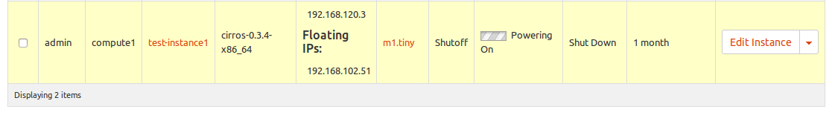
Compute Node nicht erreichbar Experiment 1
Wie und Wo wird der Fehler ausgelöst?
Management Network Interface auf Control Node auf down setzen
Ergebnis beobachten, danach Compute Node abschalten, beobachten
Wie kann der Fehler beobachtet werden?
Auf dem Control Node bzw. Horizon wird
eine vor dem Fehler gestartete VM als Active angezeigt, egal ob sie läuft oder nicht
eine nach dem Fehler gestartete VM wird permanent als hochfahrend angezeigt ohne eine Fehlermeldung auszugeben.

Slide 21
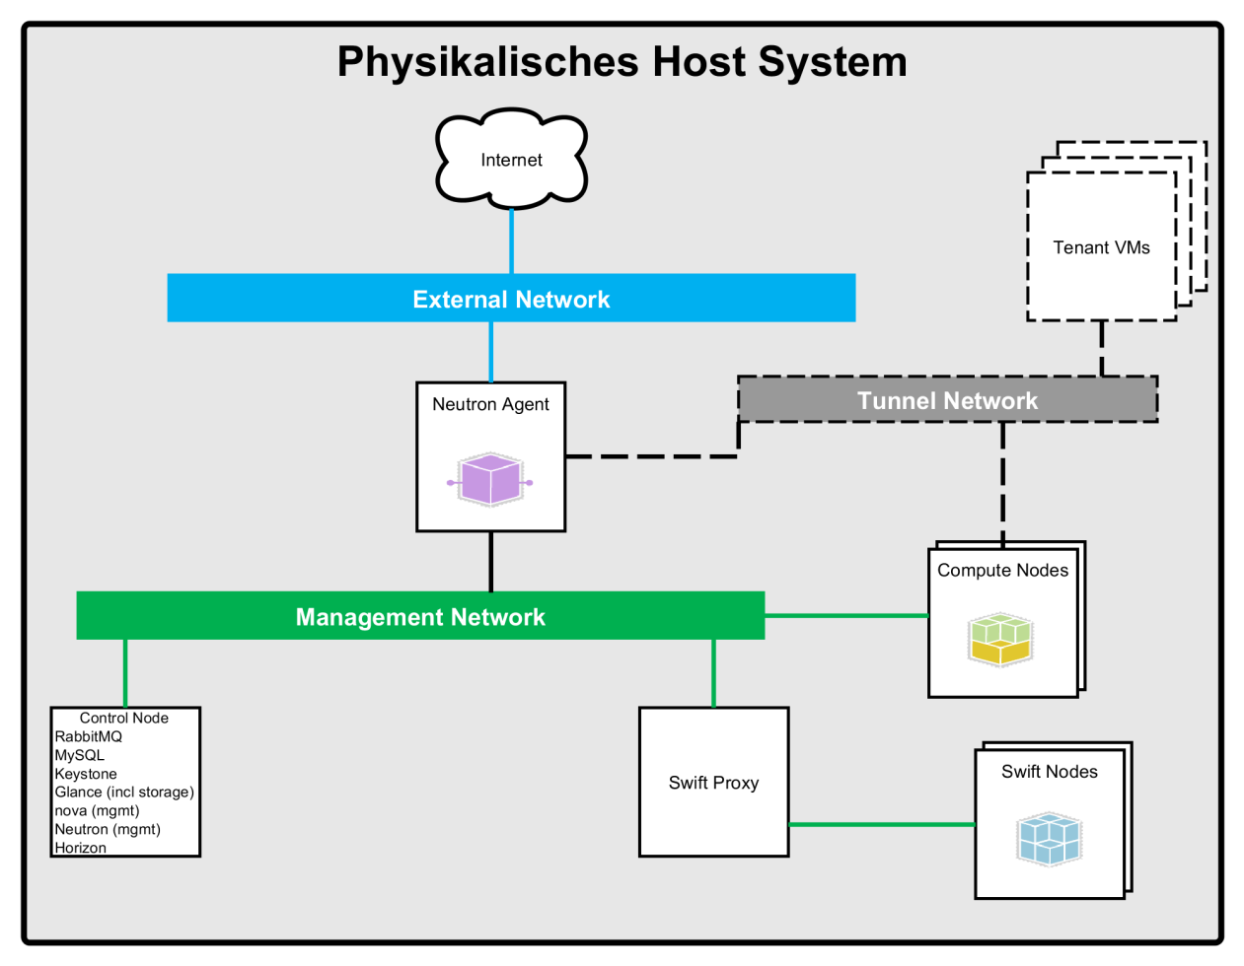

Compute Node nicht erreichbar Experiment 1

Slide 22
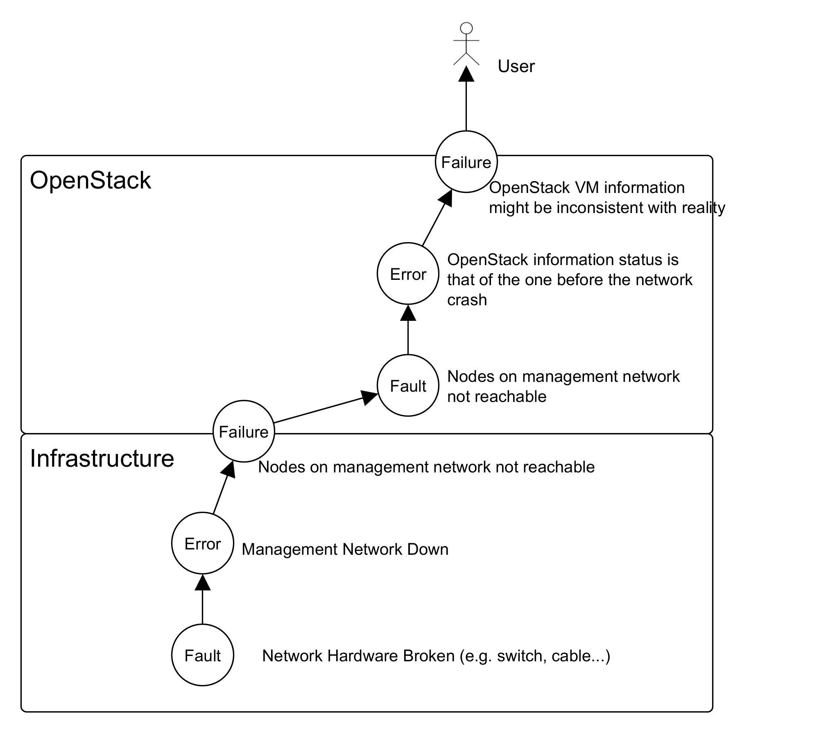
Compute Node nicht erreichbar Experiment 1

Slide 23
Ausfall des Controller Nodes Experiment 2
Wie und Wo wird der Fehler ausgelöst?
VM Controller Node abschalten (Simuliert Hardwaredefekt etc.)
Wie kann der Fehler beobachtet werden?
Keystone nicht mehr verfügbar
APIs nicht mehr verfügbar
Virtuelle Maschinen jedoch erreichbar und funktionsfähig

Slide 24
Ausfall der Netzwerk Node Experiment 3
Wie und Wo wird der Fehler ausgelöst?
Network Node VM abschalten
Wie kann der Fehler beobachtet werden?
Verbindungen zwischen VMs unterbrochen
Verbindungen zwischen VMs und Außenwelt unterbrochen

Slide 25
Ausfall einer Object-Storage Node Experiment 4
Wie und Wo wird der Fehler ausgelöst?
Object-Storage Node VM abschalten
Wie kann der Fehler beobachtet werden?
Abhängig von Konfiguration sind vorherig gespeicherte Objekte noch verfügbar/nicht mehr verfügbar

