Slide 1


NEXDOC
Search Your Documents.
Contextually & Instantly.
Nexdoc is a high-performance offline document search engine that processes PDFs, images, spreadsheets and presentations locally, generates semantic embeddings, and delivers fast, context-aware search — with an optional AI mode for synthesized, cited answers.
OFFLINE-FIRST · DESKTOP AI DOCUMENT INTELLIGENCE
01 / 09

Slide 2







Nexdoc
CORE CAPABILITIES
Features
Multi-Format Support
High-Performance Processing
Document Intelligence
Processes PDF, images (OCR), PPTX, TXT and XLS/XLSX out of the box.
Multi-threaded pipeline with a dynamic worker pool and real-time file watching.
Extracts text, topics and metadata, then generates semantic embeddings for each chunk.
Advanced Search
Efficient Storage
Optional AI Mode
Semantic vector search with hybrid filtering and relevance ranking on every query.
LanceDB for vector search, SQLite for app data — fully persistent and local.
Gemini-powered synthesized answers with cited sources; offline mode works without it.
02 / 09

Slide 3




Nexdoc
TARGET AUDIENCE
Who Is Nexdoc For
Professional & Legal Firms
Privacy-Conscious Enterprises
Evaluating an offline document assistant to search contracts, filings and case files without sending sensitive data anywhere.
Organizations handling confidential documents that need semantic search without a cloud dependency.
Research & Knowledge Teams
Developers & Power Users
Teams managing large, growing document libraries who need fast, context-aware retrieval across formats.
Individuals who want a local semantic search layer over their own PDFs, notes and technical documents.
03 / 09

Slide 4
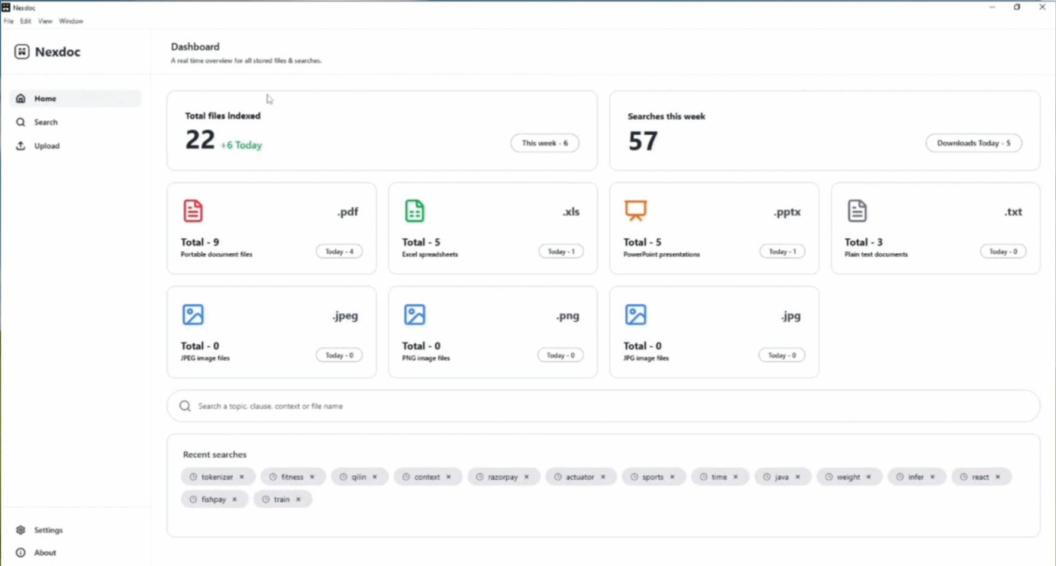
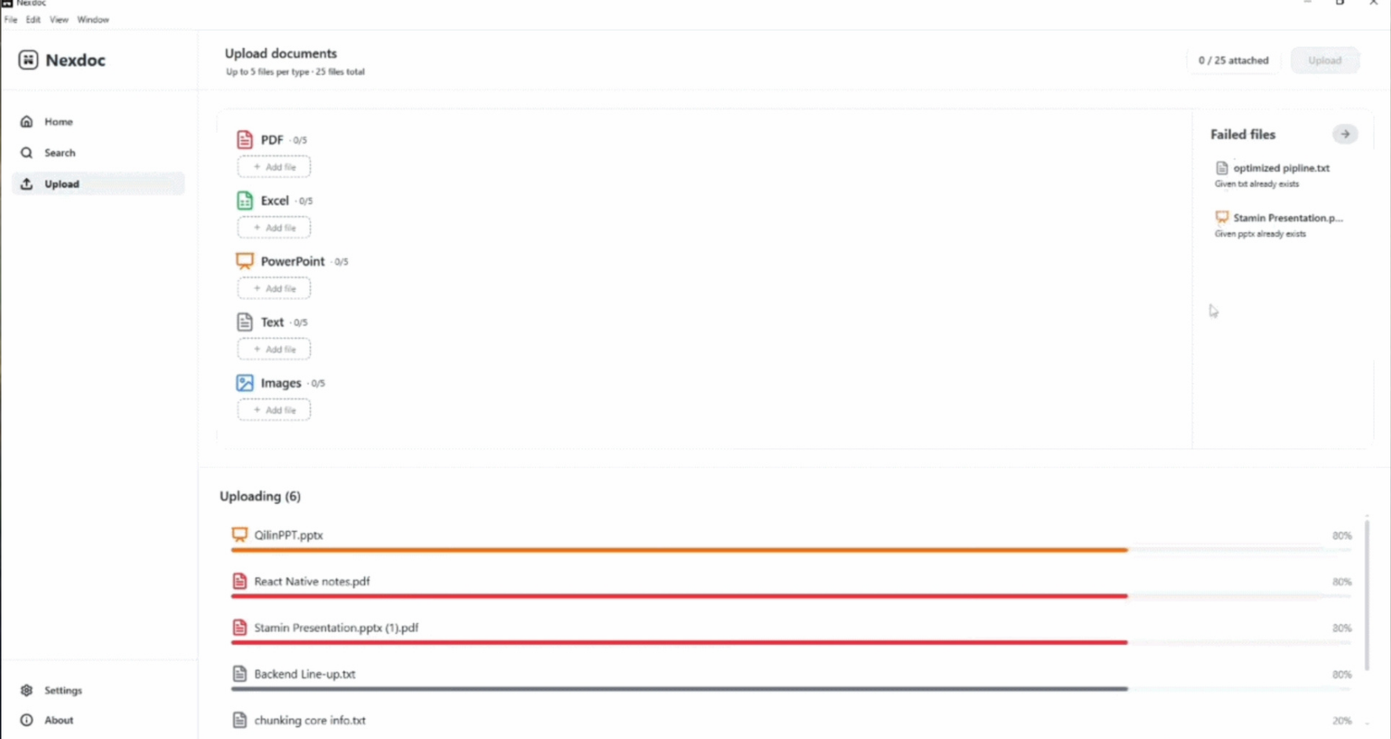
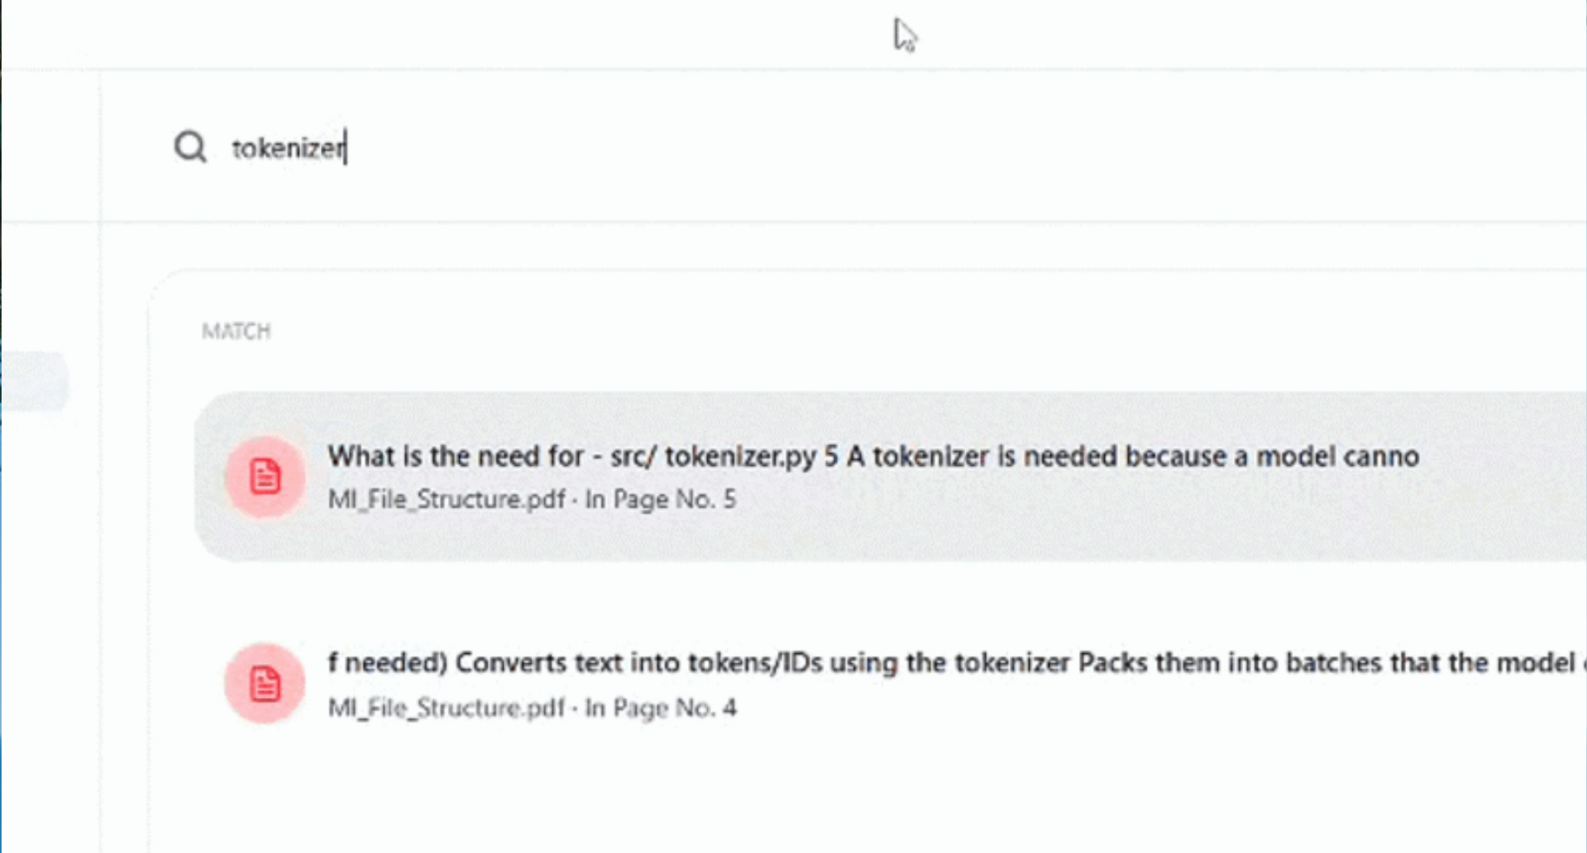
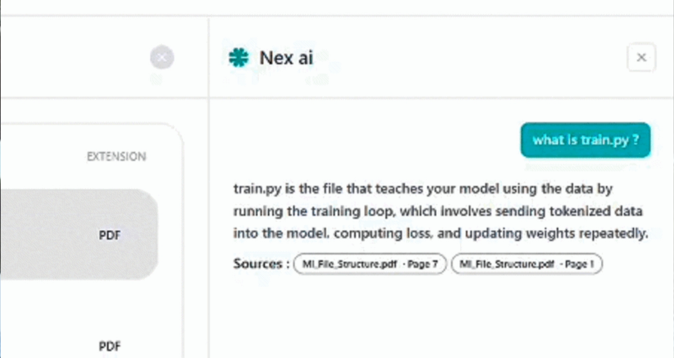
Nexdoc
SEE IT IN ACTION
Product Walkthrough
01 Home Dashboard
02 Upload Documents
Real-time overview of indexed files, weekly searches and recent queries.
Drop in PDFs, Excel, PowerPoint, text or images — up to 25 files at once.
03 Semantic Search
04 AI Search
Every query is matched against indexed chunks with exact page references.
Ask questions in plain language and get synthesized answers with cited sources.
04 / 09

Slide 5







Nexdoc
UNDER THE HOOD
Tech Stack
Python + FastAPI
Sentence Transformers + PyTorch
LanceDB
SQLite
Async-ready REST layer with Pydantic validation and Uvicorn serving.
Local embedding generation (all-MiniLM-L12-v2) — no external API calls.
Embedded vector database for fast semantic similarity search.
Lightweight local storage for processing status, stats & recent searches.
Watchdog
Gemini API
Electron
Real-time file-system monitoring to auto-detect and queue new documents.
Optional AI mode for synthesized, cited answers — offline mode needs none of it.
Wraps the desktop UI around the local FastAPI backend for a native app feel.
DOCUMENT PROCESSING · PyMuPDF · pytesseract · python-pptx · pandas · openpyxl | PACKAGING · PyInstaller
05 / 09

Slide 6


Nexdoc
SYSTEM DESIGN
Architecture & Data Flow
INGESTION PIPELINE
SEARCH PIPELINE
Upload / File Watcher (Watchdog)
User Query
Layered Backend
Processing Queue
Controllers → Services → Features (Search, Chunking, Embedding, Worker Mgmt) → Repositories → LanceDB / SQLite / Filesystem.
Query Processing
Dynamic Worker Pool (CPU-aware)
Candidate Retrieval (Vector Search)
Text + Metadata Extraction
Desktop Packaging
Electron Frontend → Local FastAPI Backend (PyInstaller) → Local Processing → Local Storage. No server deployment required.
Cleaning & Normalization
Hybrid Filtering
Chunking
Result Ranking
Embedding Generation
Offline Response / AI Response
LanceDB Storage
06 / 09

Slide 7

Nexdoc
ENGINEERING HIGHLIGHTS
Key Engineered Areas
DYNAMIC WORKER POOL — ADAPTIVE CONCURRENCY
Available CPU
Resources
Worker Capacity
Calculation
Dynamic Worker
Creation
Concurrent File
Processing
Instead of a fixed thread count, Nexdoc calculates worker capacity from the machine's available CPU cores at runtime — the same backend adapts its processing concurrency across different desktop systems automatically.
OFFLINE-FIRST ARCHITECTURE — PRIVACY BY DESIGN
Documents
Local
Filesystem
Local
Processing
Local
Embeddings
Local
LanceDB
Core document processing, embedding generation and search all run locally — sensitive files never leave the machine. AI Mode is the only optional, internet-dependent capability, used solely for synthesized answers via Gemini.
07 / 09

Slide 8







Nexdoc
WHERE WE STAND
Current Status & Roadmap
Nexdoc's backend is feature-complete and packaged as a working Electron desktop application. The roadmap ahead is about optimization, not core functionality.
SHIPPED
WHAT'S NEXT
Multi-format processing — PDF, OCR images, PPTX, TXT, XLS/XLSX
ONNX-Based Inference
File watching, queue-based & multi-threaded processing
Faster embedding model startup and lower runtime overhead.
Search Result Caching
Dynamic CPU-aware worker pool
Cache frequent queries to cut repeated retrieval latency.
Local embedding generation + LanceDB vector storage
Advanced Ranking & Hybrid Retrieval
Deeper relevance tuning beyond current hybrid filtering.
Semantic search with hybrid filtering & ranking
Additional Document Formats
Offline search mode and AI search mode
Expanding beyond PDF, PPTX, TXT, XLS and images.
FastAPI REST layer + SQLite app storage
Worker-Pool Optimization
Further tuning of concurrency under heavier workloads.
PyInstaller packaging + Electron desktop integration
Application Observability
Improved monitoring into processing & search performance.
08 / 09

Slide 9
NEXDOC
Search Your Documents. Contextually & Instantly.
THANK YOU
09 / 09

