Slide 1
Clustering

Slide 2
Agenda
What is clustering?
What is it used for?
K-means
Hierarchal (agglomerative) clustering
Two new different approaches to clustering:
Density based clustering (DBSCAN)
Spectral clustering

Slide 3

What is clustering?
“Grouping similar objects together”, as simple as that, right?
Possible clustering criteria:
Language
Actor
Genre
Novel based or not
...
“You need to know the question you are trying to answer”

Slide 4
Where is clustering used?
Explore a dataset
Segment customers
Data compression
Structuring web search results
Outlier detection
Deduplicate entities
Find entities similar to entities of interest
Additional feature to enhance predictive models

Slide 5
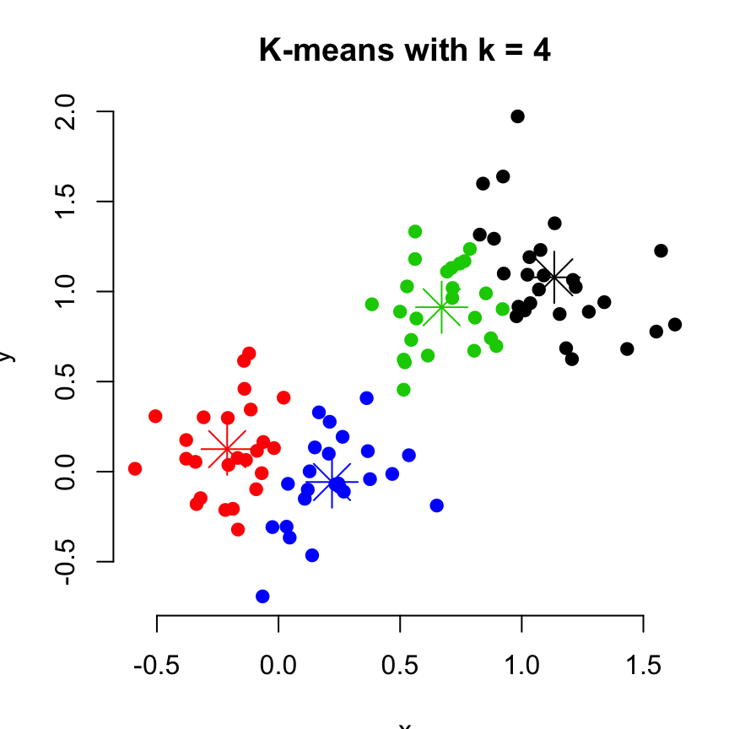
K-means clustering
Probably the most popular (and the only one many folks know)
Approach: partition the data into specified number of globular chunks
Benefits:
Simple and powerful
Intuitive parameters
Scales well to large datasets (high speed, now mini batch processing)
May be the only option for huge datasets
Available in all popular packages
Drawbacks:
Pre-specify K
Finds convex/spherical/globular clusters only
Forced assignment to nearest clusters (whether they belong there or not)

Slide 6
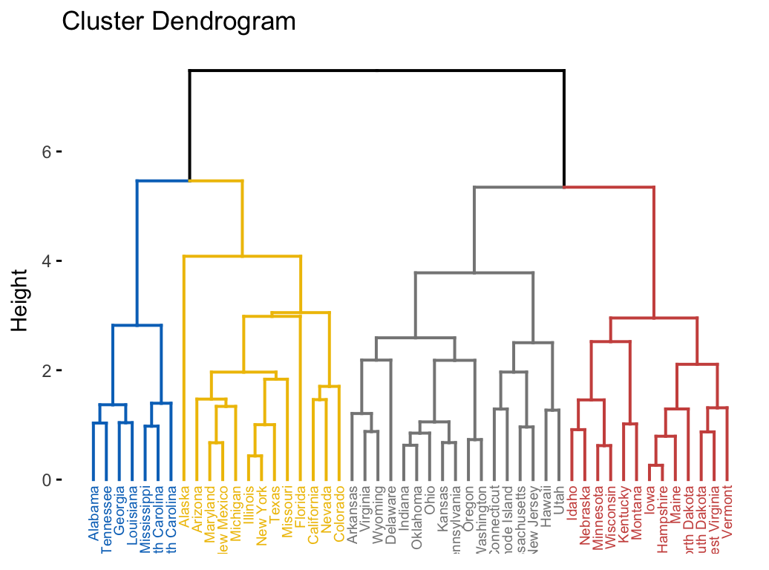
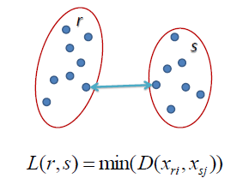
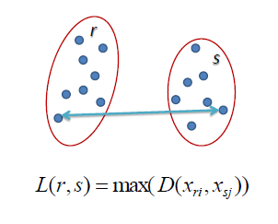
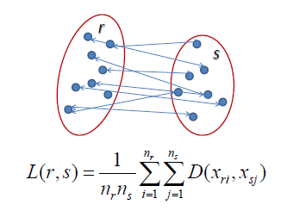
Hierarchal clustering
Probably the 2nd most popular
Benefits:
Can find non-convex clusters
Multiple linkage strategies
Stable
Available in most popular packages
Drawbacks:
Needs user to decide K
Not very scalable to large datasets
Very sensitive to linkage
Single
Complete
Average

Slide 7
Density based clustering - DBSCAN
Density Based Spatial Clustering of Applications with Noise (Ester, et. al, 1996)
Key idea:
Captures the insight that clusters are dense groups of points
Separated by regions of lower object density
If a particular point belongs to a cluster, it should be near to lots of other points in that cluster

Slide 8
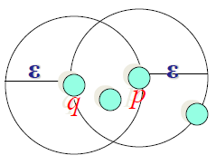
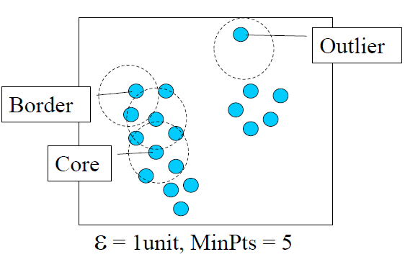
Density based clustering - key parameters and definitions
ε-Neighbourhood: Objects within a radius of ε from an object minPoints: minimum number of points that make a region ‘high density
3 types of points:
Core
Border/Boundary
Noise
Given an ε, and a minPoints value, the core (high density) points get connected to form clusters along with their border/boundary points.

Slide 9
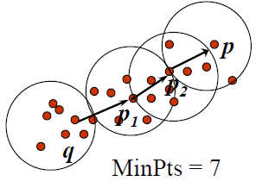
Density based clustering - how it works
Given ε and minPoints
Pick an arbitrary point
If there are more than minPoints points within ε from that point, (including the original point itself), we consider all of them to be part of a "cluster"
Expand that cluster by checking all of the new points and seeing if they too have more than minPoints points within a distance of epsilon growing the cluster recursively if so.
Naftali Harris’ amazing visualization
What other clustering technique does this remind you of?

Slide 10
Benefits and drawbacks of density based clustering
Benefits:
Don’t need to know k beforehand
Discovers clusters of arbitrary shape
Easily identifies outliers / resistant to noise
Easy implementation
Drawbacks:
Not as scalable as k-means (but pretty efficient otherwise)
Performs poorly when there are large differences in densities
Highly sensitive to the parameters
Choosing epsilon not very straightforward

Slide 11
Spectral clustering
A graph clustering approach - ‘connectivity’ over ‘compactness’
Steps:
Construct a similarity graph (KNN graph or dense) for all data points
Embed data in low dimensional space (spectral embedding)
Apply a classic clustering algorithm (k-means) to partition the embedding
In (relatively) simple terms:
represent your data points in terms of connectivity/adjacency
find a new space in which the connectivity is emphasized
then perform k-means in that space
The key step: a ‘suitable’ transformation of the space

Slide 12
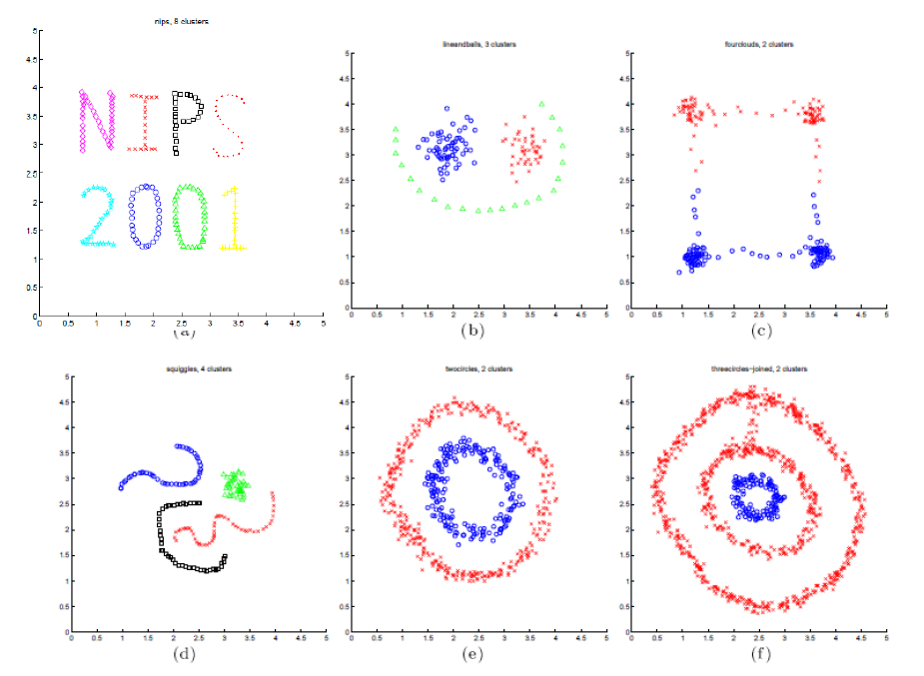
Spectral clustering - some examples

Slide 13
Benefits and drawbacks of spectral clustering
Benefits:
Discovers clusters of arbitrary shape
Greater stability than k-means
Drawbacks:
Number of clusters need to be specified
Computationally expensive (for dense graphs/data)
Sensitive to noise

Slide 14
Appendix

Slide 15


Spectral clustering - definitions and high level workings
Affinity matrix (A): Gaussian kernel as measure
Degree matrix (D): diagonal matrix measuring degree at each node (sum of Ai’s)
Laplacian (L):
Eigen space of the Laplactian emphasizes connectivity.
Apply k-means on the Eigen space

