Slide 1

Detecting Toxic persons using Machine Learning Models in Twitter
Marlon Segarra
Piero Ulloa
Tahís Ahtty

Slide 2
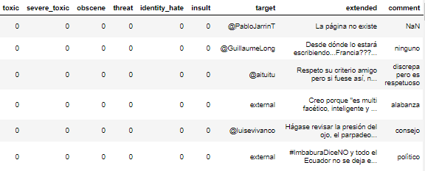
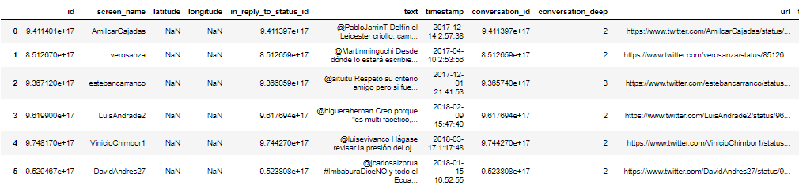
Structure of the dataset

Slide 3
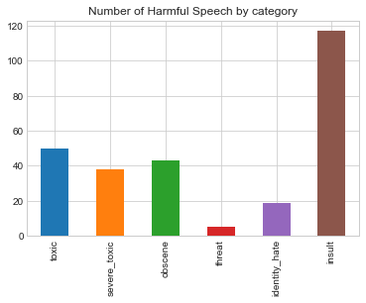
Harmful Speech

Slide 4
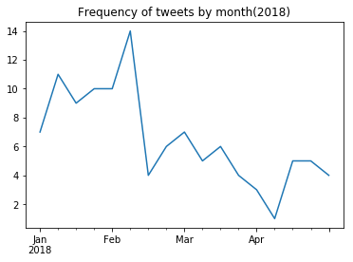
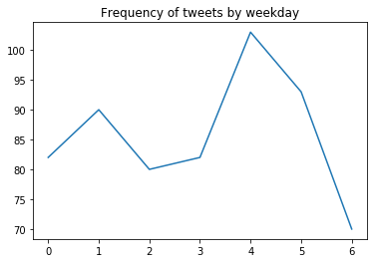
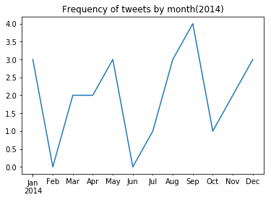
Analysis

Slide 5
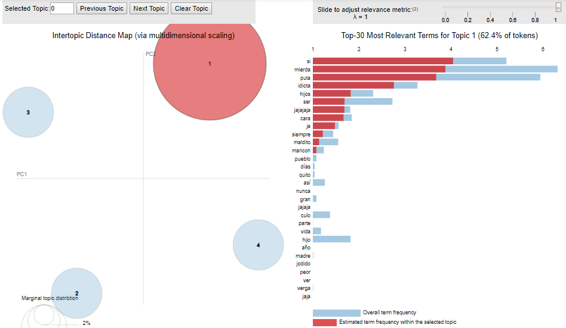
Most relevant terms

Slide 6
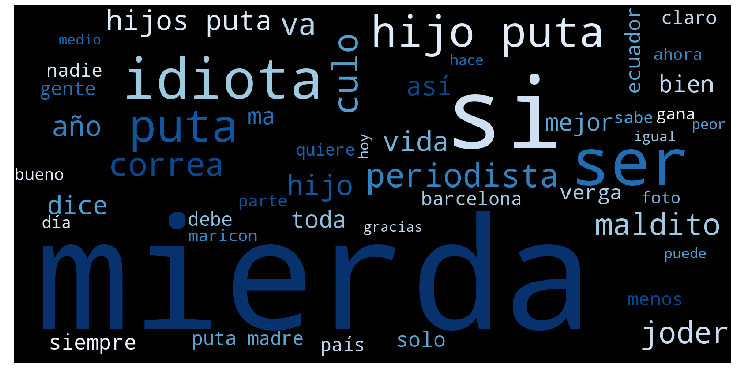
Wordcloud

Slide 7
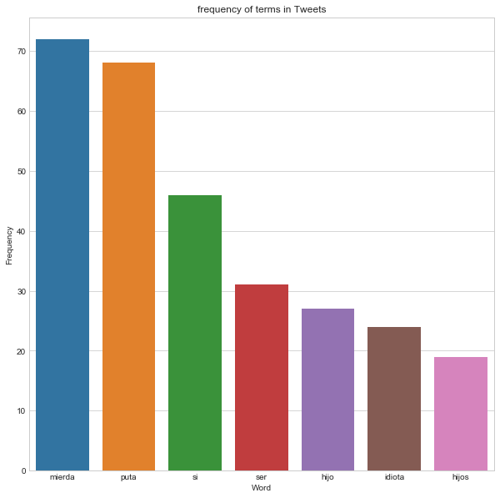
Frequency of terms

Slide 8
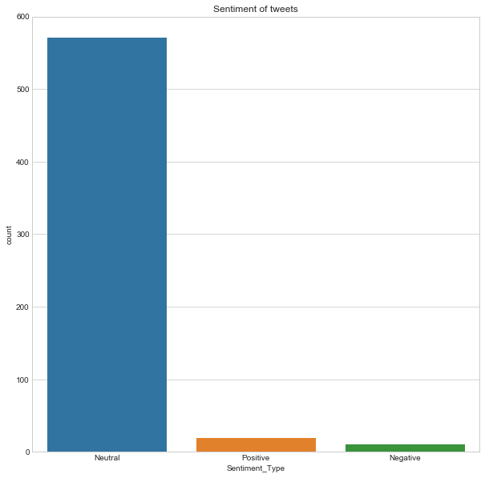
Sentiment Analysis

Slide 9

Features
Number of Mentions
Sentiment
Number of Bad Words

Slide 10
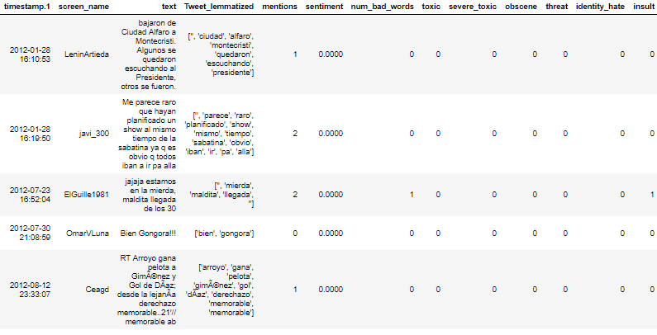
New Dataset Created

Slide 11
Models Used
Logistic Regression
Linear Regression
Ridge Regression
Random Forest
Ensemble Algorithms
Gradient Boost

Slide 12
Accuracy
Logistic Regression
Training: 0.783333333333333
Test: 0.783333333333333
Linear Regression
Training: 0.757142857142857
Test:0.766666666666667
Ridge Regression
Training: 0.792857142857143
Test: 0.805555555555556
Random Forest
Training: 0.857142857142857
Test: 0.8
Gradient Boost
Training: 0.823809523809524
Test: 0.783333333333333

Slide 13
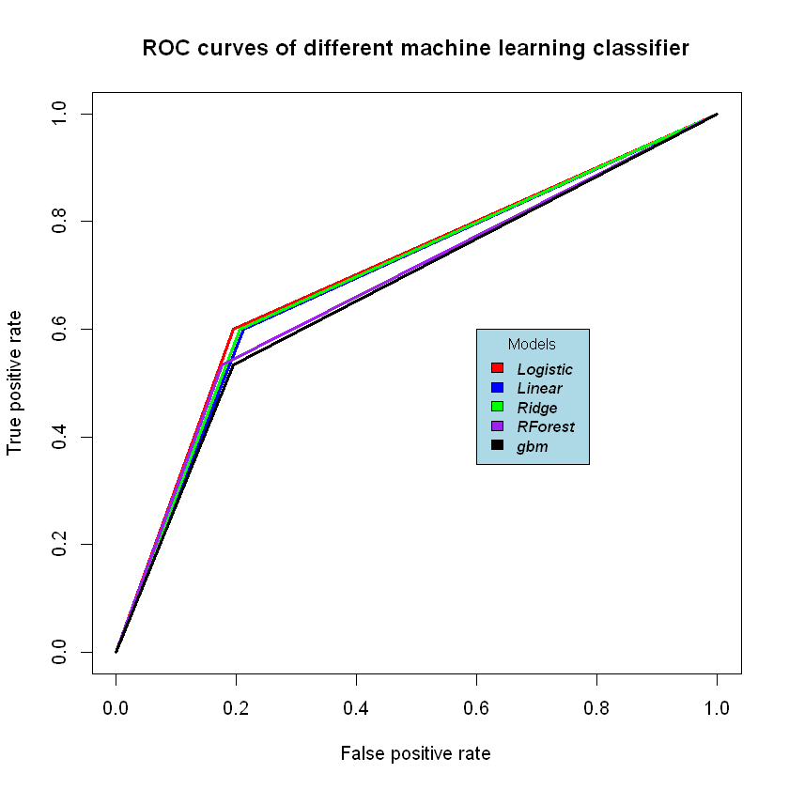
ROC Curves Comparison

Slide 14
Conclusions
Neutral Sentiment
Regression Models → Logistic better performance
Ensemble Models → Random Forest better peformance

Slide 15
Conclusions
Important and festive dates
True positive rate distinctive
False positive rate not distinctive

