Slide 1
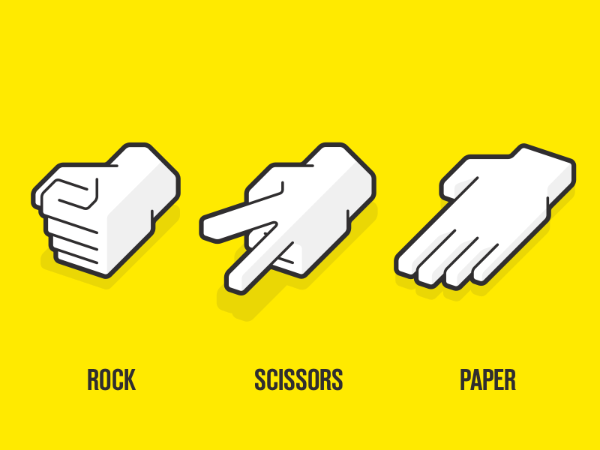


Slide 2
3 POINTS GAME
5 POINTS GAME
10 POINTS GAME

Slide 3



CHOOSE ONE

Slide 4
VS

Slide 5
YOU WON ☺

Slide 6
YOU LOST ☹

Slide 7
WANT TO PLAY AGAIN?
O X

Slide 8
THANKS FOR PLAYING THIS GAME
-AHAMMAD SHAWKI

Slide 9


Slide 10


