Slide 1
Bubbles of Trust
April 2022
A decentralized blockchain-based authentication system for IoT
Chawin Metah
Computer Science Department

Slide 2
Outline
Background and research problem
Approach applied and main contributions
Difficulties of the re-implementation
My learning experience from the paper

Slide 3
Background
Author
Mohamed Tahar Hammi
LTCI, Télécom ParisTech, Université Paris-Saclay, Paris, France

Slide 4
Background: The system
Decentralized communication system for IoT
Bubbles of Trust – virtual zone
C++
Ethereum
Goals
Decentralized system
Secure, high efficiency, low cost

Slide 5
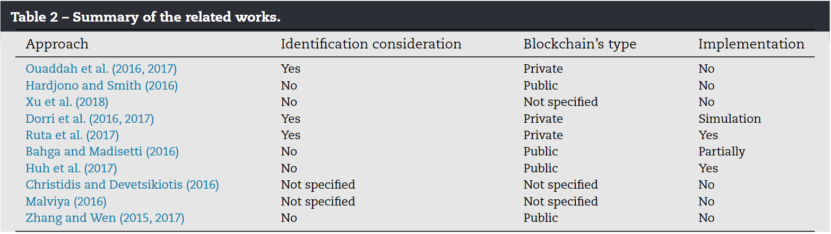
Research Problem

Slide 6
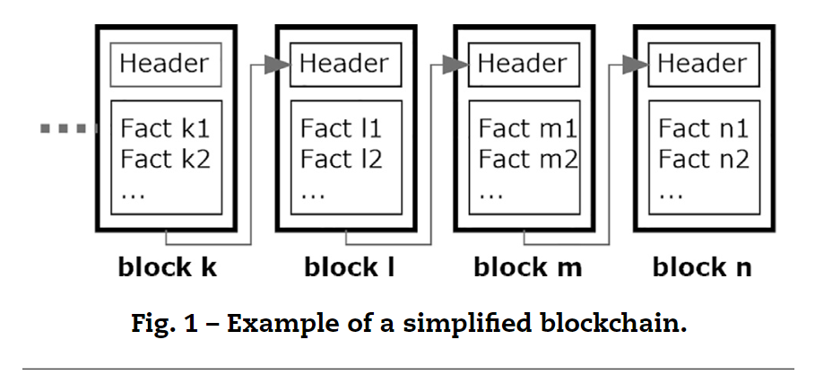
Blockchain

Slide 7
Blockchain (Cont.)
Header
Timestamp
Hash value of the transactions
Hash value of the pervious block
Transactions/facts

Slide 8
Blockchain: Steps
The transaction is grouped
Miners verify the transactions
Miners validate the added block
A reward is given to the miner
A validated block is added to the chain

Slide 9
Ethereum
A public blockchain platform
Ether (ETH)
Smart contracts
Ethereum Virtual Machine (EVM)
Approximate validation time 13.5 seconds
Miners will receive a reward and transactional fees “Gas”

Slide 10
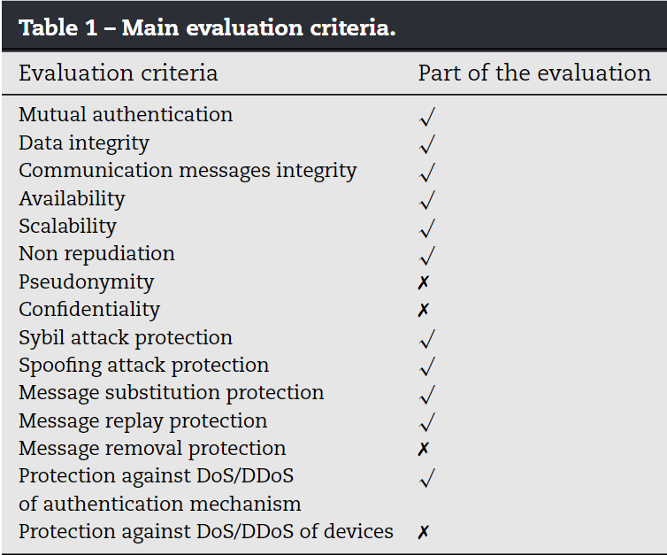
Security requirements

Slide 11
About the system
Unlimited device
Master can create only one bubble
If the Master is out of service, it does not affect the system apart from adding new devices

Slide 12
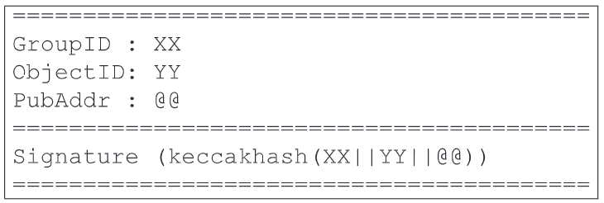
Initialization phase: Ticket
Light weight certificate of 64 bytes
Utilize SHA-3 hash function
Signed using Master’s private key (ECDSA)

Slide 13
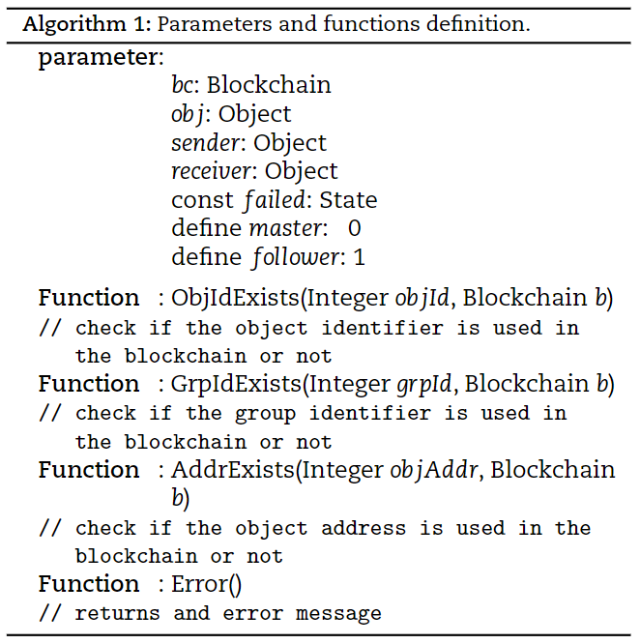
Initialization phase

Slide 14
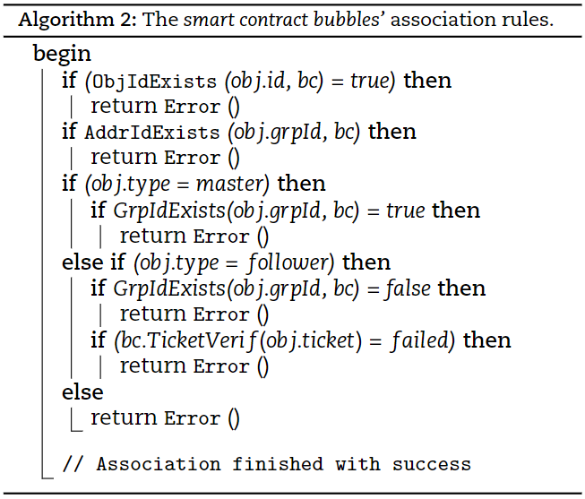
Initialization phase (Cont.)

Slide 15
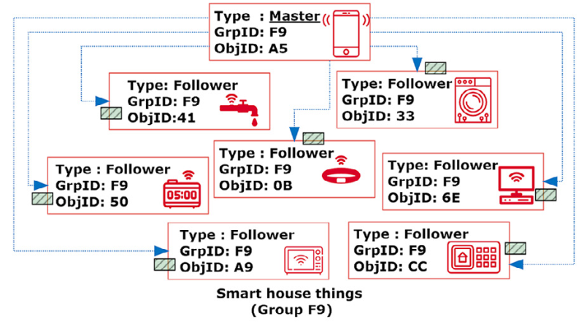
Initialization phase (Cont.)

Slide 16
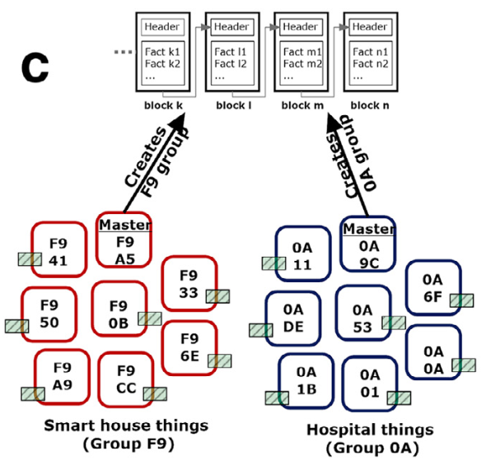
Group creation

Slide 17
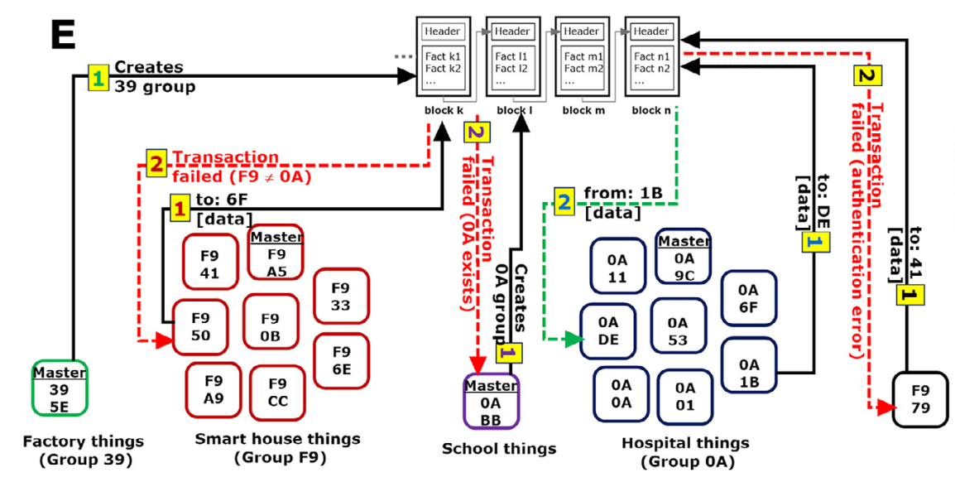
Communications

Slide 18
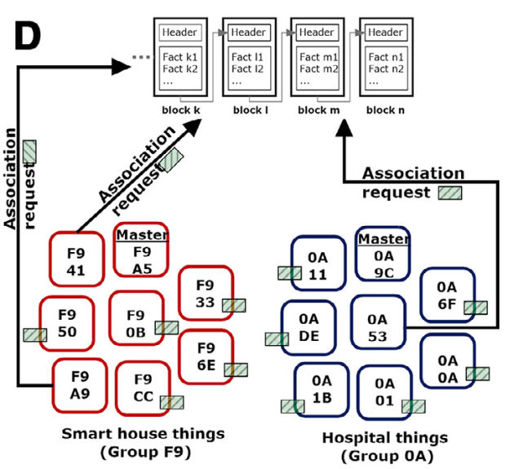
Group association

Slide 19
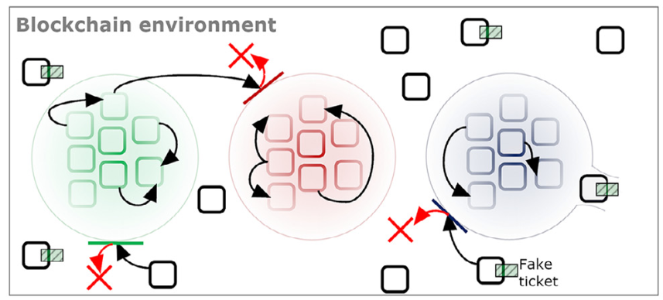
BBTrust environment

Slide 20
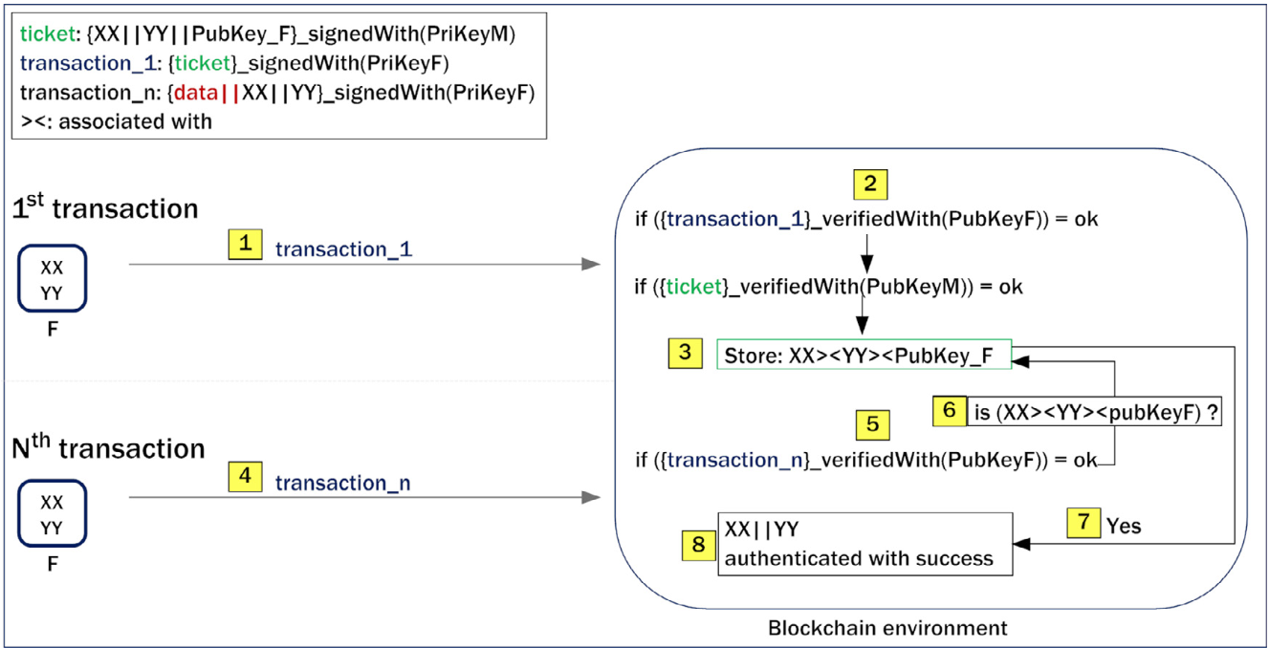
Communications within a bubble

Slide 21
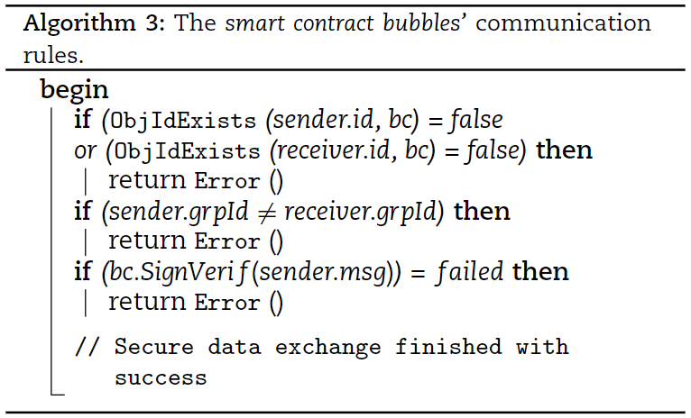
Smart Contract

Slide 22
Evaluation framework
C++ on Qt framework
A smart contract using Solidity language
JSON Remote Procedure Call (RPC)
Ethereum client TestRPC (Ganache)

Slide 23
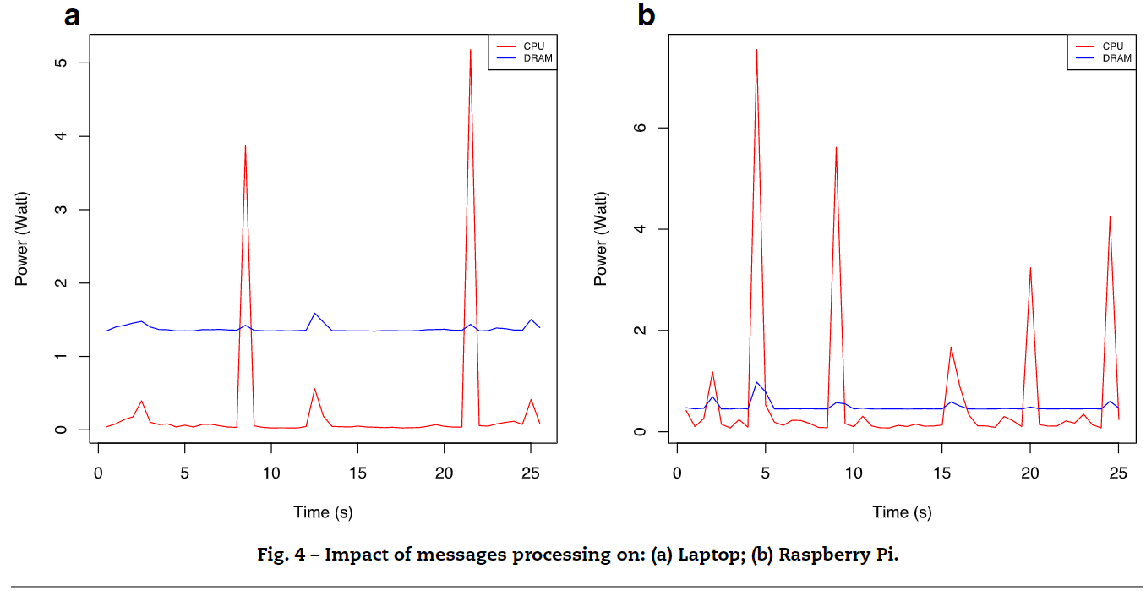
Other results by the Author

Slide 24
Difficulties of the re-implementation
Outdated software and libraries
Software compatibility
New learning curve
Limited resources

Slide 25
Experiences
Concept of Blockchain
Decentralized Blockchain on IoT
New software and libraries

Slide 26
Sources
https://github.com/MohamedTaharHAMMI/BubblesOfTrust-BBTrust-
https://www.youtube.com/watch?v=XE13QGR1czE
https://github.com/trufflesuite/ganache-cli-archive
https://bitbucket.org/devonit/qjsonrpc/src/master/
https://github.com/kmackay/micro-ecc
https://github.com/rhash/RHash/blob/master/librhash/sha3.c

